Slide 1
October 17 2016
Professional Development Day for a Chinese Physics Teacher Delegation
Dr. Marina Milner-Bolotin
UBC Department of Curriculum and Pedagogy

Slide 2
Agenda for the Day
9:00 – 9:15: Introductions
9:15 – 10:30: Canadian education and teacher ed.
10:30 – 10-45: break
10:45 – 12:15: Technology in M&S teacher ed.
Lunch 12:30 – 2 pm
2 pm – 3:15 pm: A physics methods course
3:30: Exploring UBC campus/Museum visit
5 pm: Pick up at the Faculty of Education lobby.

Slide 3
1
Dr. Marina Milner-Bolotin
Associate Professor in Science Education, UBC, Canada
Department of Curriculum & Pedagogy
e-mail: marina.milner-bolotin@ubc.ca
Web site: http://blogs.ubc.ca/mmilner/

Slide 4
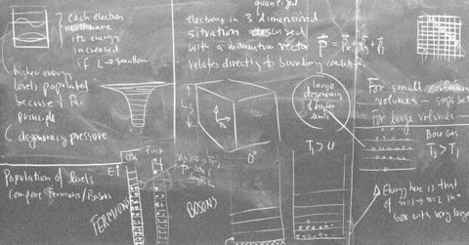
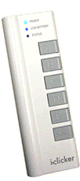
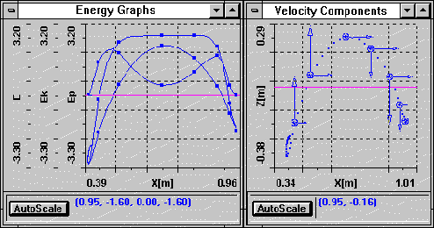
1
My Math & Science Education Trajectory
V-scope
4

Slide 5
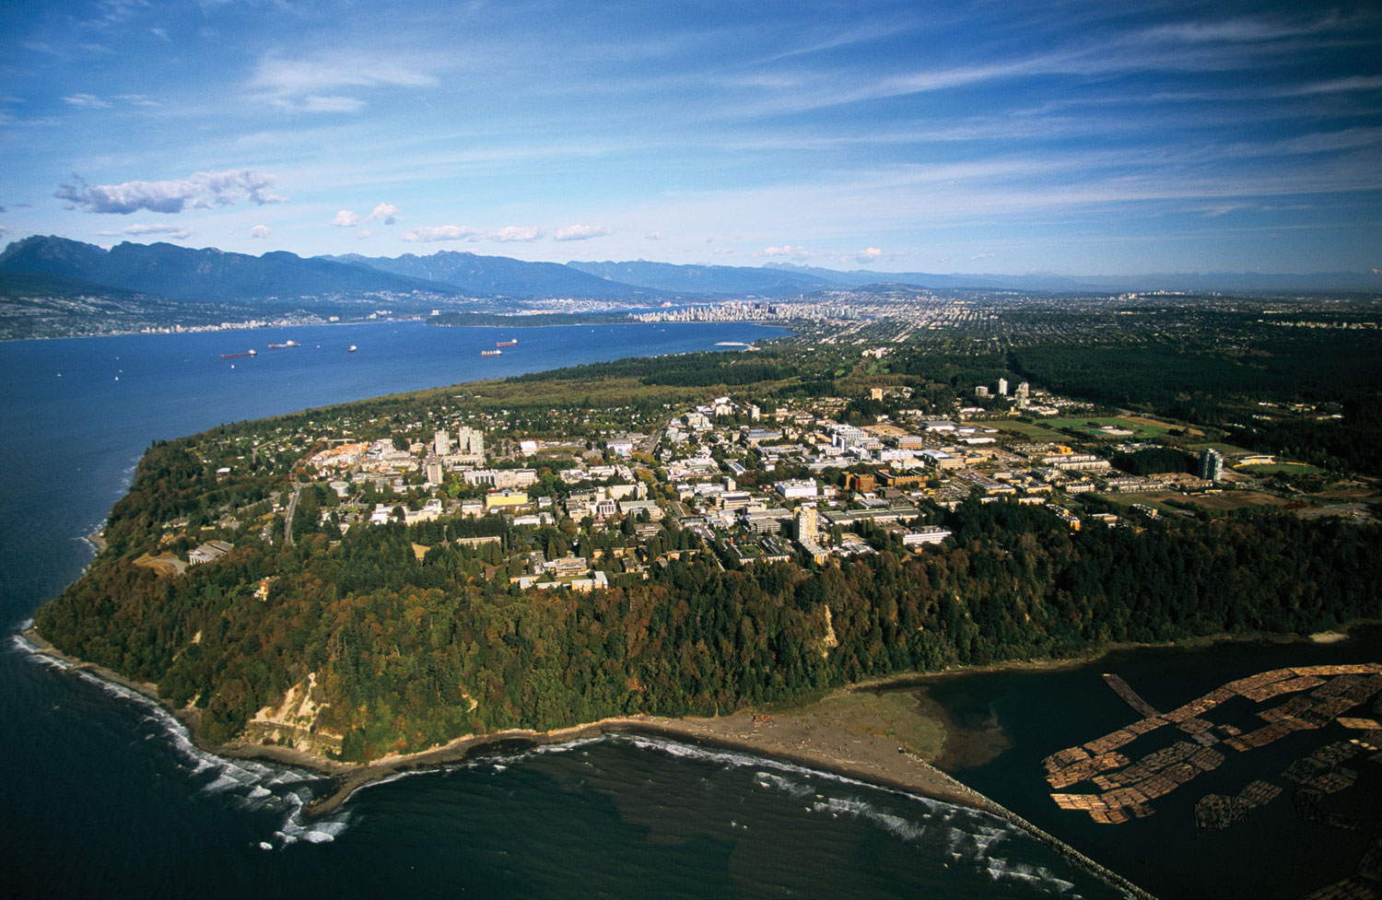
1
UBC (University of British Columbia)
UBC Facts:
Public university
Established: 1908
2 campuses: Vancouver & Kelowna
~61,000 students
Academic staff: 5334+
Acceptance rate: 64%
International ranking – 34th (U.S. News and World Report 2016)
13,189 international students from 139 countries!

Slide 6
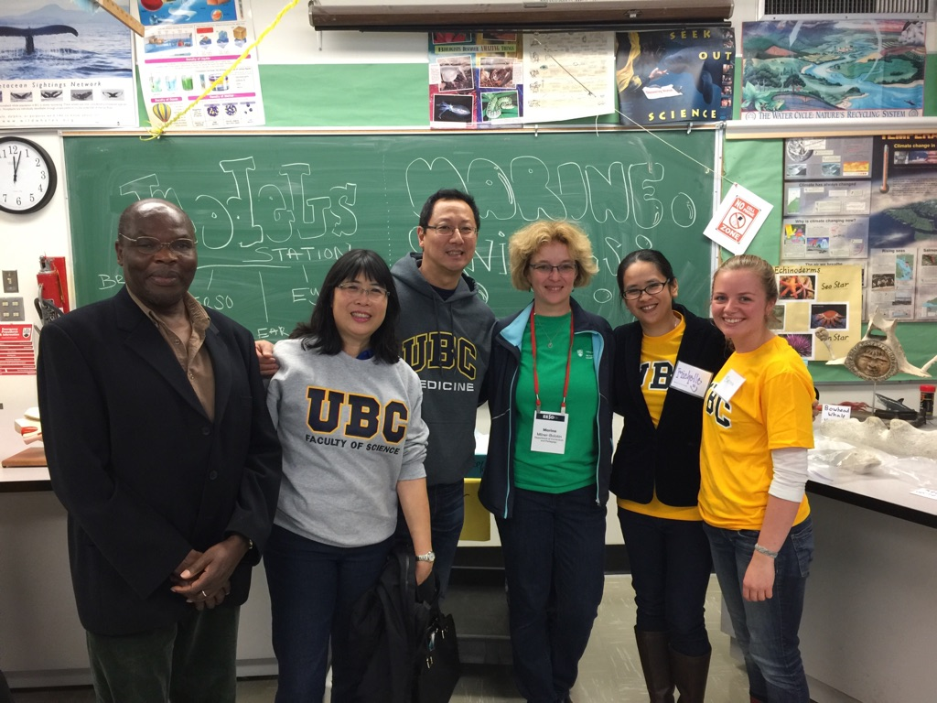
1
UBC Outreach Experience
Notes:
Work with teachers, teacher-candidates and students:
UBC teacher educator
Past president of BC Association of Physics Teachers
Co-Organizer of UBC Physics Olympics
Founder: UBC Family Math and Science Day

Slide 7
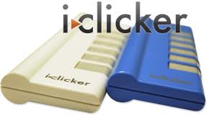
1
Getting to Know Each Other
What subjects do you teach?
Mainly physics
Physics and mathematics
Physics and chemistry
General science
Other

Slide 8
1
Getting to Know Each Other
What is your favourite subject to teach?
Mathematics
Biology
Chemistry
Physics and astronomy
Other science

Slide 9
Agenda for the Day
9:00 – 9:15: Introductions
9:15 – 10:30: Canadian education & teacher ed.
10:30 – 10-45: break
10:45 – 12:15: Technology in M&S teacher ed.
Lunch 12:30 – 2 pm
2 pm – 3:15 pm: A physics methods course
3:30: Exploring UBC campus/Museum visit
5 pm: Pick up at the Faculty of Education lobby.

Slide 10
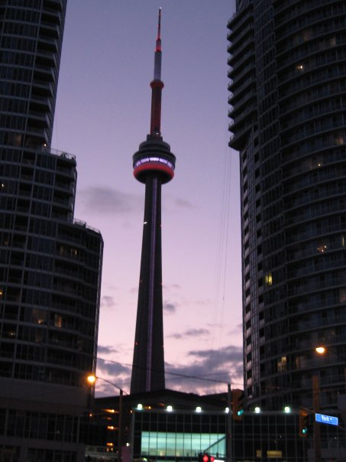
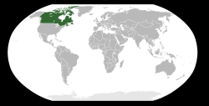
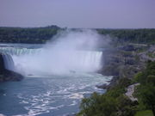
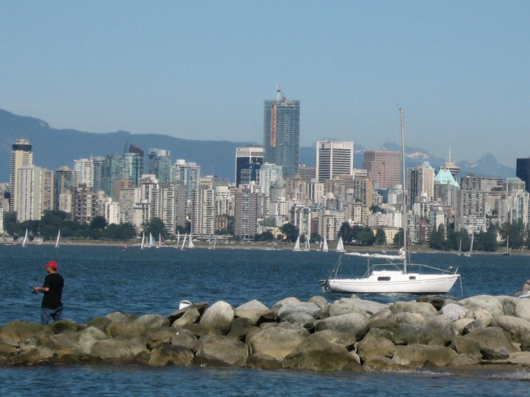
2
Canadian Education and Teacher Education
20.6% of the total population of Canada are immigrants! Toronto transit offers information in > 70 languages. English is often 2nd language.
~75% of Canada's population live within 150 km of the US border.
Notes:
Canadian Science Education landscape is as vast and diverse as the geographical landscape of the country.
In order to appreciate the challenges science educators face in Canada we have to recall that while Canada's population is only 33 million, Canada is one of the largest (in terms of the area) and the most diverse countries in the world. According to 2008 World Factbook , the immigration rate to Canada in 2007 reached 0.585% (5.85 immigrants per 1,000 Canadians). This is one of the highest per capita immigration rates in the world (18th among all the countries and #1 among the developed countries). Immigrant population growth in Canada is concentrated in or near large cities (particularly Vancouver, Toronto, and Montreal), which requires local science educators (many of whom are immigrants as well) to adjust to teaching students who started their education elsewhere, for whom English is not their first language and whose prior backgrounds in science and mathematics are very diverse.
In addition to that, Canada’s population is distributed very unevenly and sparsely across the country, with the especially high density near the US border (75% of Canada’s population live within 150 km or 90 miles of the US border in Ontario, Quebec and the West Coast) and extremely low density in the Northern and Central parts of the country. This again posts a serious challenge as the quality of science education in Canada is very uneven and strongly depends on the province a student comes from

Slide 11
Science Education in Canada
K-12
Elem
Second
University
B. Science
Other fields
Science Exposure

Slide 12
Teacher Education in Canada
Elem
B.A.
B.Ed.
Secondary
B.Sc.
B.Ed.
Bachelor Subject + B.Ed.

Slide 13
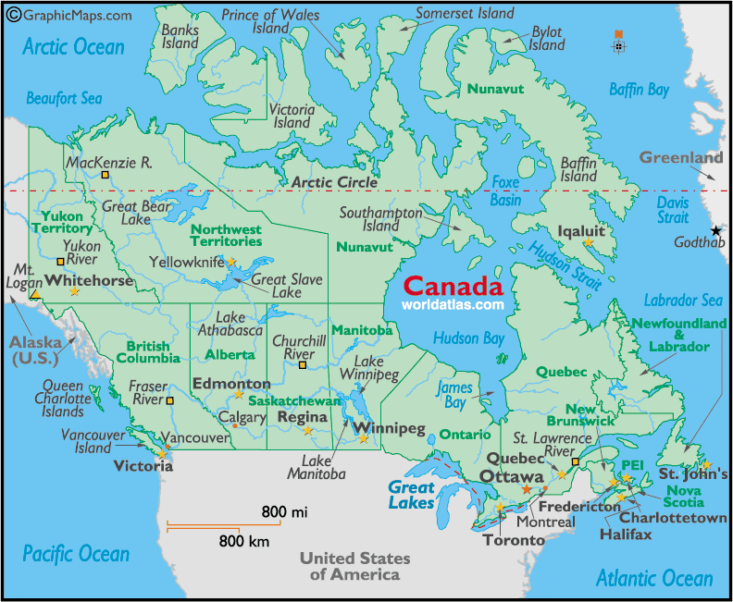
Notes:
Similarly to the Canadian geographical landscape, Canadian Science Education Research Groups are also very diverse. As you can see, their geographical locations reflect the population distribution of Canada – most of the science education groups are located near the US border: The University of British Columbia, The University of Calgary, The University of Toronto, Ryerson University, McGill University, etc. Another interesting observation regarding Canadian science education landscape is that not all of the provinces have science teachers' professional development organizations. For example, there is no Physics Teachers Association in Saskatchewan or Manitoba. This is also reflected in the number of professional development activities offered to the local physics teachers. On the other hand, the provinces of British Columbia, Alberta and Ontario have vibrant sections of the American Association of Physics Teachers and a large number of professional development activities. The vast size of Canada makes professional development and communication between science educators living in different provinces or even living within the same province very challenging. Once again, I strongly believe that modern technology will provide us with effective ways of addressing this challenge.

Slide 14
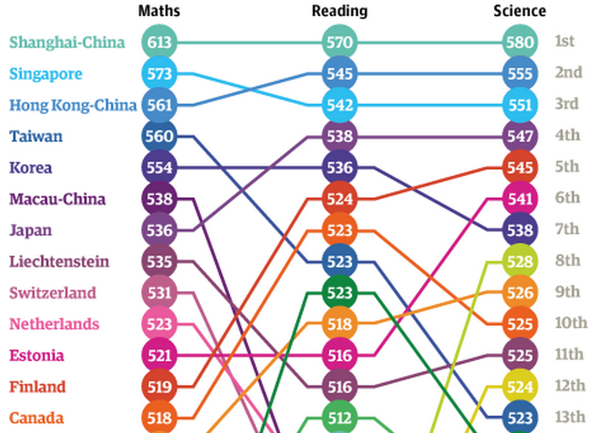
PISA 2012 Results
[OECD, PISA 2012 Results]

Slide 15
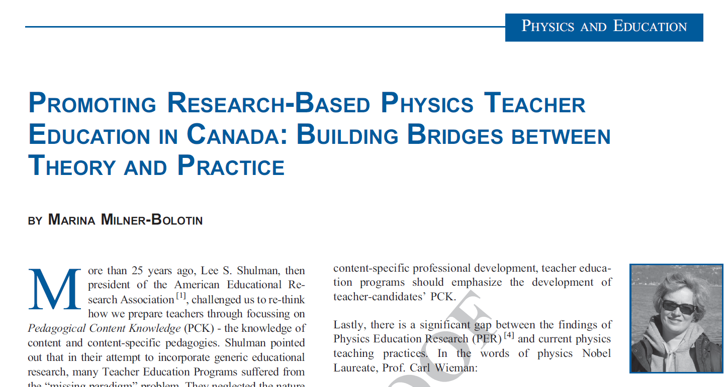
2
Teacher Education in Canada

Slide 16
Agenda for the Day
9:00 – 9:15: Introductions
9:15 – 10:30: Canadian education & teacher ed.
10:30 – 10-45: break
10:45 – 12:15: Technology in M&S teacher ed.
Lunch 12:30 – 2 pm
2 pm – 3:15 pm: A physics methods course
3:30: Exploring UBC campus/Museum visit
5 pm: Pick up at the Faculty of Education lobby.

Slide 17
Agenda for the Day
9:00 – 9:15: Introductions
9:15 – 10:30: Canadian education & teacher ed.
10:30 – 10-45: break
10:45 – 12:15: Technology in M&S teacher ed.
Lunch 12:30 – 2 pm
2 pm – 3:15 pm: A physics methods course
3:30: Exploring UBC campus/Museum visit
5 pm: Pick up at the Faculty of Education lobby.

Slide 18
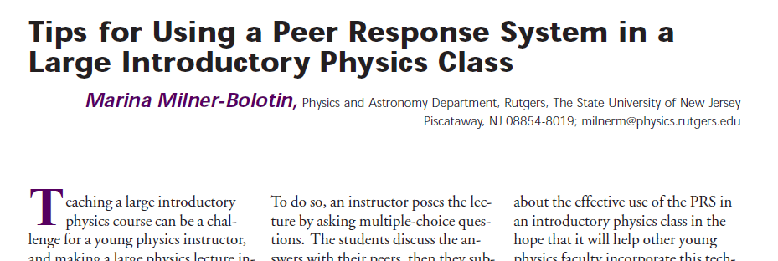
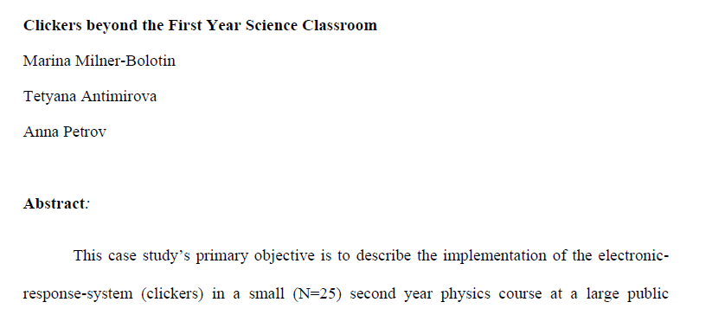
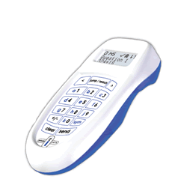
4
Clickers & Active Learning
2004, The Physics Teacher, 42(8), 47-48.
Journal of College Science Teaching, Fall 2009
2010, Journal of College Science Teaching,
40(2), 18-22.
Notes:
Since today we will focus on clicker-enhanced pedagogy, I would like to say a few words about Eric Mazur, a physics professor at Harvard University, who more than 25 years ago proposed Peer Instruction pedagogy that takes advantage of clickers. In Peer Instruction, a teacher uses clickers to facilitate formative assessment. Peer Instructions relies on class activities that address student conceptual difficulties as they grapple with science concepts. Enacting Peer Instruction pedagogy in a science classroom, as I am sure you agree with me, requires much greater Pedagogical Technological Content Knowledge (TPCK) and flexibility from the teacher, than a traditional teacher-centered instruction. Let me give you an example.

Slide 19
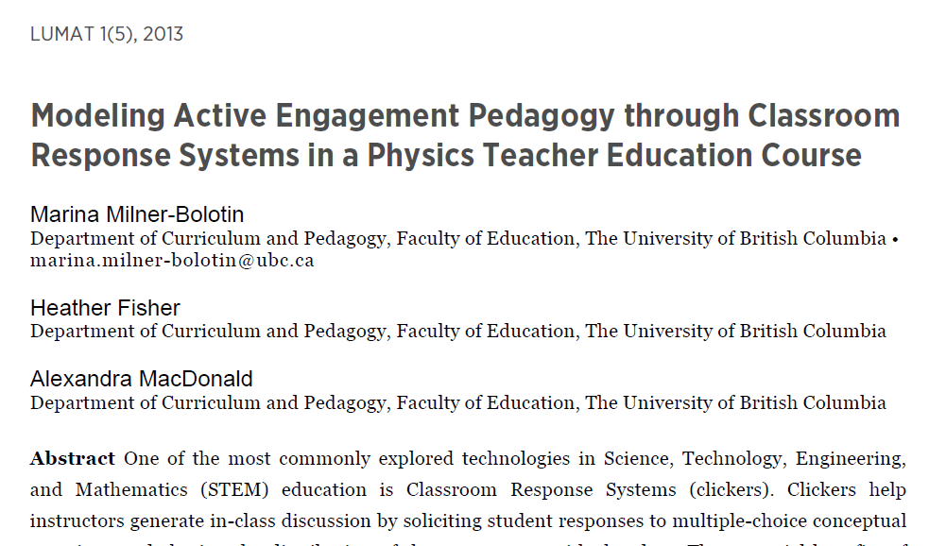
4
Peer Instruction Pedagogy
[LUMAT: Research and Practice in Math, Science & Technology Education, 2013. 1(5): p. 525-544.]
Notes:
We attempted to answer these questions in our recent paper titled Modeling Active Engagement Pedagogy though Classroom Response System in Physics Teacher Education Course, where Classroom Response Systems is an alternative name for clickers.

Slide 20
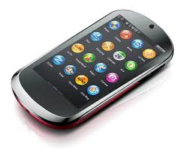
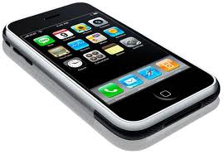
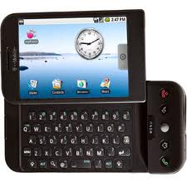
4
Technology for Peer Instruction
In near future smart phones, i-pads and other devices will replace clickers, but the basic pedagogy will remain the same…
Notes:
As a teacher, you can ask a conceptual question and the students can use clickers to choose an answer. You can see two different examples of conceptual questions. In both of them, we can see the students are being very confused. The immediate pedagogical questions that I see here are:
What do you, as a teacher, do in such a scenario in your classroom?
Are teachers’ equipped to be flexible and to address student difficulties instead of proceeding with the pre-planned lesson?
Where do you find conceptual questions that will help elicit student difficulties?

Slide 21
4
Peer Instruction Example 1
Find the magnitude of the force a 60 kg person has to pull the rope with in order to pull himself upwards with a constant speed.
600 N
450 N
300 N
200 N
150 N

Slide 22
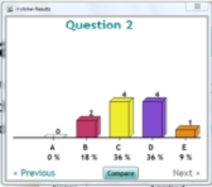
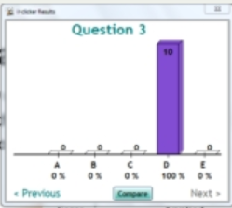
4
Peer Instruction in Action
Pre-Discussion Poll
Post-Disc. Poll
10
4
4
2
1
0
Respondents: Physics Teacher-Candidates

Slide 23
4
Peer Instruction Example 2

Slide 24
4
Peer Instruction Example 3
(A)
(B)
(C)
(D)
(E)

Slide 25
4
Peer Instruction Example 4
You have a uniform metal plate with a circular hole inside it. You heat it up by 200ºC. As a result of heating, the hole will:
Increase
Decrease
Remain the same

Slide 26
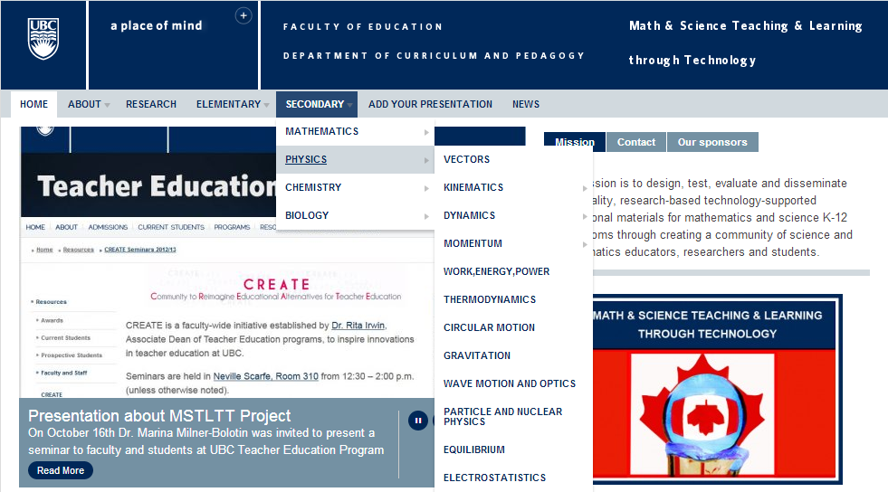
4
Math & Science Teaching & Learning through Technology
http://scienceres-edcp-educ.sites.olt.ubc.ca/
Notes:
This slides shows how our resource looks like. It is divided into primary and secondary, by subject area, and then by specific topics within each subject. These topics are determined largely by the British Columbia Ministry of Education and question sets in the database are developed to meet the Prescribed Learning Outcomes outlined in the Ministry documents.

Slide 27
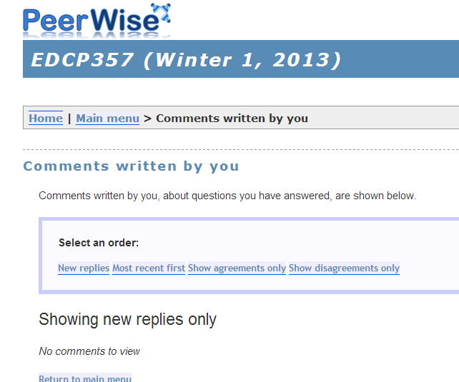
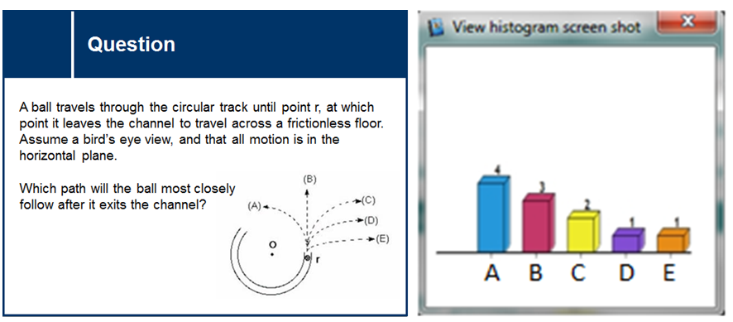
4
Technology-Enhanced Science Education
Peer Instruction and PeerWise integration
Notes:
Why did we decide to integrate modeling Peer Instruction with using PeerWise for out-of-class teacher-candidates’ interactions?
Modeling is a case of practicing what you preach.
The idea behind modeling is help students learn through the observation of experts.
For many teacher candidates, the Teacher Education program is the first opportunity to intentionally reflect on the pedagogies they have experienced as learners over the last 16 years or so.
So we need to model good, research-based pedagogy for them, to ensure they have had a good experience with it
However, if we are going to expect them to take this behaviour into their own classrooms, they need good resources/materials to use
This is the meat of what we wanted to explore in this project.
As instructors we choose to model a variety of pedagogies. We are intentional in our choice of pedagogy. We also want teacher-candidates to understand why we are making certain choices, so they can make their own informed choices in their future classrooms.

Slide 28
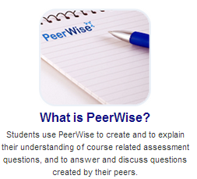
4
PeerWise Online System
http://peerwise.cs.auckland.ac.nz/
Notes:
The second major technological component in our research is a PeerWise online system. It is developed by our colleagues in New Zealand (Paul Denny, et al.) allows to take PI one step further. It allows teacher-candidate to collaborate online on creating education resources at the same time playing roles of students and teachers.

Slide 29
4
Let us Play a Game
You have a light bulb, a battery and a wire. Draw all possible way how you can connect them to light up the light bulb

Slide 30
4
How Students Learn
Unsuccessful attempts
Notes:
http://earthquake.usgs.gov/learn/topics/how_much_bigger.php
http://www.screenr.com/hEH

Slide 31
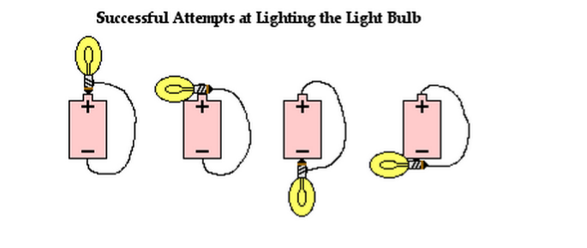
4
How Students Learn
Unsuccessful attemps
Notes:
http://earthquake.usgs.gov/learn/topics/how_much_bigger.php
http://www.screenr.com/hEH

Slide 32
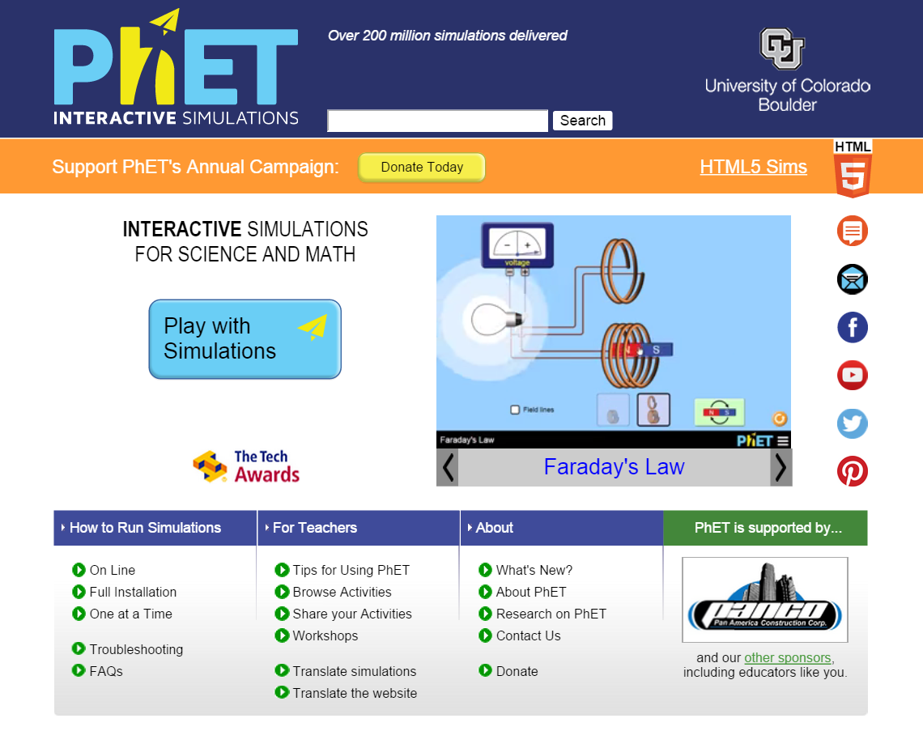
4
What is PhET?
PhET Computer simulations from the University of Colorado, Boulder
You can download the simulations. You can also use Chinese!
Notes:
https://phet.colorado.edu/en/for-teachers

Slide 33
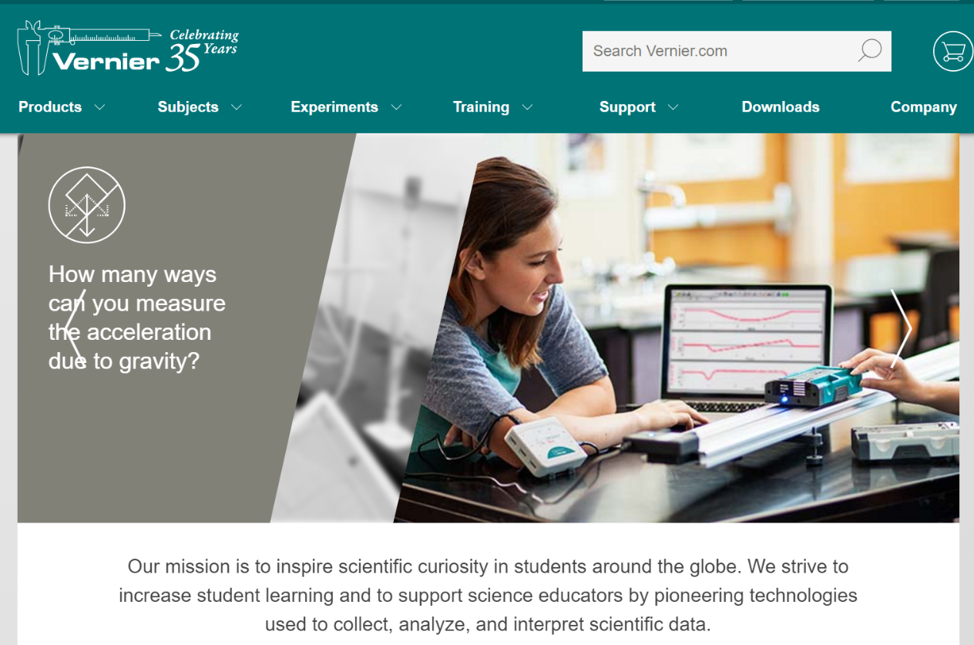
4
Sensors in Physics Teaching

Slide 34
4
Reconsidering Assessment
34

Slide 35
Workshop: Feedback 1
How satisfied are you with the day?
1 3 5

Slide 36
Workshop: Feedback 2
Do you feel you have learned new ideas for math and science teaching?
1 3 5

