Slide 1
ESSHC 2016 University of Valencia
“Families Without Schools: Rurality, Remoteness, and the Promise of Schooling in Western Canada, 1919 to the 1940s”
Mona Gleason, Department of Educational Studies
University of British Columbia
mona.gleason@ubc.ca
(Not for citation or download. © of author)

Slide 2
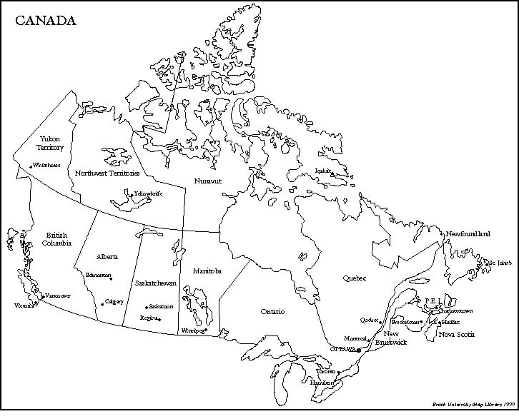

Slide 3
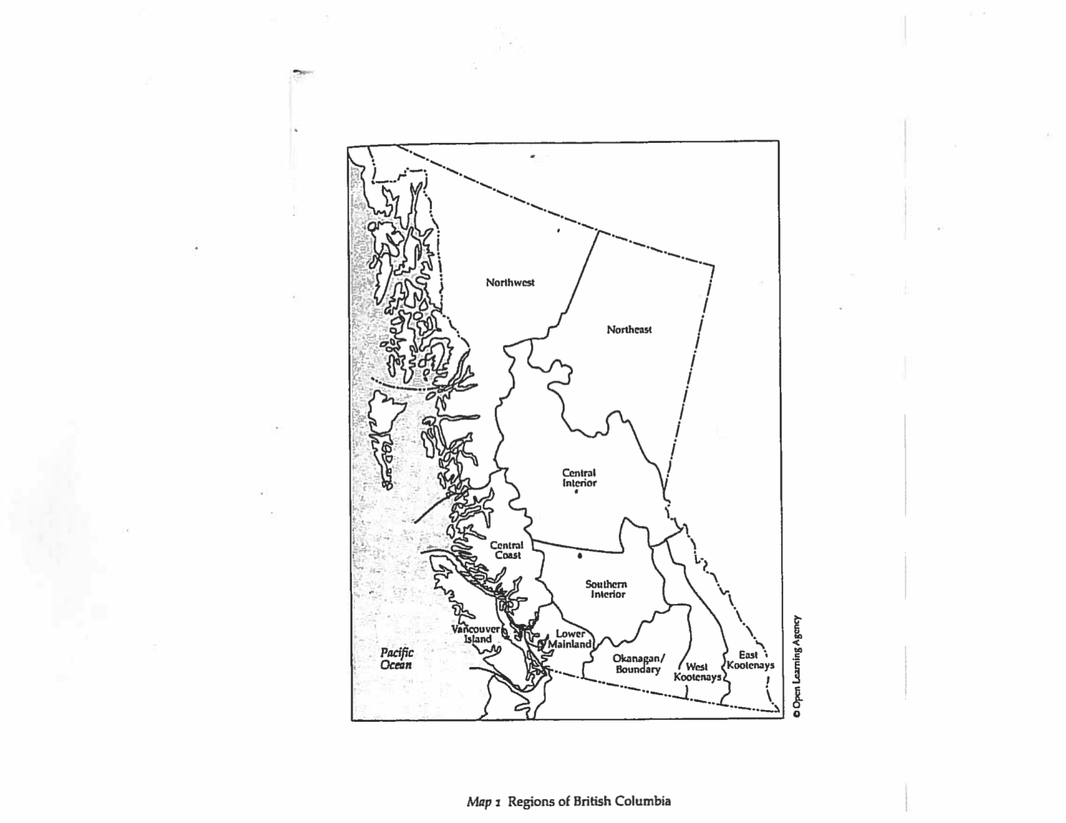

Slide 4
Contextualizing the ECS
Began in 1919 to help isolated children and families
1925 – 8600 elementary students in provincial public schools
By 1929 – ECS became a separate branch of the Dept of Education and served over 600 children - grew to 900 in 1934; and 1400 by the end of 1940s
Directors: James Hargreaves (1919-1933); Isobel Bescoby (1934-37); Anna Miller (1937-1950)
ECS catered to children 5 miles from an established school
(High school courses commenced in 1929 – first Canadian province to offer this service)
Families would initiate the process of enrolment
Notes:
Enrolment figures over period under study:
1919 -1925: 301
1925 -1930: 593
1930 -1935: 1097
1935 -1940: 1120
1940 - 1945: 1563
1945 - 1950: 1624
Steady growth until end of the 1960s

Slide 5
Focus of research in the historiography
Rural vs. Urban; working class vs. middle class
“…living and working largely outside the close disciplinary gaze of the bureaucratic state well into the twentieth century, rural people arguably had lives that differed significantly from their urban and suburban counterparts as the twentieth century progressed; unfortunately, they are very difficult to ‘see’ in the kind of easily-accessible collections of documents available to many urban historians.” Ruth Sandwell, “Introduction to Special Issue on the History of Rural Education in Canada,” Historical Studies in Education / Revue d’histoire de l’éducation 24, 1 (Spring 2012): 43-46.

Slide 6
Contextualizing the ECS in British Columbia
Settlers vs. Aboriginal peoples
“By 1900 British Columbia possessed fourteen residential and twenty-eight day schools, enrolling some 40 percent of Indian children across the province. By the end of the First World War most attended school for at least a year or two. This achievement was somewhat misleading. Whereas virtually all of pupils in provincial schools completed the elementary grades, the overwhelming majority of Indian children never got beyond grade one or two. In the 1940s just 6 percent of native peoples reached grade six or higher.”
Jean Barman, The West Beyond the West: A History of British Columbia (Toronto: University of Toronto Press, 1991), p. 161-162.

Slide 7
The ECS Letters
How did settler parents and children in rural and remote areas of the province secure access to schooling? What were the difficulties in doing so and how did families respond?
Important limitations: distance from “the truth,” what was thrown out in the files? Why? Be mindful of perspective

Slide 8
New window on “public” education in the British Columbian context
Letters: draw attention to the fact that LOCATION, in concert with gender, class, and age, provided a rationale or an excuse for provincial authorities to limit equitable access to public schooling in BC over the period under study.
The province depended on the labour of these families but did not offer adequate assistance in return – particularly holds true for the provision of public schooling

Slide 9
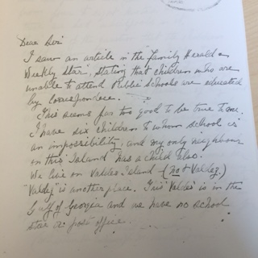
Evidence from the Letters and Theoretical Framings
Brief examples of 3 key themes that have emerged and theoretical framing these themes have inspired
Isolation, remote locations and anxiety about success - Role of “rurality” as having discursive and material consequences
I have six children to (sic) whom school is an impossibility
and my only neighbour on the island has a child also.
We live on Valdes Island…and we have no school, store, or
post office. Our nearest school is over two miles away on
Galiano Island but the intervening water in Portier Pass is
very treacherous and unsafe. The tides flow through at
from four to eight knots an hour and there are bad
whirlpools in it.
It is out of the question that the children could row there,
and we have no motorboat, so I have been trying to teach
them myself. (Mrs. E.M. Patterson, Valdes Island, BC. 1923)

Slide 10
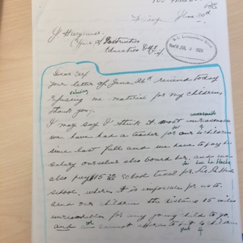
Evidence from the Letters and Theoretical Framings
2) Unequal relations of power: race, gender, class, and age
Gender: mothers overburdened and sometimes pushing back

Slide 11
Mothers Pushing Back
“….all we are asking for is one reader and a pack of drawing paper.
I may say I would not take the trouble to send for it if it were not needed. What do you suppose we are doing with the other material?
Why, we used it of course…Seeing that our taxes for school to educate other children are $15.00 which we consider out of all reason (our own children receiving no benefit at all from it.) Mr. Walter wishes me to say he will be much obliged to receive the necessary material
as soon as possible so that our children may lose no time. If not, he will have to take the matter further...”
Mrs. S.G. Walter, 100 Mile House, BC, 1928

Slide 12
Evidence from the Letters and Theoretical Framings
2) Unequal relations of power: race, gender, class, and age
Class: rural working class realities, necessity of social assistance, children’s labour
Letter:
“….we applied for relief and received a small monthly allowance
just enough for groceries and, by scrimping on them, a few of the
most necessary clothing. Mr. Piper asked to be allowed enough
to pay postage and school supplies but he was refused…the
children have to help me get the garden stuff in and cut a supply
of wood before the deep snow or real cold weather sets in.
I do not think children can do good lessons when they are tired
from outside work.” Mrs. D. Piper, Giscome, BC, 1935

Slide 13
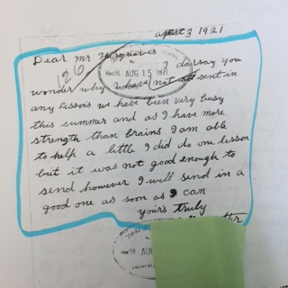
Evidence from the Letters and Theoretical Framings
2) Unequal relations of power: race, gender, class, and age
Age: a significant source of tension and difficulty faced by ECS families was the need to comply with young people’s social/normative construction as primarily “students.”

Slide 14
Children: work and school in tension
“I keep house for my father, brother, and sister and it sure does keep me busy cooking, washing and looking after the house, I am home most of the time alone, but I have one very nice girl who has just moved in for a friend.”
For example, John Welton, 15 in 1938, wrote to this teachers that along with helping on the farm, he had a trap line for pelts that “helped his family a lot” during the winter months.

Slide 15
Evidence from the Letters and Theoretical Framings
3) Lack of governmental prioritizing around schooling for rural and remotely located settlers
The children of rural Canada are the caretakers of the
nation’s food supply and compared to the city child sacrifice
their education in order that urban populations may eat
without any regard to the cost of production…the trouble is
purely economic… I am on relief with 90%
of this District and have been compelled to put in my work in this
connection 28 miles from home…(work at home) falls upon these
two boys during my long absences to the serious detriment of their
schooling. (Frank Ellard, Mapes, BC 1934)

Slide 16
Some Tentative Conclusions
ECS family letters help fill some gaps in knowledge
Understand schooling from the vantage point of working class rural settlers in BC’s rural and remote communities
Emergent themes: isolation, remoteness, anxiety about school success – rurality as frame
Race, gender, class and age - unequal relations of power as frame
Despite governmental rhetoric praising the triumph of widespread public schooling over these years, many families continued to cope without schools well into the twentieth century.

