Slide 1
?
PLENTY OF SHEETS
BUT NO BED IN SIGHT
IT CAN CUT YOU
BUT IT DOESN’T BITE

Slide 2
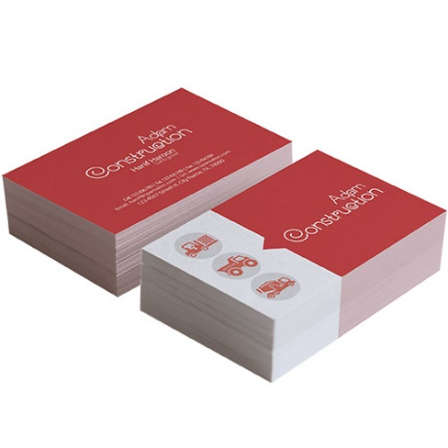
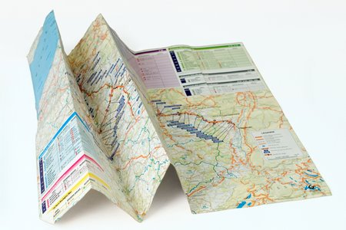
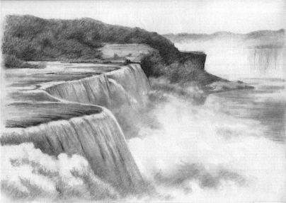
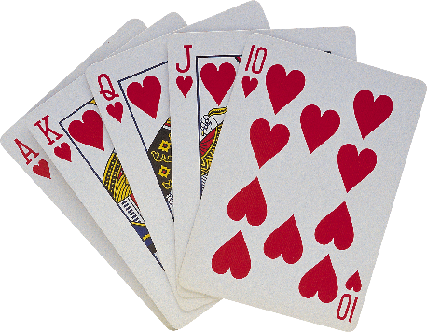
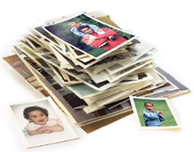
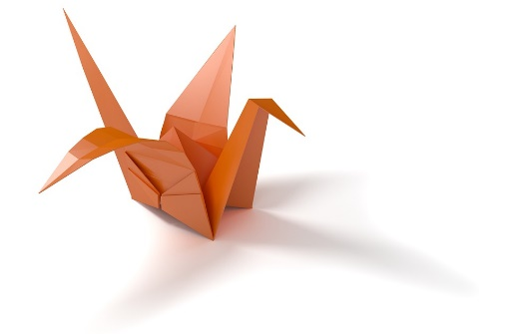
PAPER

Slide 3
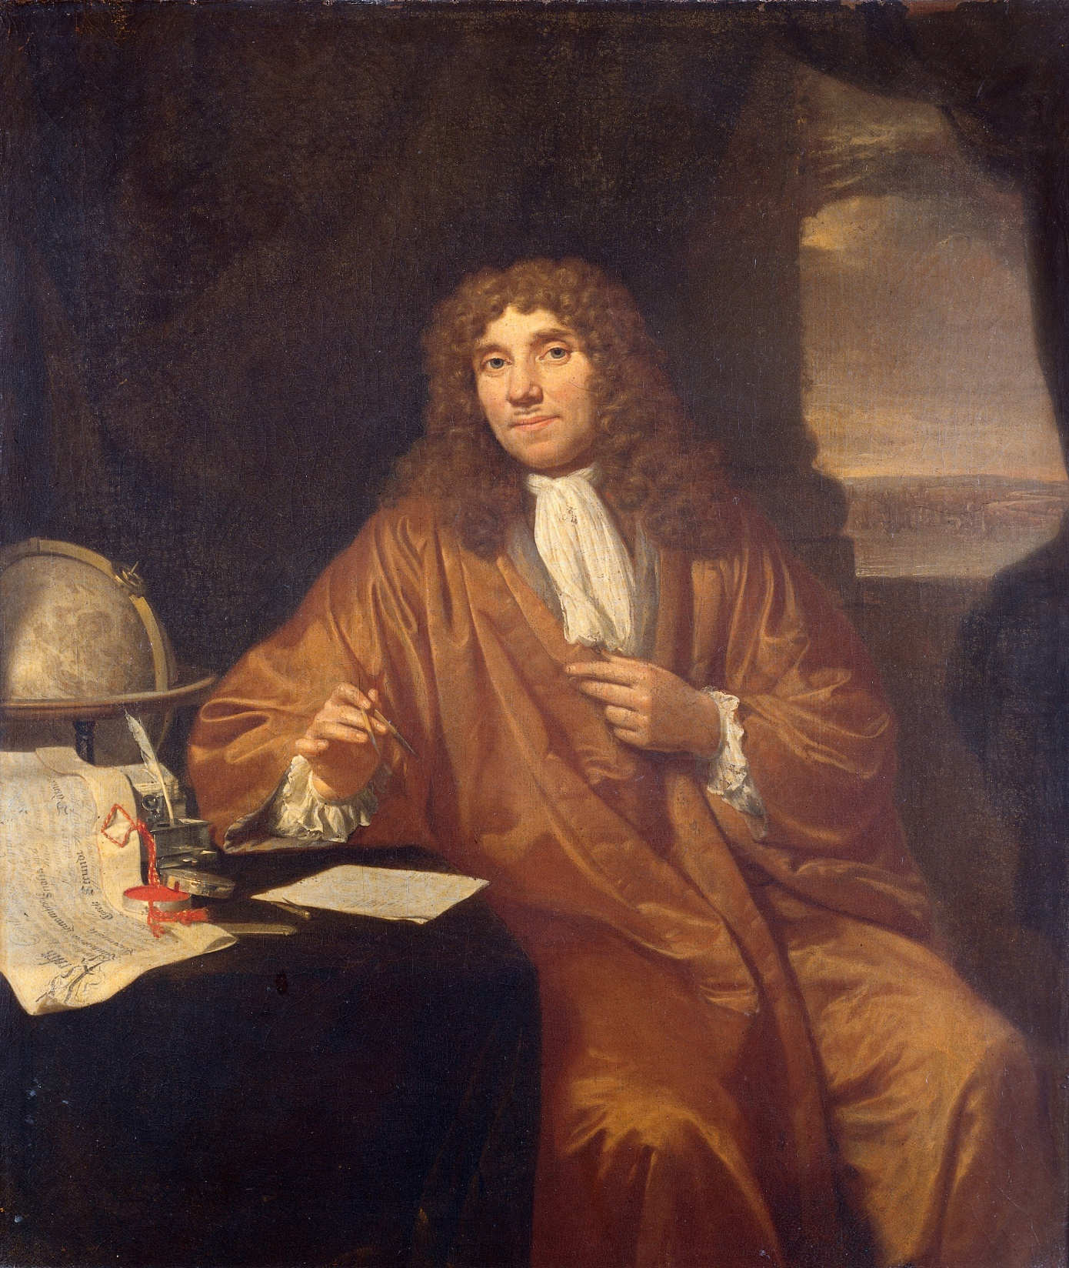
“Whenever I found out anything remarkable, I have thought it my duty to put down my discovery on paper so that all ingenious people might be informed thereof”
Antoine van leeuwenhoek (microbiologist)

Slide 4
KNOWLEDGE

Slide 5
STAYING
CONNECTED

Slide 6
?
WHERE DID PAPER COME FROM

Slide 7
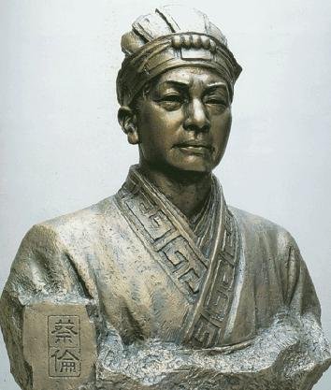
Cai Lun (AD 50-121)
Is credited with inventing a paper composition similar to modern day paper and the process of making paper.

Slide 8
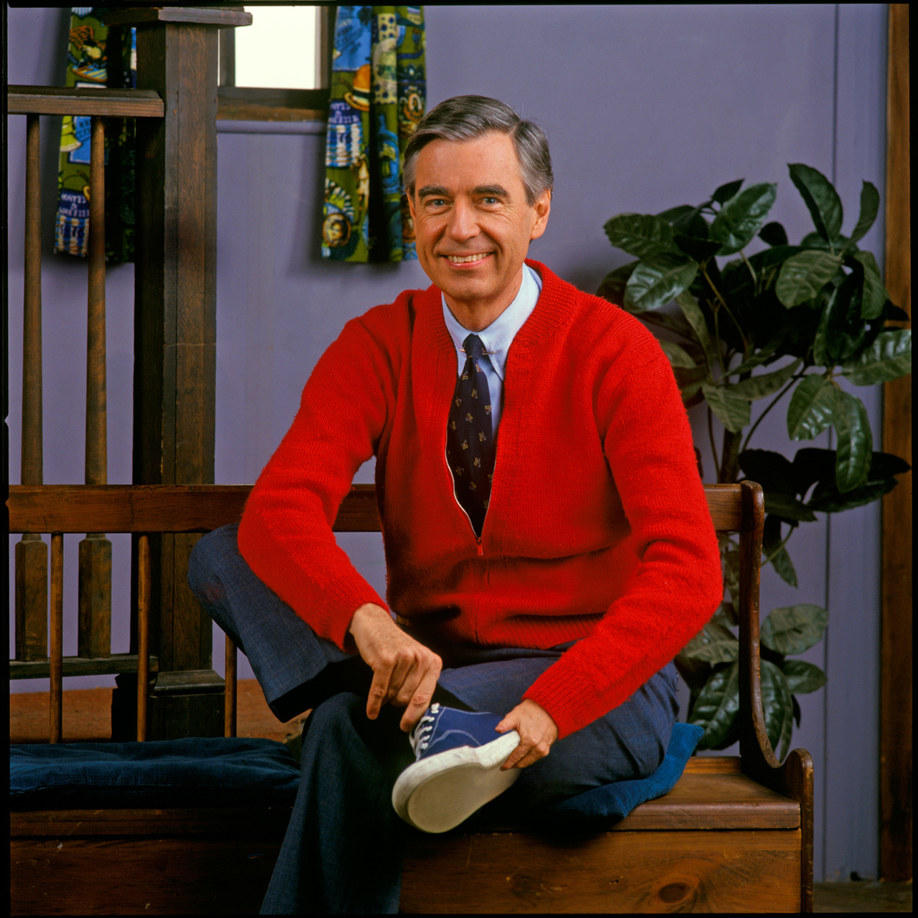
HOW IS PAPER MADE TODAY

Slide 9
RECYCLED CLOTH
WOOD
FIBRE
RAW MATERIALS
RECYCLED PAPER
VEGETABLE MATTER
WOOD

Slide 10
PULP
MECHANICAL
FILTERED
GRINDED
TUMBLED

Slide 11
COOKED
PULP
SODIUM
HYDROXIDE
SODIUM
SULFIDE
CHEMICAL

Slide 12
COLOUR
BEATED
SIZING
BEATING

Slide 13
MESH SCREEN
WOOL ROLLERS
HEATED CYLINDERS
FOURDRINIER
ROLLERS

Slide 14
T
E
X
TUR
E
G
L
O
S
S
Y
W
E
I
G
H
T
COLOUR

Slide 15
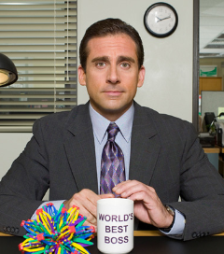
“A blank sheet of paper equals endless possibilities.”
Michael Scott
(The Office)

Slide 16
THE SCIENCE OF PAPER

Slide 17
Impaired Comprehension
Limited
Scanning
Impaired Sensory

Slide 18
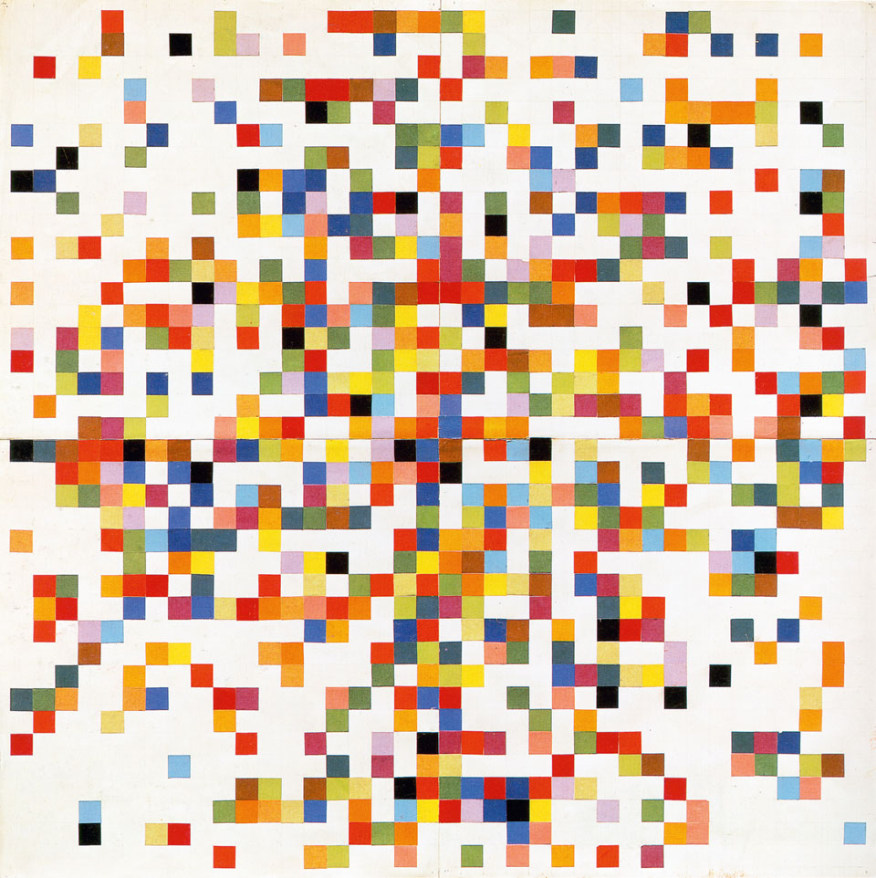
“When I see a white piece of paper, I feel I've got to draw. And drawing, for me, is the beginning of everything.”
Ellsworth Kelly
(Artist)

Slide 19
I
PAPER

Slide 20
REDUCE
SUSTAINABILITY
REUSE
RECYCLE

