Slide 1
Five Themes of Geography at UBC
Mike Rosse, Edward Dengler, Semir Ivziku, Taylor Sarchet (Swift)

Slide 2
What are the “five themes of geography”?
Video: https://www.youtube.com/watch?v=AIqC79WrpKg

Slide 3
The five themes of Geography:
Location (Absolute and Relative)
Place
Movement
Regions
Human-Environment Interactions

Slide 4
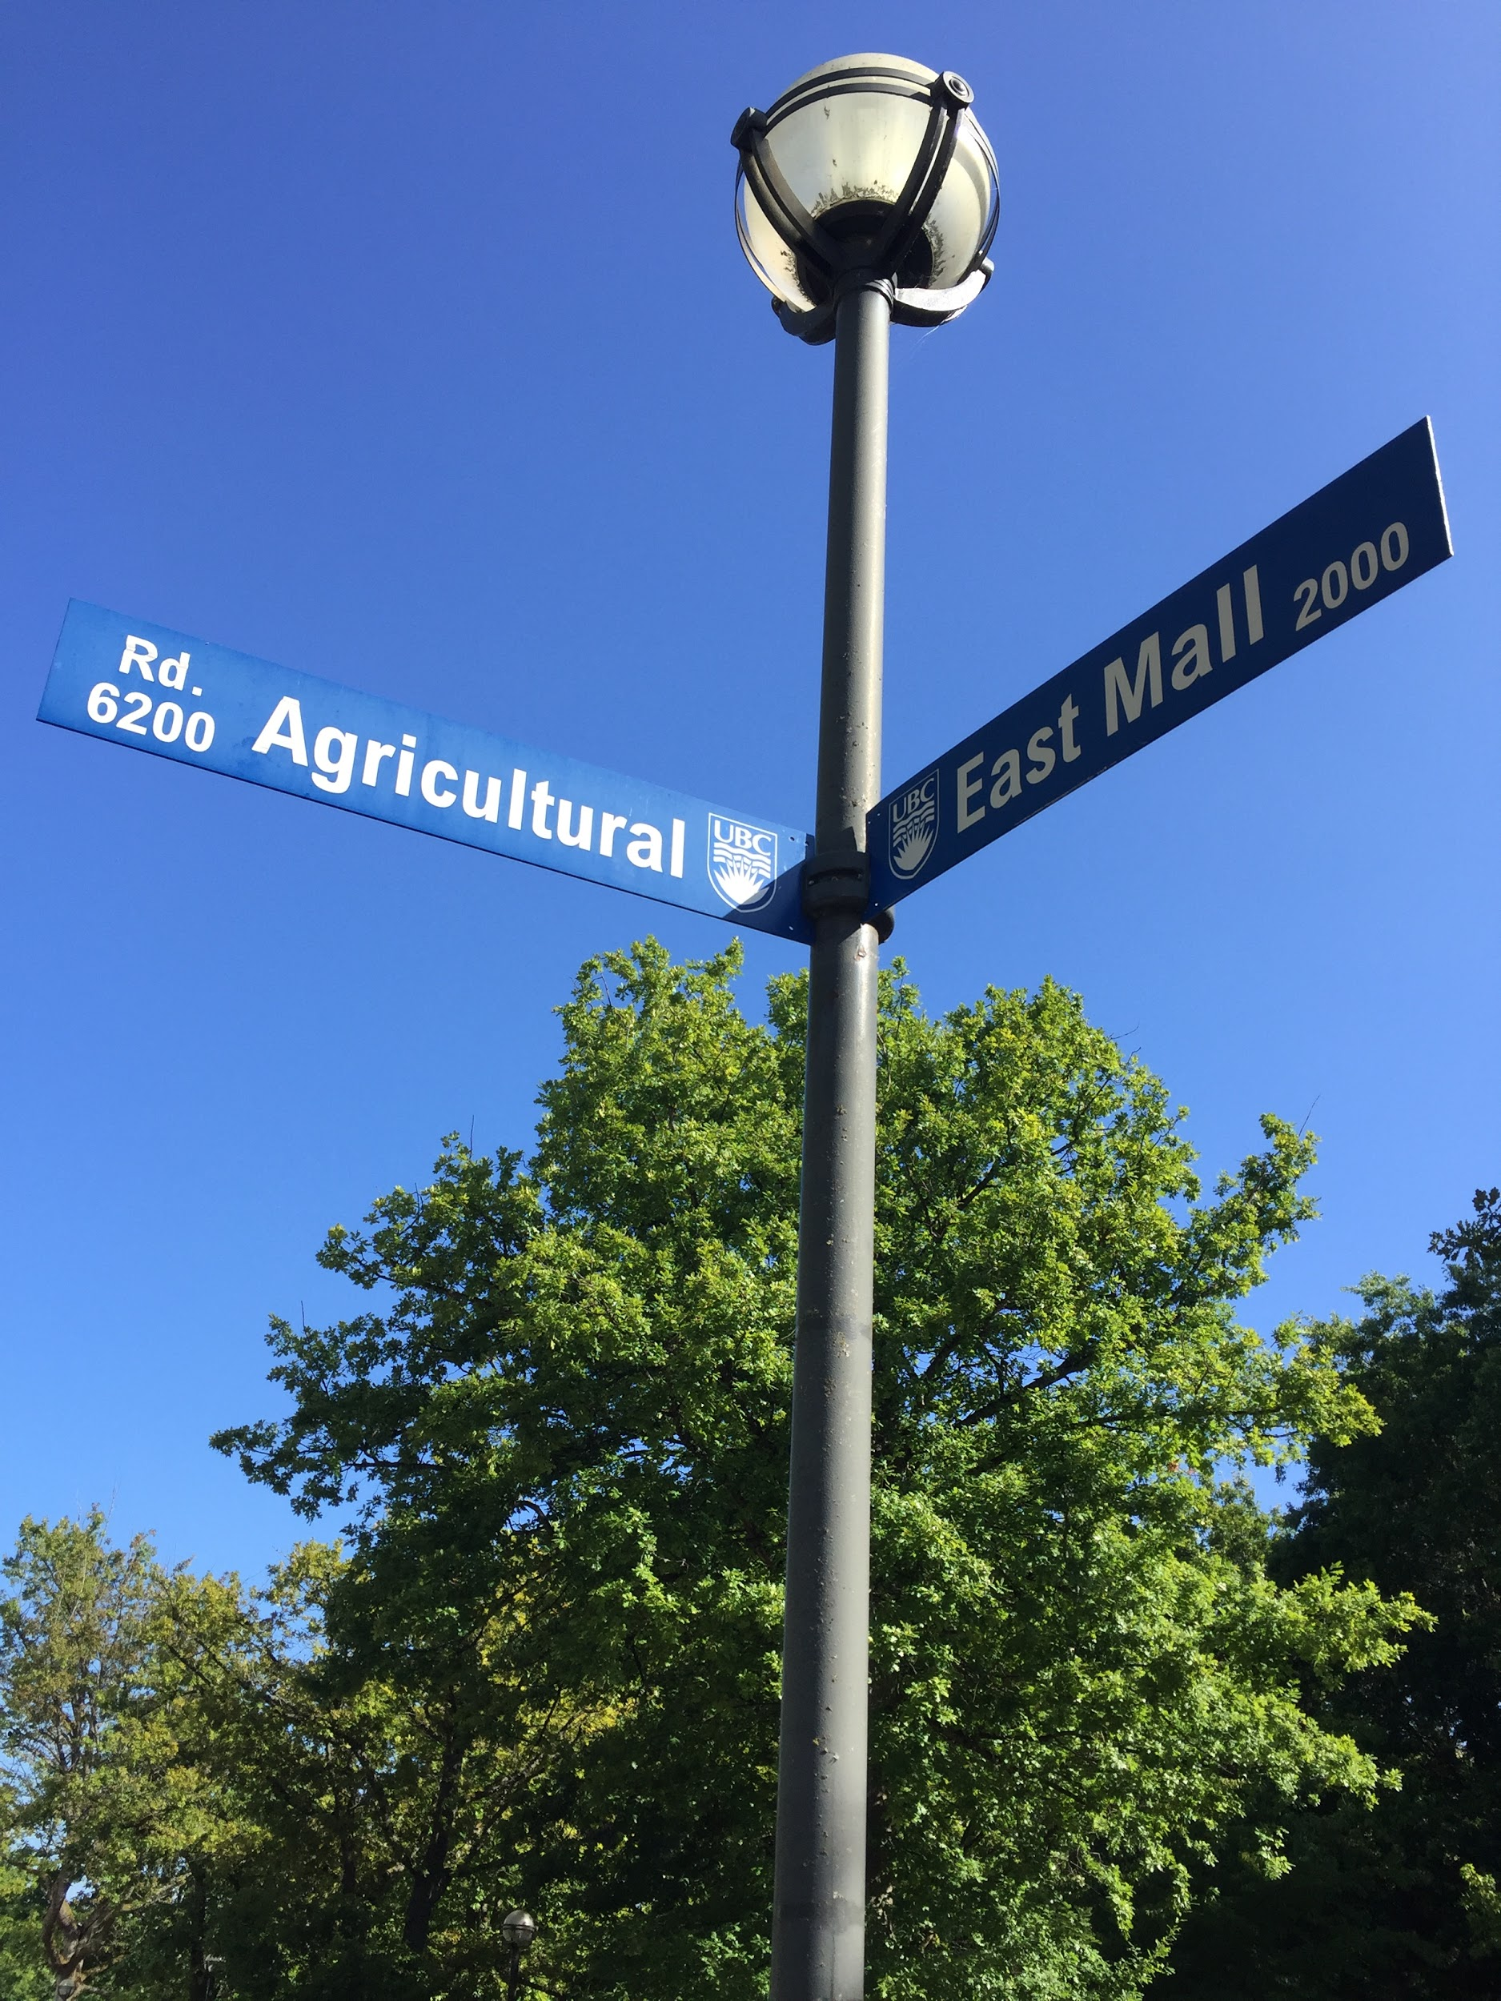
Absolute Location: It is the exact location using coordinates which pin points a place where no other place could be.
Example: Intersection of Agricultural Rd and East Mall. This is the only location where both roads meet.

Slide 5
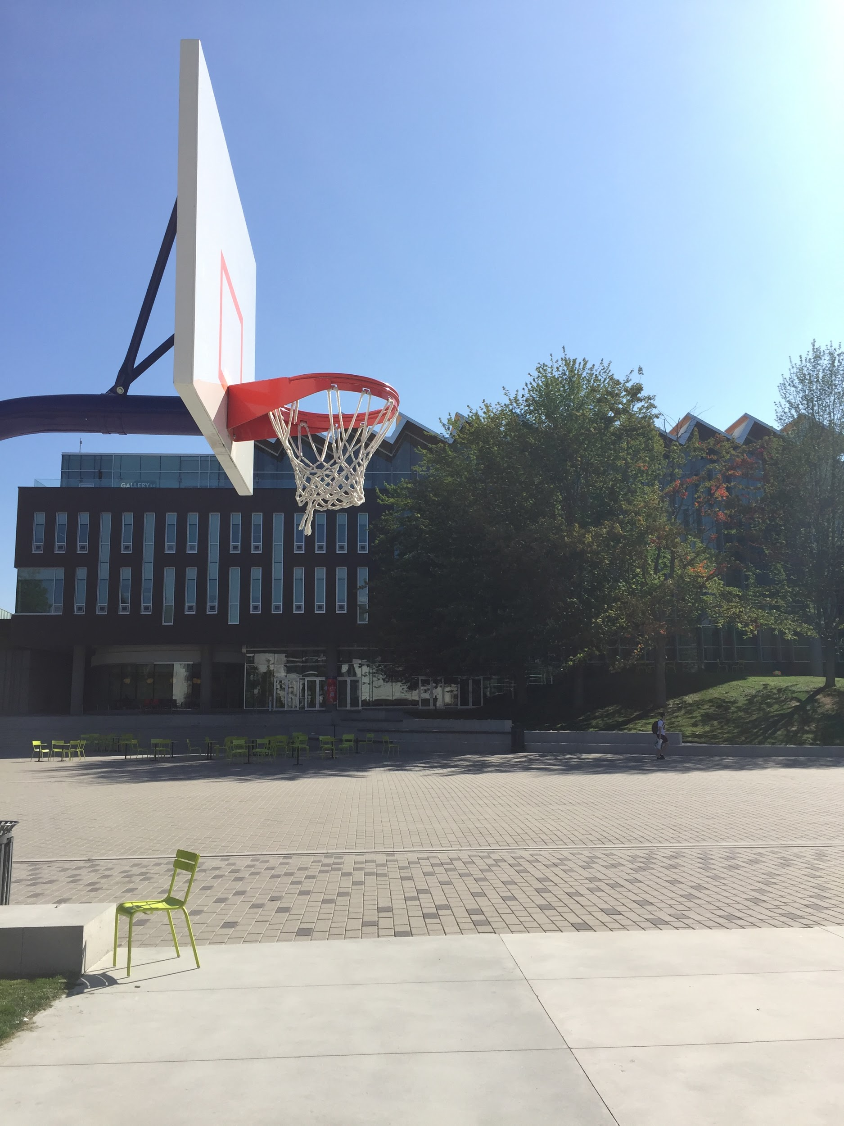
Relative Location: A location that corresponds to another location in, around, or nearby.
Example:The basketball court next to the Student Union Building.

Slide 6
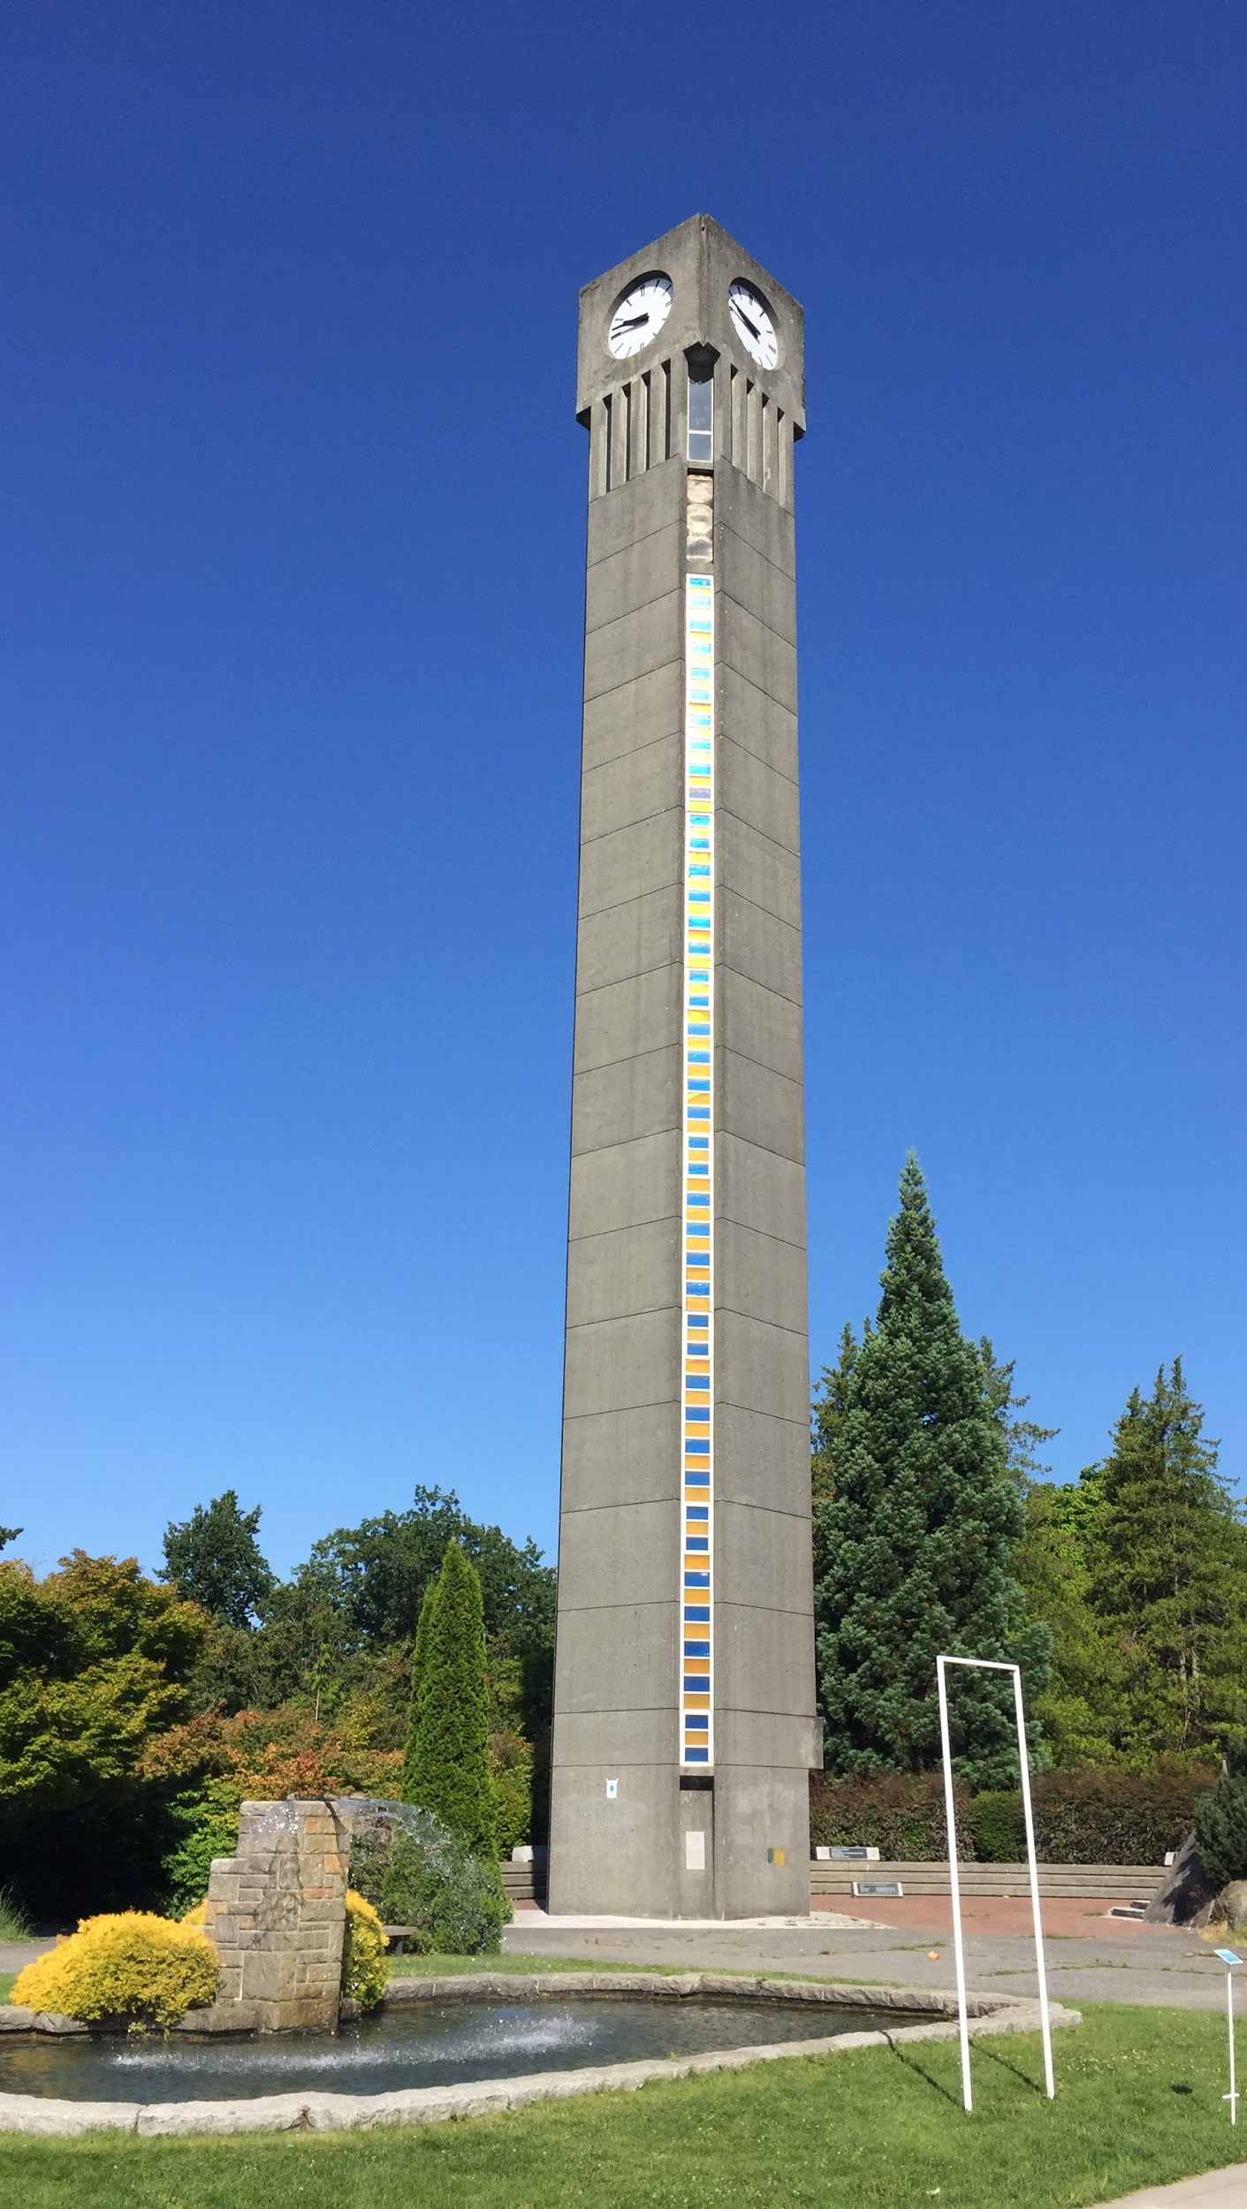
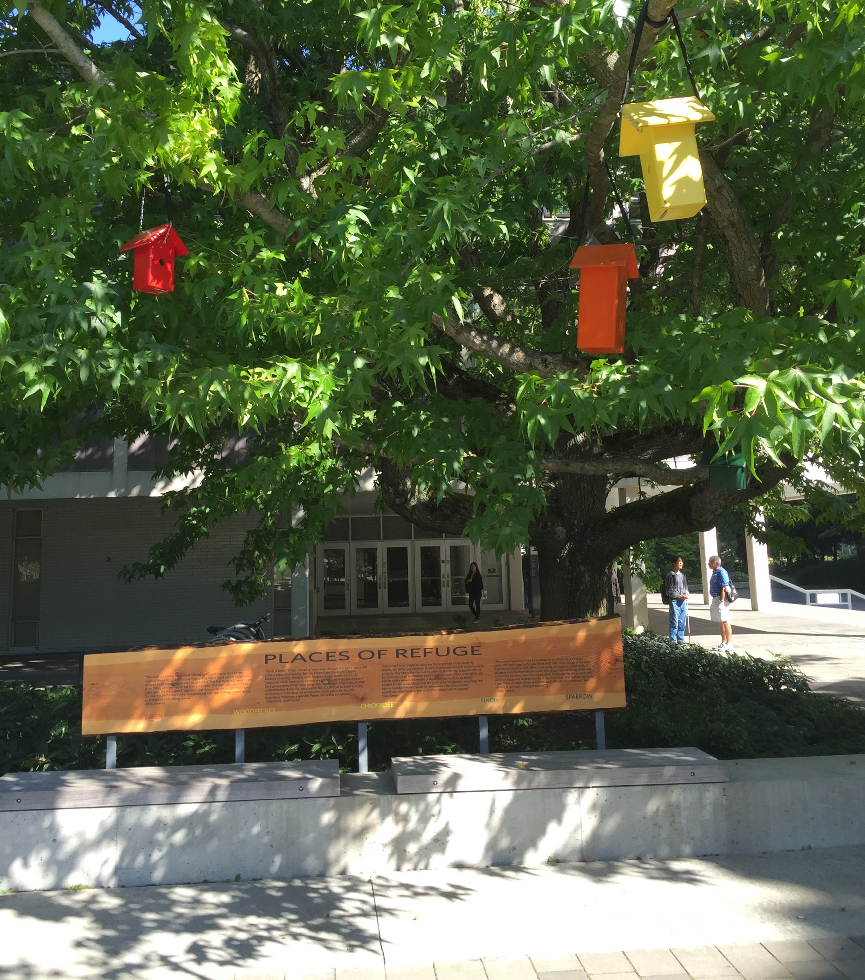
Place: An area defined by everything in it. All places have features that give them personality and distinguishes them from another place.
Example: Within UBC there are different places with various characteristics, and histories, which makes them unique and distinguishable from any other place on campus.
UBC fountain
“Place of Refuge”
UBC Clock Tower

Slide 7
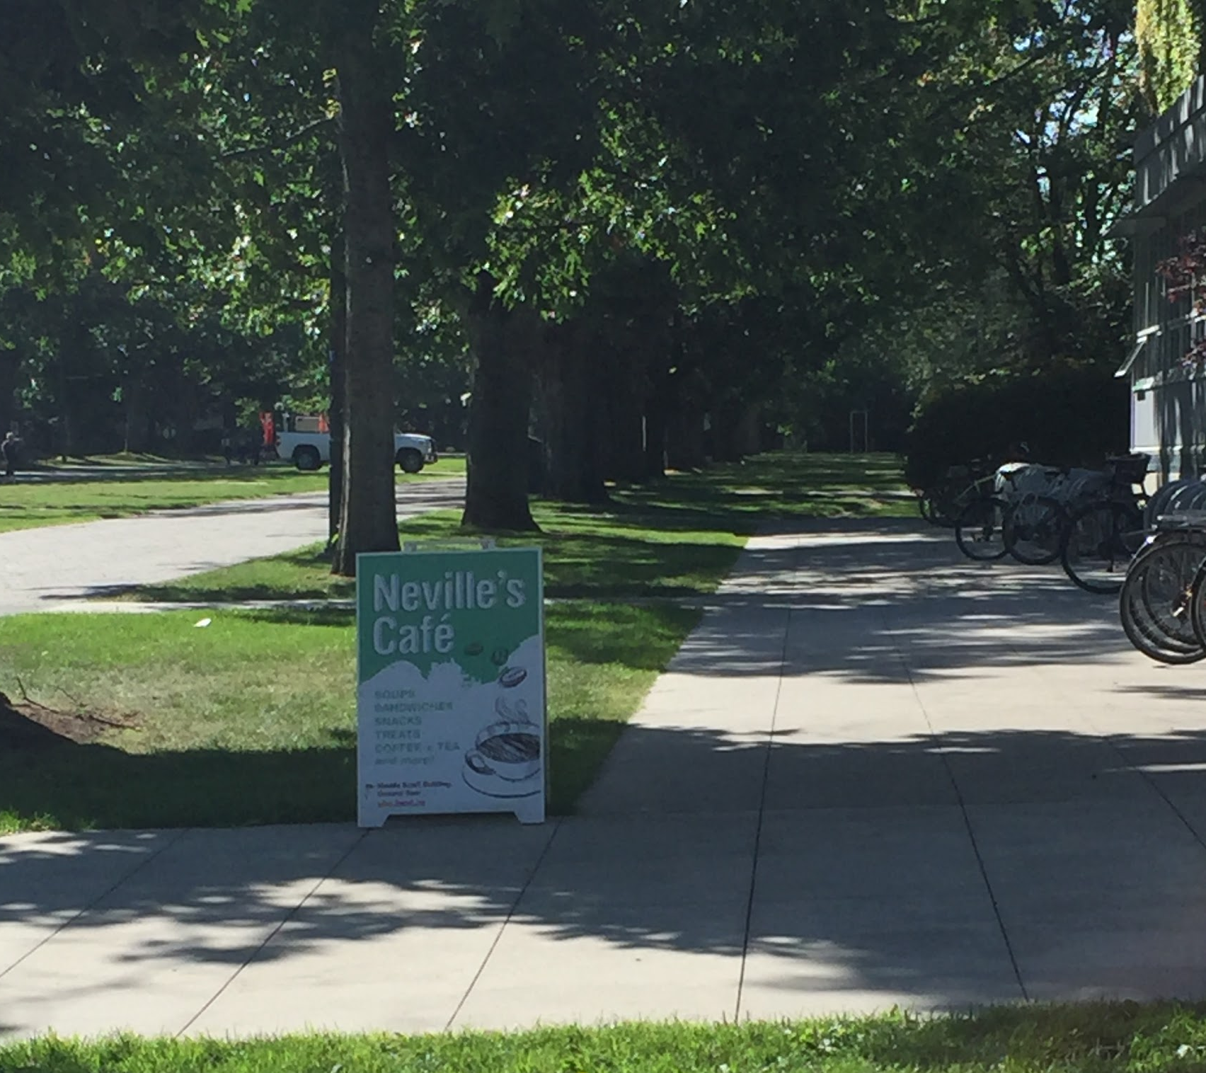
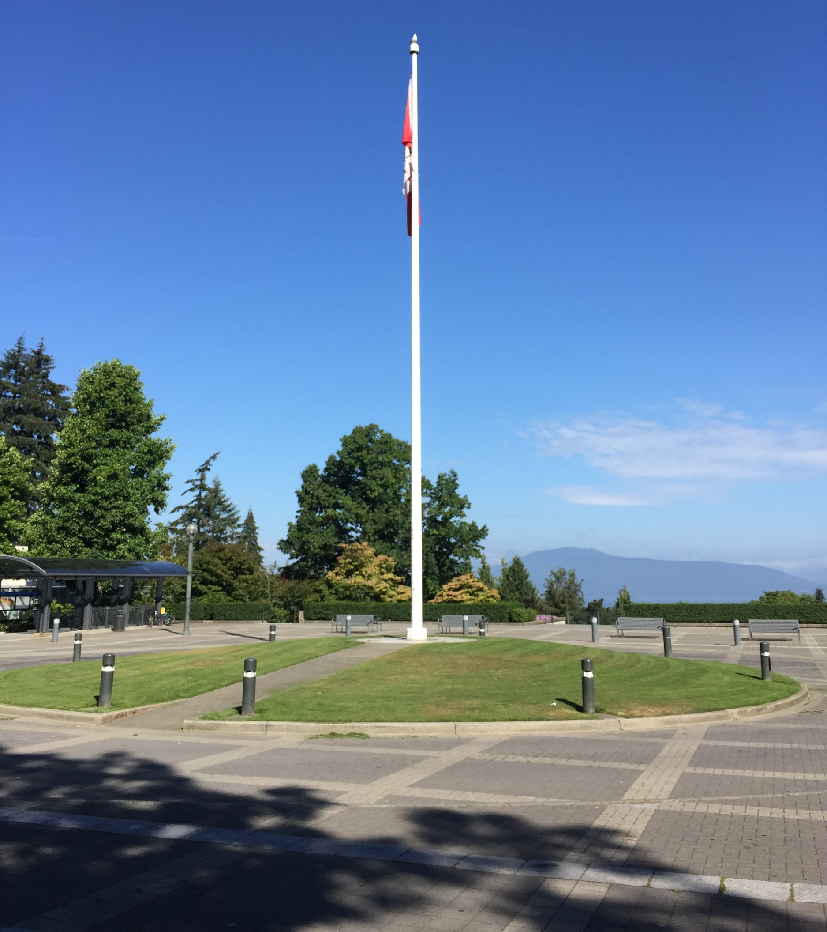
Movement: The undertaking of going from one place to another. This can be humans, ideas or products maneuvering from place to place.
Example: West Mall represents a space where students can move from building to building.
The roundabout can used by pedestrians, bicyclists and vehicles.

Slide 8
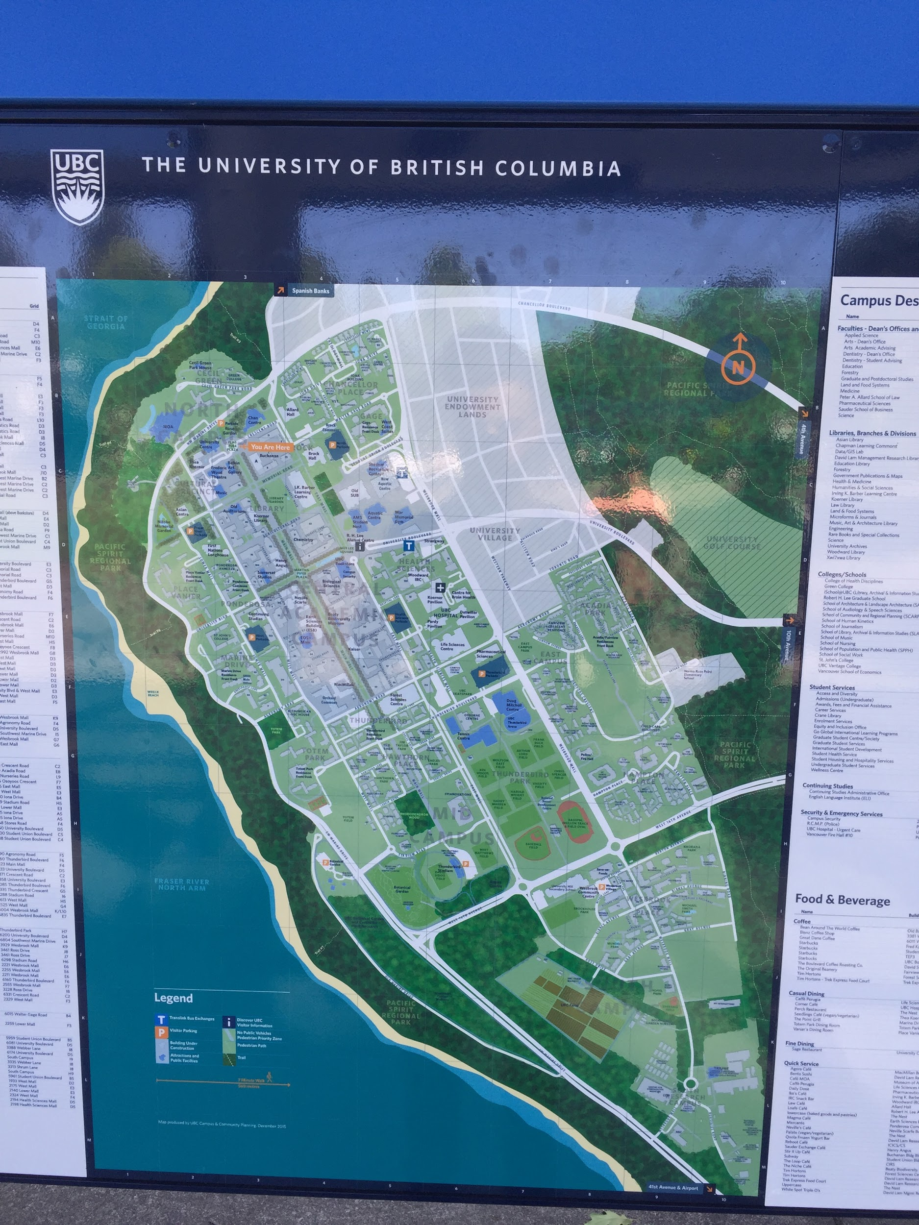
Regions: Interactions, similarities, and differences between locations (such as, politics, demographics, physical characteristics, etc.)
Example: Faculties at UBC are generally attributed to different areas of the campus, and each have their own associations, yet we are all governed under the School of UBC.

Slide 9
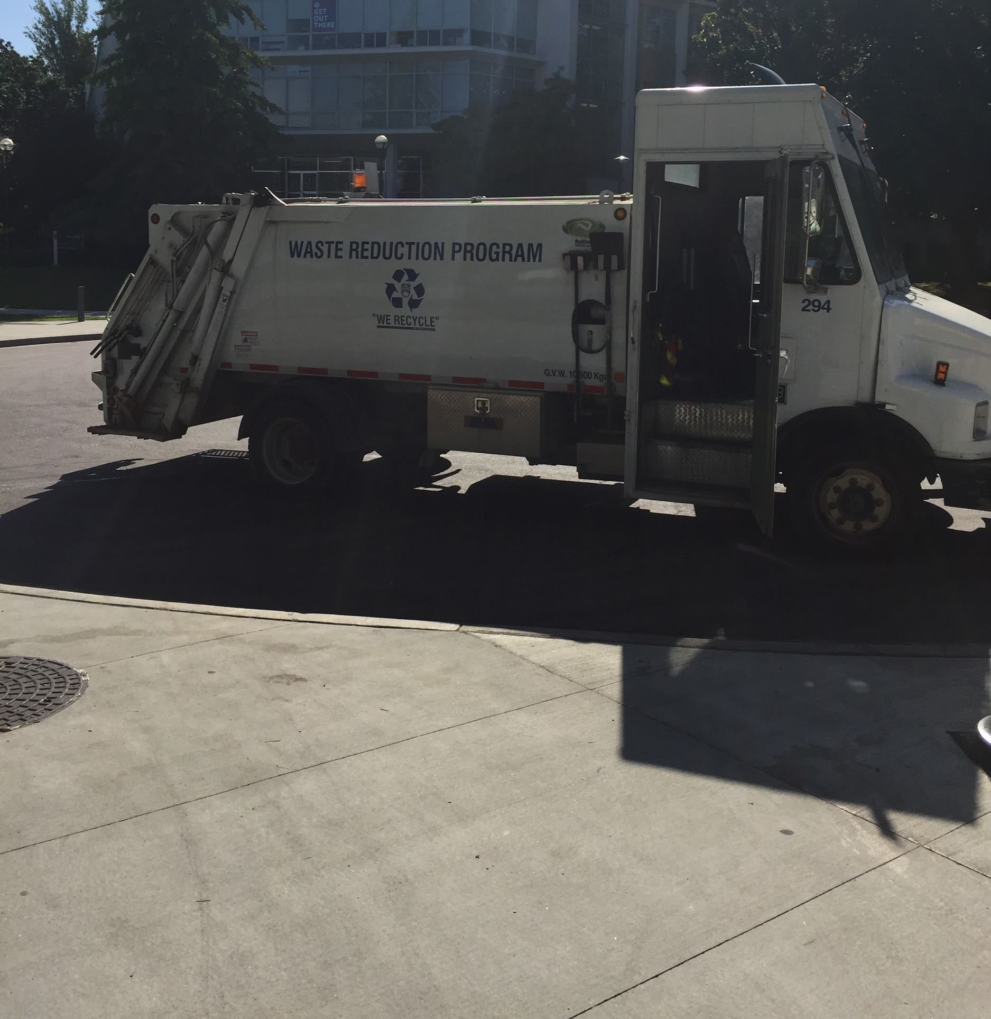
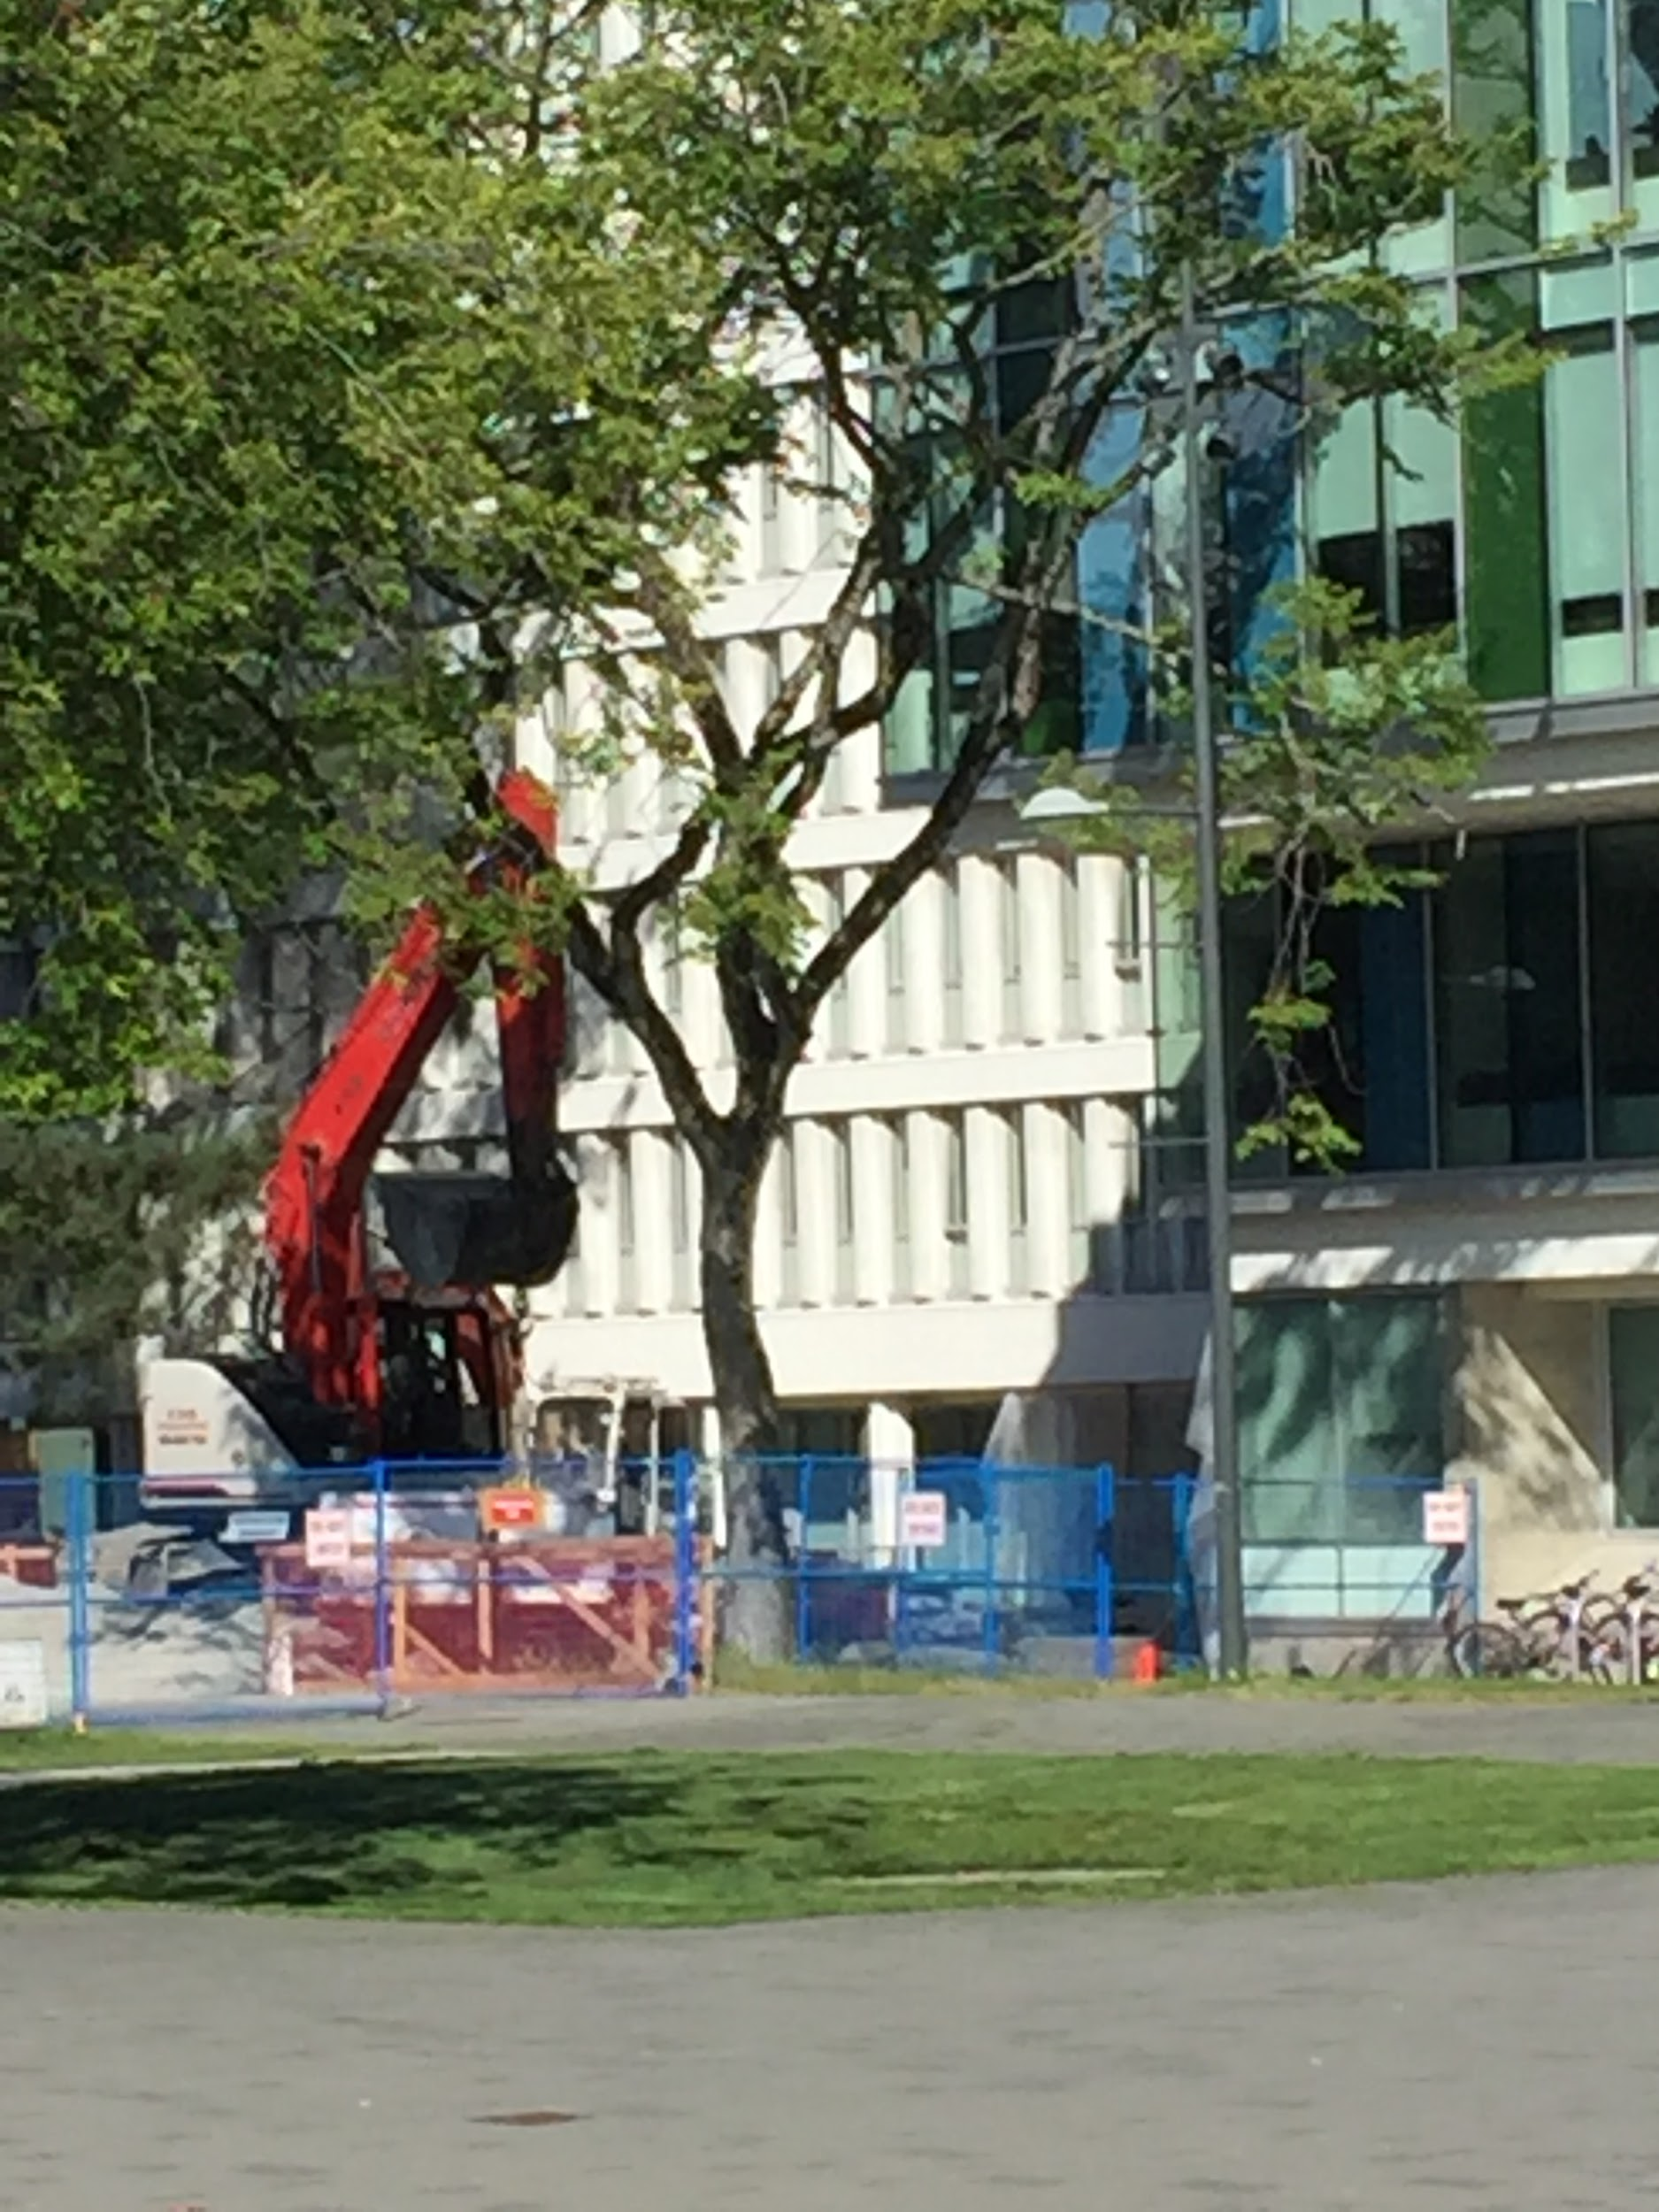
Human-Environment Interactions: The synergy between humans and the environment. It investigates how humans and the environment cooperate with each other. It also involves how humans and the environment respond to each other.
Examples: The Waste Reduction Program (promotes better ways of dealing with our waste) and Construction (new building change our landscape).

Slide 10
Critical Thinking Question: Pick a place, culture or object (Example: Vancouver Canucks). How can it relate it to each of the five themes of geography?

