Slide 1
Review – for marks!
1) What is the difference between a mirror an a lens?
2) Why do you think we have a lens in our eye instead of a mirror?

Slide 2
Trade papers with your partner
1) Lens – refracts light, Mirror – reflects light
2) Light needs to be focused (refracted) onto the retina, a mirror would reflect the light back away from our eye

Slide 3
Lens Questions

Slide 4
1) What happens to light rays as they pass through air and into glass? What is this called?
As light rays pass from air into glass, they slow down and bend. This is called refraction.

Slide 5
2) What happens to parallel light rays as they pass through a concave lens?
As parallel light rays pass through a concave lens they diverge
(spread apart)

Slide 6
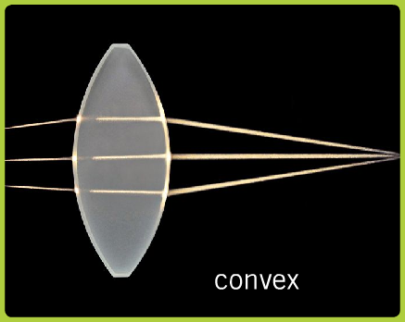
3) What happens to parallel light rays as they pass through a convex lens?
Parallel light rays converge as they pass through a convex lens.
(come together towards a focal point)

Slide 7
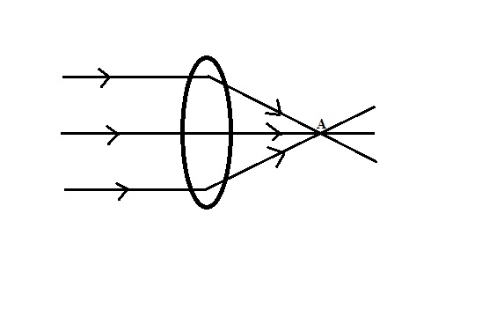
4) What is a focal point?
A focal point is the single point at which converging light rays meet.

Slide 8
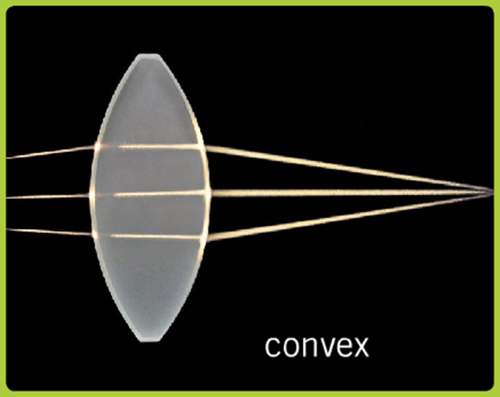
5) Will a concave or a convex lens have a focal point?
A convex lens will create a focal point.

Slide 9
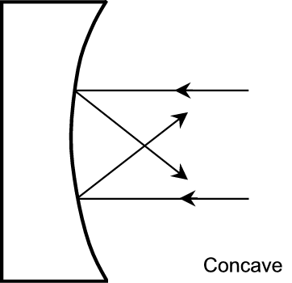
6) What type of mirror also has a focal point?
A concave mirror also has a focal point.

Slide 10
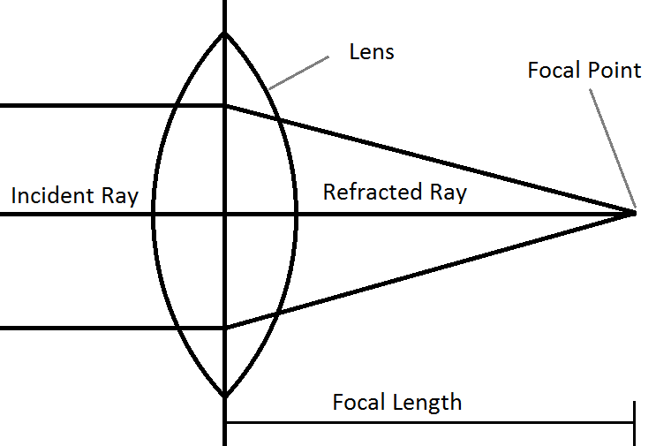
7) What is a focal length?
The focal length is the distance between the center of the mirror or lens to the focal point.

Slide 11
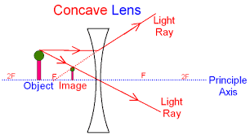
8) Describe an image formed by a concave lens.
An image formed by a concave lens will be smaller then the object and will appear right way up.

Slide 12
9) What determines the type of image formed by a convex lens? Describe what these images look like in a chart.
The distance the object is from the lens will determine the image formed by a convex lens.
Chart p. 192

Slide 13
10) Give an example of a common use for both a concave lens and a convex lens.
Concave lenses are commonly used in telescopes and eyeglasses.
Convex lenses are commonly used in magnifying glasses.

Slide 14
Parts of the Eye

Slide 16
Parts of the Eye – Purpose and Functions
Lens – causes light rays to refract as it passes through. Able to change shape to change the focal length of the object being looked at
Iris – coloured circle of muscle surrounding the pupil, controls the amount of light let into the eye by changing the size of the pupil

Slide 17
Pupil – an opening in the eye, allows light to pass though it
Sclera – the white part of the eye, a opaque tissue surrounding the cornea
Cornea – a transparent tissue covering the pupil and iris. Refracts light rays so they converge towards the lens

Slide 18
Vitreous humor – watery fluid inside the eye that gives it shape and supports the lens
Retina – a layer of cells on the back of the eye, these light sensitive cells detect the image
Optic Nerve – nerve at the back of the eye that sends all detected light to the brain

Slide 19
Blind Spot – the point at which the retina meets the optic nerve. This area contains no light detecting cells and therefore cannot detect an image
Fovea - area packed with light sensitive cells. Used for activities where visual detail is very important, such as reading

Slide 20
sclera
pupil
iris

Slide 21
Vision Problems

Slide 22
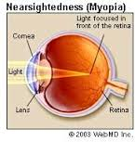
Nearsightedness
Unable to focus on objects at a distance
Focal point is before, rather then on the retina
Corrected with
eyeglasses or laser
treatment

Slide 23
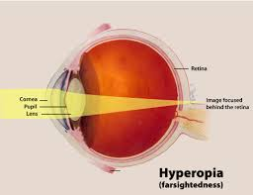
Farsightedness
Unable to focus on near objects
Focal point is behind, not on the retina
Corrected with
eyeglasses or
laser surgery

Slide 24
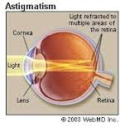
Astigmatism
Distorted cornea shape
Creates multiple focal points on the retina
Corrected with
eyeglasses or
laser surgery

Slide 25
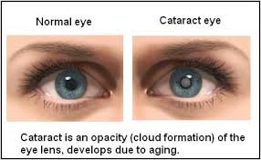
Cataracts
Clouding of the lens
Proteins clump together and become opaque
Removal with
surgery

Slide 26
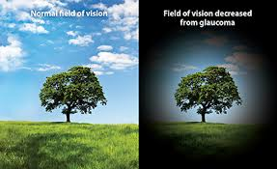
Glaucoma
Damage to the optic nerve
Pressure build up in the eye
Treated with
medicine, but
there is no cure

