Slide 1
Bacterial Reproduction

Slide 2
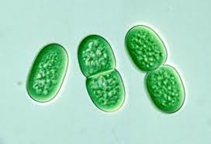
Binary Fission
Bacteria begins to grow until it has doubled in size
Replicates DNA
Divides to make 2 daughter cells
No exchange of genetic material = asexual reproduction

Slide 4
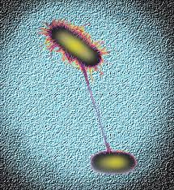
Conjugation
Protein bridge forms between bacteria cells
Genetic material passed between bacteria
Genetic exchange = sexual reproduction
Increases genetic diversity

Slide 6
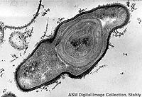
Spore Formation
Formed when living conditions become unfavourable
Enclose DNA and cytoplasm in endospore
Able to stay dormant until conditions improve
Technically not reproduction, be a method to prolong life

