Slide 1
What do soy sauce, a Begonia and a dented can have in common?

Slide 2
Bacteria and People
The Good, the Bad and the Essential

Slide 3
Essential Bacteria

Slide 4
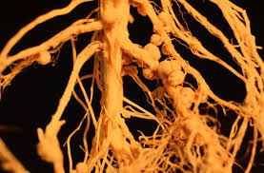
Essential Bacteria
Nitrogen fixing bacteria → Atmospheric N₂ into NH₄

Slide 5
Essential Bacteria
Gut flora → helps animals digest food

Slide 7
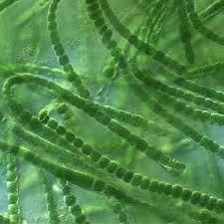
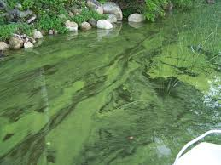
Essential Bacteria
Cyanobacteria →
blue-green algae, create oxygen with photosynthesis

Slide 8
Useful Bacteria

Slide 9
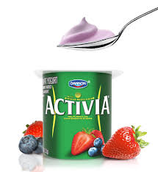
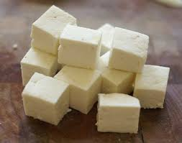
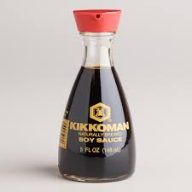
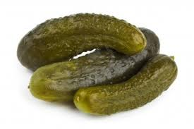
Useful Bacteria
Food →
yogurt, cheese, soy sauce, pickles

Slide 10
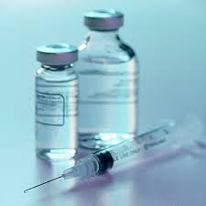
Useful Bacteria
Insulin production →
faster and more effective

Slide 11
Harmful bacteria

Slide 12
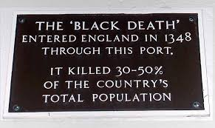
Harmful Bacteria
Pathogens!!
Bubonic Plague/ Black Death →
Killed half the population of Britain in the 14th century

Slide 13
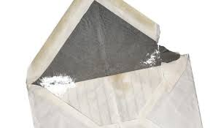
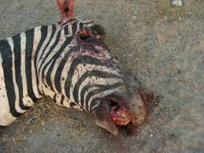
Harmful Bacteria
Anthrax →
Sent out in mail in 2001, killed 5

Slide 14
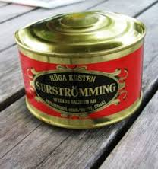
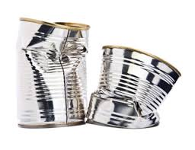
Harmful Bacteria
Botulism →
Anaerobic bacteria creates toxins

