Slide 1
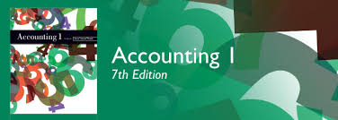
Financial Accounting Fundamentals
Chapter 1

Slide 2

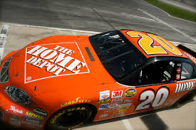
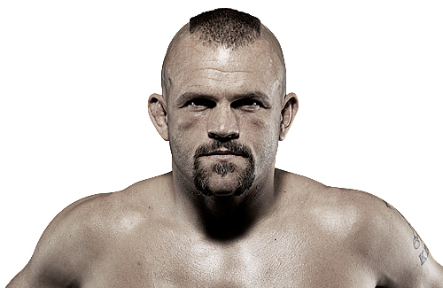

Slide 3
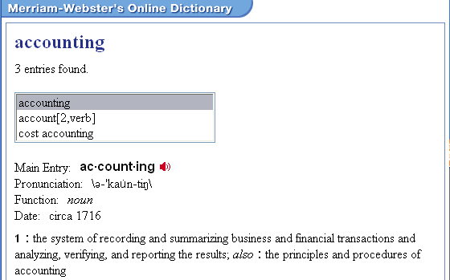
What is Accounting?
According to Merriam-Webster’s dictionary accounting is …
1 : the system of dealing with financial data that provides information for decision making

Slide 4
What is Accounting?
Does accounting only apply in the business world?
What day-to-day activities are related to accounting?
Can you think of any games that would lend themselves to the world of accounting?

Slide 5
Why Study Accounting?
Accounting on the job.
  Great background knowledge for many careers
Accounting in daily life.
  Balancing your bank book, filing your tax returns, preparing personal budgets, etc.
Owning your own business.
Accounting as a profession.
  CPA: CA, CMA, CGA

Slide 6
Five Main Activities?
Gathering financial information.
Preparing and collecting permanent records.
Rearranging, summarizing, and classifying financial information.

Slide 7
Five Main Activities?
Preparing information reports and summaries to:
  Help management reach decisions;
  Serve the needs of groups outside the business; and
  Measure the profitability of the business.
To establish controls to promote accuracy and honesty among employees.

Slide 8
Forms of Business Ownership
Sole proprietorship.
  One owner.
Partnership.
  More than one owner.
Corporations.
  Owned by shareholders.
The focus of most of this course.

Slide 9
Types of Business
Service Business
Merchandising Business
Manufacturing or Producing Business
Non-Profit Organizations
The focus of most of this course.

Slide 10
The Accounting Cycle
Transactions occur
Transactions recorded in journals
Journal entries posted to ledger accounts
Trial balance and interim financial statements prepared
Work sheet prepared
Formal financial statements prepared
Ledger account adjusted and closed
Post-closing trial balance prepared

Slide 11
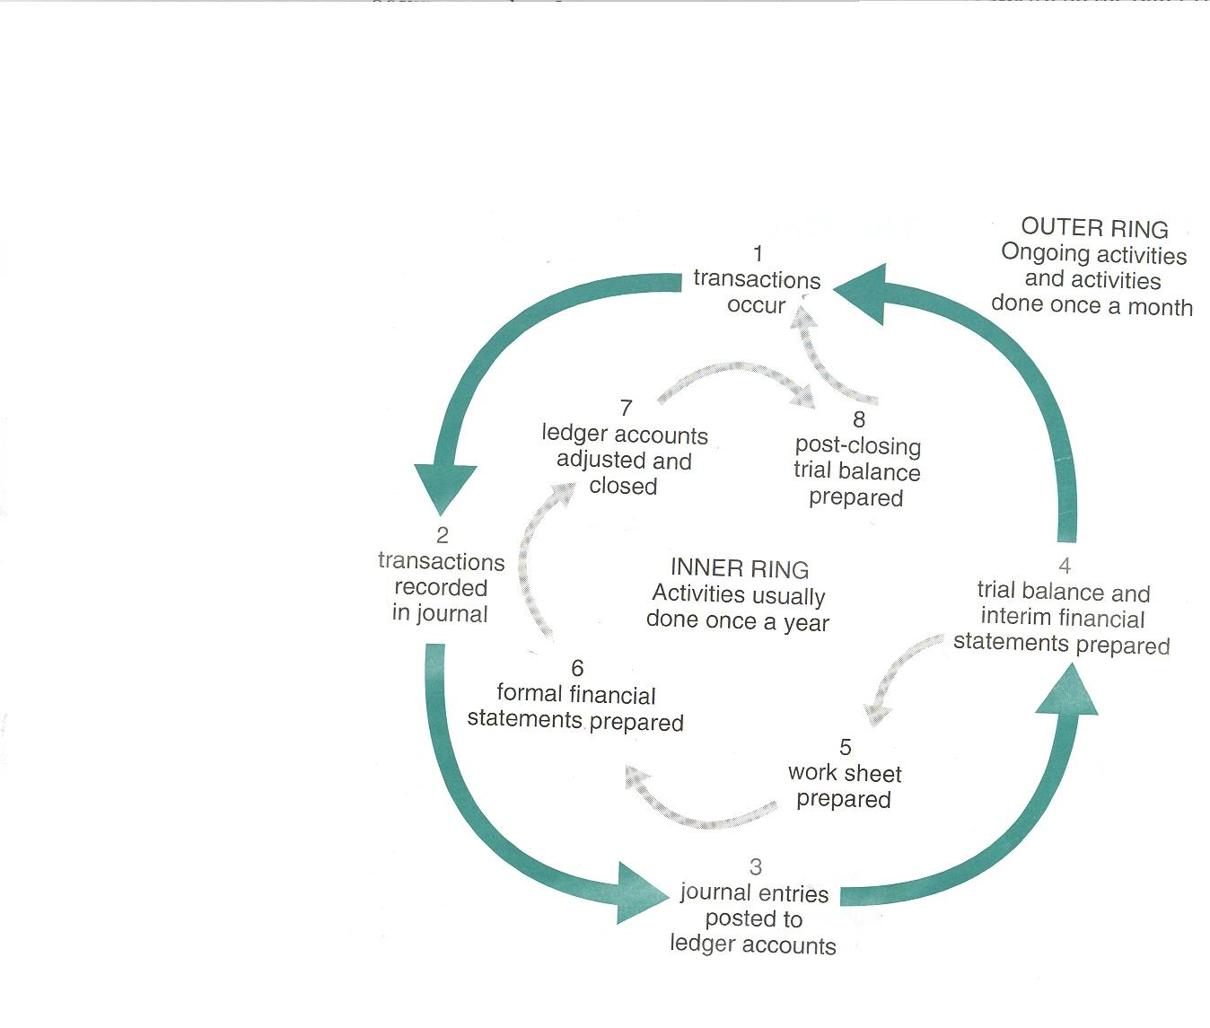
The Accounting Cycle

Slide 12
Roles in Accounting
The Accounting Clerk
vs.
The Accountant

Slide 13
Roles in Accounting
The Accounting Clerk
  Records transactions with necessary supporting documents
  Records accounting entries and balances ledgers
  Perform payroll calculations, prepares payroll cheques and related records
  Carry out all banking transactions.

Slide 14
Roles in Accounting
The Accountant
  Develop systems to ensure that correct data is entered into accounting systems
  Ensure GAAP are met
  Interpret data produced by accounting systems
  Prepare reports based on output from systems
  Participate in decision making
  Supervise the work of accounting staff

Slide 15
Class / Homework
The following slides reflect Review Exercises …
Page 13 Exercise 1
Page 14 Exercise 2 & 3

Slide 16
Identify which accounting term best matches the following statements.
- Accounting
cycle
- Auditing
- CGA
Association
- Corporation
- Financial
statements
- CICA
- Manufacturing
business
- Merchandising
business
- Non-profit
business
- Public
accountants
- Service
business
- Society of
Management
Accountants
- Sole proprietor
The professional accounting organization that is well-known for distance education.
The professional accounting organization that emphasizes management accounting.
The professional accounting organization that publishes a handbook of Canadian accounting rules and standards.
Formal accounting data, prepared at least once a year.
An organization whose main aim is to provide a social benefit, usually at little or not cost to the user.
The recurring set of accounting procedures carried out during each fiscal period.

Slide 17
Identify which accounting term best matches the following statements.
- Accounting
cycle
- Auditing
- CGA
Association
- Corporation
- Financial
statements
- CICA
- Manufacturing
business
- Merchandising
business
- Non-profit
business
- Public
accountants
- Service
business
- Society of
Management
Accountants
- Sole proprietor
A business that buys goods and resells them at a higher price for profit.
The owner of a business who is in business alone.
A special form of business that is owned by a number of persons called shareholders.
Professional persons who offer their services as accountants to the general public.
The examining and testing of the books, records, and procedures of a business.
A business that sells a service to the public and does not make or sell a product.
A business that buys raw materials, converts them into a new product, and sells that product to earn a profit.

Slide 18
For each of following statements, fill in the blank with accountant, accounting or accounting clerk.
The work of an __________ is clerical in nature.
The work of an __________ is concerned with routine matters.
An __________ ensures that the supporting documents are present and correct for every transaction.
An __________ ensures that generally accepted accounting principles are followed.
An __________ records the accounting entries in the books of accounts.
An __________ makes the payroll calculations.

Slide 19
For each of following statements, fill in the blank with accountant, accounting or accounting clerk.
An __________ prepares reports based on the data produced by the accounting system.
An __________ carries out all the necessary banking transactions.
An __________ participates in management meetings.
A professional __________ has a high-level position.
For centuries, all __________ was handwritten.
Some small businesses still do their __________ by hand.

Slide 20
Multiple choice:
Which of the following statements does not fit the job title of an accounting clerk?
  Verifies source documents.
  Ensures that the ledger balances.
  Works neatly to guard against errors.
  Studies tax bulletins to keep up to date.
Which of the following statements does not fit the job title of an accounting clerk?
  Works out accounting entries.
  Together with the owner, compares this year’s and last year’s income statements.
  Records accounting entries in the books.
  Inquires about a suspected error made by the bank.

Slide 21
Multiple choice:
Which of the following statements does not fit the job title of an accountant?
  Is a professional person.
  Has a broad knowledge of accounting.
  Ensures the accuracy of the payroll deductions.
  Discusses the business’s “cash flow” with the owners.
Which of the following statements does not fit the job title of an accountant?
  Works out accounting entries.
  Together with the owner, compares this year’s and last year’s income statements.
  Records accounting entries in the books.
  Inquires about a suspected error made by the bank.

Slide 22
Multiple choice:
Which of the following does not fit the facts about computers?
  Ideal machine for use in an accounting environment.
  Handles large quantities of data.
  Produce better profit figures.
  Provide information for management very quickly.
Group Presentation Assignment:
Assignment: In groups of 2-3 research and present on topics of interest relating the accounting. This is a short presentation (5-10 minutes) and the goal is reinforce presentation skills while discovering more about the accounting profession. Some sample topics include: What is a CPA? How do you become a CPA? What are some careers in accounting and the related schooling requirements? Select a university (UBC, SFU, Kwantlen…) and discuss their accounting program). Emphasis should be placed on content, presentation skills/class engagement.

