Slide 1
CONSUMERISM & PRODUCTION CYCLE

Slide 2
1.
CONSUMER
V.
CUSTOMER

Slide 3
DEFINITION
Customer: the buyer of the product
Consumer: the user of the product

Slide 4
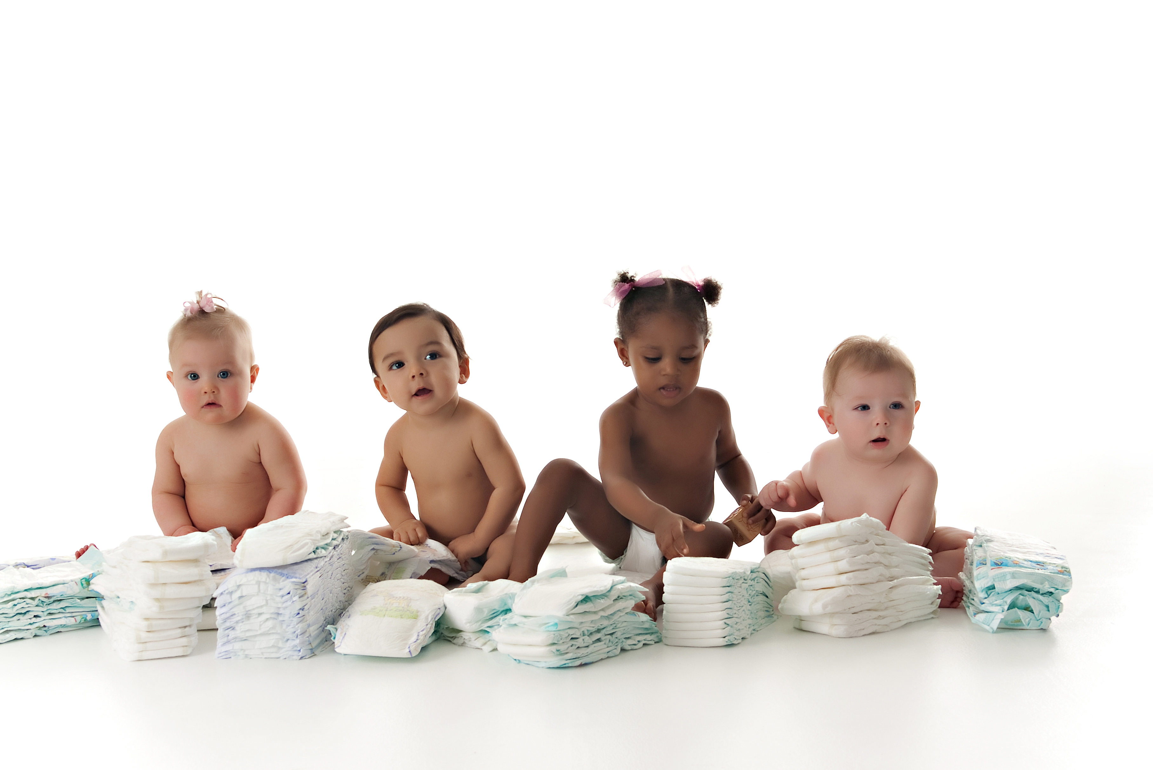
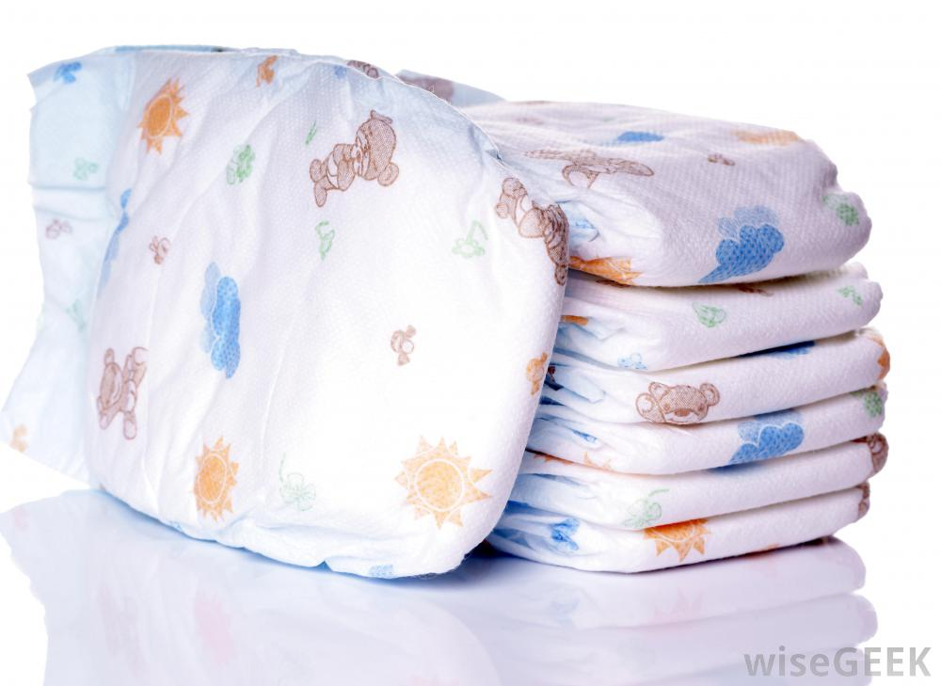

WHO ARE THE CONSUMERS AND THECUSTOMERS?

Slide 5

WHO ARE THE CONSUMERS AND THECUSTOMERS?

Slide 6
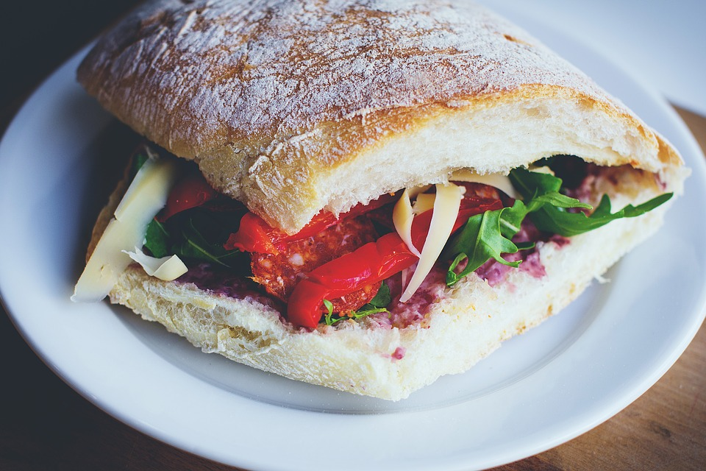
WHO ARE THE CONSUMERS AND THECUSTOMERS?

Slide 7
CAN YOU THINK OF PRODUCTS FOR WHICH THE CONSUMER AND THECUSTOMER ARE DIFFERENT?

Slide 8
CONSUMER INFLUENCE
Stew Leonard’s (a chain of American supermarkets) believes in the following
  Rule #1: The customer is always right.
  Rule #2: If the customer is wrong, re-read Rule #1.

Slide 9
CONSUMER INFLUENCE ON PRODUCTS
Our preferences shape the products.
Our choices create a competition among businesses.

Slide 10
CONSUMER INFLUENCE ON PRICE
Businesses used to have the pricing power (the ability to charge high prices and raise prices).
Consumers have lots of choices (competition) and can affect the pricing.

Slide 11
CONSUMER INFLUENCE ON SERVICE
Consumers have the purchasing power (the ability to choose where to shop).
Businesses change their service to meet the needs and wants of consumers.

Slide 12
NEEDS V. WANTS
Needs: something you have to have
Wants: something you would like to have

Slide 13
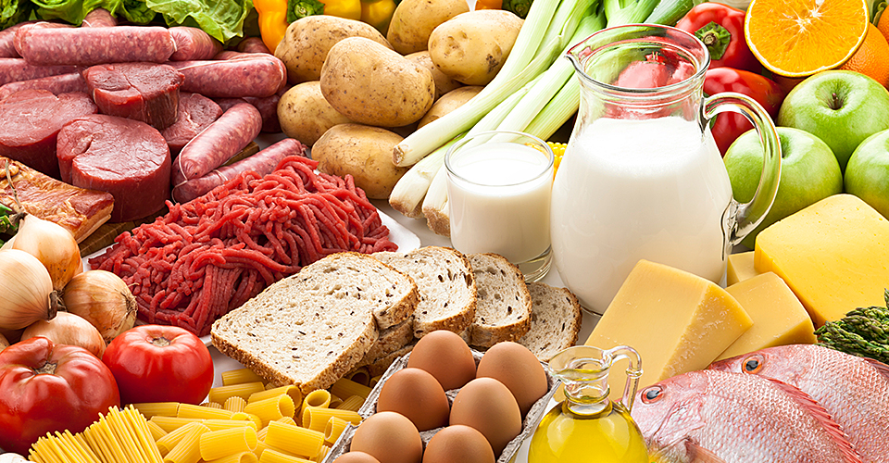
A NEED OR A WANT?
Food

Slide 14
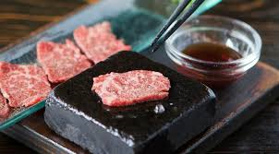
A NEED OR A WANT?
$300 Wagyu Beef

Slide 15

A NEED OR A WANT?
Water

Slide 16

A NEED OR A WANT?
Water

Slide 17
2.
PRODUCTION CYCLE AND OBSOLESCENCE

Slide 18
OBSOLESCENCE
The process of a product becoming obsolete (outdated and no longer used)

Slide 19
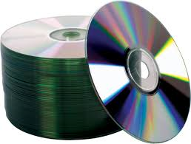
DO YOU KNOW WHAT THIS IS?
CDs

Slide 20
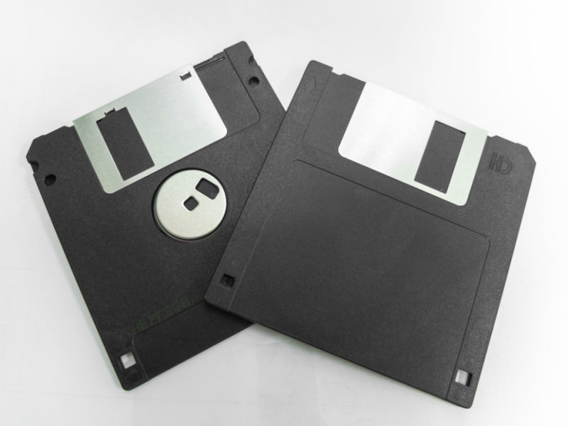
DO YOU KNOW WHAT THIS IS?
Floppy Discs

Slide 21
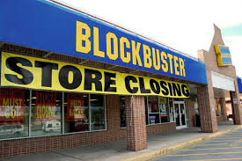
DO YOU KNOW WHAT THIS IS?
Video Rental Stores

Slide 22

DO YOU KNOW WHAT THIS IS?
Map

Slide 23

DO YOU KNOW WHAT THIS IS?
Landline Phone

