Slide 1
Chapter 1.
Introduction to Business

Slide 2
1.
Entrepreneurship

Slide 3
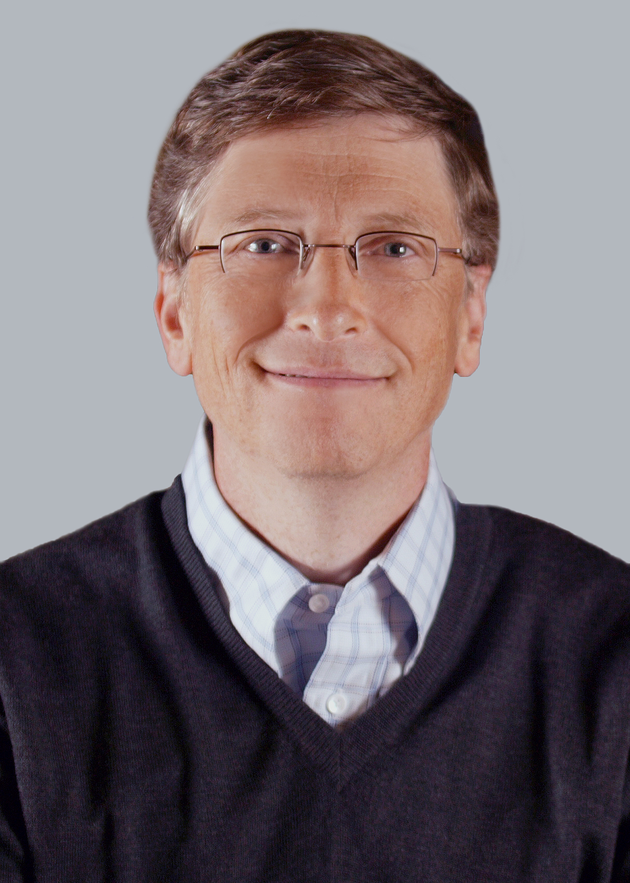
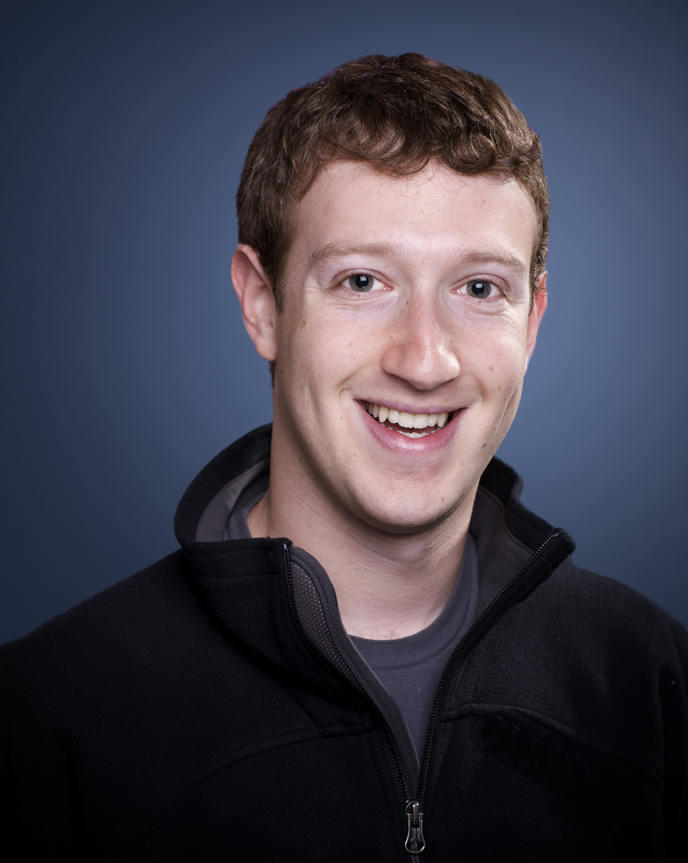

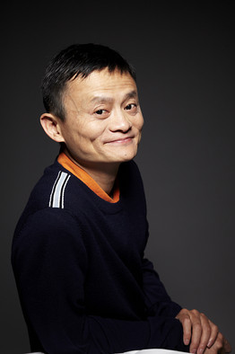
Who is an entrepreneur?
Entrepreneur is a person who organizes and operates a business.

Slide 4
Do you have what it takes to be an entrepreneur?
Characteristics of an entrepreneur:
Self-confidence
A flair for innovation
Rick-taking
The ability to work alone
An aptitude of managing others

Slide 5
Do you have what it takes to be an entrepreneur?
https://www.bdc.ca/en/articles-tools/entrepreneur-toolkit/business-assessments/pages/self-assessment-test-your-entrepreneurial-potential.aspx

