Slide 1
2.
THE ECONOMIC RESOURCES
Notes:
The championship of national football league (NFL) in the states

Slide 2
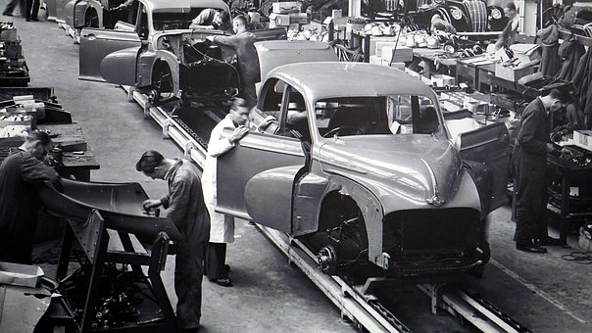
Resources?
A business needs resources to produce, distribute and sell its goods/services.

Slide 3
3 Types of Resources
Natural resources
Human resources
Capital resources

Slide 4
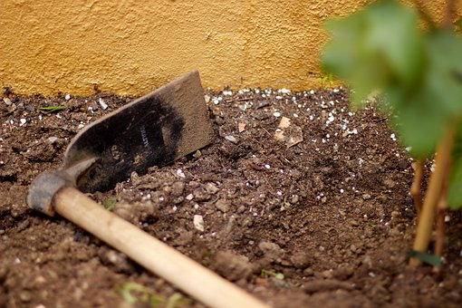
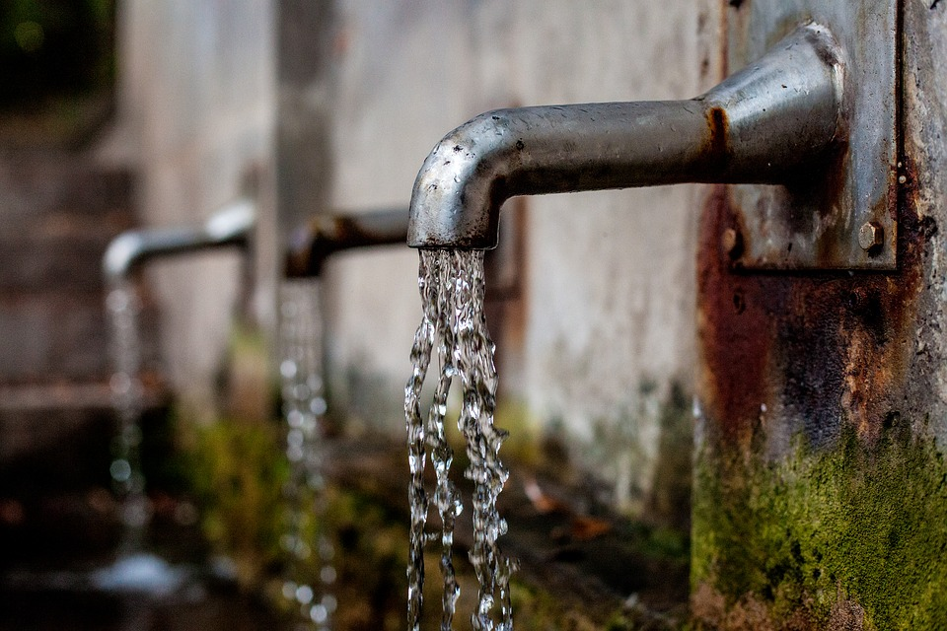
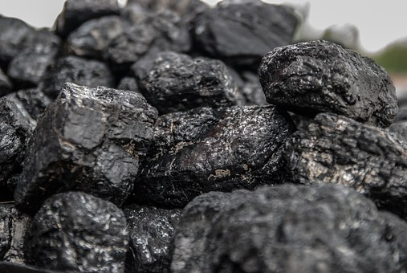
Natural Resources
Materials that come from the earth, water, and air.
Examples:
Most natural resources are non-renewable.

Slide 5
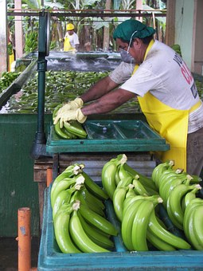
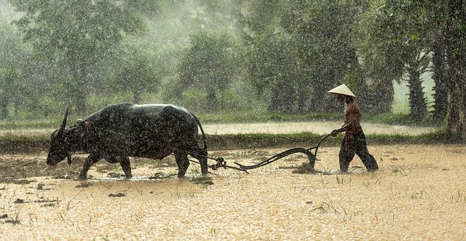
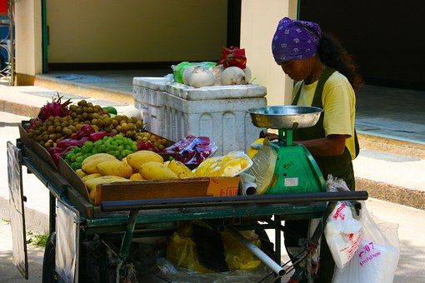
Human Resources (Labour)
People who work to create goods/services.
Examples:

Slide 6

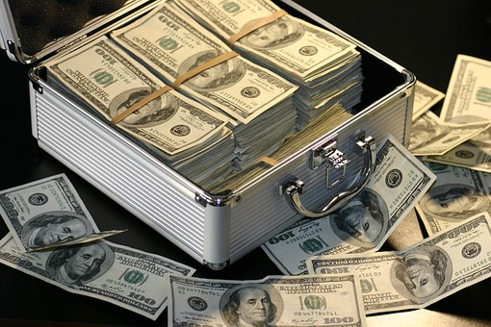

Capital Resources
Everything else ☺
Examples:
Most capital resources last a long time, but are expensive!

Slide 7

Identify the Economic Resources
Choose one good or service.
Identify all resources that are required to make the good/service.
Categorize the resources as
natural, human, or
capital resources!

