Slide 1
2.
SUPPLY, DEMAND AND PRICE
Notes:
The championship of national football league (NFL) in the states

Slide 2

What is Demand?
The quantity of a good or service that consumers are willing and able to buy at a particular price.

Slide 3
Conditions for Demand
The consumers must be aware of the good / service.
The good / service must be available.
The good / service must be accessible.
The price should be reasonable and competitive.

Slide 4
Law of Demand
Price Demand
Price Demand

Slide 5
Factors Influencing Demand
Change in Consumer’s Income
Income Demand Income Demand
Change in Consumer’s Taste
Taste Demand Taste Demand
Change in expectations for the future
Hope Demand Hope Demand
Change in Population
Population Demand Population Demand

Slide 6
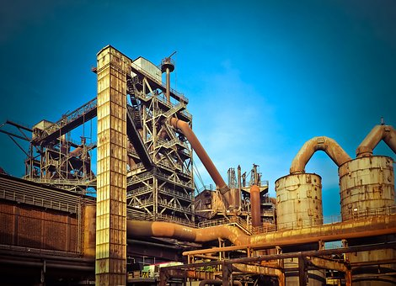
What is Supply?
The quantity of a good or service that businesses are willing and able to produce at a particular price.

Slide 7
Law of Supply
Price Supply
Price Supply

Slide 8
Factors Influencing Supply
Change in Number of Producers
Number Supply Number Supply
Change in Technology
Technology Supply Technology Supply
Change in expectations for the future
Hope Supply Hope Supply
Change in Production Cost
Cost Supply Cost Supply

Slide 9

Identify the Change in Demand or Supply
What would happen to the market because of each statement? Identify the factor influencing demand or supply, and tell me if it will increase or decreas.

Slide 10
Example: Question # 1
A recent science research revealed that bananas are expected to become extinct in 5 years. How will this influence the banana market?
Supply will DECREASE, because there has been a change in expectations for the future.

