Slide 1
Review

Slide 2
What is ethics? Why do we need it?
Ethics is personal beliefs and social standards about what is right and wrong.
Ethics helps people tell the difference between right and wrong.
Ethics encourages people to do the right thing.

Slide 3
5 Fundamental Questions to Solve an Ethical Dilemma
What are the choices?
Who will be helped by your decision?
Who will be hurt?
What are the benefits and problems of your decision?
Will the decision survive the test of time?

Slide 4
Unethical Behaviours in Business

Slide 5
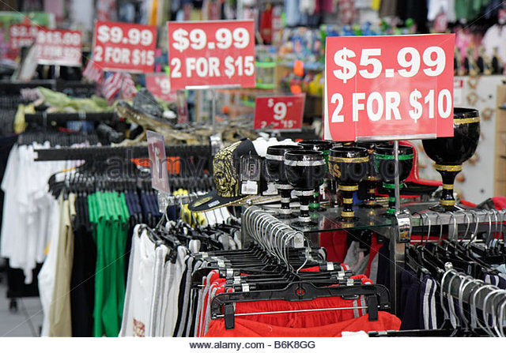
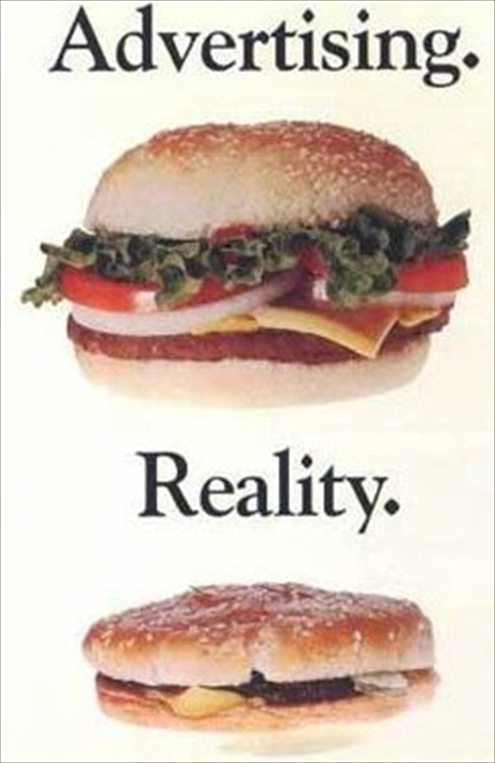
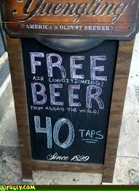
Fraud
The crime of lying or pretending.
False or misleading advertising
Bait and Switch: advertising a bargain price that is unavailable for sale in reasonable quantity
Double ticketing: placing two different prices on a product and selling it at a higher price

Slide 6
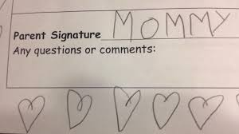
Forgery
A form of fraud that involves passing bad cheques by using someone else’s name

Slide 7
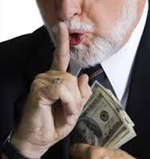
Embezzlement
A form of fraud where a person violates a trust by moving funds into their account instead of the correct account

Slide 8
Tampering with Records
A form of fraud where records are altered to deceive other people

Slide 9
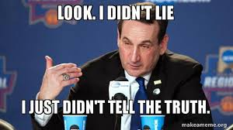
Concealing information
Not disclosing data that should be shared (e.g., defective products)

Slide 10
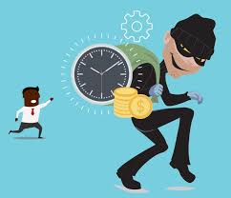
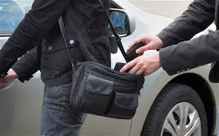
Theft
Stealing someone’s property

Slide 11
Employer Theft
Taking advantage of employees by not paying for overtime

Slide 12
Information for BC Employers (and Employees)
http://www2.gov.bc.ca/gov/content/employment-business/employment-standards-advice/employment-standards/guide-to-the-employment-standards-act

Slide 13
Discrimination
Not hiring a person because of an issue not related to the person’s ability to do the job (e.g., race, religion, gender, or disability)

Slide 14
Environmental Violations
Ignoring laws and regulations that involve toxic waste

Slide 15
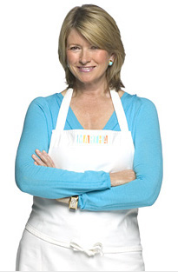
Insider trading
Martha Stewart
Buying and selling shares in a company based on confidential information (information that is not shared with the public)
In 2001, Martha Stewart sold 4,000 shares she had owned in ImClone (pharmaceutical company) just before FDA’s rejection was announced. She saved approximately $45,673.

