Slide 1
The Health Crisis
In Developing Nations

Slide 2
Lack of Clean Water
1.2 billion people around the world lack access to clean water.
Why?
Open water sources are contaminated.
Rivers used for drinking water are also used for washing and disposal of waste.
Most water is used for agriculture – most crops are exported to wealthier countries.
Many developing countries are located in areas that experience a dry season every year.

Slide 3
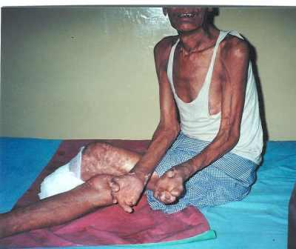
Dirty Water - Consequences
The World Health Organization (WHO) estimates that 80% of diseases are caused by contaminated water.
Examples:
Cholera
Typhoid fever
Malaria
Leprosy
Bilharzia

Slide 4
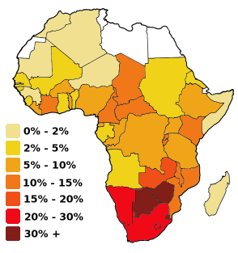
AIDS
Of all the infectious diseases, AIDS is the one that has had the most noticeable impact on developing nations.
In some African countries, more than one third of the population is infected with the AIDS virus!

Slide 5
Consequences of AIDS
More than 7,000 people die every day. Most of these deaths occur in Africa.
Millions of children in Africa have become AIDS orphans – both of their parents have died because of the AIDS virus.
Most of the dead are young adults – potentially productive workers. The result is that too many dependents (old and young) are left with no one to rely on.
Life expectancy has fallen by as much as 30 years!

Slide 6
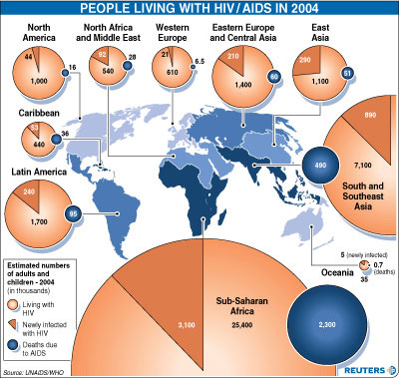

Slide 7
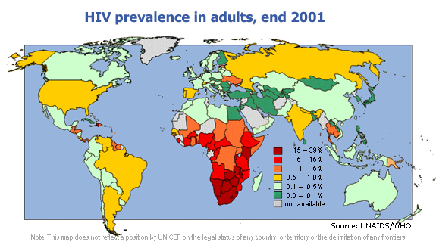

Slide 8
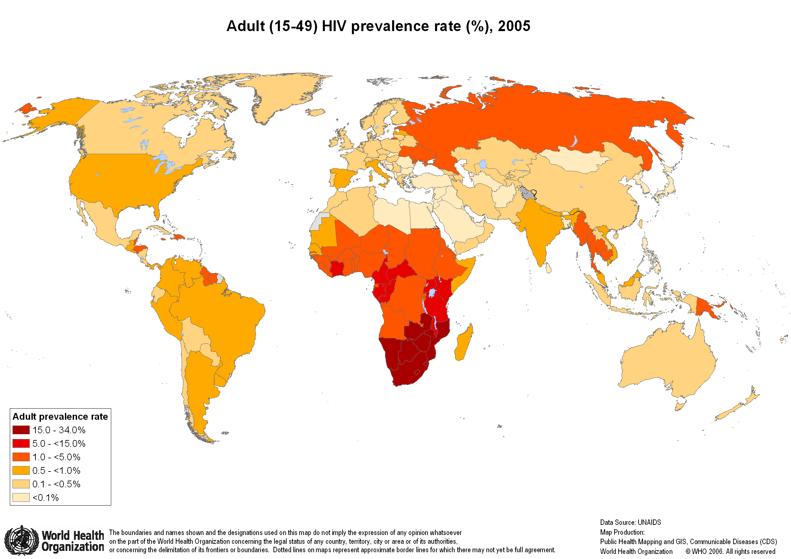

Slide 9
Country / Territory | Ranked by HIV/AIDS population | people living with HIV/AIDS | Date of Population Data | Ranked by prevalence rate | HIV/AIDS adult prevalence rate(%) | Date of Prevalence Data
World | — | 38,217,530 | — | — | 0.57 | —
Swaziland | 033 | 190,000 | 2008 est. | 001 | 26.01 | 2008 est.
Botswana | 024 | 300,000 | 2008 est. | 002 | 23.09 | 2008 est.
Lesotho | 023 | 320,000 | 2003 est. | 003 | 28.09 | 2003 est.
Zimbabwe | 005 | 1,800,000 | 2001 est. | 004 | 24.06 | 2001 est.
South Africa | 001 | 5,700,000 | 2003 est. | 005 | 18.01 | 2003 est.
Namibia | 031 | 200,000 | 2008 est. | 006 | 15.03 | 2008 est.
Zambia | 008 | 1,100,000 | 2008 est. | 007 | 15.02 | 2008 est.

Slide 10
Why is this happening?
Lack of education in developing countries
High cost of AIDS treatments
Lack of action from the international community.
Lack of government money.

Slide 11
Essay – Preview
What obstacles exist for people trying to escape poverty?
How would you suggest people can overcome these obstacles?

