Slide 1
Consequences of Poverty
In Developing Countries

Slide 2
The Position of Women
Most developing countries have male-dominated societies.
Result: Women have lower status than men.
Women have no legal rights
Women are treated as property
Women and children often eat only what is leftover after the men have finished their meals.
Result: Malnutrition

Slide 3
The Position of Women
Because of their lower status, women
Often work for 12-15 hours a day to ensure the survival of their family.
Have very limited access to education
Are forced to marry at very young ages

Slide 4
How can we improve this situation?
The key is education!
Studies show that educated women have fewer children.
They marry later and have children later.
They are more aware of how to prevent pregnancy.
They are more aware of the difficulties involved in raising a large family.
Having fewer children allows mothers to have more time to focus on improving their family’s standard of living.

Slide 5
How can we improve this situation?
Educated mothers also have another advantage:
They are more knowledgeable, so their children are more likely to survive!
They know more about immunization, medical care, clean water, and good nutrition
Since their children are more likely to survive, they are less likely to have more children.

Slide 6
The Situation of Children
Children are always the first victims of poverty and underdevelopment:
Famine, disease, and war often kill more children than adults.
Children are also the first to be taken advantage of during a time of need.

Slide 7
The Situation of Children
Children in developing countries face the following obstacles:
Few educational opportunities
Weak immune systems due to malnutrition
Higher risk of disease
Exploitation by adults

Slide 8
The Situation of Children
How do adults exploit children in developing countries?
Used as child labour
Sold into the sex trade
Forced into war (child soldiers)

Slide 9
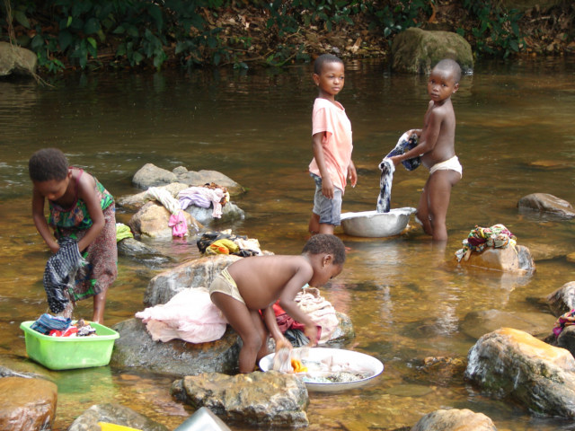

Slide 10
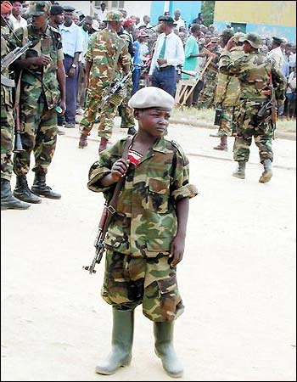

Slide 11
Under-five Mortality
This is the principal measurement of how good or bad the situation is for children in a country.
It measures the number of children under age 5 who die every year compared to the total population of children in that age group.
Most deaths to children under five occur because of
Diarrhoea
Malaria

Slide 12
