Slide 1
THE DURHAM REPORT
GOVERNOR’S BRIEFING

Slide 2
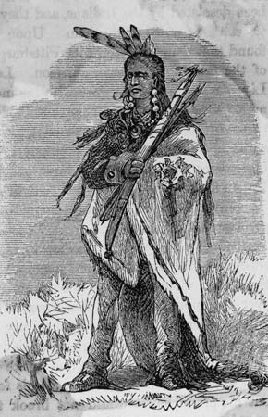
#1 - Chief Pontiac – 7 yrs war
In 1760 allowed British army to travel in territory unhindered to access surrendered French Forts
Under British rule, Pontiac’s people were not going to be welcome back at these Forts
Settlers came fast & took over traditional hunting grounds…
Ottawa & Ojibwe
Notes:
http://www.britannica.com/EBchecked/topic/469724/Pontiac

Slide 3
#1 - Chief Pontiac – 7 yrs war
1762 – supported by every tribe from Lake Superior to Lower Mississippi, led a campaign to expel the British
May 1763 – every group attacks the nearest Fort at the same time
He was betrayed in his surprise-attack on Detroit
British Army is mighty…peace concluded in 1766
Stabbed & killed 3 years later – started a bloody feud
Notes:
http://www.britannica.com/EBchecked/topic/469724/Pontiac

Slide 4
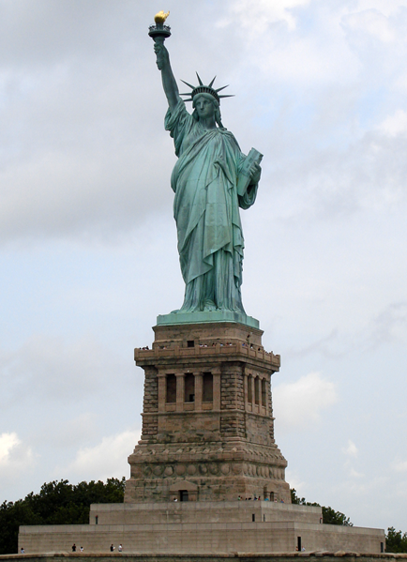
1776 - American Revolution
1776 – Americans gain independence from Britian
…with the help of France
Americans who do not believe in independence moved to Quebec
Called “Loyalists” because they were loyal to Great Britain
RESULT: Quebec began to have people who spoke English as well as French

Slide 5
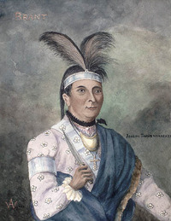
#2 – THAYENDANEGEA – Joseph Brant
Went to England to defend traditional territory occupation against the American settlers - 1785
Asked for confirmation that aboriginal people loyal to the crown could expect military support from the British government
if American settlers encroached too far on traditional lands
Britain refused – would rather not get involved
RESULT: 3 full-scale American retaliatory invasions against the settlers
Leader of Six Nations Confederacy
Notes:
http://www.biographi.ca/en/bio/thayendanegea_5E.html

Slide 6
#2 – THAYENDANEGEA – Joseph Brant
Idea:
Land belonged to all Aboriginal people
Land negotiations with individual tribes were invalid
Although tribes did negotiate individually, this is an important beginning to a united movement for aboriginal rights
Leader of Six Nations Confederacy
Notes:
http://www.eighteentwelve.ca/?q=eng/Topic/6

Slide 8
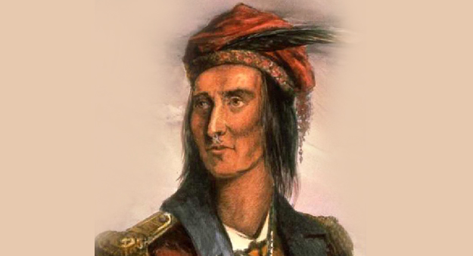
#3 – 1812 - Chief Tecumseh
Shawnee Chief
Military leader in 1812
Distrusted the British, but found the Americans more offensive to native people
Attacked Detroit with BROCK – “This is a man!”
Fearful of how many people could be in the dark…Detroit surrenders without a shot!
RESULT: Huge British victory
Notes:
http://www.eighteentwelve.ca/?q=eng/Topic/6

Slide 9
Tecumseh’s death
Tecumseh’s death was the end of serious resistance in the Northwest.
Peace of Ghent – nothing for First Nations
Ottawa Chief Naywash said:
“Since our Great Chief Tecumtha [sic] has been killed we do not listen to one another, we do not rise together.”
Notes:
http://www.eighteentwelve.ca/?q=eng/Topic/6

Slide 10
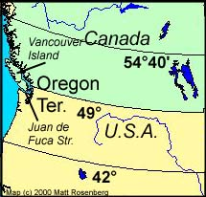
181 – Political Boundaries
Join control in Oregon
From 42° North and 54°40' North (the southern boundary of Russia's Alaska territory).
MANIFEST DESTINY –
Americans were destined to take over all of North America…coast to coast
1844: Fifty-Four Forty or Fight!

Slide 11
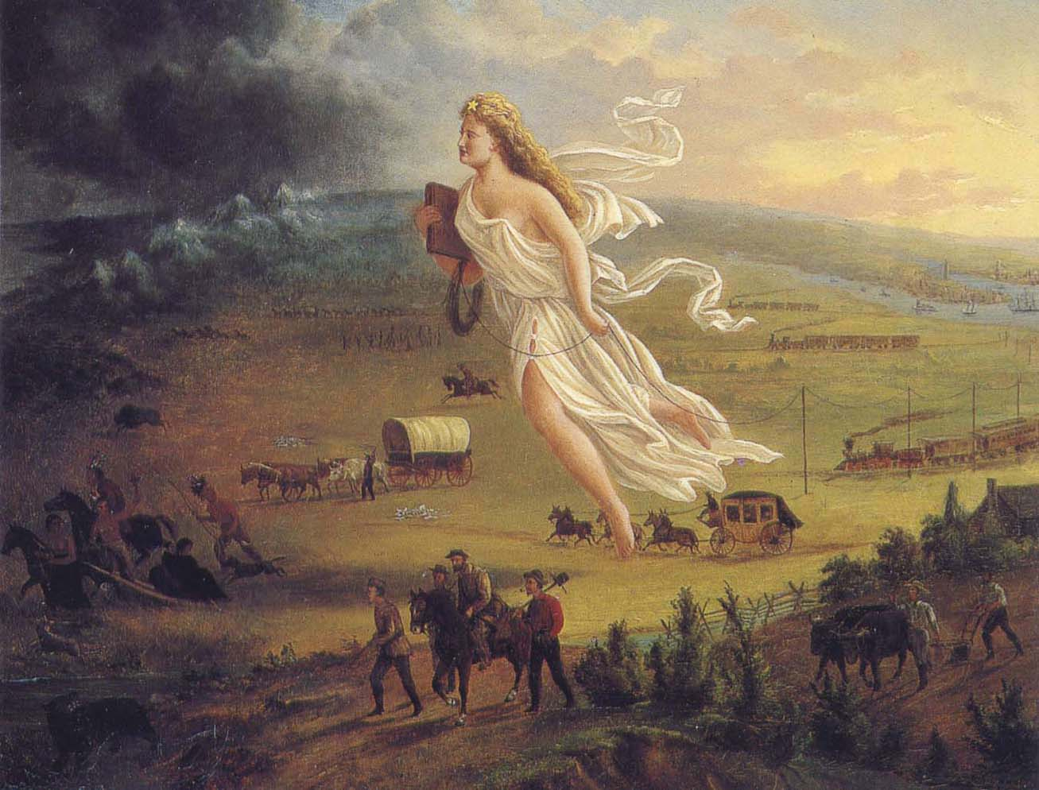
MANIFEST DESTINY
“This attitude helped fuel western settlement, Native American removal and war with Mexico.”
Notes:
http://www.history.com/topics/manifest-destiny

Slide 12
MANIFEST DESTINY
This attitude helped fuel western settlement, Native American removal and war with Mexico.
By the end of the century, expansionists were employing quasi-Darwinist reasoning to argue that because its ‘Anglo-Saxon heritage’ made America supremely fit, it had become the nation’s ‘manifest destiny’ to extend its influence beyond its continental boundaries into the Pacific and Caribbean basins.
Notes:
http://www.history.com/topics/manifest-destiny

Slide 13
1911 – MEXICAN REVOLUTION

Slide 14
1812 – British Identity
Returning to the question at hand…how did the war of 1812 contribute to a British identity in Canada?

Slide 16
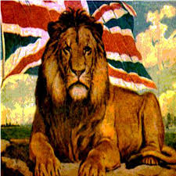
1812 – British Identity
French and British worked together against US, who tried to invade Canada
Canada is “not America”
…for the second time

Slide 17
Emigration from Britain, 1815-1850
Population growth exploding in Europe
Improved farming methods - SCIENCE
Industrial Revolution – but jobs are scarce
800,000 migrants came to Canada
60% are from Britain – and speak English
Asian & Americans look for gold
Cheap or free land
Built infrastructure from scratch
Notes:
http://www.exodus2013.co.uk/the-great-migration-of-canada/

Slide 18
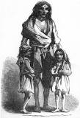
Emigration from Britain, 1815-1850
Underground Railroad, US Civil War
Irish potato famine (six year) from 1845
Killed over 1 million ppl
Notes:
http://www.exodus2013.co.uk/the-great-migration-of-canada/

Slide 19
World Events – impacts on migrations in Canada
Underground Railroad, US Civil War, 1840-1860
Fight to abolish slavery
Slavery already over in French & British Empires
Opium Wars in China (1840-60)
Britain selling China opium
Chinese outlawed opium
China forced to trade & legalize opium
Irish POTATO FAMINE – 1845-52

Slide 20
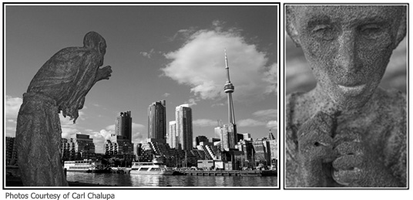
Ireland Park - Toronto

Slide 21
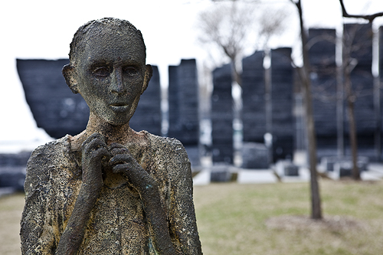
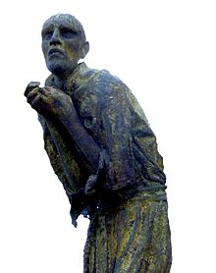
Ireland Park Toronto

Slide 22
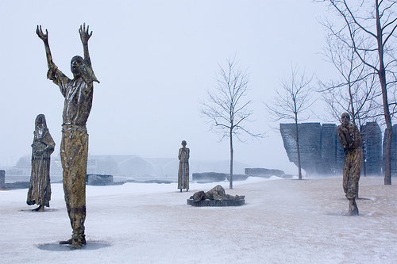
Ireland Park - Toronto

Slide 23
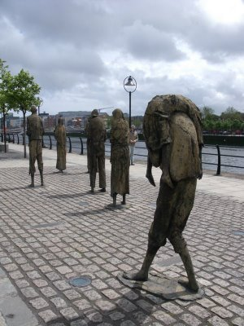

Slide 24
British Identity
French Canadiens and British Canadians resented British rule
British gov’t is too far away to understand their needs…

Slide 26
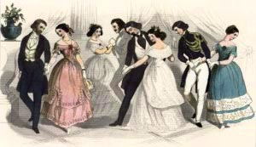
Gov’t in Lower Canada
Government est. by Constitutional Act in 1791
Power limited by governors and councils
Members of legislative councils were voted in for life
Political party with most power in unelected council was Chateau Clique
Believed that power should be
in hands of a few capable people
Wanted the Roman Catholic church
to stay in power

Slide 27
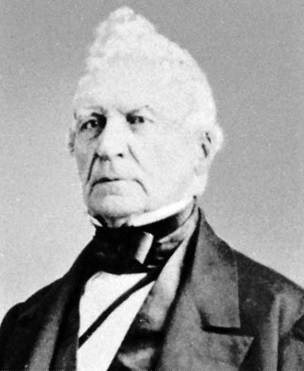
Lower Canada Rebellion - 1837
1837 – Louis Papineau organized a revolt to establish Quebec as a separate country
PARTI PATRIOTE
PARTI CANADIEN
75% Patriots are elected
Send England 92 Resolutions
Wait 3 years, Governor Rejects
REBELLION OF 1837
Key Battle St. Eustache- rebellion collapses
British troops charged and the rebellion lost
Papineau flees to U.S.

Slide 28
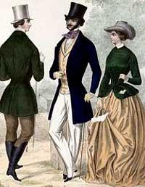
Government of Upper Canada
Government established by Constitutional Act in 1791
Two main political groups
Family Compact (Tories)
Businessmen and elite
Lieutenant Governor
Bond Head represented their views

Slide 29
Government of Upper Canada
Government established by Constitutional Act in 1791
Two main political groups
Family Compact (Tories)
Businessmen and elite
Lieutenant Governor
Bond Head represented their views

Slide 30
Family Compact:
A small group of powerful elites in the colony of upper Canada
Defended tradition (The things that had always been done) and opposed change
Believed power should be in the hands of a few capable people (themselves)
Believed the Church of England should be powerful in the colony
Were loyal to Great Britain and the British government
Had power to stop any laws passed by the legislative assembly
Most Family Compact members were British immigrants who arrived before the 1800’s

Slide 31
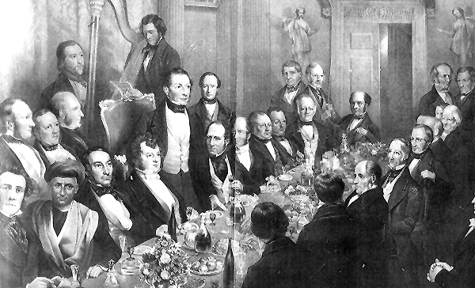
The Reformers
Reformers Led by Robert Baldwin and William Lyon Mackenzie
What did they oppose?
Opposed the power of the Family Compact
Wanted changes in government and society of Upper Canada
Divided into moderate (led by Baldwin) and radical (led by Mackenzie)
Gurley: sent a questionnaire to farmers; bring poor people to farm in Canada

Slide 32
Upper Canada Rebellion - 1838
When the Lower Canada rebellion began, Bond Head sends troops to seize Toronto
Mackenzie later organizes Upper Canada revolt beginning at Montgomery’s Tavern
March down Yonge Street, Toronto
Attack lasted about half hour
Rebel forces dispersed

Slide 33
Results:
Upper Canada Rebellion was very short and disorganized
Bond Head was recalled in 1837 he was replaced with Sir George Arthur
Lord Durham assigned to report grievances among the colonists and find a way to appease them
Lord Durham’s report led to the Union of Upper and Lower Canada into the province of Canada in 1840

Slide 34
Change in Britain’s Colonial Policy
Britain was starting to rethink its colonial policies in the 1840s. The purpose of having colonies was to provide cheap natural resources for the imperial power.
However, the colonies were becoming very expensive ($$$).
Therefore the British government decided to stop giving its colonies special trading protection and to trade freely with other nations.
As a result, it affected Britain’s attitude towards its colonies.
LORD DURHAM IS SENT OUT…

Slide 35
Lord Durham’s observations
Britain sends Earl of Durham
Canadians want:
More control over government
All Provinces to unite
> The British only wanted Quebec and Ontario to unite. All provinces together could create a successful rebellion….
Notes:
http://www.slideshare.net/esample458/history-of-canada-colonization-and?related=1

Slide 36
The Durham Report & the British Identity
Durham refers to French Canadians as backward and illiterate. Argues that irresponsible leaders easily manipulate them.
Called the Canadiens “devoid of history and literature”
They lacked in anything that elevates people
Proposed assimilation of the French
Thought this would eliminate racial antagonism that had paralyzed Lower Canada
Thought it would give French Canadians more opportunity as English would be language of business and social promotion

Slide 37
The Durham Report
Two Major Recommendations
The two colonies of Upper and Lower Canada should become one colony called the United Province of Canada.
*This would give the English a majority and help unite English speaking people
Notes:
http://www.slideshare.net/esample458/history-of-canada-colonization-and?related=1

Slide 38
The Durham Report
The new united colony should have responsible government.
*All other local powers would be handled by the colonies.
*On matters involving only colony, the Governor would be advised only be his Executive Council with no input from the British Government.
*The Executive Council members would be chosen by the leaders of the largest group in the Legislative Assembly rather than by the governor
*Members of the Executive Council would keep their jobs only as long as they had the support of more than half the members of the Legislative Assembly, rather than for as long as the governor chose to keep them on the council.

Slide 39
Partner Activity – (Groups of Two)
Lord Durham had two recommendations. Who benefited or were happy because of the first recommendation? Why?
Who benefited or was happy because of the second recommendation? Why?

Slide 40
RESULT: Act of Union – 1840 English is the only official language.

Slide 42
The Act of Union, 1841
The British government acted on Lord Durham’s recommendations.
The Act of Union of 1841 joined Upper and Lower Canada together as the United Province of Canada. This united Upper and Lower Canada and is a first step towards confederations.

Slide 43
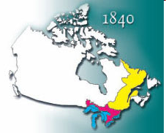
The Act of Union, 1841
Aim: To unite the into colonies of Canada into a single unit, and to give the English-speaking people control of the newly named colony.
Important Points:
The system of government was to be the same as in the past.
Established English as the official language
It united both colonies under one government.

Slide 44
Partner Activity – (Groups of Two)
How was the Act of Union of 1840 an attempt to resolve the issues raised by the 1837 and 1838 Rebellions in Lower and Upper Canada?
To what extent was the Act of Union of 1840 an attempt to provide the populations of Quebec and Ontario with increased control over their own affairs?

Slide 45
Change in Britain’s Colonial Policy
Britain was starting to rethink its colonial policies in the 1840s. The purpose of having colonies was to provide cheap natural resources for the imperial power.
However, the colonies were becoming very expensive ($$$).
Therefore the British government decided to stop giving its colonies special trading protection and to trade freely with other nations.
As a result, it affected Britain’s attitude towards its colonies.

Slide 46
People Passport
For each person, provide the following information:
Why is the person a significant historical figure?
Events, accomplishments, impacts?
Citations – provide links to your sources
Include a visual - cite your image source
3 pts per person

Slide 47
Letter to the Queen
OPENING
POINT
EXAMPLE
POINT
EXAMPLE
CONCLUSION

Slide 48
PARTI 2

Slide 49
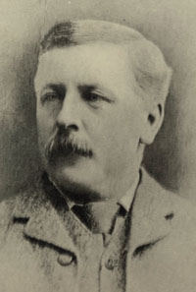
Canada First
Of course there were some English Canadians who wanted an independent Canada.
However, this “Canada First” movement was small in number and resentful of the Canadiens – the only other group who supported a distinctly Canadian nationalism.
Charles Mair – of Canada First

Slide 50
Lord Durham- 1839
March on Toronto

