Slide 1
much period!
So interest
Very Meiji
So Amaze
Wow

Slide 2
How did Japan adapt to changes brought on by the transition from feudal to modern models of organization?
Critical Question

Slide 3
Page 180~Ishan
-Talks about Charter Of Oath
- Was a consensus oath made by the daimyo and emperor
-It focused on 3 elements, economy, social systems, and culture
-All 3 of these changed after WW2.
-It was presented by the Emperor and members of the new government
-The New Government was created because Tokugawa agreed that Japan needed to correspond with the outside world or the would be taken over

Slide 4
183~ Ishan
-During the Meiji period Japan made several new inventions, and discoveries
-A new invention was made every couple of years, and Japan was able to keep up
-Japan was not to fall behind and reproduced all the inventions from the western word
-This included the morse code

Slide 5
194~ Ishan
-Since the Americans have come, Japan needed a strong, organized, central government
-Japan copied what America was doing and set up a constitutional government
-Constitutional government is a government that is controlled by a strict set of rules
-It was at this time Japan’s capital was changed from Kyoto to Edo, and renamed Tokyo
-Using the new form of government Japan was able to compete with the westerners

Slide 6
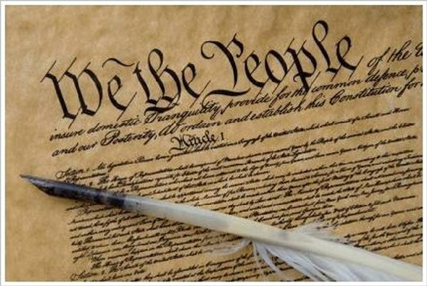
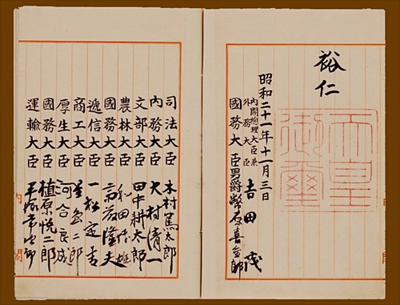
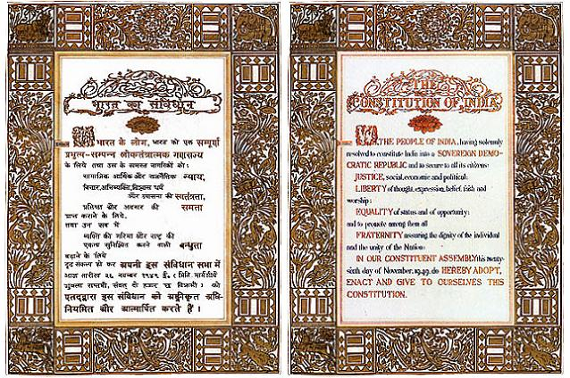
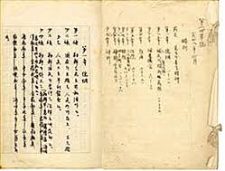
Constitution Acts around the world

Slide 7
185~Ethan
-Japan’s worldview changed drastically
-The samurai feared and distrusted any foreign presence in the country for generations
-Now Japan is letting in foreigners
-This is a huge leap for the samurai

Slide 8
186~Ethan
-Japan had to change their education system to make the switch into modernization
-Japan had to adapt to new religions in their country
-No other nation banned Christianity, so they allowed the japanese people to have religious freedom
-The new education system would develop the appropriate knowledge and technical skills
-The new education system will help Japan become a modernized country

Slide 9
187~Ethan
-Japan was in a position to rapidly move toward industrialization because of the legacy left by the by the Tokugawa
-The last shogun invited Western experts to the country to assist Japanese engineers and technicians with Western technology
-Some Japanese people were ready for this change

Slide 10
Pg. 192~Danelle
Leaders of the Meiji Period adapted Western beliefs, such as elected representatives and public education.
Adopted automations like steam-powered machinery.
no other country had deliberately adapted so quickly.
Changes altered Japans worldviews on its culture, economic system, political system, and social system.
Leaders had to choose what traditions they wanted to preserve.

Slide 11
Pg. 195~Danelle
Leaders needed military support from the domains; samurai fought along with the leaders at one point.
Hanseki Hokan (Return of the Registers) was a petition that set laws and regulations over domains that had surrendered their land and census documents to the imperial government.
1871: all domains were replaced with administrative districts (prefecture system).
Emperor was the new nationalistic symbol of a newly unified and modernized nation.

Slide 12
Pg. 196~Danelle
The government wanted to be more efficient and economical, but the leaders disagreed on developing Japan.
Liberal supported French and American concept of human rights and democracy; Conservative backed German centralized control.
Dajokan.
Social systems were removed; giving all Japanese the same obligations.

Slide 13
Pg. 197~Danelle
Japan was a world leader, not a world (just as strong as any other nation).
Leaders wanted Japan to have a constitution because:
~ Strong European countries had constitutions.
~ Western countries would think higher of Japan.
~ A constitution would unify Japan.
Leaders disagreed about what model the constitution would follow and who would write it.
Japanese and former samurai (shizoku) wanted to participate in government; newspapers wanted a democracy.

Slide 14
Mikaili- 184- Reshaping Japan's Worldveiw to Modrenize
-When Tokugawa was over thrown an oligarchy was in charge. -They changed Japan to have economic growth and industrialization. -These leaders of change were young, intelligent samurai under the use of 30. -They all had academic and military skills. -They had 2 goals. 1. To modernize Japan 2. To renegotiate the unequal treaties. -To achieve this they had to change politically and economically. -They wanted to be equal in all treaty's. -To be distanced from old traditions and build back up new. -They looked upon very Western countries for structure.

Slide 15
Mikaili- 198- Creating a Constitution
-Three political party's supported by a different newspaper, were formed. -Political debates were happening all over the country. -Violent revolts erupted all over the country. -The government reacted in 1875, with a law for the government to censer newspapers. -Also public assemblies were banned -In response people's rights and political clubs wanted a government representative.

Slide 16
Mikaili- 199- How did Japan change Economically?
-The leaders decided to make Japan very industrialized. -They also wanted to be economically secure. -Though even then, Japan was restricted to trade agreements it had signed with the Western countries. -They were not aloud to lover the taxes on domestic goods or raise taxes on foreign goods. -The unequal treaty's made it difficult for domestic industries to survive.

Slide 17
Mikaili- 213- How Did Ideas of Citizenship & Participation Change?
-The education in this time was increasing. -The peasants becoming more involved I'm more day-day concerns. -They started to lobby and sent concerning letters to the government based on how they are treated. -The government responded with new stricter government.

