Slide 1
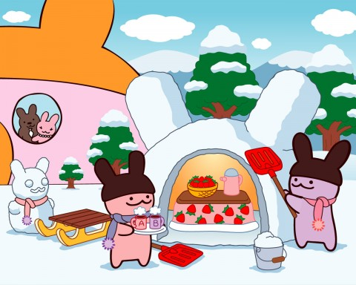
The Meiji Period
By: Kevin, Zoé, and Cale

Slide 2
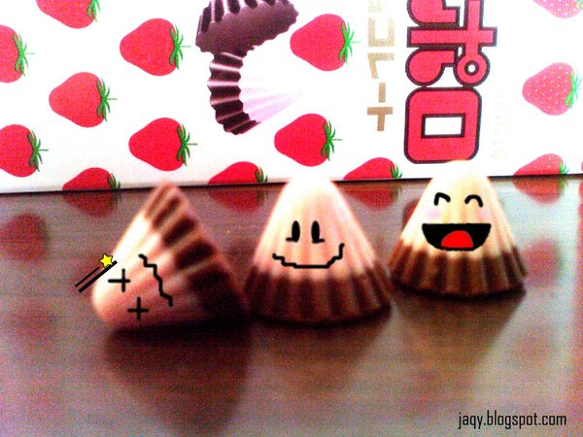
Question #3: How did the changes resulting from adaptation affect Japan economically, politically and socially during the Meiji period?

Slide 3
Economic
Industrialization- Pg. 199 - 200
Capitalism- 201 - 202

Slide 4
Industrialization
The treaties and agreements with the Western world made it hard for Japan to advance with industrialization.
National Seclusion Policy.
Many people also suffered from over-work and the working conditions from industrialization in such a large scale.

Slide 5
Japan started small, with Military and silk companies.
Over several years the cost of modernization was overwhelming.
Most industries were handed over to private companies also called “zaibatsu”
Mitsubishi built boats, trains and other modern technology.

Slide 6
Advantages
The private companies strengthened their bonds with the Meiji.
Japan soon became the leaders of industrialization because of their hard work and strive to move forward in the Asian world.
Japan survived off of modernization which until now kept them economically stable.

Slide 7
• New railroads were built to join all four major islands; roads and highways were paved.
• Telegraph and telephone systems were built.
• New technologies and industries were imported, as well as hundreds of foreigners to train the Japanese.
• A Ministry of Banking was set up to provide new businesses.

Slide 8
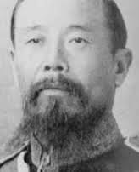
Capitalism
Matsukata Masayoshi was the Finance minister in 1881 in Japan.
Matsukata Masayoshi

Slide 9
Under his reign, Japan didn’t immediately advance and grow in economy.
Many businesses were bankrupt and farmers lost their land.
As industrial output increased, Japan became wealthier and wealthier.
By the end of the Meiji era, Japan’s national income DOUBLED.
Japan quickly became a capitalist society.

Slide 10
Capitalist Society?
The goal is to make a profit by producing or obtaining goods at one price and then selling them for more money.
Individuals or the government are engaged in business.
People work for wages, not goods. They use their wages to purchase the goods they need or want.

Slide 11
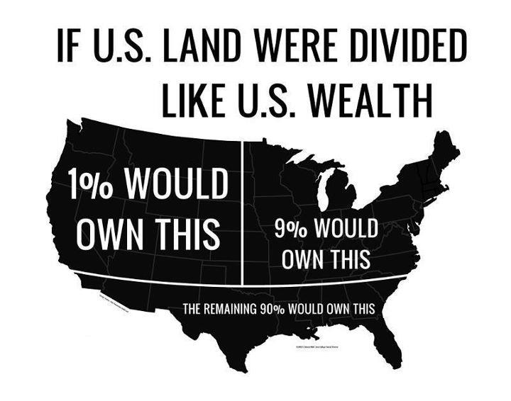
How
Capitalism
Works

Slide 12
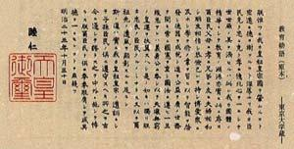
The Charter Oath - Pg. 181
Emperor Meiji signed a document called the Charter Oath in April 1868, which allowed Japan to have a new government
The Charter Oath dictated that whenever a new policy came to be, it would be voted on by the daimyo lords
It took many tries to write the Charter so that everyone was happy, but finally they did it
When the Charter was finished, it showed change in:
Social Systems
Political and Economic Systems
Culture

Slide 13
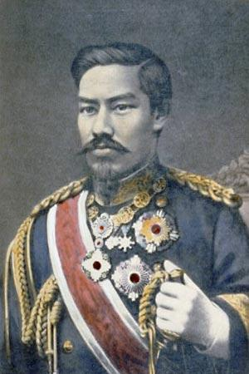
Unifying The Country - Pg. 195
The young leaders used their past relationships with samurai to overthrow the Tokugawa rule
When they gained support, the daimyo surrendered their census records and lands to the government
The daimyo petitioned to the government that their lands be placed under a set of laws called hanseki hokan, which means the “Return of the Registers”
Emperor Meiji

Slide 14
New Model of Government - Pg. 196
The new government’s objective was to be both economical and efficient, but none of the leaders could agree on how to do it
One part of the government wanted to base the new government off of the French and American ideas of representative government and human rights
The more conservative part of the government wanted the government to be like the German government, which had more of a centralized control
After a long time, the leaders finally decided to go with the German idea of government

Slide 15
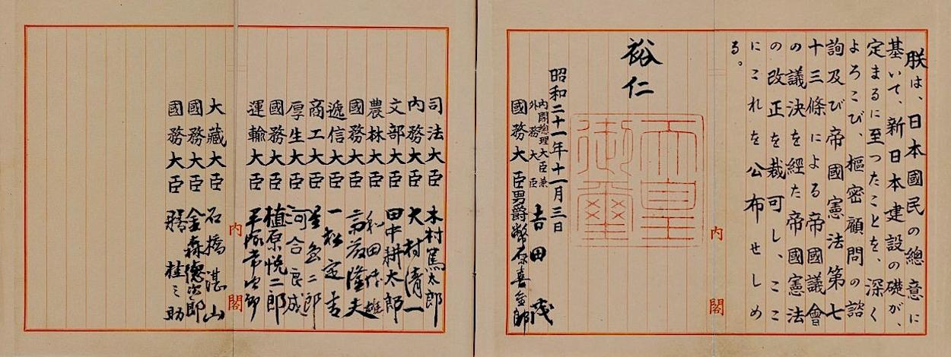
Constitution - Pg. 197
Japan developed a new outlook about its place in the world - it was a leader, not a follower
The leaders wanted Japan to have a constitution because:
Almost all of the European countries had a constitution
Western countries would see Japan as a strong nation because they had a western constitution
Having a constitution would unify Japan
The leaders of Japan all agreed that there should be a constitution, but they disagreed about who should write it and what model it should follow

Slide 16
Constitution Cont’d - Pg. 197
The people of Japan wanted the constitution, especially the former samurai or shizoku.
The shizoku did not like having a central government, because they wanted to have greater participation in the government
During this time, three political parties emerged, each backed by a newspaper
Many debates happened all over the country, violent revolts often being an outcome

Slide 17
Constitution Cont’d - Pg. 198
The Meiji government created more restrictions
The government could decide what the newspapers were allowed to print
Public assemblies were also banned
The people responded to the new laws by creating rights organizations throughout the country
Overall, the Constitution was very much like Germany’s but it still reflected some aspects of Japanese culture

Slide 18
The Constitution of Japan - Pg. 197
In 1889, the constitution of Japan was made.
The Emperor is sacred and inviolable and is above the law of the Constitution.
Government ministers are responsible to the Emperor.
The Emperor has the power to:
command military forces and control foreign policy
appoint cabinet members, judges, and Privy Council members
convene and dissolve the Imperial Diet (Parliament) at will

Slide 19
The Constitution of Japan Cont’d - pg. 197
The Imperial Diet is divided into two houses of equal power:
The Upper House is called the House of Peers. Members are selected for life by the Emperor.
The Lower House consists of 300 members who are elected by citizens for 4 years.
Citizens are granted freedom of speech, religion, and association. However, the government has the right to withdraw these rights.

Slide 20
Social
The lives of the Samurai, Daimyo and Commoners all changed.
Samurai: There allowances changed.
They were cut down significantly and they eventually didn’t get an allowance at all.
There military changed a lot.
Samurai were eventually not even important and needed any more. There special dresses and even there hairstyles changed.

Slide 21
Social Cont’d
Daimyo: The court changed the Daimyo into the aristocratic class.
They couldn’t get money from their domains anymore.
The government gave them a big sum of money. They could also get pensions and all their debt was paid of by the government.
They got invited to Tokyo to get assisted to investing in their capital in businesses.

Slide 22
Social Cont’d
Commoners: The feudal system got destroyed so the people with lower income could move up to higher pay.
Commoners could have surnames.
Samurais and Commoners could get married
Lower classes were raised to the status of a commoner.
They had to pay more tax now though.
Christians could practise their religion.

