Slide 2
The Meiji Restoration of Japan
By Ashley, Caitlin and Riley

Slide 3
What challenges emerged for the Japanese in maintaining traditional cultural aspects of their society while undergoing rapid change?
Question #5

Slide 4
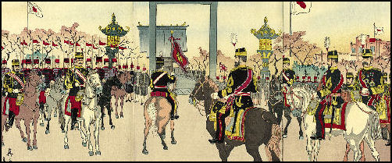
T h e M e i j i P e r i o d
The Meiji period began when people started combining the technologies of the West with the customs of Japan.
Japan had to model their society on Western practices while maintaining their identity
4 main aspects of their worldview changed; political structure, economy, social systems and culture

Slide 5
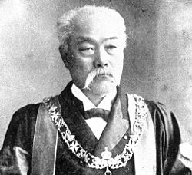
Economy
Factories were made for the military- gunpowder and weapons
Factories were made for people- silk, glass and chemical factories
Eventually became too expensive and the businesses were given to private companies (reduced competition, helped economy)
Matsukata Masayoshi…
1. Renegotiated the unequal treaties
2. Lowered the value of printed money
3. Imposed new taxes
Matsukata Masayoshi-Japan’s Minister of Finance in 1881

Slide 6
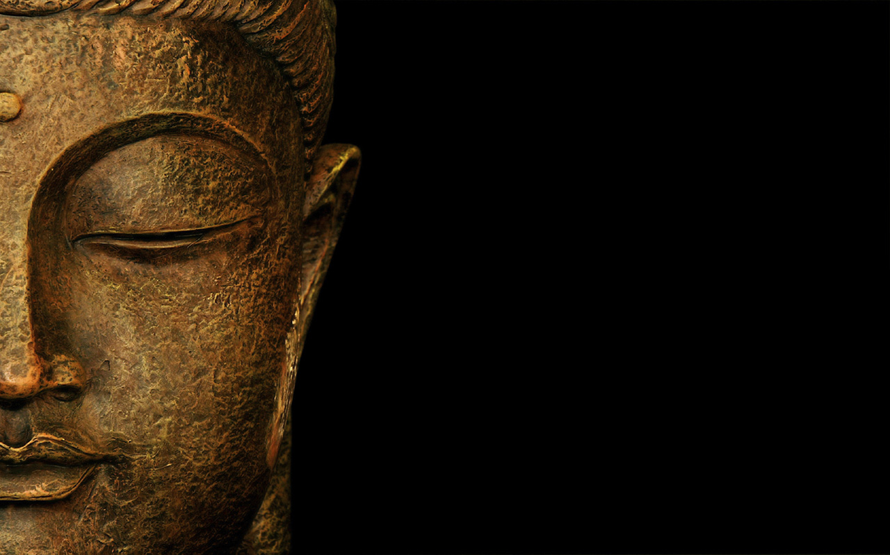
Japanese Culture
Eventually Buddhism was made a national religion.
The government wanted to make the official religion of Japan Shintoism, but people still practiced Buddhism
The government thought that having one religion would make the country more unified
In the Edo Period, individuality was not encouraged… In the Meiji Period people had more of a say
Mistreating was a challenge, so people could write to the government about their concerns

Slide 7
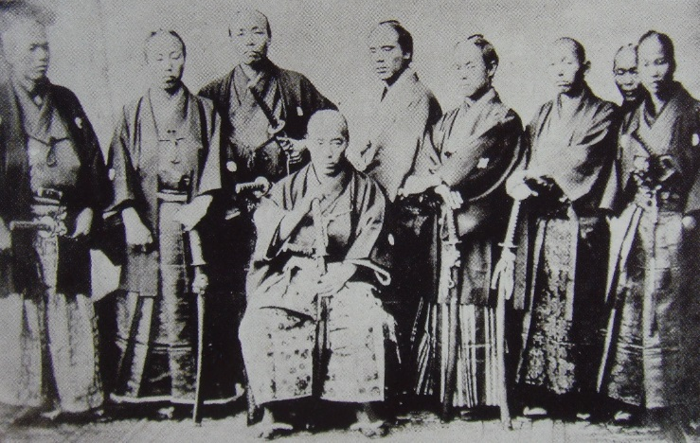
P o l i t i c a l Sy s t e m
All classes were included when making important decisions, people were judged on talent, not their family status.
The government had challenges: the public was not used to this new system. implementing these changes with the public. To stop this, the government made the Emperor say that he supported it.
Elections were a challenge: every newspaper supported a different party, causing fights
The German-style government was used while still reflecting Japan’s values.
Emperor
House of Peers
The Lower House
Limited freedom of speech, religion and association.

Slide 8
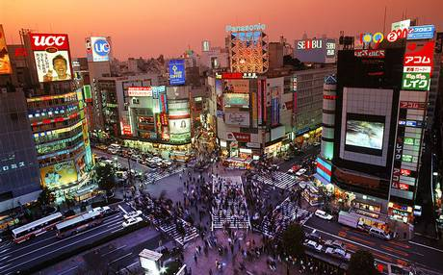
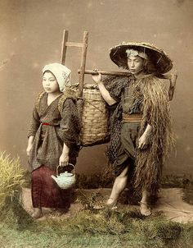
S o c i a l S y s t e m
In the Meiji period, the previous social system was eliminated!
Samurai’s had a challenge; they did not carry their swords and had to get jobs like the normal people
Farmers had challenges: they had a 3% tax on the land, and taxes rose which caused a series of angry protests
In terms of changes, Japan did not keep the traditional ways of the social system or schooling at all!
Poorer farmers sold their farms and became tenants to wealthier farmers.

Slide 9
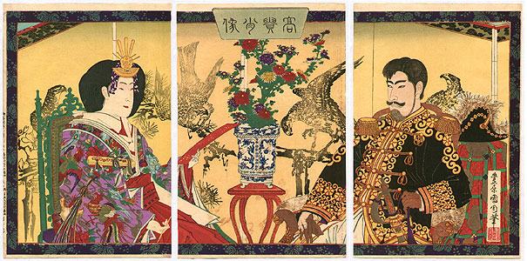
Effective Source
These are good sources because they are researched they are original and they have references. They are also written by experts.
The challenges and changes are:
Growth of cities meant less emphasis on traditional agricultural way of life and traditions
increased contact with West influenced politics and economy away from Eastern influences
Religion and philosophy challenged by Christianity
Japanese people had and openness to Western ways which made it difficult for Japanese leaders to maintain their ways
The government played a big role in social change by creating big laws
School was now required for all children, not just the higher class
the government thought the country would be more powerful if citizens were well educated
The feudal system was out

Slide 10
Effective Source
The class system was out and people could change their jobs and where they lived
Samurai were replaced by western style armies
Farmers could own land
People could practice any religion
Women's roles changed they could chose jobs and a spouse
railroad systems were built
Private business started instead of the government owning everything
experts were brought to give advice on the military and science
Japanese traveled to understand Western ways and came back to Japan
Many of these changes in business, agriculture military and government meant that some people lost power and others gained it this sometime caused riots
Jordanahjilljessiesarah.weebly.com
“Traditional Cultures and Modernization: Several Problems in the Case of Japan”

Slide 11
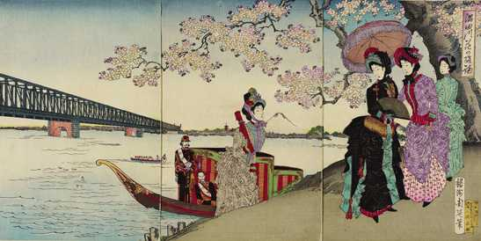
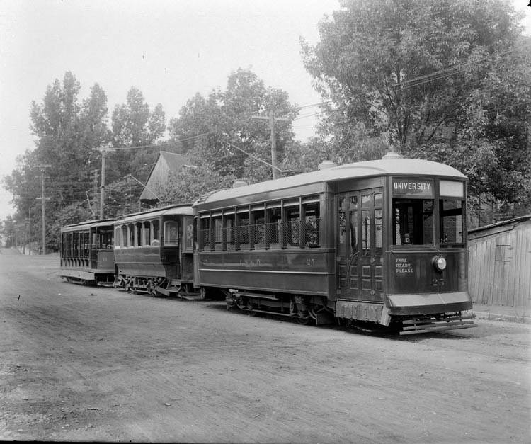
Conclusion
What challenges emerged for the Japanese in maintaining traditional cultural aspects of their society while undergoing rapid change?
Everything changed quickly! (political structure, economy, social system, culture)
Japan pretty much kept the same view of life while becoming modern.
Some people felt Westernization had gone too far; others embraced the change.

Slide 12
