Slide 1
Chapter 5
How Well do Canada’s Immigration Laws and Policies Respond to Immigration Issues?

Slide 2
Curriculum Qs
What factors influence immigration policies in Canada (i.e., economic, political, health, security)?
How are changes to Canadian policies on immigration and refugees a reflection of world issues?
What impact does increasing immigration have on Aboriginal peoples and communities?
How are provincial governments able to influence and implement immigration policies?

Slide 3
Curriculum Qs
How is the implementation of immigration policies in Québec an attempt to strengthen the French language in North America?
What is the relationship between immigration policies in Canada and the rights guaranteed in the Canadian Charter of Rights and Freedoms?
To what extent does Canada benefit from immigration?

Slide 4
Before we get started…
In order to become a Canadian Citizen you must first pass a written test
Would you pass?

Slide 5
Is this a fair test?
Should this be mandatory to become a Canadian citizen?
In order to immigrate to Canada should you be forced to learn this material?

Slide 6
Immigration – cnt’d
How many of your parents or grandparents are from another country?
Do you have any friends that were born in another country?
What did they have to do in order to move to Canada?
Are they now Canadian citizens?
Why would someone want to move to Canada? (Hint QOL)

Slide 7
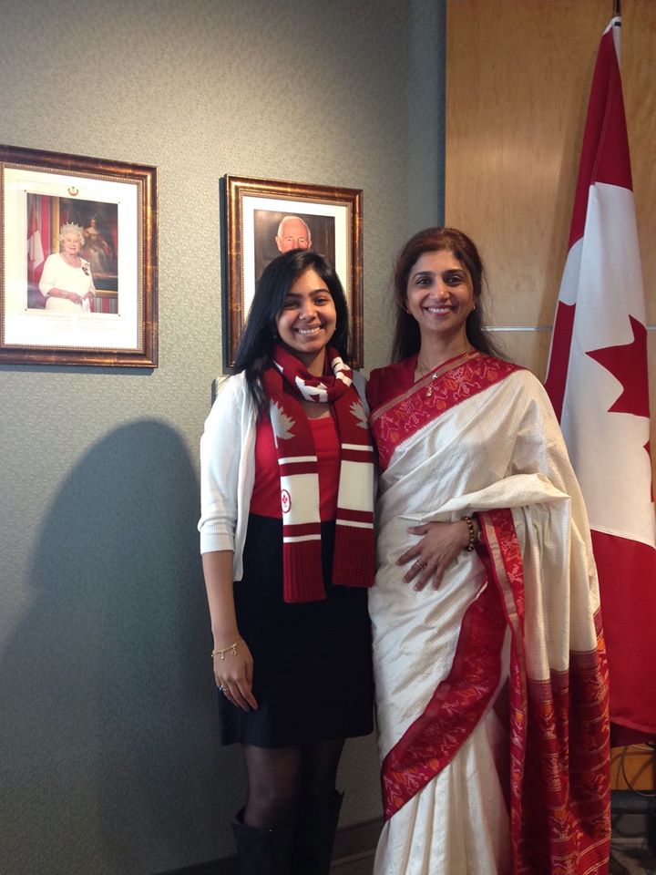
So grateful to be able to share my happiest moments with my mom. Proud citizens of Canada! What a great country. — with Pooja Khandelwal.

Slide 8
The Immigration and Refugee Protection Act
Most recent immigration legislation; established in 2002
Classifies potential immigrants into categories and establishes criteria for each category
Every year about 170,000 people become new citizens of Canada.

Slide 9
Objectives of the IRPA
Keep Canada bilingual and multicultural
Pursue social, cultural and economic benefits for all Canadians
Develop minority official language communities
Support economic development across Canada
Reunite families that have been separated
Successful integration of immigrants into society

Slide 10
Something to think about?
In 2007 Canada accepted more then 250 000 immigrants, the highest amount in 50 years. What might be the reason for this?

Slide 11
Immigration Application Process
To be eligible to become a Canadian citizen, you must meet the requirements in all of the following areas:
Age → Over 18 to file for citizenship; under 18 – parents must apply on your behalf
Permanent resident status
Time lived in Canada → minimum 3 years
Language abilities → must know English or French
Criminal history
Knowledge of Canada → must pass citizenship test

Slide 12
Economic Immigrants Canada’s Points System
In order to Immigrate to Canada you must first qualify
Read together- pg 169

Slide 13
The Points System
Established in 1967
Must have 67 points to immigrate
Evaluated under the following categories:
Education (Ph.D → 25 points)
French/English language abilities (Completely bilingual → 24 points)
Work Experience (4 years in a skilled occupation → 21 points)
Age (21 – 49 years old → 10 points)
Arranged employment (job offer approved by Human Resources Development Canada → 10 points)
Adaptability (proof of support network → 10 points)
Proof of funds (single with $10 168 → 10 points)

Slide 14
Could you immigrate to Canada?
Let’s Check!

Slide 15
Think about it…
Why do you think immigration criteria exists?
Why might Canadians have different views and perspectives on these Criteria?
What issues arise from immigration based on Economic Factors?

Slide 16
Economic Immigrants – Health
As an economic immigrant, a person must prove they are in good health:
Free of diseases that could put the health of other Canadians at risk (i.e. tuberculosis)
No conditions that could endanger the public (i.e. mental illness)
No conditions that could put an “excessive demand” on Canada’s health services (i.e. HIV/AIDS)

Slide 17
Now vs. Then- Are Canada’s Immigration Laws Different today then in the Past?
Then → Canada’s immigration policies favored immigrants from the UK and limited immigrants of certain ethnicities.
Chinese head tax
Chinese head Tax 2
Prohibited immigrants from India traveling on ships with indirect routes (no direct routes were available)
Now → Race and country of origin are not part of the criteria for evaluating immigrants.

Slide 18
Think About it….
Why do you think Canada’s immigration policies have changed over time?
How do you think they might change in the future?

Slide 19
What is Canada’s policy towards Refugees?
Terms to Know
Refugee – a person who seeks refuge in another country because of danger or persecution in their home country
Persecution - to pursue with harassing or oppressive treatment, especially because of religion, race, or beliefs

Slide 20
What is Canada’s policy towards refugees?
U.N. Convention Relating to the Status of Refugees (1951)
Defines refugee as
"A person who owing to a well-founded fear of being persecuted for reasons of race, religion, nationality, membership of a particular social group or political opinion, is outside the country of his nationality and is unable or, owing to such fear, is unwilling to avail himself of the protection of that country; or who, not having a nationality and being outside the country of his former habitual residence as a result of such events, is unable or, owing to such fear, is unwilling to return to it..“
Excludes people from refugee status (i.e. war criminals)
1950s and 60s – Canada accepts refugees on a crisis by crisis basis
1976 – Canada makes “refugee” an official immigration category, therefore, accepting refugees on a steady basis

Slide 21
Objectives of the Immigrant and Refugee Protection Act, 2002
Save lives and offer protection
Fulfill and affirm Canada’s international commitment to protect refuges
Grant fair consideration to people who claim to be persecuted
Offer refuge to people facing persecution

Slide 22
How might the challenges of Refugees be Similar or different from the challenges of other immigrants to Canada?
Refugee Resettlement

Slide 23
Resettling Refugees
Since most refugees are fleeing bad situations, they often need help to establish themselves in Canada
Private Sponsorship of Refugees Program
Private groups, such as churches, commit to providing financial settlement assistance to refugees for one year or until they can support themselves financially, whichever comes first.
This assistance includes accommodation, clothing and food.
Joint Assistance Sponsorship
Provided to refugees with special needs (trauma because of violence or torture, medical disabilities, effects of systemic discrimination and gender persecution )
Combined government and private assistance for a maximum of 3 years

Slide 24
How do the Individual and Collective rights of Canadians Influence Immigration Laws and Policies?
In the section…..
Information and views about a supreme court decision involving individual rights and refugees
Perspectives of First Nations on Immigration Policy
Issues for Francophone's in Alberta arising from immigration

Slide 25
The Singh Decision
April 4th is known as Refugee rights day, following a 1985 supreme court ruling known as the Singh Decision.
Satnam Singh came to Canada seeking refugee status. His case was rejected under the immigration in 1976.
The immigration act at that time did not allow immigrants to state their case in person or appeal the decision
The supreme court said this violated section 7 of the Charter of Rights and Freedoms
The charter applies to everyone physically present in Canada

Slide 26
The Result….
People claiming refugee status have the right to a hearing which they attend in person
Canada established the Immigration and Refugee Board to provide quick and fair hearings
Canada’s government provides people seeking refugee status with the necessities while they wait for their hearing

Slide 27
The Fallout…
Canadians have different opinions about the Singh decision and still debate its affects
Read some examples on pg 183
To what extent should Canada status to all people that request it?
What individual rights do refugees seeking entry into Canada have that Canadian citizens also have?
Should they have the same rights?

Slide 28
How does immigration involve the collective rights of Aboriginal People?
Aboriginal peoples are partners in Canada
Treaties and agreements between aboriginal peoples and the government created a commitment to work together and share prosperity
However, many aboriginal people face health, education, and employment challenges linked to poverty and the impact of past laws and policies

Slide 29
Many First Nation groups have difficulty finding education, training, and employment opportunities
This causes issues to arise when Canada allows immigration of skilled workers and professionals

Slide 30
Why do many first nations groups have an issue with Canada’s immigration policies?

Slide 31
How do Provinces Influence Immigration Laws?
What can we conclude from the map on pg 188?

Slide 32
Why might immigrants to Canada choose to settle in Toronto, Montreal, or Vancouver?
An objective of the IRPA is to share the economic benefits of immigration across all of Canada. Based on the map and the chart on pg 190 is this happening?

Slide 33
Provincial Nomination Program
Provinces can nominate a percentage of the immigrants Canada selects each year.
This means that Alberta can specify its immigrant needs
The federal government can’t make immigrants settle in a particular area, but they allow provinces to set up incentive programs.
Alberta example?

Slide 34
Time to Think…
Based on the chart on pg 190, what percentage of immigrant workers does Alberta receive?
Is this enough? What challenges does Alberta face?
What might a solution be?

Slide 35
The Debate - To what extent does Canada benefit from immigration?

