Slide 1
By: Namrata Verma
66230153

Slide 2
My Question:
How can teachers and students share in classroom management?
Or
What is the role of equity in classroom management amongst teachers and students?

Slide 3
Why it is significant to have equity in classroom
management among students and teachers?
Positive classroom environment
Student-teacher relationship
Understanding adolescent
Multi-Cultural
Consistent and Fair
Stating simple and clear expectations
Guidelines for effective learning

Slide 4
Objectives of a well organized classroom
To promote an atmosphere which foster imaginative and creative activities
To efficiently use the physical facilities of school
To have efficiency in the teachers and student`s time, efforts and energies.
Creating safe spaces for students.

Slide 5
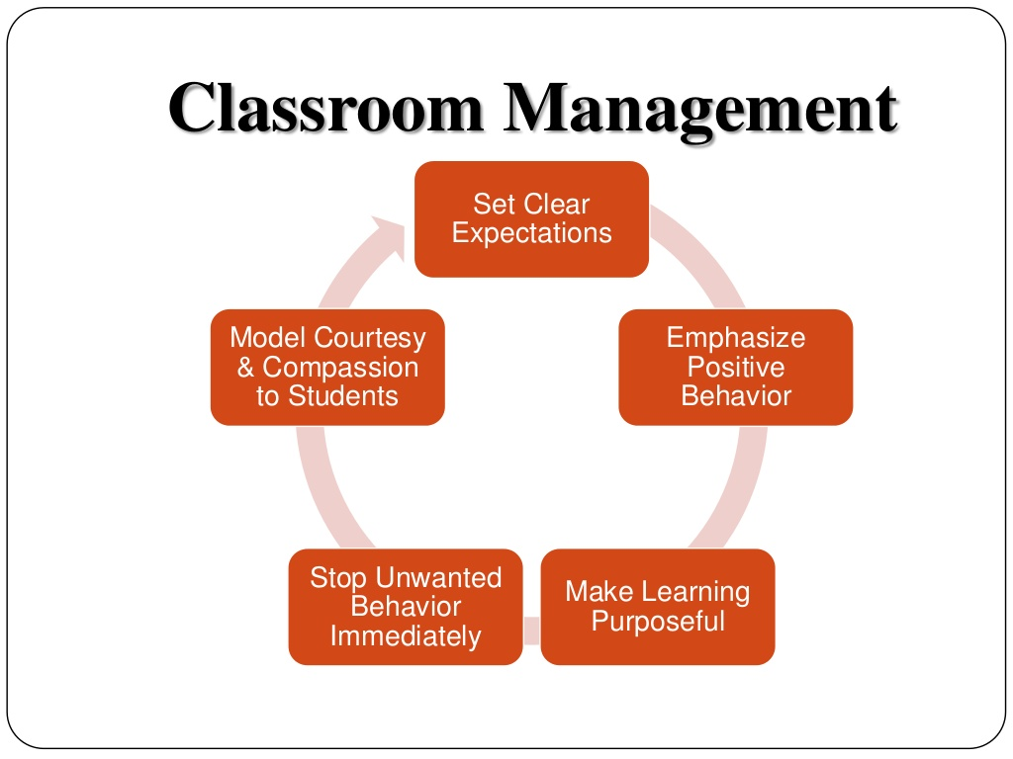

Slide 7
Key fundamental for Teacher
Know what you want and what you don`t want.
Show and tell your students what you expect (want).
When you get what you expect/ want, acknowledge (not praise) it.
When you get something else, act quickly and appropriately.

Slide 8
Teacher should …
Do
Don`t do
Use different pedagogy
Be Creative
Set guidelines
Use technology in class
( only for learning purpose)
Don’t use same teaching style –its Boring
Avoid Repetitive activities
Don`t ignore it, In fact enforce them as a teacher with students
Don`t just rely all the time on technology.

Slide 12
References:
Moore, K., & Hansen, J. (2012). Effective strategies for teaching in K-8 classrooms (pp. 52-75). Thousand Oaks: SAGE Publications.
Parkay, F., & Stanford, B. (1998). Becoming a teacher (4th ed.). Boston: Allyn and Bacon.
Parkay, F., & Stanford, B. (1998). Becoming a teacher (4th ed.). Boston: Allyn and Bacon.
Raffaelli, L. (2014, August 20). The Dos and Don'ts of Classroom Management: Your 25 Best Tips. Retrieved December 12, 2015, from http://www.edutopia.org/discussion/dos-and-donts-classroom-management-your-25-best-tips
Johnson, B. (2015, June 17). How to Manage Cell Phones in the Classroom. Retrieved December 12, 2015, from http://www.edutopia.org/blog/how-manage-cell-phones-classroom-ben-johnson

Slide 13
