Slide 1
By:
Namrata, Sarah, Alexis, Erik & Shirel
CLASSROOM MANAGEMENT

Slide 2
Our Question:
How can you, as a teacher, maintain an emotional connection with your students while also ensuring your own mental stability and health?

Slide 3

Classroom Management
What are some important elements of classroom management?
How is classroom management related to teacher wellness and sanity?

Slide 4
Objectives of a well organized classroom
To promote an atmosphere which foster imaginative and creative activities
To efficiently use the physical facilities of school
To have efficiency in the teacher's and student's time, efforts and energies.
Creating safe spaces for students.

Slide 5
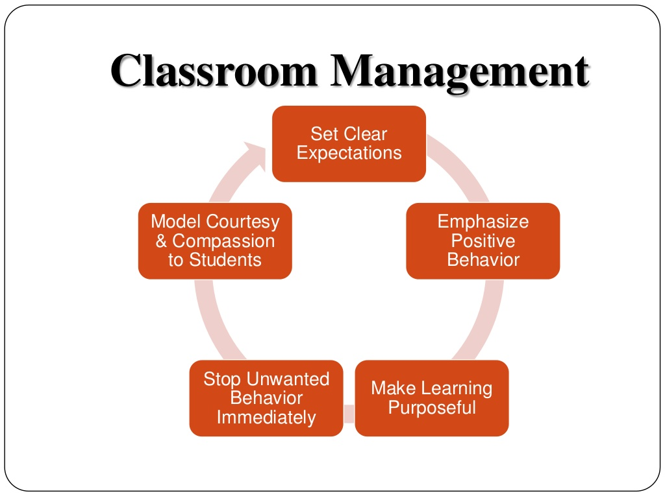

Slide 6
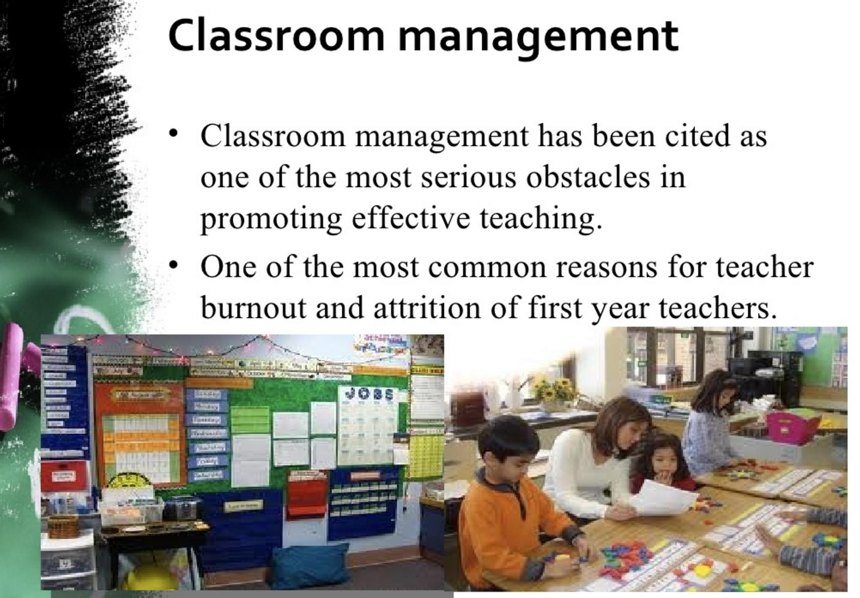
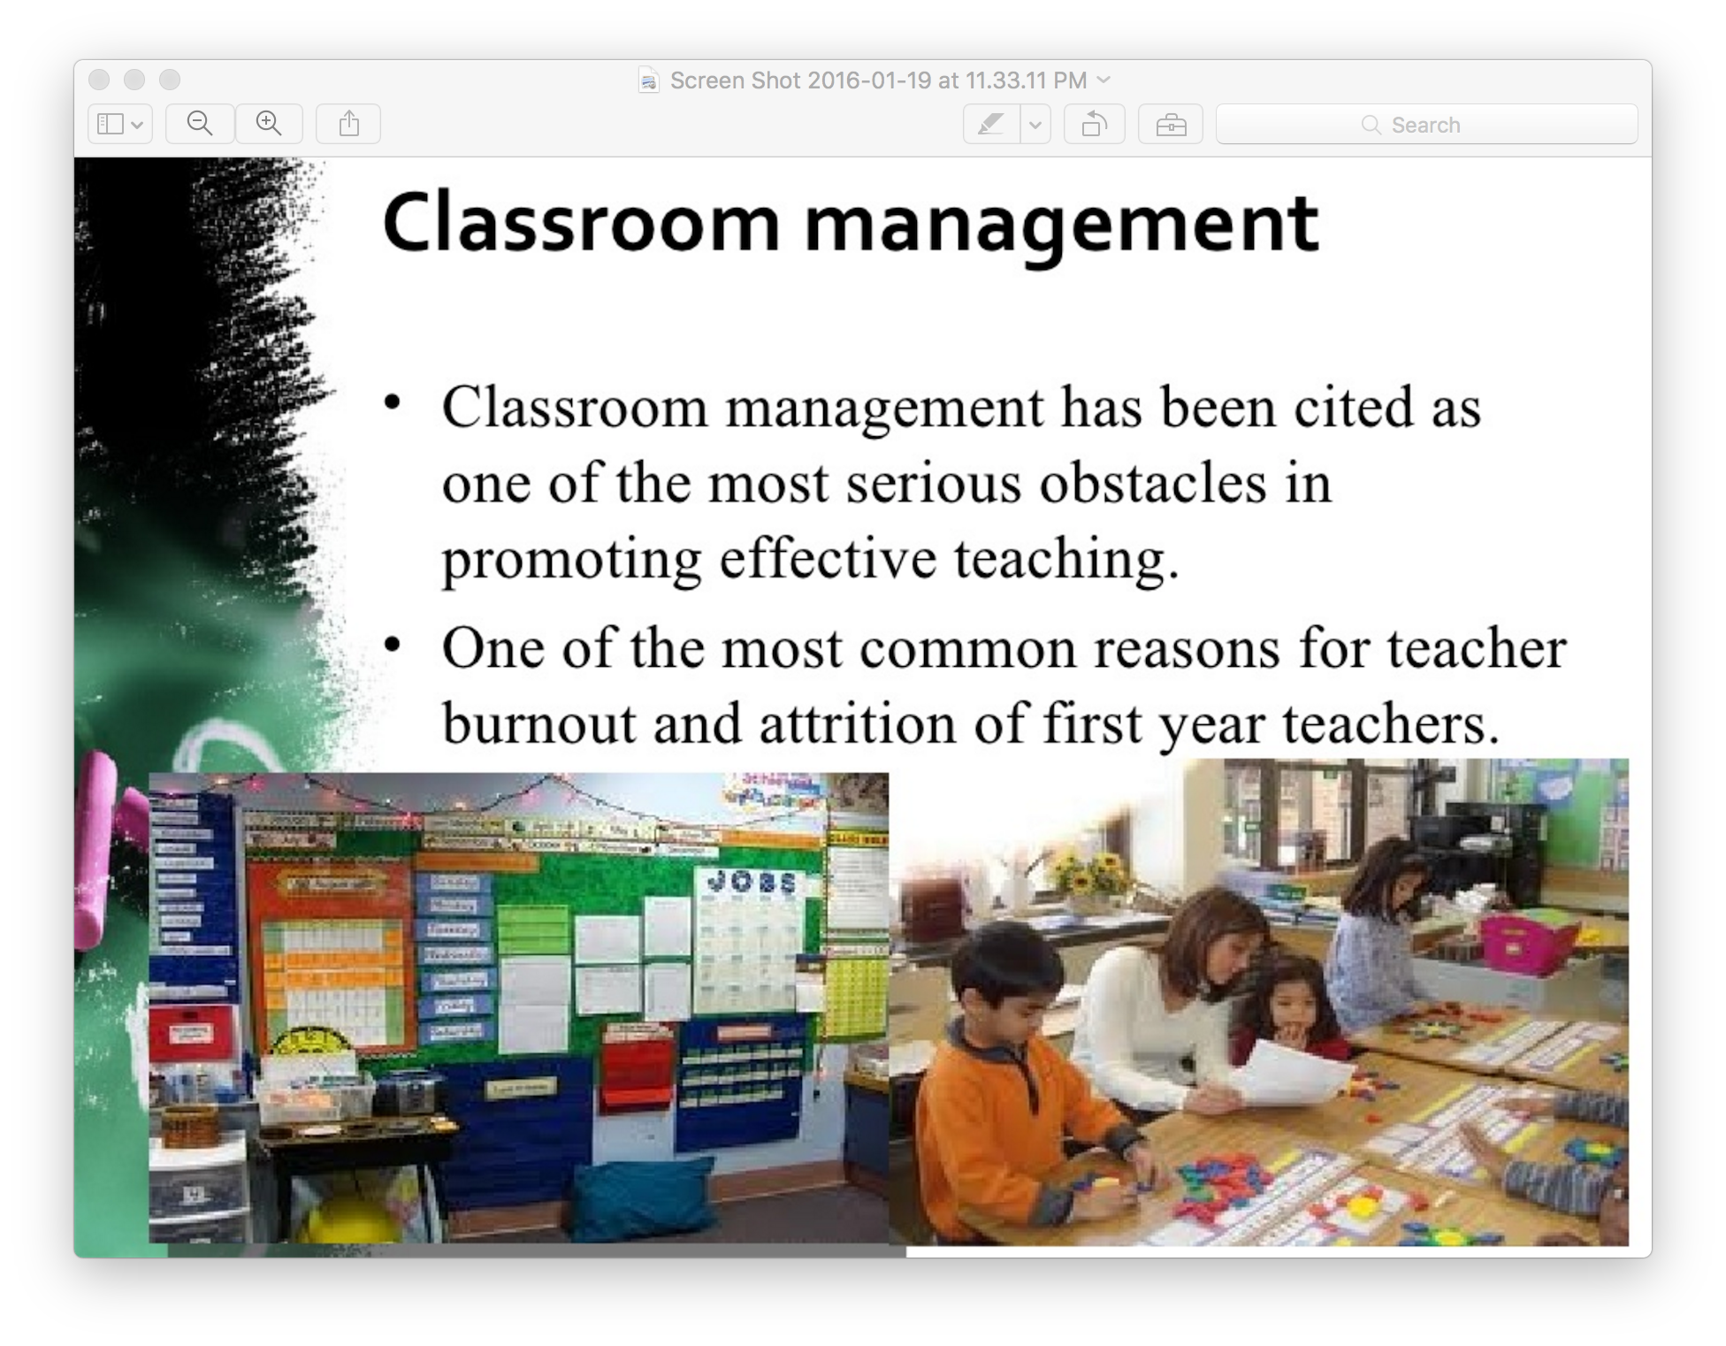

Slide 7
Key fundamentals for Teachers
Know what you want and what you don`t want.
Show and tell your students what you expect (want).
When you get what you expect/ want, acknowledge (not praise) it.
When you get something else, act quickly and appropriately.

Slide 8
Establishing Classroom Expectations-
● Respect one another and the classroom and school property.
Listen to:
● Directions and instructions.
● Peer questions and opinions.
● Class discussion, presentation.
● Always raise your hand to speak or ask any questions.
During Class:
● Be present in the room on time.
● In order to be dismissed, all materials must be put away, desks cleared.
● You are here to study, to learn, for that you don't need any sort of electronic device.

Slide 9
● You are responsible for the assigned readings and homework, even if
absent.
● To use appropriate behaviour during class time and be in class on time.
● You earn your grades, not given them.
● If you are not able to attend the class have your parent inform the office
as soon as possible.
● If you have any questions or need any extra help with regards to
studying material: let the teacher know

Slide 10
Be sure to:
Check out the school’s policy regarding devices in the classroom.
Can they be taken away?
Some schools ban them at school, others encourage their use.
Devices can be problematic for classroom management.
Be sure you know what the chain of discipline in the school and follow it consistently.
You may not treat all students equally, but treat them all fairly.

Slide 11
Teacher Wellness
- Teachers often experience burnout in their first few years of working because of lack of time, resources, and support, with high expectations, and making the workload overwhelming.
- A consequence of high workloads and stress may include the onset mental health issues, a lack of self-care, working excessively, becoming sick, affecting family life and relationships and ultimately quitting teaching.
-

Slide 12
Teacher Wellness
Finding time to balance life interests, and exercise or participate in relaxation exercises will improve the teacher’s overall wellbeing.
Teachers that are healthier, happier and less stressed are able to establish more supportive and effective learning environments.

Slide 13



Teacher Wellness
Get proper sleep, healthy eating, exercising
We have found various techniques teachers can use to maintain their physical and mental health
We will be showing a series of quick exercises you all can use when it gets to be a little too much

Slide 14
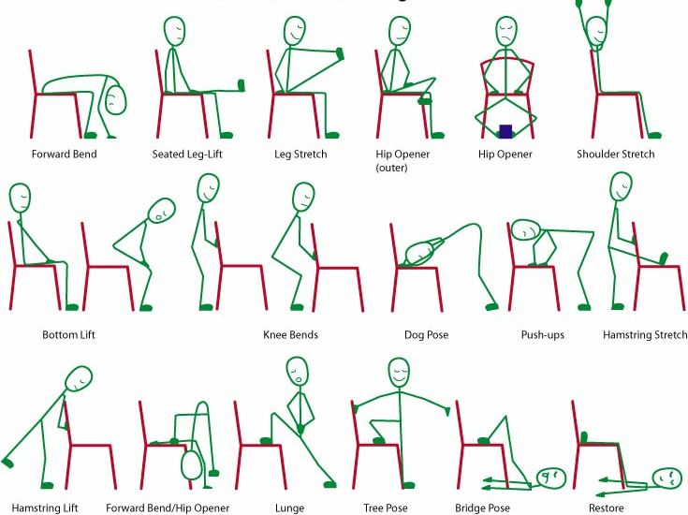
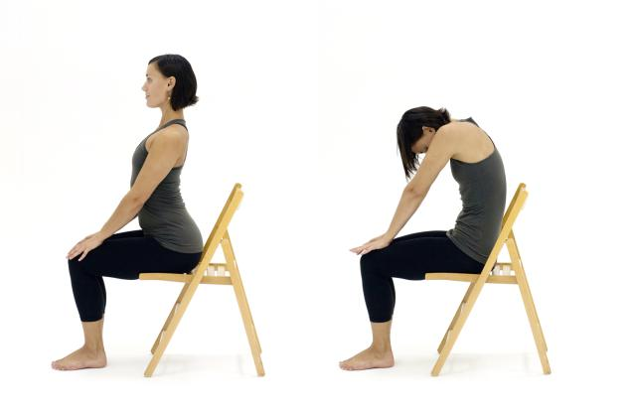
Exercises
Deep Breathing Exercises
Seated Camel Pose
Seated Pigeon Pose

Slide 15


Slide 16
References:
Banks, Tachelle. (2014). Creating Positive Environments: Antecedent Strategies For Managing The Classroom Environment And Student Behavior. Creative Education. Retrieved July 14th, 2016, from http://file.scirp.org/pdf/CE_2014042813551739.pdf
Moore, K., & Hansen, J. (2012). Effective strategies for teaching in K-8 classrooms (pp. 52-75). Thousand Oaks: SAGE Publications.
Parkay, F., & Stanford, B. (1998). Becoming a teacher (4th ed.). Boston: Allyn and Bacon.
Parkay, F., & Stanford, B. (1998). Becoming a teacher (4th ed.). Boston: Allyn and Bacon.
Raffaelli, L. (2014, August 20). The Dos and Don'ts of Classroom Management: Your 25 Best Tips. Retrieved December 12, 2015, from http://www.edutopia.org/discussion/dos-and-donts-classroom-management-your-25-best-tips
Johnson, B. (2015, June 17). How to Manage Cell Phones in the Classroom. Retrieved December 12, 2015, from http://www.edutopia.org/blog/how-manage-cell-phones-classroom-ben-johnson

Slide 17
References:
https://bctf.ca/uploadedFiles/Public/SalaryBenefits/Rehab/HW-ArticleReviews.pdf
Naylor, Charlie. "What Do British Columbia Teachers Consider To Be the Most Significant Aspects of Workload and Stress in Their Work? Analysis of Qualitative Data from the BCTF Worklife of Teachers Survey Series, 1: Workload and Stress. BCTF Research Report." (2001).
Lauzon, Lara. "Teacher wellness: An interpretive inquiry." Edited by Budd L. Hall and María del Carmen Rodríguez de France 146-151. University of Victoria. (2004).
McConaghy, Tom. "Teacher wellness: An educational concern." Phi Delta Kappan 74.4 (1992): 349.
Kipps-Vaughan, Debi, Tyler Ponsart, and Tammy Gilligan. "Teacher Wellness: Too Stressed for Stress Management?." Communique 41.1 (2012): 1-26.
Sellgren, Kathrine. “Teachers ‘Need More Training’ On Classroom Management.” BBC. (2010). Retrieved from http://www.bbc.com/news/education-11531261

