Slide 1
Pathos & Pathic Knowledge
Norm Friesen

Slide 2
Overview
Etymology
Waldenfels on Pathos; Widerfahrnis
Pathic knowledge and L. Wittgenstein
Pathic Practice
Two examples

Slide 3
Pathos: What is it?
"quality that arouses pity or sorrow," 1660s, from Greek pathos "suffering, feeling, emotion, calamity," literally "what befalls one," related to paskhein "to suffer," and penthos "grief, sorrow;" from PIE root *kwent(h)- "to suffer, endure" (cognates: Old Irishcessaim "I suffer," Lithuanian kenčiu "to suffer," pakanta "patience").

Slide 4
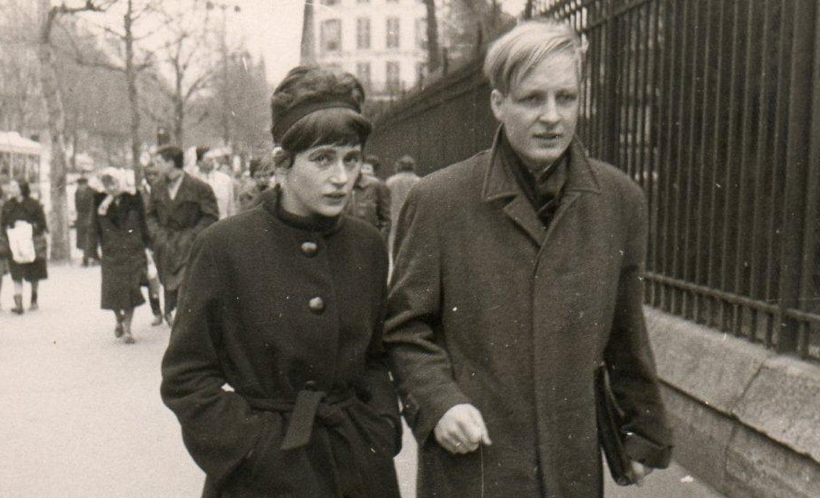
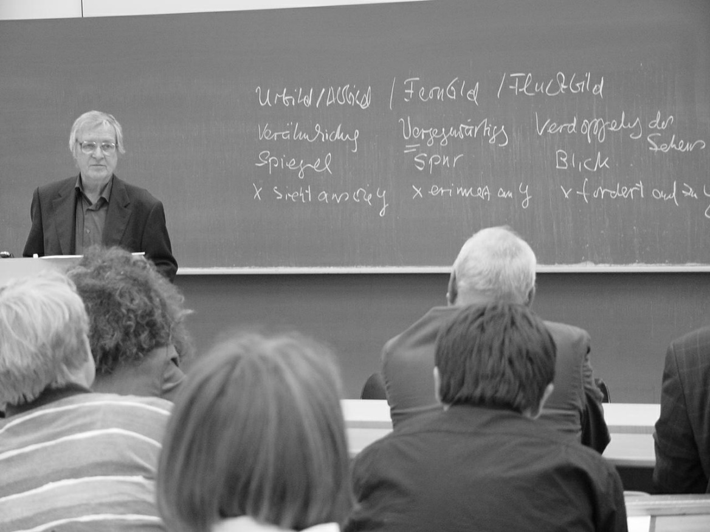
B. Waldenfels (1934 - )
intentionality as “something show[ing] itself as something,”
What is “given, apprehended, understood or interpreted as something i.e. endowed with a certain sense” (2007, p. 72).
Bernhard Waldenfels’ Responsive Phenomenology of the Alien: An Introduction and Review http://ejournals.library.ualberta.ca/index.php/pandpr/article/view/20640

Slide 5
Waldenfels on Pathos
The moment of the now is simply an “event,” one in which intentionality (taking “something as something”) may certainly be present but is not dominant:
In sum, everything that appears as something has to be described not simply as something which receives a sense, but as something which provokes sense without being meaningful itself yet still as something by which we are touched, affected, stimulated, surprised and to some extent violated. I call this happening pathos, Widerfahrnis or affect, marked by a hyphen in order to suggest that something is done to us. (2007, p. 74)

Slide 6
“Widerfahrnis” & Pathos
Wider-fahr-nis
Wider “against”
fahren to travel the verb for experience = erfahren; “-nis” meants it is a “thing;”
Drives against one, against the grain, despite oneself; an experiential “friction”
Exemplified in the Event
It happens to us jolts us, is negative, shakes us up, rattles us.
Arises through one’s passivity.
Ongoing, a part of every event: “Everything that happens to us, right up to the limit events of birth and death which are repeated in our life in different ways, may be called pathos, which is to be understood as what in German is called Widerfahrnis” (2007, p. 45).

Slide 7
“Widerfahrnis” & Pathos
our response to the “event” is not one of sense-making or ordering.
A reaction; a sensing and feeling that exceeds and envelops cognition:
Responsivity goes beyond every intentionality because responding to that which happens to us cannot be exhausted in the meaning, understanding, or truth of our response. All this is not restricted to the affective background of our cognitive and practical modes of comportment; it concerns these modes in their essence… (2011, p. 28)

Slide 8
Heidegger, M. (1982). On the way to language
To undergo an experience with something… means that this something befalls us, strikes us, comes over us, overwhelms us, and transforms us. When we talk of “undergoing” an experience we mean specifically that the experience is not of our making. To undergo here means that we endure it, suffer it, receive it as it strikes us, and submit to it. (1971, p. 57)

Slide 9
Widerfahrnis: “In praise of tiredness”
[It] is the tired person, rather than the person who [is] fresh and wide-awake who is the most sensitive to flows and atmospheres. Of course, there are many forms of tiredness, such as tense or nervous exhaustion which can make one weak, and can prevent sleep. But our concern here is with a more benevolent form of tiredness, one that slackens the whole body without leaving any knots or points of tension whatever. In this kind of tiredness, the body comes to its own, the breath flows steadily and independently. [...] This kind of tiredness not only increases emotional alertness, it also boosts one’s capability for empathic embodied communication. (Schmitz, as quoted in: Soentgen 1998, p. 75)

Slide 10
Pathic Knowledge
pathic refers to the general mood, sensibility; felt sense of being in the world
Heidegger: Befindlichkeit ("the way one finds oneself“) to refer to the sense that we have of ourselves in situations; the implicit felt understanding of ourselves in situations
E. Gendlin: "It is sensed or felt, rather than thought--and it may not even be sensed or felt directly with attention.”

Slide 11
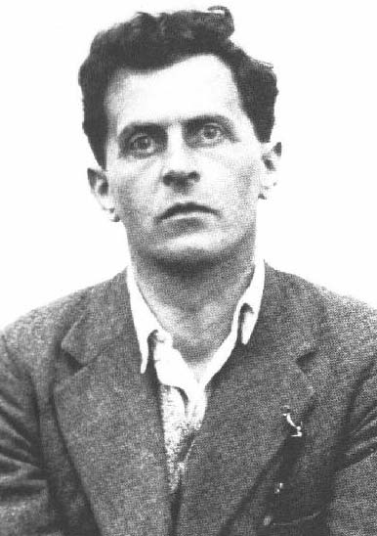
The limits of positive, explicit knowledge
476. Children do not learn that books exist, that armchairs exist[. T]hey learn to fetch books, sit in armchairs, etc… 478. Does a child believe that milk exists? Or does it know that milk exists? Does a cat know that a mouse exists? 479. Are we to say that the knowledge that there are physical objects comes very early or very late?...
480. …Admittedly it’s true that ‘knowing something’ doesn’t [necessarily] involve thinking about it.” (On Certainty)

Slide 12
Modalities of Pathic Understanding (van Manen, 2010)
Actional: In our professional practices we may distinguish several modalities of pathic understanding: situated, relational, embodied, and enactive.
Embodied: “the body knows” how to do things. And if we wanted to gain intellectual control of this “knowledge”, we might in fact hamper our ability to do the things we are doing as embodied beings.
Relational: in the presence of one person we may feel totally stupid while in discussion with an other person we may feel really smart? …saying or telling something –and as the words fall from our tongue we hear ourselves speak, and we think, “Not bad!” We may be surprised at our own thought and eloquence. …Thus, Merleau-Ponty can say, “my spoken words surprise me myself and teach me my thought.”

Slide 13
Modalities of Pathic Understanding
Situational: in a strange environment or unfamiliar world, we may not only feel disoriented but also quite stupid, naive, ignorant. For example, many teachers know how a positive atmosphere, trustful habits, and productive routines seem, in part, to be a function of the room, the physical space, the social ambience, and the cultural ecology of the school where they feel comfortable and at home.

Slide 14
Practice
The novice wonders…
"How can it be that I try so hard to put into practice what I learned about motivation and enrichment--but feel totally deflated when I overhear a student saying she’s bored with the program?"
“I worked for hours to put that lesson together: why did that class go so badly?”
Why is it that I received top marks in my courses on educational psychology--but when Jane broke down and told me to leave her alone when I tried to help her, I did not know what to say?“ (adapted from van Manen, 1996).

Slide 15
Aspects of Practice and Knowing
“practices as embodied, materially mediated arrays of human activity centrally organized around shared practical understanding.” (Schatzki, 2001, 2)
“practice brings into view activities which are situated, corporeal, and shaped by habits without reflection.” (Thévenot, 2000, p. 64)
Wenger: “Geography” and “landscape” of practice.

Slide 16
But we are limited only to a topology
Is by definition shared and experienced together
Is something pointed to
Is a part of the tacit background
But determines what we do, how we interact
We can experience only a part at a time, not as a map from above

Slide 17
Patricia Hawley, Nurse:
I have a patient, Bob, a high school teacher and soccer coach. He is 29 years old. He was admitted to our neurosurgical ICU with a broken neck. It was the last day of school. The teachers were having a party at the principal's cottage at the lake. Bob dived into shallow water.
One day an independent, active man, whole and mobile. The next, he lies in a hospital bed, motionless. His head suspended in traction. Mouth, face and eyes are the only body parts moving.

Slide 18
One day I sensed that Bob was having a [specially] rough time-I just knew. I could feel the tension. He was experiencing a lot of pent-up frustration. Just before leaving I bent over and said, "Bob, when I go for coffee ... I'll scream for you.“ (Hawley, 2002)

Slide 19
Lived experience and reflection from a “Shop” Teacher
After cramming the 76th panel into the thickness planer, I had learned the idiosyncrasies of the machine. It pulled just a little to the left as it snapped the wood down onto the feeder bed and inhaled it to slice away the top with whirring spinning knives. Stuck at this task for four days, I began to wonder about the usefulness of a class project. Was I just learning the pull and whine of the planer or was there deeper learning that I was missing? How could a production project of this kind be utilized to foster motivation in a shop class? I found a few answers.

