Slide 1
Hermeneutic Phenomenology vs. “Cartesian” Cognitivism: Theoretical Implications
EDCP 585-D
January 14, 2015

Slide 2
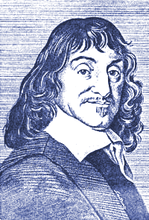
Cartesian Tradition
Skepticism; hyperbolic doubt: “Since I sometimes believe that others go astray in cases where they think they have the most perfect knowledge, may I not similarly go wrong every time I add two and three or count the sides of a square, or in some even simpler matter, if that is imaginable?”
1596 - 1650
Notes:
malevolent demon

Slide 3
Implications of Skepticism
Certainty is obtained in repose through reflection --intellectually
Cogito ergo sum: 'this proposition, I am, I exist, is necessarily true whenever it is put forward by me or conceived by my mind‘
The self is the source of certainty; is known immediately
The outside world, including other minds, are much less certain

Slide 4
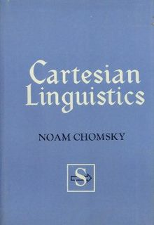
Implications for Language
Phenomena exist outside of language, and language can exist independently of these phenomena
Correspondence of language to phenomena is key
Language:
Follows an internal logic
Mirrors human reason
Expected to be adequate to the world
Language has the potential to deceive, to be inadequate, sometimes challenging via its illogic

Slide 5
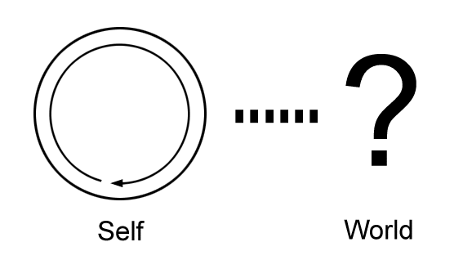
Descartes: Self and World
From the “I think” [the] world had to be derived by means of the geometrical method of inference.
-Don Ihde, Existential Technics

Slide 6
Cartesian Tradition & Understandings of Computers
?
A.M. Turing (1950) “Computing Machinery and Intelligence.”
“I PROPOSE to consider the question, 'Can machines think?’”
Done through the “imitation game” AKA, “Turing test”
See: http://www.loebner.net/Prizef/TuringArticle.html

Slide 7
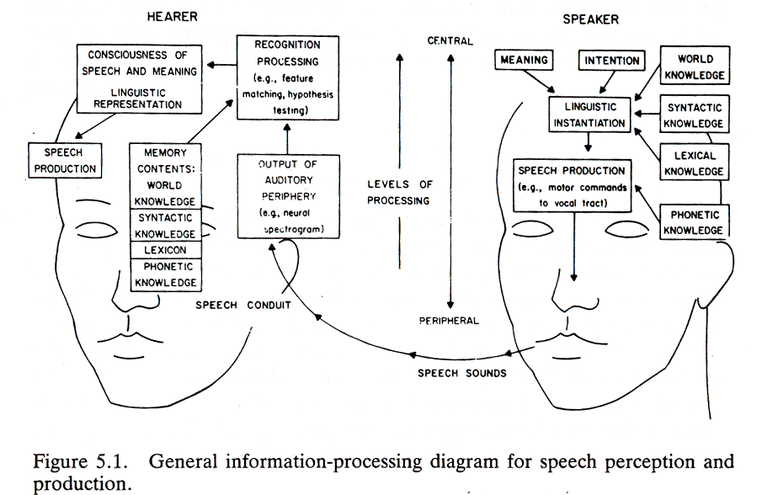
Agre, P. (1997, 240): "Technology at present is covert philosophy; the point is to make it openly philosophical."

Slide 8
Phenom-Hermeneutics: First Principles
“The detached, reflective stance is derivative, not primary” (Dreyfus, 1991)
“We are caught up in the world and we do not succeed in extricating ourselves from it in order to achieve consciousness of it. (Merleau-Ponty, 1945/62)
Before all, comes embodiment, language, and many other “certainties.”

Slide 9
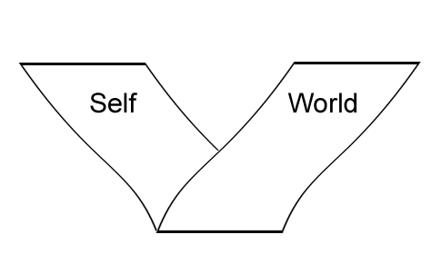
Self & World: A Post-Cartesian Configuration?
Self and world as made of the same “flesh” --the generality of the sensible.
The body as at the place of a “fold” “by which the sensible reveals itself.”
Maurice
Merleau-Ponty
(1969)
The Visible and
the Invisible
plato.stanford.edu/entries/merleau-ponty/

Slide 10
Heidegger on Descartes
If the ‘cogito sum’ is to serve as the point of departure for the existential analytic of dasein then it needs to be turned around, and furthermore needs new ontologico-phenomenal confirmation. The “sum” is then asserted first, and indeed in the sense that “I am in a world.” -Being & Time, p. 254
How I “am” (ontology), rather than how I perceive (epistemology) as fundamental

Slide 11
“Existential analytic”: Background
we are always already in a context which cannot be completely explicated or formalized
“An attempt to explicate all the content of a background is bound to failure since every step of such an explication would introduce new expressions which would require a further explication, and so ad infinitum. On the other hand, assertions without a background would have no meanings (i.e. no interpretation) at all.”
- Schweizer, 1997

Slide 12
Background: Example
What was actually said
I got some new shoe laces for my shoes.
Your loafers need new heels badly.
What was understood
As you will remember I broke a shoe lace on one of my brown oxfords the other day...
Something else you could have gotten that I was thinking of ... You’d better get them taken care of pretty soon.
Garfinkel, H. Studies in Ethnomethodology

Slide 13
“Existential analytic”: Commitment
human knowledge & communication both consist in concernful acting, not information processing or transmission.
we cannot be said to understand a situation or an assertion (heard or said) without being somehow committed to/by its content. -Schweizer, 1997
“You cannot formalize the act of commitment, for you cannot express your commitment non-formally.” -Polanyi, 1966

Slide 14
Phenom-Hermeneutics & Language John Lye, 1996 http://www.brocku.ca/english/courses/4F70/ph.htm
Our symbolic world is not separate from our beings
We are not beings who 'use' symbols, but beings who are constituted by their use.
Words and the world are co-emergent; the adequacy of expression is not about correspondence between word and object in the world
We live in the world: in history, in concretion: we do not live anywhere else, and all meaning is only meaning in relation to particular, concrete, historical existence.
Our existence as beings includes: our situation; our tools-to-hand with and through which we manipulate and articulate the world; and our fore-understandings of the world.

Slide 15
Being in Heidegger & Dreyfus; Winograd & Flores
Being: “the intelligibility correlative with our everyday background practices:”
“non-cognitive”
“cannot be spelled out in so definite and context-free a way that they could be communicated to any rational being or represented in a computer.”
computers "are incapable of making commitments and [therefore] cannot themselves enter into language" (Winograd & Flores, 1986, p. 60)
"Their power as tools for linguistic action derives from their ability to manipulate formal tokens of the kinds that constitute the structural elements of language (76).

Slide 16
Words and Worlds
Words are co-emergent with the experiential world of the computer
Abstract → Concrete (e.g. “content,” “communication”)
The word gains cogency, but must be qualified in practice
Computational/abstract → Experiential (e.g. “interaction,” “feedback,” “input,” “output”)
“applies a mechanistic lexicon to human interaction, while describing computer processes in human terms”
Words shape the potential of the technology (and vice-versa); orient engagement

Slide 17
 | “Covert” or traditional philosophy | Hermeneutic Phenomenology
Nature of Knowledge | ... as the accumulation of data and the verification of hypotheses | ... as non-cognitive “attunement”
Function of Language | Language designates data, facts and hypotheses | Language “co-emerges” with the shared lifeworld
Structure of Experience | Data accumulated and hypotheses verified through experience are not qualitatively differentiated | Experience is structured as movement between “foreground” and inexhaustible “background”
Meaning of Communication | Communication as the transmission of information | Communication as shared “attunement”

Slide 18
Descartes' Blind Man (Attempt at a summary)
"The blind man can 'see' how far the object is from the size of the angles f and g at the base of the triangle he forms with two sticks.“
In a sense, we have become convinced that this is what seeing is!
What is not being seen?

Slide 19
Merleau-Ponty’s Blind Man
The blind man's stick has ceased to be an object for him, and is no longer perceived for itself; its point has become an area of sensitivity, extending the scope and active radius of touch.. . In the exploration of things, the length of the stick does not enter expressly as a middle term.

Slide 20
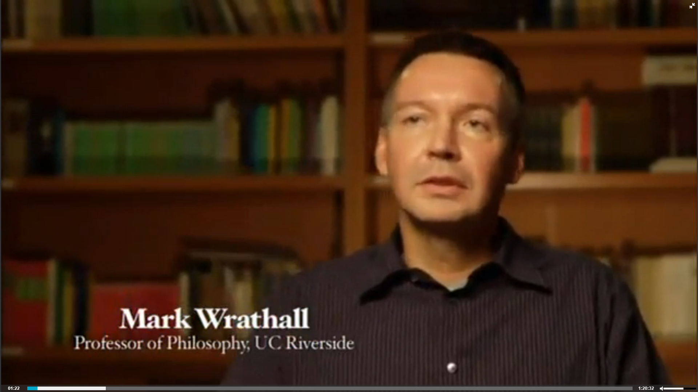
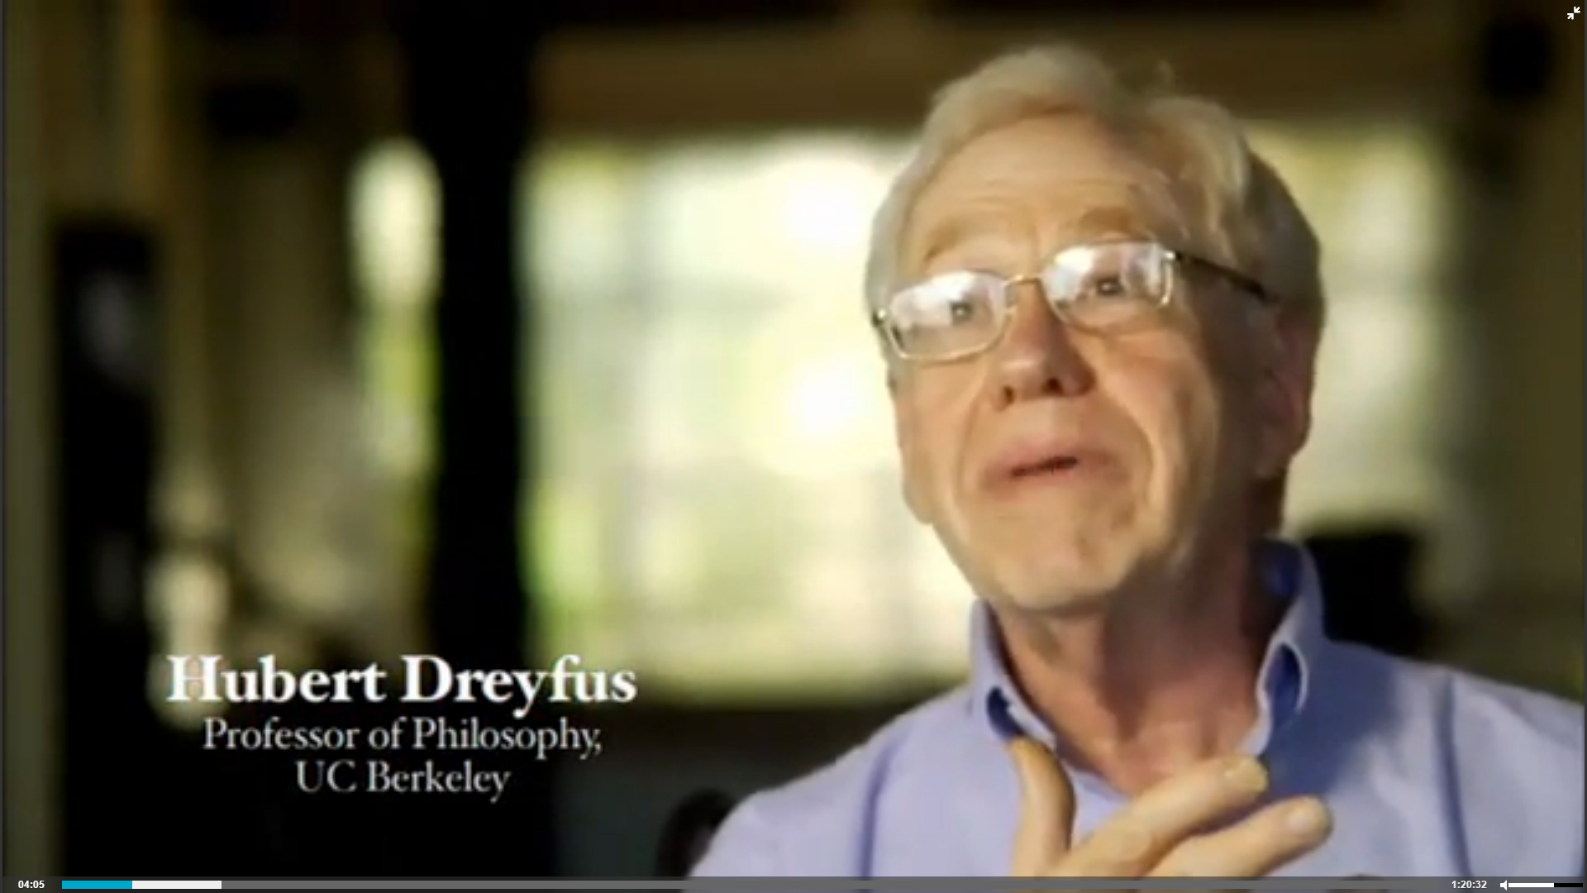
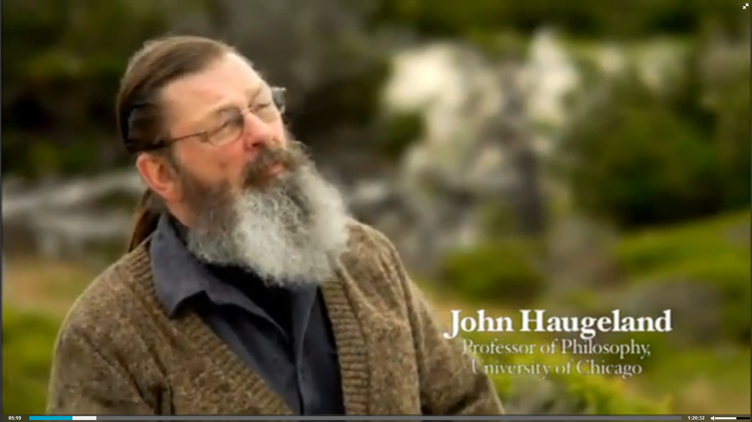
http://www.disclose.tv/action/viewvideo/151991/Being_in_the_world_Documentary

Slide 21
iPod Exercise (adapted from van Manen)
The purpose of the exercise: To provide researchers using hermeneutic phenomenology with a chance to work on a "lived experience description“ (which is kind of a descriptive starting point for an "anecdote"). The experience to be described, of course, is that of going for a walk while listening to music with headphones. It begins when you put the headphones on and begin walking, and ends when you take the headphones off. This gives the experience and phenomena in question a clear beginning and end point (unlike many pedagogical experiences, which can occur either inside or outside of school hours, while "teaching" and at other times, with various combinations of people, etc.).

Slide 22
iPod Exercise (con’t)
What to do: Go for a walk while listening to music. It is easiest/best if you engage with the experience be in terms of the world around you, not in terms of your thoughts.
You can reflect in terms of the four existentials:
Lived space,
Lived time
Lived body (how your body feels)
Relation (e.g. if you pass by someone on the street).
How does the experience of the world unfold in these terms?

Slide 23
iPod Exercise (con’t)
Writing: Write a paragraph or two describing the experience in these terms (1/2 -2/3rds of a page). Use the first person.
We will use it as a basis for "orienting" to ways of describing, so any writing is productive: don't worry about polishing or perfecting it before sending it my way for discussion.

