Slide 1
Differentiated Instruction Reaching to all our students
Inquiry Project by Patricia Ma-Chan

Slide 2
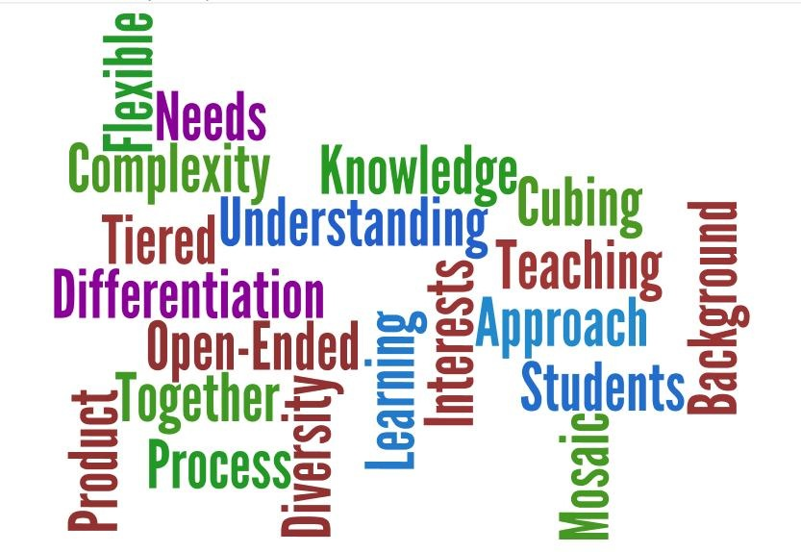
The biggest mistake of past centuries in teaching has been to treat all children as if they were variants of the same individual, and thus to feel justified in teaching them the same subjects in the same ways. - Howard Gardner (1994, Phi Delta Kappan)

Slide 3
What are the different needs in our classrooms?
1. Ability levels and readiness
2. Learning styles and multiple intelligences
3. Prior experiences and individual interests
- In the diverse population of students, we often can identify these different needs from students who are EAL learners, have special needs and embrace a variety of cultural, religious and gender values.

Slide 4
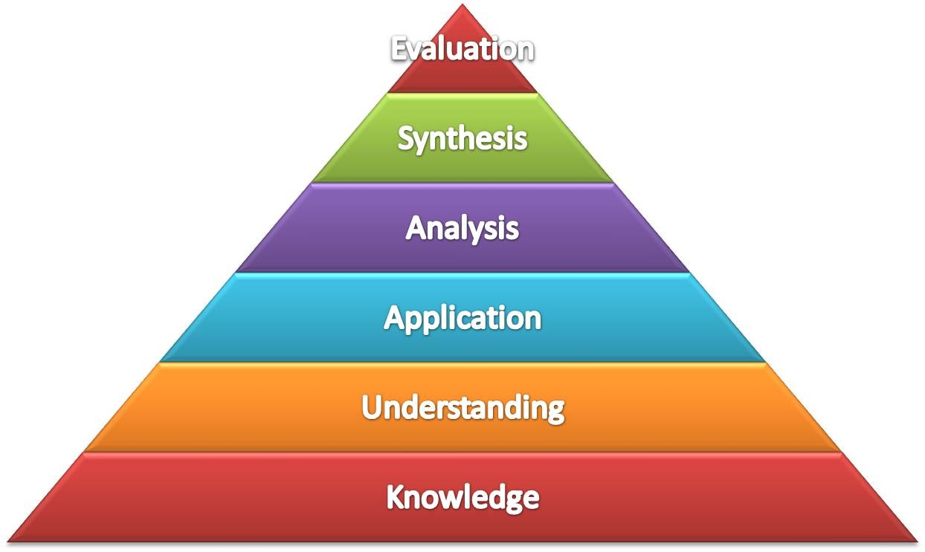
Ability Levels and Readiness
According to the Bloom’s Taxonomy, students can go into three groups to work on various levels of thinking: (1) Knowledge and Understanding, (2) Application and Analysis, and (3) Synthesis and Evaluation.
Teachers can ‘fill in the gaps’ for the readiness of learning by all students.

Slide 5
Multiple Intelligences and Learning Style
Linguistic intelligence
Logical-mathematical intelligence
Spatial intelligence
Bodily-kinesthetic intelligence
Musical intelligence
Interpersonal intelligence
Intrapersonal intelligence
Naturalist intelligence

Slide 6
Individual Interests
Offer choices to students!
Examples:
1. Reading - fantasy novels vs. encyclopedia
Numeracy
- base ten blocks vs. virtual manipulatives
3. PE - soccer vs. hockey

Slide 7
How to do it?
1. Readiness and Ability: ‘fill in the gaps’
2. Learning Style: Multi-intelligence grouping
Interests: Offer choices for students to complete their tasks with a variety of topics & learning styles
Be FLEXIBLE!

Slide 8
My Practicum Class
Active participation of students
People learn in a variety of ways and different rates
Processes of learning as an individual and groups
Grades 3-4: Reading, Writing and Math
Tiered by abilities, learning styles and interest

Slide 9
Other Perspectives
Landrum and McDuffie (2010)
Students benefit most from open-ended strategies by constructing positive learning experiences, not by differentiating learning styles.
Walker-Dalhouse et al. (2009)
- Students feel empowered that they can do a better job in a direction guided, but not directly taught by their teachers

Slide 10
Closing Thoughts
We are all different, it is the difference that makes us interesting
Look to the differences in your students not obstacles but as ways to stretch your teaching
Don’t attempt to do everything at once
Give yourself time to change but don’t stop changing

Slide 11
Online Resources for Beginning Teachers
Best Practice – Tiered Instruction http://www.saskschools.ca/curr_content/bestpractice/
Differentiated Instruction http://www.learnerslink.com/curriculum.htm
8 Lesson Learnt on Differentiated Learning http://www2.scholastic.com/browse/article.jsp?id=3747932
PETALS – People Exploring Teaching/ Learning Styles http://www.petalslearning.com/

Slide 12
More Resources - Differentiated Instruction: Lesson Plan Checklist (Based on Tomlinson, 1996)
Use this checklist as a guide as you plan for differentiated instruction.
1. I’m clear on what I want my students to…
know (facts, information)
understand (concepts, principles, generalizations, ideas)
be able to do

Slide 13
2. In deciding content, I’ve thought about and selected…
alternate sources/resources
varied support systems (reading buddies, tapes, direct instruction groups, graphic organizers, etc.)
varied pacing plans
3. I’ve pre-assessed student readiness to…
make appropriate content and/or activity assignments
get a picture of understanding and skill as opposed to facts only
focus the lesson squarely on what students should know, understand, and be able to do

Slide 14
4. As I assign students to groups or tasks, I’ve made certain that…
student group assignments vary from recent ones
all students are encouraged to “work up”
if appropriate, provisions are made for students who need or prefer to work alone
group sizes match student need

Slide 15
5. As I create differentiated activities, I’ve made certain that…
all of them call for high-level thinking
all appear about equally interesting to my learners
if readiness based, they vary along a continuum of Bloom’s Taxonomy
if interest based, students have choices about how to apply skills and understandings or how to express them
varied modes of learning opportunities accommodate carried learning profiles
each activity is squarely focused in one, or very few, key concept or generalization
student choice is maximized within my parameters for focus and growth
appropriate skills have been integrated into the activity requirements
expectations for high-quality task completion are clear for all students
I have a plan for gathering ongoing assessment data from the activity
I have a means for bringing closure and clarity to the tasks

Slide 16
6. When creating assignments for differentiated products, I’ve made certain they…
vary along a continuum of Bloom’s Taxonomy based on student readiness
require all students to use key concepts, generalizations, ideas, and skills to solve problems, extend understandings, and/or create meaningful products
maximize student choice within parameters necessary to demonstrate essential understandings and skills
include a core of clear and appropriately challenging expectations for the content of the product, processes involved in the production, and production requirements for the product
provide for formative evaluation and modification of the product
provide for summative evaluation by teacher, students, peers, and/or others
involve and inform parents as appropriate

Slide 17
7. I’ve also thought about…
instructional strategies like learning contracts, centers, interest groups, compacting, etc. to vary learning options
small groups for re-teaching and extension activities
sampling students to assess understanding, group processes, and production needs
meaningful tasks for reinforcement, extension, and exploration when students complete required work (anchor activities)

