Slide 1
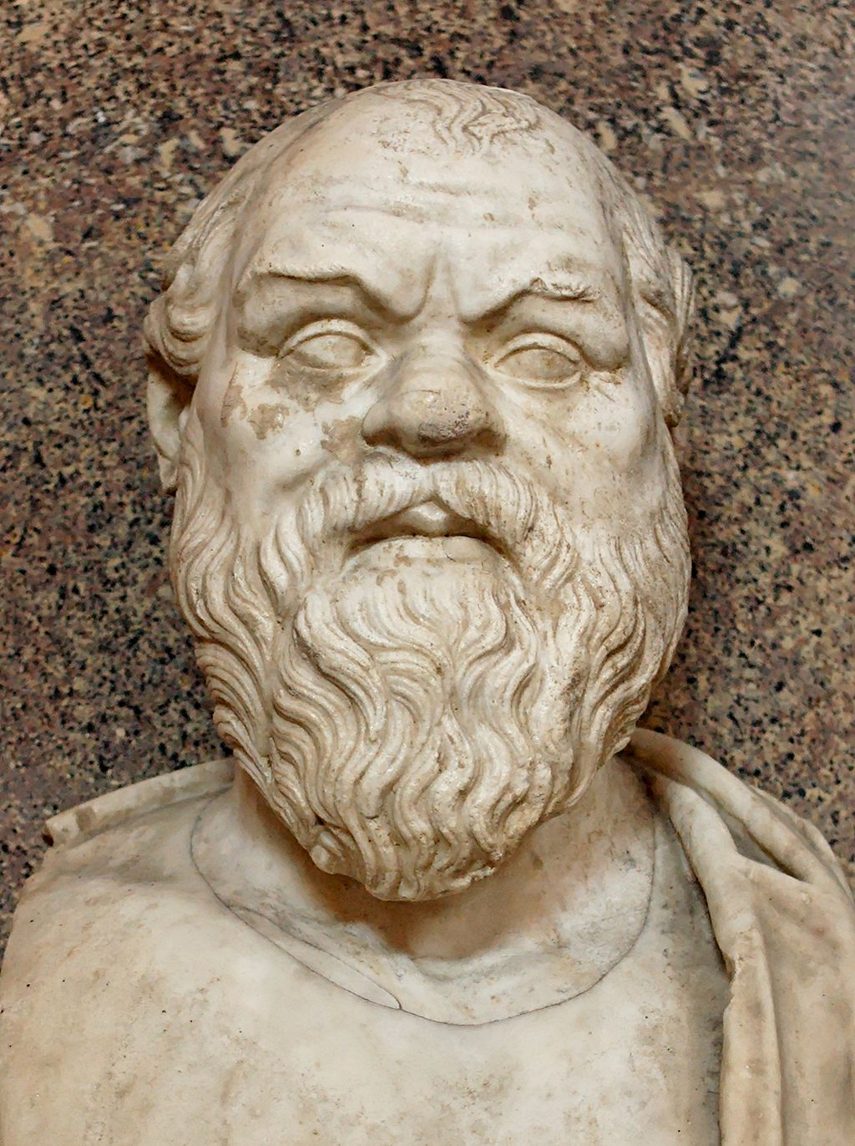
Plato, Apology
PHIL 102, UBC
Christina Hendricks
Spring 2018
Bust of Socrates at the Museo Pio-Clementino,
Public domain on Wikimedia Commons
Except images licensed otherwise,
this presentation is licensed CC BY 4.0

Slide 2
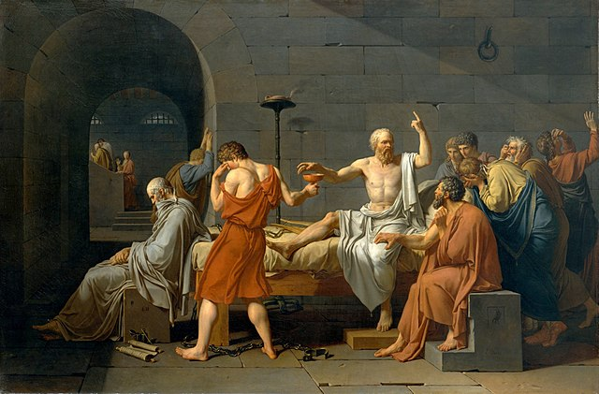
Questions about the text?
How trials worked at the time
Social & political context of this trial (oracle at Delphi?)
Death of Socrates, Jacques-Louis David, public domain on Wikimedia Commons

Slide 3
Socrates, in Euth. & Apology
Do you get a different sense in Apology of how Socrates acts, and why he thinks his philosophical activity is important, than in Euthyphro?

Slide 4
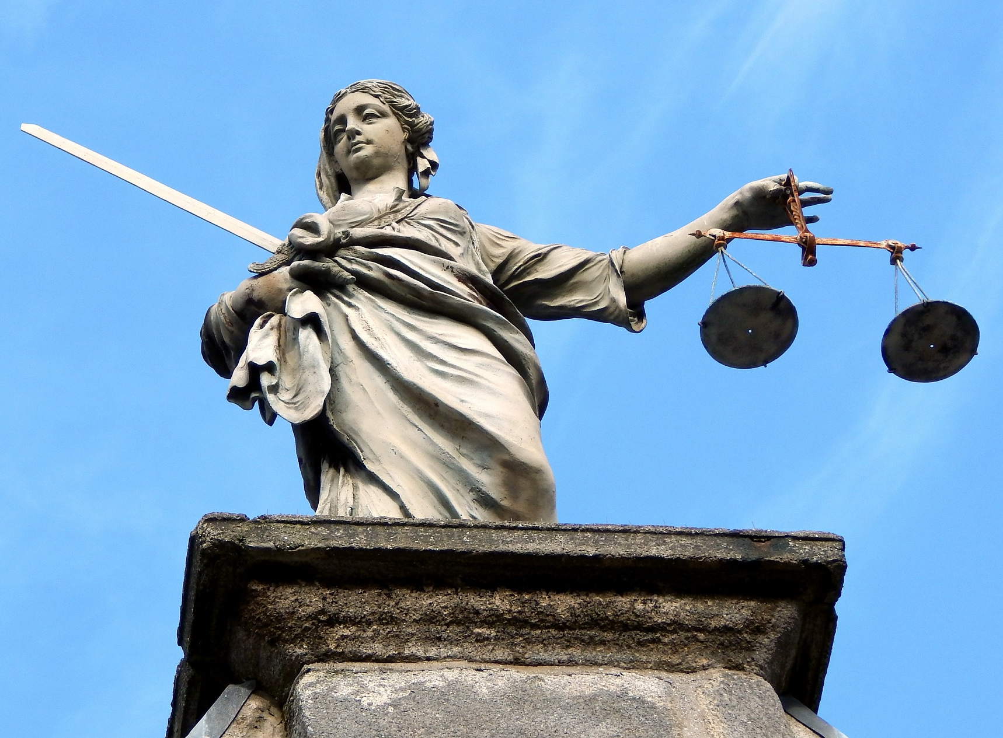
The charges
Impiety
Why was this important at the time?
Corruption of the youth
Outline Socrates’ defense in conversation with Meletus
Statue of Justice, licensed CC0 on pixabay.com

Slide 5
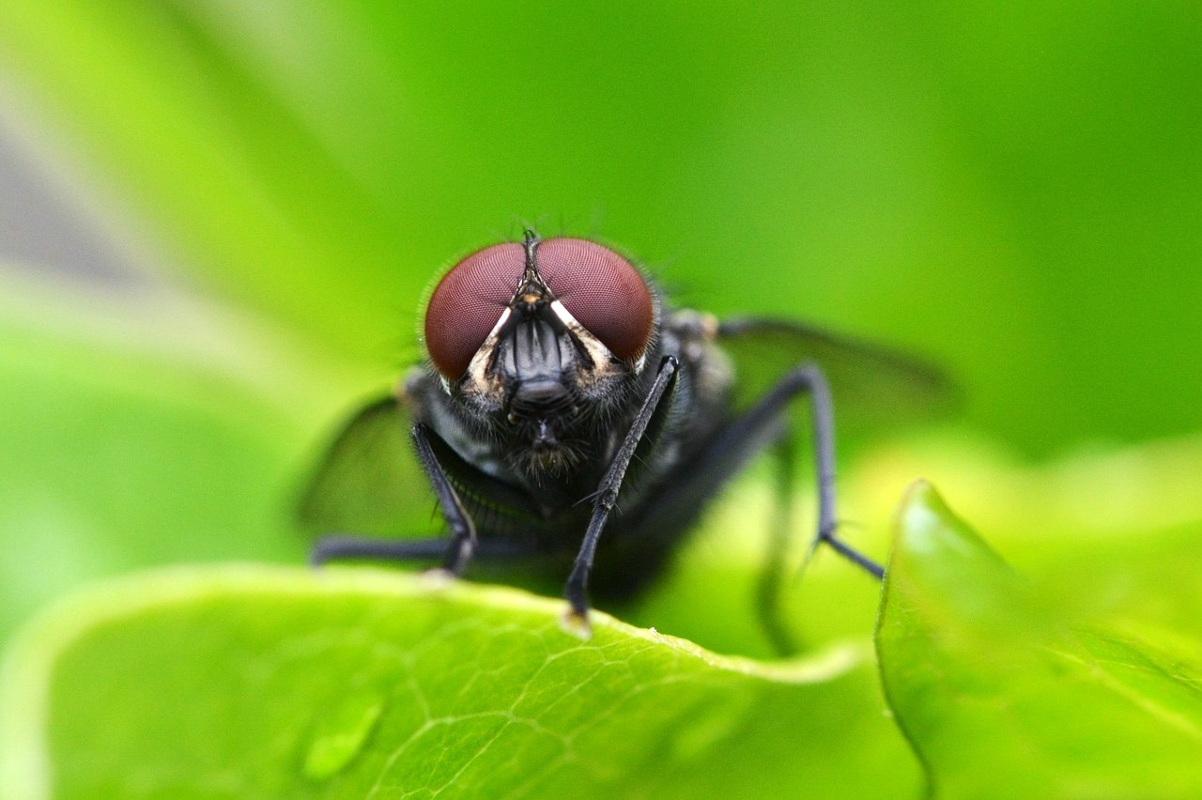
Famous statements
Socratic wisdom (p. 3)
Socrates as gadfly (p. 9-10)
The unexamined life (p. 13)
Fly image, licensed CC0 on pixabay.com
Socrates statue at the Louvre, by Derek Key,
Licensed CC BY 2.0 on Flickr

Slide 6
Intro to Epicurus & Cicero

Slide 7
Timeline
Socrates: 469-399 BCE
Plato: 427-348 BCE
Epicurus: 341-271 BCE (also lived in Greece)
Cicero: c. 106-43BCE (Roman)
Roman copy of a bust of Epicurus, after a lost Greek original, Wikimedia Commons, public domain

Slide 8
Macedonia & Greece, 336 BCE
Much of Greece
conquered by Philip of Macedon
-- Father of Alexander the Great
Map of Macedonia, Wikimedia Commons, licensed CC BY SA 2.5

Slide 9
Alexander the Great’s empire, 334-323 BCE
Macedon Empire, Wikimedia Commons, licensed CC BY SA 3.0

Slide 10
Texts we’re reading
Epicurus: “Letter to Menoeceus”: a letter by Epicurus to someone named Menoeceus, telling him how to live a good life
Epicurus: “Principal Doctrines”: a list of short sayings by Epicurus, designed to be easily remembered and put into practice
Cicero: Selections from De Finibus Book 1: a dialogue that includes multiple philosophical views prevalent in Rome at the time

