Slide 1
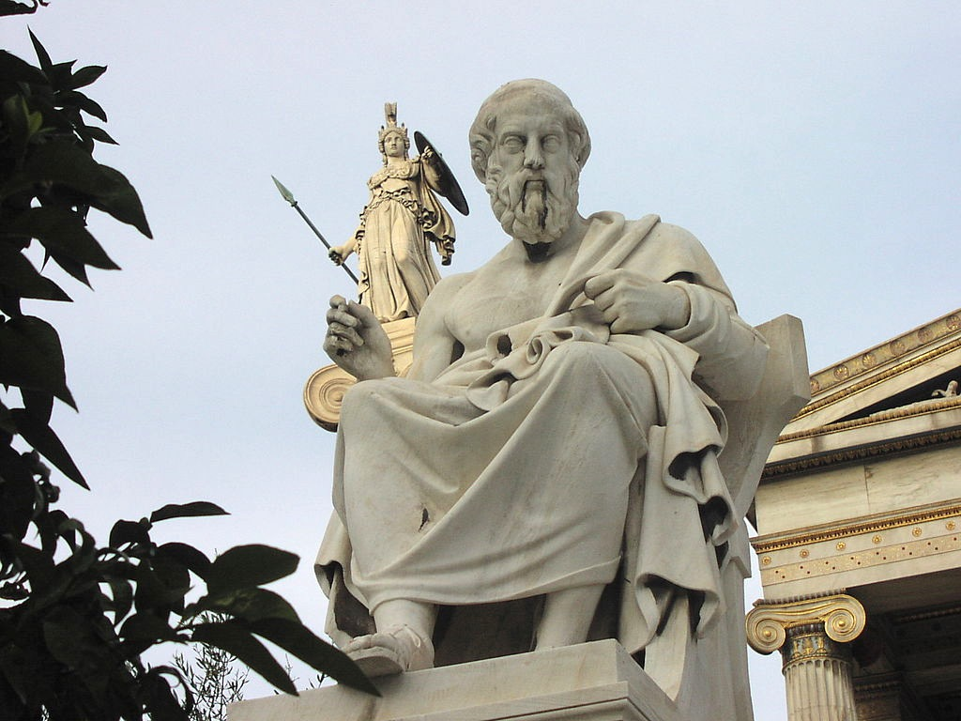
Plato, Euthyphro
PHIL 102, UBC
Christina Hendricks
Spring 2018
Athena Looking Over Plato, by Sébastian Bertrand,
Licensed CC BY 2.0 on Wikimedia Commons
Except images licensed otherwise,
this presentation is licensed CC BY 4.0

Slide 2
Your questions & thoughts
What questions do you have about this text?
How would you characterize Socrates’ method of discussion in it? How does he act?
http://is.gd/phil102_euthyphro_18
Case sensitive! Underscores!

Slide 3
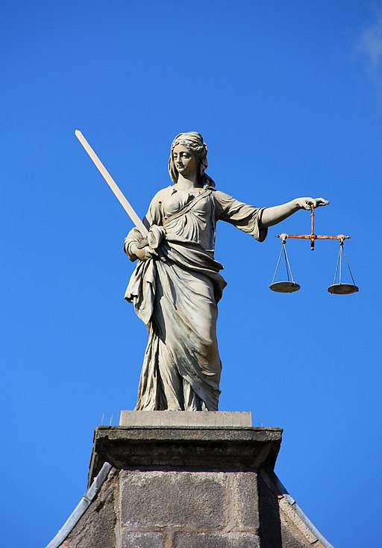
(More) background to dialogue
Who are these people?
What is the significance of the setting?
“Piety”…?
Dublin Castle Gates of Fortitude & Justice,
By J.-H. Janßen, licensed CC BY-SA 3.0

Slide 4
What kind of definition is Socrates looking for?
“Is not piety in every action always the same? And impiety, again—is it not always the opposite of piety … having … one notion which includes whatever is impious?” (p. 4)
Piety
Act 1
Act 2
Act 3

Slide 5
Group activity
In the pages assigned to your section of the room, find one definition of piety and Socrates’ criticism of it, and write down here: http://is.gd/phil102_euthyphro_18
Right side of room (when facing forward): pp. 5-7
Middle of room: pp. 8-10
Left side of room: pp. 14-16

Slide 6
Arguments
Conclusion:
A statement that one is trying to show is true, by providing reasons
Premises:
Reasons provided in order to support the conclusion, to show it is true

Slide 7
Sample arguments
Sample conclusions:
Cats are better pets than dogs
Flying is safer than driving
It makes sense for Canada to have a law against driving while under the influence of marijuana

Slide 8
Outline an argument from Euthyphro
Euthyphro’s second definition of piety:
“Piety, then, is that which is dear to the gods, and impiety is that which is not dear to them” (5).
Outline on the board Socrates’ argument for what is wrong with this…

Slide 9
E’s 3rd definition of piety
“what all the gods love is pious” (8)
Could mean two things:
(A)
Certain acts are pious
Loved by gods b/c
they are pious
Acts are pious first, then loved by gods
(B)
Gods love certain acts
These are pious b/c
loved by the gods
Gods love acts first, then they become pious

Slide 10
Pious ≠ what is dear to gods
“one is of a kind to be loved because it is loved [B], and the other is loved because it is of a kind to be loved [A]” (10).
Euthyphro provided “an attribute only, not the essence” of piety” (10).
Ancient Greek temple image licensed CC0 on pixabay.com

Slide 11
Larger implications…
Piety
Acts are pious
Gods love those acts
We can use our own reason to determine this
Criticism of “divine command theory” of ethics

