Slide 1
J.S. Mill, Utilitarianism (1863)
PHIL 102, UBC
Christina Hendricks
Except parts noted otherwise, this presentation is licensed CC-BY 4.0

Slide 2
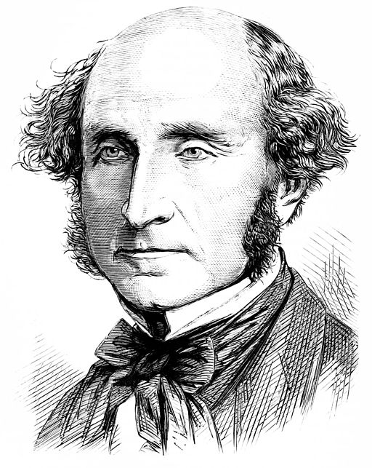
John Stuart Mill (1806-1873, England)
Mill “had a lifelong goal of reforming the world in the interest of human well-being” http://plato.stanford.edu/entries/mill
Image of JS Mill from Wikimedia Commons, public domain

Slide 3
When asking what is right/wrong morally, what to evaluate?
Person | Action | Consequences
Intention, motive | What act was done? | What resulted from the act?
Habitual disposition |  | What usually results from this kind of act?

Slide 4
Consequentialism
“whether an act is morally right depends only on consequences (as opposed to the …intrinsic nature of the act or anything that happens before the act).”
Stanford Encyclopedia of Philosophy on consequentialism:
http://plato.stanford.edu/entries/consequentialism/#ClaUti

Slide 5
Hedonistic consequentialism
Value hedonism: “all and only pleasure is intrinsically valuable and all and only pain is intrinsically disvaluable.”
-- Internet Encycl. of Philosophy: http://www.iep.utm.edu/hedonism/#SH1b
Hedonistic consequentialism: we can determine the moral value of consequences, and therefore of acts, by how much pleasure/pain is produced

Slide 6
Utilitarianism, Chpt 1
“There ought either to be some one fundamental principle or law, at the root of all morality, or if there be several, there should be a determinate order of precedence among them…” (1).
Why?
What is that principle, for Mill?

Slide 7
Greatest Happiness Principle
“actions are [morally] right in proportion as they tend to promote happiness, [morally] wrong as they tend to produce the reverse of happiness” (Mill, Chpt. 2, p. 2).
“happiness” is defined in terms of pleasure and reduction or absence of pain

Slide 8
Simplified overview of Mill’s Utilitarianism
We can judge the moral value of actions by the degree of happiness they tend to produce
Image licensed CC0 on pixabay.com

Slide 9
Groups on moral questions
Read the question assigned to your group (see instructions on the doc) and write down:
Your own answers to the question
What you think a utilitarian who agrees with Mill would say about it
https://is.gd/phil102mill

Slide 10
Support for Greatest Happiness Principle (more in Chapter IV)
“pleasure, and freedom from pain, are the only things desirable as ends” (2)
Mill on the highest good (5)
The “end of human action is necessarily also the standard of morality” (5)
action
goal
Pleasure, reduction of pain
(self & others)
goal
goal

Slide 11
Argument for using GHP for moral judgments
Pleasure is the only intrinsic value (p. 2, & chpt. IV)
So we should use happiness, measured in pleasure & reduction of pain, to evaluate actions morally
What matters in evaluating actions is their consequences for happiness
Therefore, we should use the GHP to evaluate actions morally

Slide 12
What kind of consequences?
Actual consequences?
Intended consequences?
Usual consequences for this kind of act?
Mill’s view

Slide 13
Consequences for whom?
Sentient beings (5)
Not the whole world for all actions (6)
Impartiality (5)
Crowd image licensed CC0 from pixabay.com

Slide 14
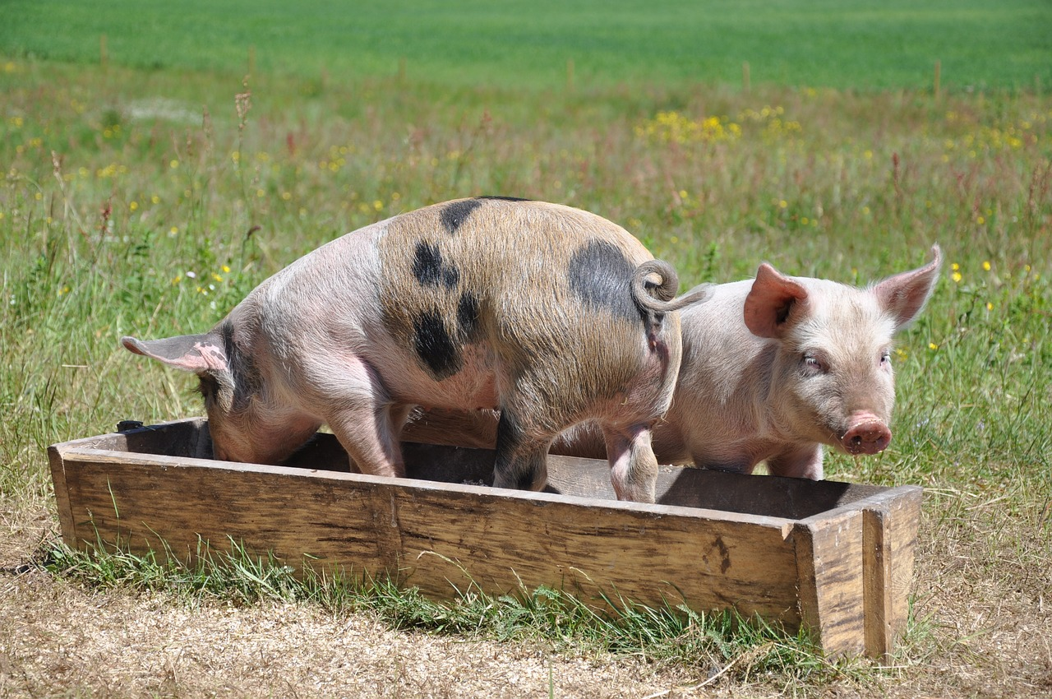
Different kinds of pleasures
Mill distinguishes between different kinds of pleasures in Chpt. 2: intellectual & sensual
Why?

Slide 15
Which kind of pleasure is best, and why?
Those who have experienced both prefer the “higher,” ”intellectual” pleasures (3-5).
Sensual pleasures
only
Sensual & intellectual
“pig satisfied”
“Socrates dissatisfied”

Slide 16
Do we have to calculate consequences each time we act?
No; we can use “subordinate principles” from the fundamental principle (GHP) (8).
Base these on experience of which kinds of actions tend to promote more/less pleasure & pain (7-8).

Slide 17
Greatest Happiness Principle (GHP): acts are morally right to the degree they tend to produce happiness
Use GHP to determine subordinate rules by asking about usual tendencies of kinds of actions
-- e.g., lying is usually wrong (7)
Act R/W?
Act R/W?
Act R/W?

Slide 18
Chpt IV: Argument for GHP
(optional reading)
Pleasure/happiness is the only thing desirable as an end goal of human action: the only intrinsically good thing
We should use the only intrinsically good thing to decide which acts are morally right/wrong (p. 5, 12)
More of what is intrinsically good is better than less
Therefore, we can judge which acts are morally right/wrong by how much happiness they produce for all involved
True?

Slide 19
Chpt V: Utilitarianism & Justice
Two questions addressed here:
What differentiates justice from the rest of morality?
2. Would utilitarianism allow people to act unjustly if that would promote more happiness overall?
Example?

Slide 20
Survey of things considered just/unjust (14-15)
Rights
Violating legal right
Violating moral right
Violating what is deserved
Breaking faith
Being partial

Slide 21
Examples
What produces happiness
Study for exams
What we should compel people to do or avoid (14)
Morality
Be generous
What people have a right to;
what protects security (16)
Avoid theft
Justice
Notes:
Example of morality

Slide 22
Question 2:
Would utilitarianism allow people to act unjustly if that would promote more happiness in a group overall?
How would Mill respond, and why?

Slide 23
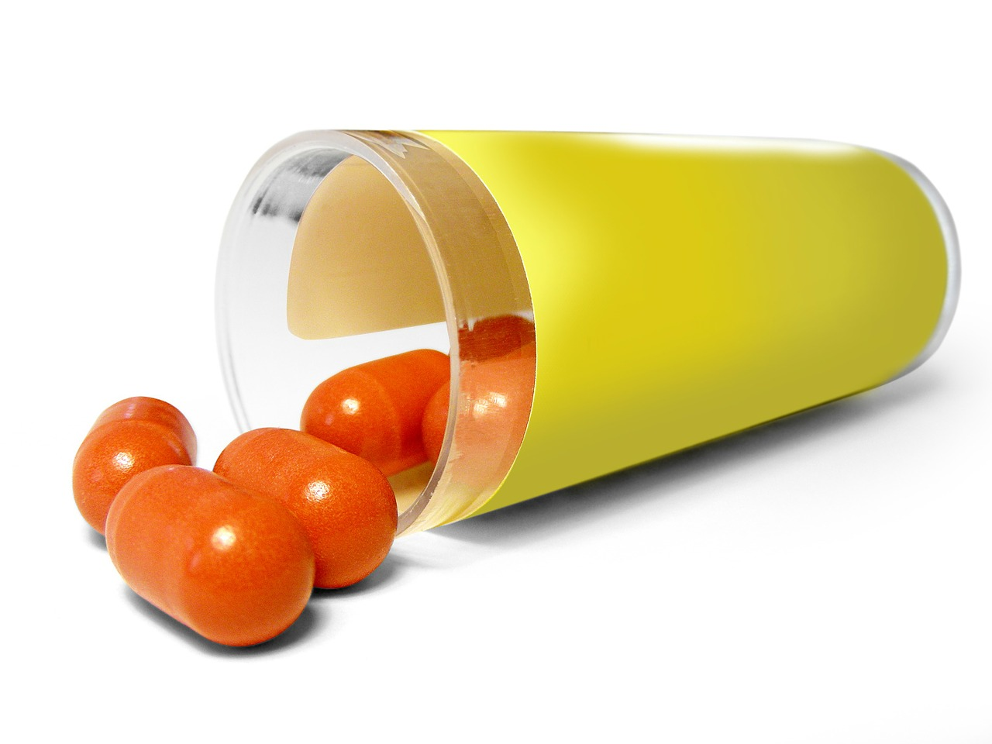
Still…
Even rules of justice can be overridden sometimes by other moral duties (17).

Slide 24
Act vs Rule utilitarianism
A distinction that didn’t exist when Mill was writing
AU: moral value of acts judged by utility of consequences of those (kinds of) acts
RU: moral value of acts judged by whether they follow rules; rules judged by utility of their consequences if generally accepted and/or followed

Slide 25
Act utilitarianism
Rule utilitarianism
Principle of utility (e.g., Mill’s GHP)
Principle of utility (e.g., Mill’s GHP)
Act R/W?
Act R/W?
Act R/W?
Rules with high obedience utility
Where does Mill’s view fit?
Act R/W?
Act R/W?
Act R/W?

Slide 26
Summary
We should judge what is morally right/wrong based on consequences: how much happiness is produced for the sentient beings involved.
Consider usual consequences for that kind of act
Consider amount of happiness (measured as pleasure) but also kind (intellectual & sensual)
Rules of justice are crucial for human happiness (so don’t violate them)

