Slide 1
A History of Existential Philosophy
Etienne Lombard
Phil 489

Slide 2
Kant
Empiricism & Idealism, Enlightenment Philosophy
“All future generations will never have any lack of new information” (pg. 127)
a priori & posteriori…. Sensibility & the Understanding (pg. 135)
Descartes
“Certainly, the idea of God, or a supremely perfect being, is one that I find within me just as surely as the idea of any shape or number (square circle). And my understanding that it belongs to his nature that he always exists is no less clear and distinct than is the case when I prove of any shape or number that some property belongs to its nature. (5th mediation)
“I call all cognition transcendental that is occupied not so much with objects but rather with our a priori concepts of objects in general” (pg. 133)

Slide 3
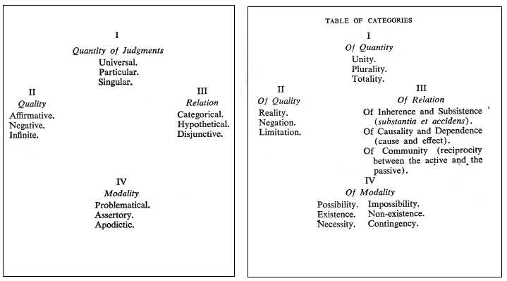
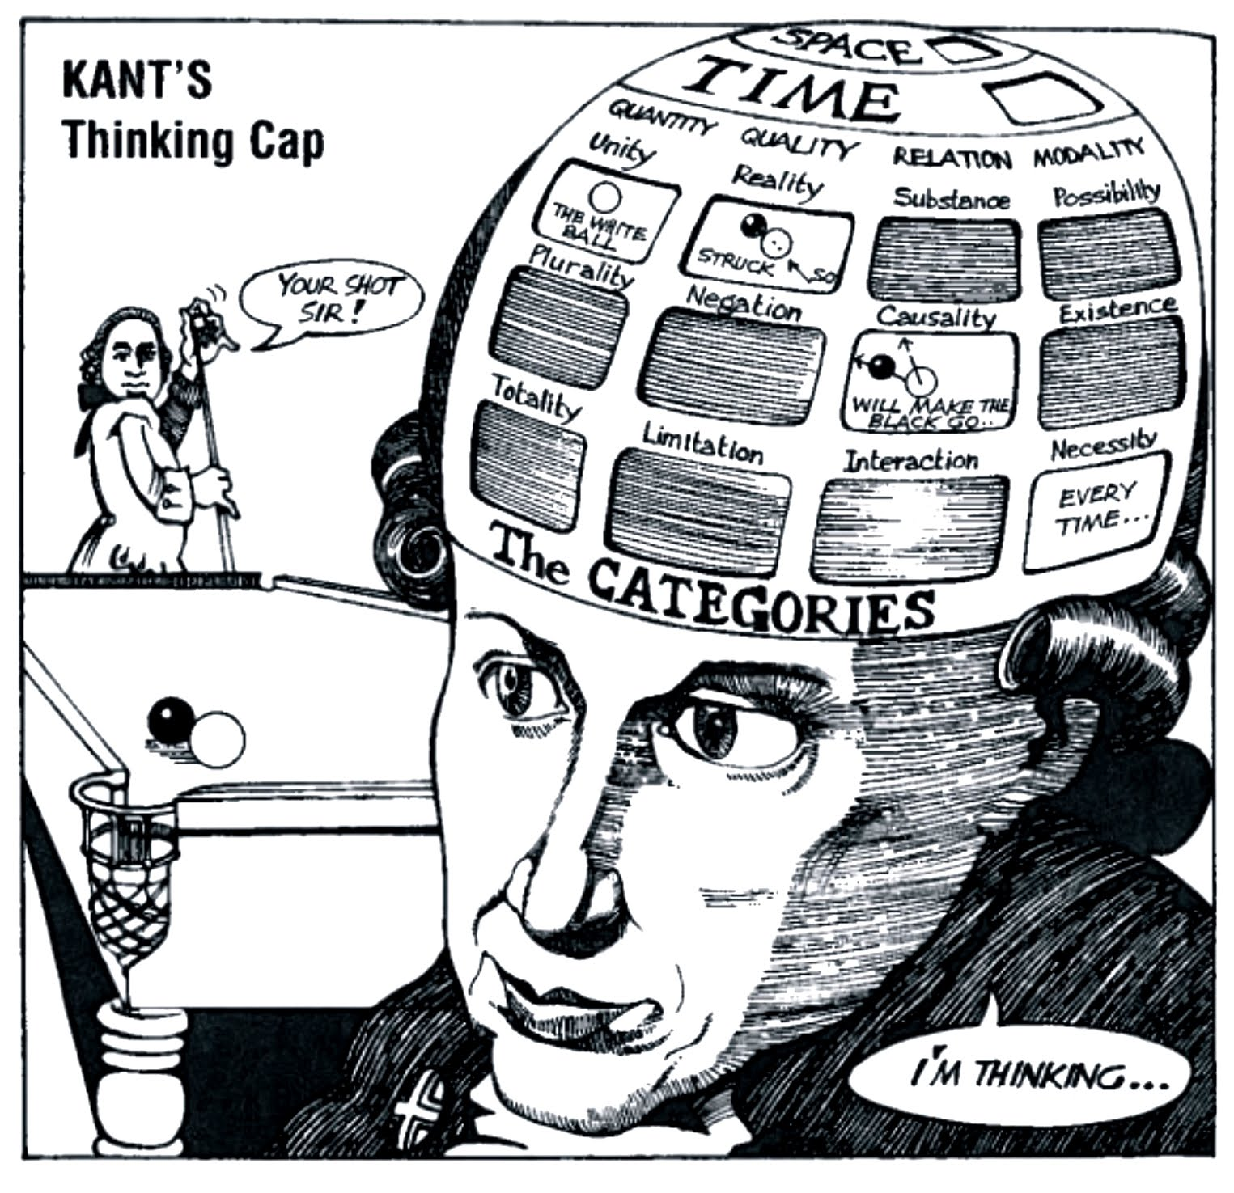
The Categories
https://kantphilosophy.files.wordpress.com/2011/07/kantcats.jpg / https://coromandal.files.wordpress.com/2011/01/kants-thinking-cap.jpg

Slide 4
Foreword to Being & Time
What is phenomenology?
Kant uses a fundamental or “pure” phenomenology
How does Heidegger’s differ?
How is being not a property of something?
- Hermeneutic ontology
- Thrown
- Pre-reflective

Slide 5
Introduction to Being & Nothingness
A breakdown of inner and out, of essence and appearance
Essence is the “principle of the series” (pg5)
The difference to Kant
Essence as inner
Appearance as given outer
Existential dialectic
Existence precedes essence…
Existence is an experience
To do philosophy, you would have to live it (Contingent)
Robert Solomon

Slide 6
Closing Notes
Sometimes philosophers complain that Sartre and Heidegger….
To do political philosophy, you should experience political stress
To do Ethic, you have to be conflicted
To understand consciousness you need to be in it
Philosophy isn’t immune from being “thrown”

