Slide 1
Simone de Beauvoir and the Ethics of Characters
Etienne Lombard - February 28th, 2018
Notes:
Themes include “the other” and “responsibility”

Slide 2
First impressions about the readings?
“In truth there is no divorce between philosophy and life”
Assuming that literature is always about life as well, what does Simone de Beauvoir’s Ethics of Ambiguity mean in terms of her fictional writing?
What does her fiction offer, that her philosophy does not?
Notes:
3 parts of the reading. Recognition, loss of recognition, reasserting it.. Destruction of the other.

Slide 3
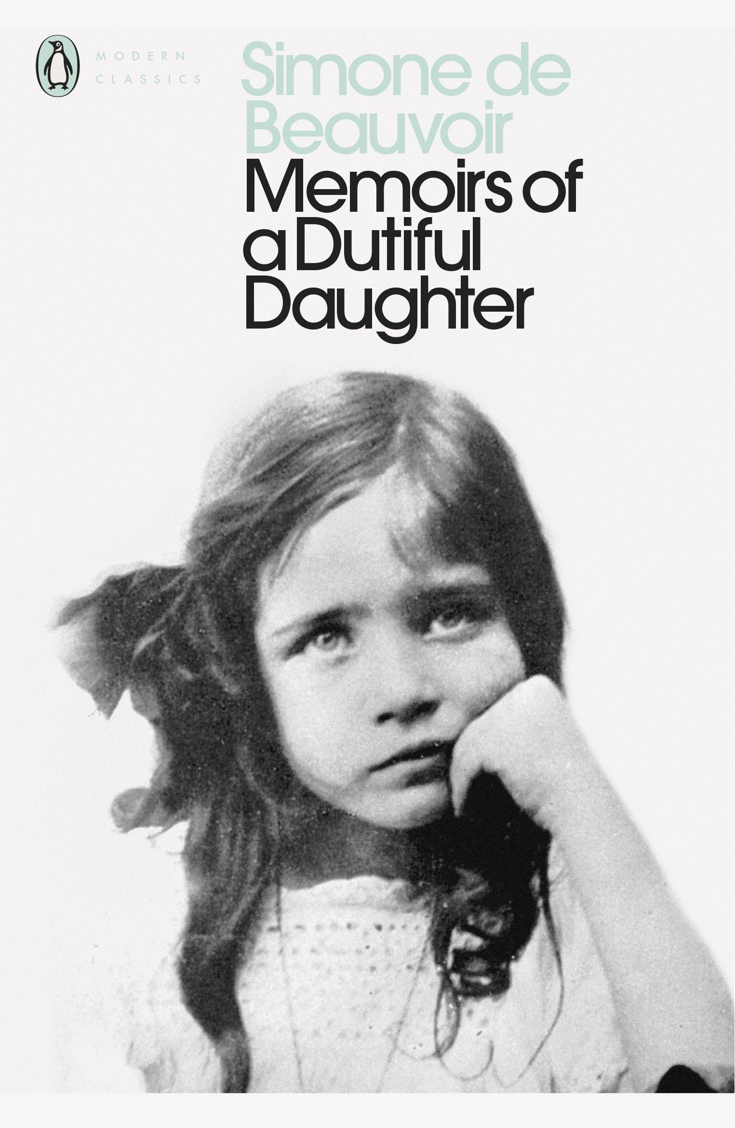
A Dutiful Daughter
Particularly bright
By her early 20s she had studied Mathematics, Literature, Language, and Philosophy, getting MA in Philosophy with a dissertation on Leibniz. She had also spent a summer specializing on Hegel.
Family Finances
Her atheistic experience as a young adolescent
Contradictory parents
Viewed herself in the literature she read: as a woman yearning for intellectual adventure.
Meeting of Sartre
A cluttered smoke filled apartment….

Slide 4
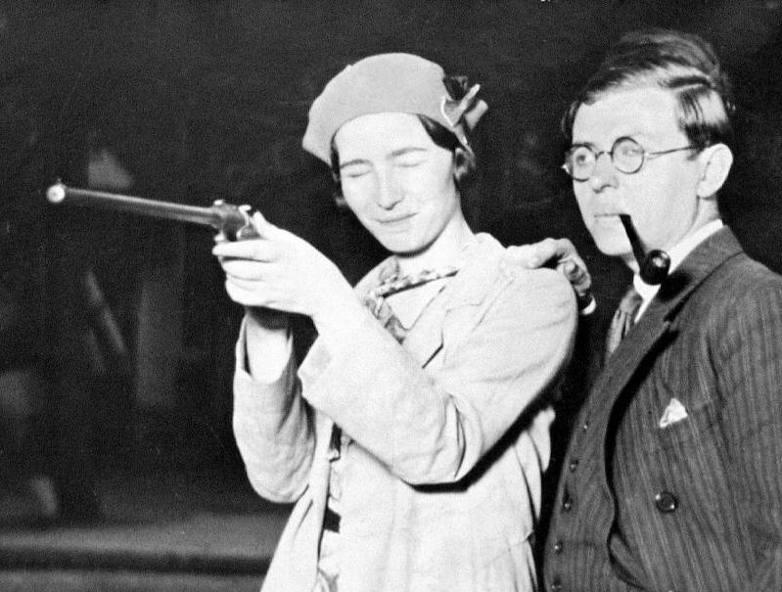
A Meeting of Minds
Met in 1929
She helped Sartre and his friends with Leibniz
Prior to meeting each other Sartre had failed his ‘agregation’ (national French philosophy exam for teaching)
Afterwards Sartre would finish top in the country, Beauvoir second behind him. In front of intellectuals such as Merleau-Ponty and Claude Levi-Strauss
They would work closely for their whole lives
Worked most closely at the founding of existential thinking, through She Came to Stay and Being and Nothingness
Were introduced to phenomenology by Sartre’s friend in 1932 drinking apricot cocktails (Existentialism and Excess Ch 7)
With Olga 1935-1936
End of WW2, founded Les Temps Modernes
Notes:
They would always live in different rooms, even if in the same buildings - Beauvoir intensely edited Nausea
- Nausea and She Came To Stay are a pair….

Slide 5
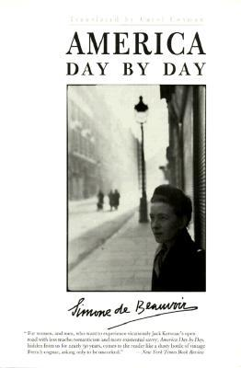
Life’s Work
School Teacher around France and in Paris in the early 1930s
They (Sartre and her) despaired that their life wasn’t going to amount to much… (Existentialism and Excess)
In the early 1940s this begins to change.
Post war
Existentialism (Pyrrhus et Cineas 1944, Ethic of Ambiguity 1947)
Feminism (The second Sex 1949, declared feminist 1972)
Autobiographical and historical non-fiction (Extensive for the rest of her life)
Existential Historian (authentic history?)
Political and social activism
Beauvoir remained somewhat behind the scenes
Progressed to become more and more marxist through her life
Notes:
She correctly identified that in A Long March China would always do what its people wanted… Tiananmen Square

Slide 6
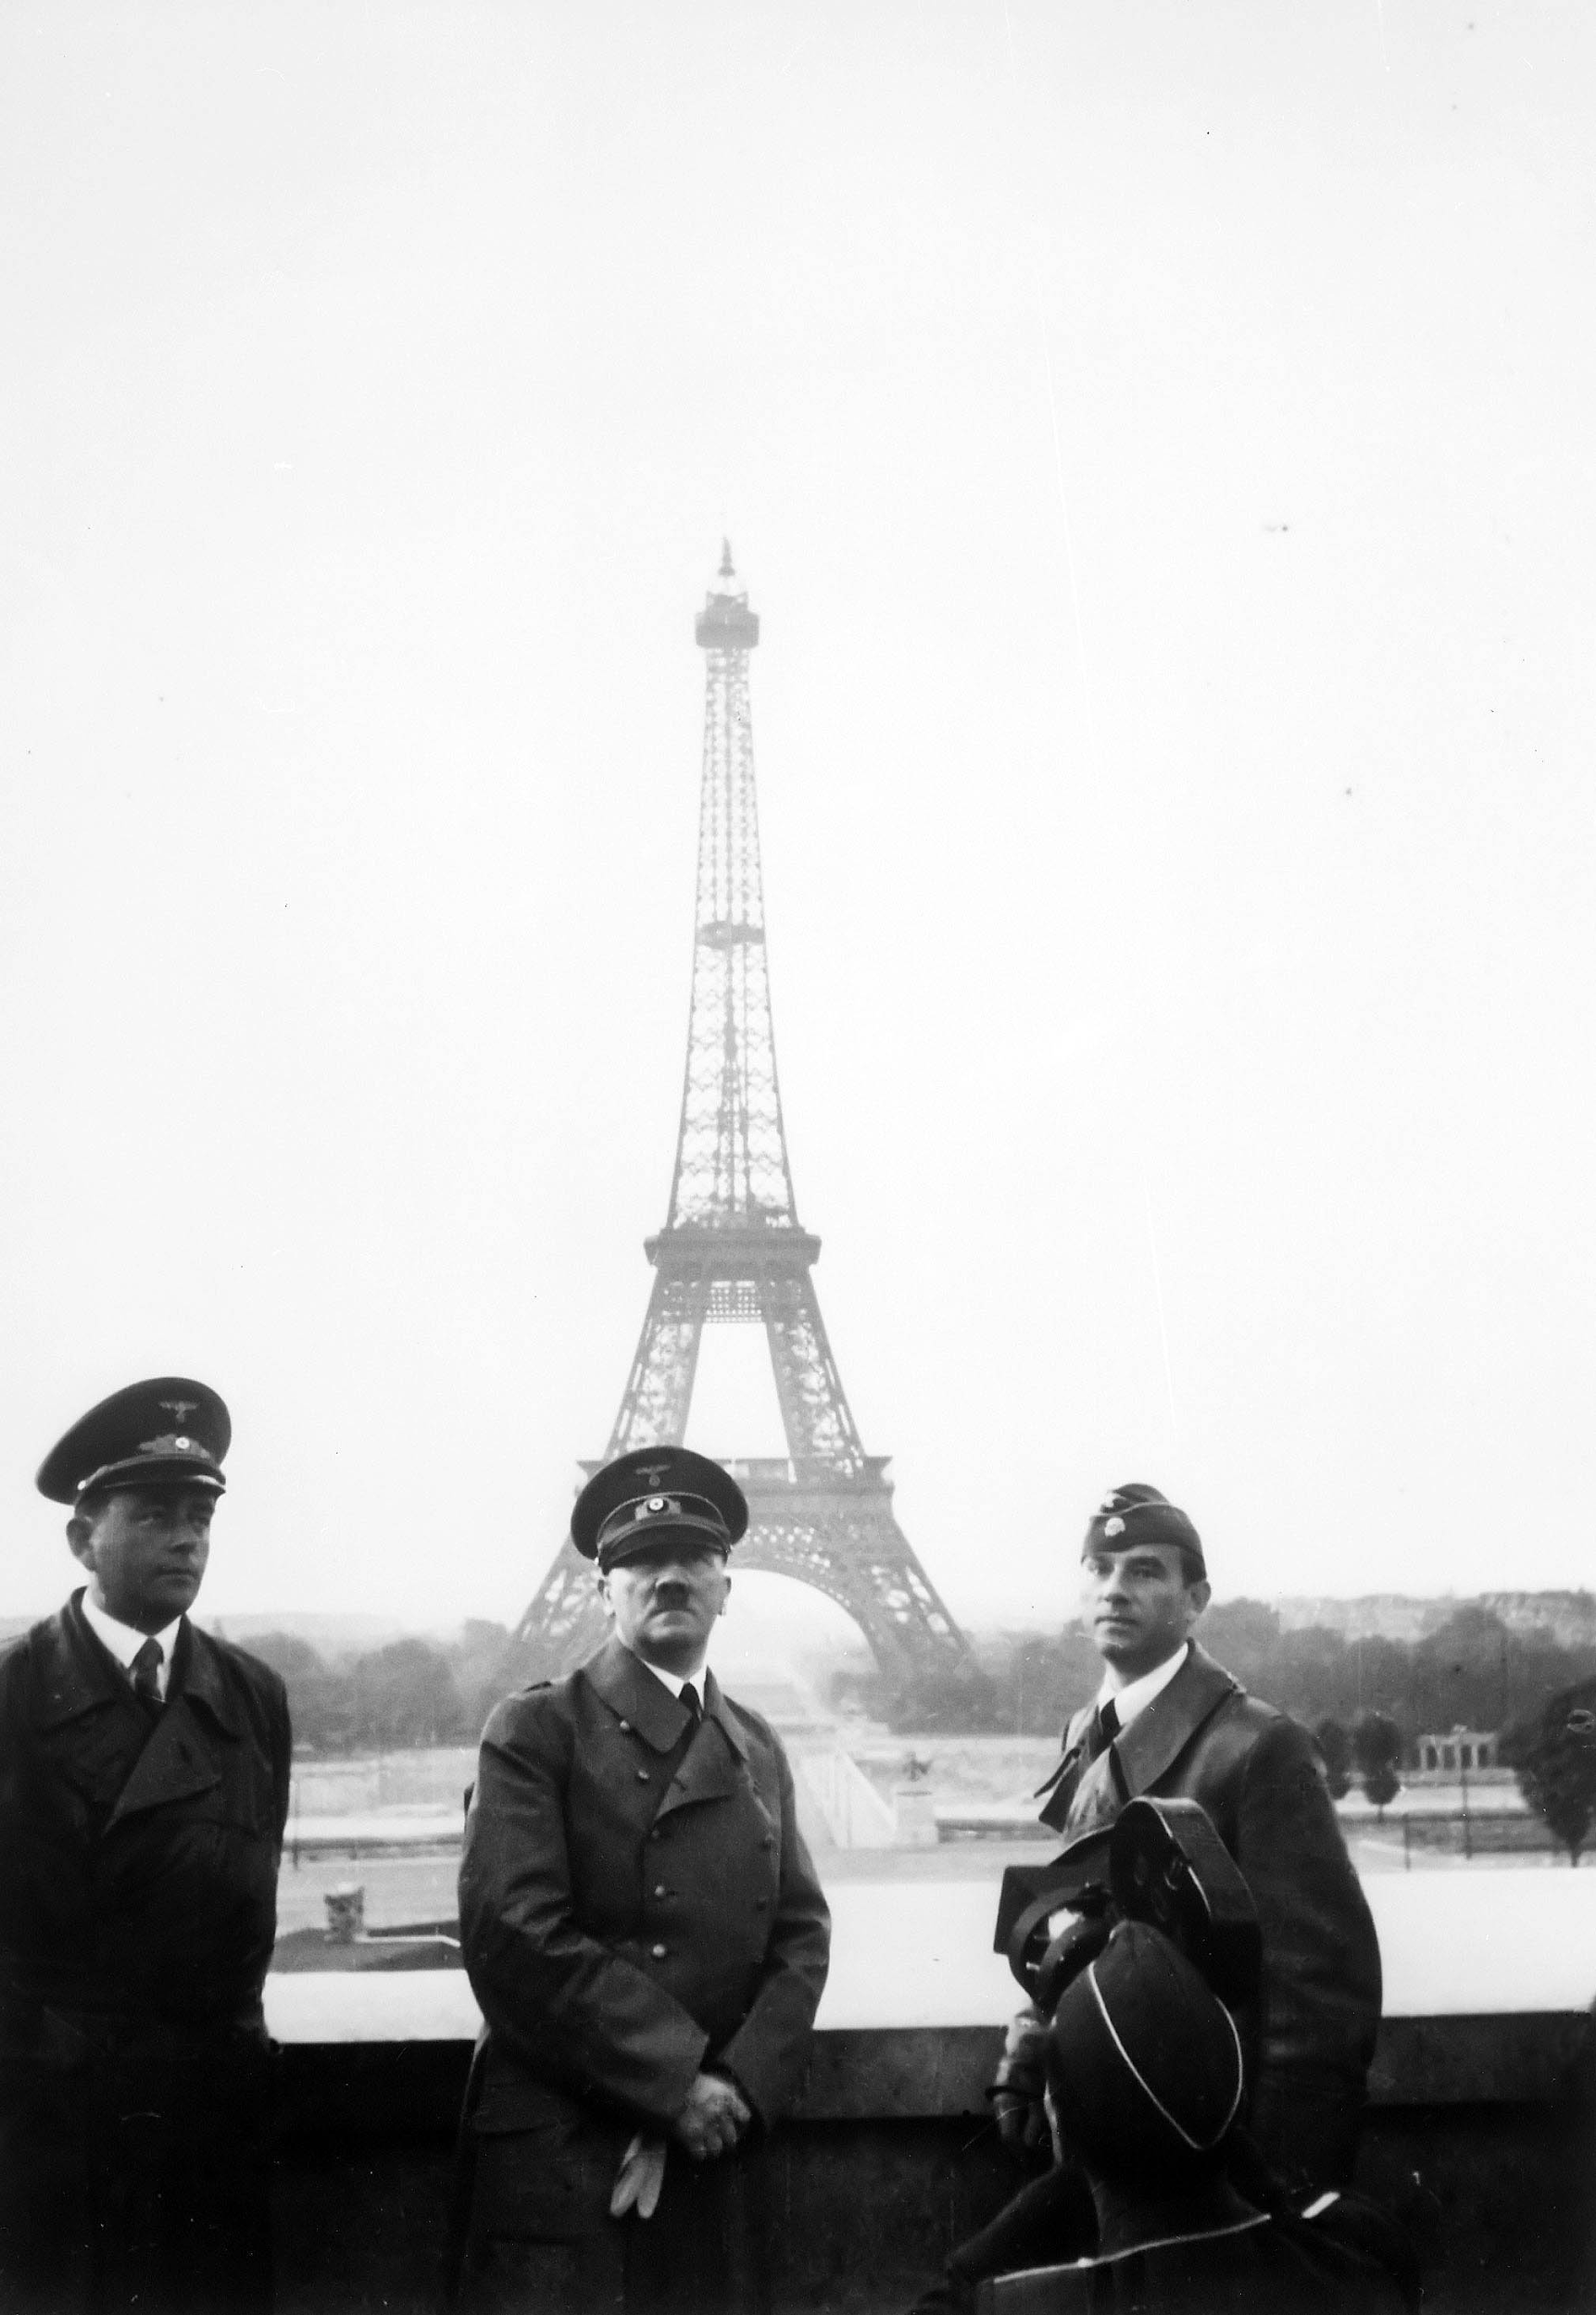
The Times
Modernism
Struggling for meaning, Einstein, Nietzsche, Kafka
It’s looking like old meta-narrative is just not holding up
People are looking for new ways to create value in the world
Political
Charles de Gaulle
PCF - Communism
World War, on the edge of She Came to Stay…
Notes:
Looking to move on and take control of their actions in the wake of the war
Sartre putting his wood rashions in the fire at the cafe during the war, they were hungry and poor during and after the war

Slide 7
She Came to Stay Rough Summary
Francoise invites Xaviere to stay with them in Paris, leaving Rouen
Xaviere and Pierre meet
Francoise starts to feel left out, losing her privileged status as having recognition from Xaviere
Xaviere becomes more and more independant
Francoise falls ill
She regains recognition when Xaviere and others attempt to care for her, eventually losing it again at the nightclub
Francoise regains recognition by sleeping with Gerbert
Xaviere accuses Francoise of knowing this, and this results in Francoise killing Xaviere, unable to deal with her any longer.
Notes:
The constant interplay of self-other, and power, leads to ambiguous act at the end

Slide 8
The Existential Phil, with the Help of the Lit.
Hegelianism as Literature…
(The Self) “Whatever face she wore tonight did not really matter: it did not exist for herself and she had a vague hope that it would be invisible to everyone else” (pg 32 She came to Stay)
(The Self) “It seems queer to think of what things are like when one isn’t there.. It’s like trying to imagine you’re dead: you can’t quite manage it, you always feel that you are somewhere in a corner, looking on” (pg5) (Thrown…)

Slide 9
The Existential Phil, with the Help of the Lit.
(The Other - without recognition) “Before Francoise very eyes, and yet apart from her, something existed like a sentence without an appeal: detached, absolute, unalterable, an alien conscience was taking up its position. It was like death, a total negation, an eternal absence, and yet, by a staggering contradiction, this abyss of nothingness could make itself present to itself and make itself fully exist for itself” (pg 292)
(The Other - with recognition) “That hotel is so dismal without you,’ said Xaviere. ‘In the old days, even when I didn’t see you for a whole day, I felt you were up there above me and I heard your step on the staircase. It’s empty now.’... ‘But I’ll be coming back,’ said Francoise, with emotion. She had never suspected that Xaviere paid such particular attention to her presence. How she had misjudged her. How she would love her, to make up for lost time! She pressed her hand and looked at her silence. Now when her temples were throbbing with fever and her throat was dry, she understood at last what miracle had entered her life. She had been slowly withering away under the protection of painstakingly built patterns and leaden-heavy thoughts, when suddenly, in a burst of purification and freedom, all this too-human world had collapsed into dust. One open childlike look from Xaviere had sufficed to destroy that prison, and now on this liberated earth a thousand marvels would come to life, thanks to this exacting young angel. A sad angel with gentle feminine hands, as red as those of a peasant woman, with lips perfumed with honey, Virginian tobacco and green tea. My precious Xaviere.” (Pg 212)

Slide 10
The Existential Phil, with the Help of the Lit.
Sartre
(Nothingness) The anguish that suddenly came over her was so violent that she wanted to scream. It was as if the world had suddenly become void; there was nothing more to fear, nor was there anything to love. There was absolutely Nothing. She was going to meet Pierre, they would exchange meaningless phrases and then they would part. If pierre’s and Xaviere’s friendship was no more that an unsubstantial mirage, then equally francoise’s and Pierre’s love did not exist. There was nothing but an infinite accumulation of meaningless moments, nothing but a chaotic seething of flesh and thought whose termination was death. (126)
More practical-theoretical nothingness….
Culture
Language
Do we understand?
Nothing
God
Self
Self

Slide 11
The Existential Phil, with the Help of the Lit.
Sartre
(Anxiety - in the other) “She watched him disappear through the small side door of the theatre and an agony of doubt assailed her. What was there beneath the phrases and gestures? ‘We are but one’. With the help of this convenient confusion she had always been relieved from worrying about Pierre - but these were only words: they were two separate persons” (pg 131)
Sartre, in Being and Nothingness gives the example of vertigo for anxiety…
That would be anxiety in the world and against one's own actions
(Facticity) (Francoise, wishing she knew how to dance) “Too late. She would never be the type of woman who had absolute mastery over her body. Whatever she might acquire today was not important: Embellishments and adornments would remain external to her. That was what to be thirty years of age really meant: a mature woman! She was forever a woman who did not know how to dance, a woman who had had only one love in her life, a woman who had not shot the Colorado Canyon by canoe, who had never crossed the tibetan plateau. These thirty years were not only a past that she dragged behind her; they had settled all about her, within her.” (pg143)

Slide 12
The Existential Phil, with the Help of the Lit.
Heidegger and Sartre… Emotion
(Mood) “It was as if the world had suddenly become void; there was nothing more to fear, nor was there anything to love. There was absolutely Nothing.” (pg 126)
Freedom as anxiety
Possibility of freedom as elation?
According to Heidegger's analysis, I am always in some mood or other. Thus say I'm depressed, such that the world opens up (is disclosed) to me as a sombre and gloomy place. I might be able to shift myself out of that mood, but only to enter a different one, say euphoria or lethargy, a mood that will open up the world to me in a different way. (SEP - On Heidegger)
Notes:
Existentialism is sometimes a bit gloomy, when freedom can be an elation rather than gloom laden.

Slide 13
The Existential Phil, with the Help of the Lit.
Heidegger and Sartre… Emotion
Xaviere and representation of pure mood, untrammelled, beastly…. (Gothic)
What did you think? Did it make sense?
(Mood of Xaviere) Well, that’s just it, her moods have a twofold basis,’ said Pierre. ‘Do you think she would have flown into a rage over a wash-basin if she hadn’t already lost control of herself? (pg 111)
Animalistic
Gothic as setting up the ambiguity of emotion and language (Holland reading)
“our emotions are not “inner states” but are ways of relating to the world; they too are “intentional.” In this case, emotive behavior involves physical changes and what he calls a quasi “magical” attempt to transform the world by changing ourselves. The person who gets “worked up” when failing to hit the golf ball or to open the jar lid, is, on Sartre's reading, “intending” a world where physiological changes “conjure up” solutions in the problematic world.” (SEP- on Sartre)
Notes:
Existentialism is sometimes a bit gloomy, when freedom can be an elation rather than gloom laden.

Slide 14
Transcendence Anxiety Freedom The Nothing
Thrown
Mood
History
Bad Faith Adventurous Man
Get authenticity (and values) if you can manage these two aspects and continuously do it! … Pg 9, 14 EoA
The Self
Through Time
Uncertainty causes the generation of self attempting to establish values in an ambiguous world (Intentionality)
Facticity Certainty Unity
Bad Faith Serious Man

Slide 15
The Existential Phil, with the Help of the Lit.
Ethics of Ambiguity
(Ambiguity) “Her life had lost all consistency of late, it had become a flacid substance into which she expected to sink at every step, and then she would get free again just enough to get stuck a little further along, with at every moment the hope of being engulfed once and for all and at every moment the hope of finding the ground suddenly solid once more.” (Pg 391)
Ambiguity towards ends…
“Freedom makes itself a lack; and it is because the latter makes itself a lack that value appears.”
Dostoevsky, “If god does not exist, everything is permitted” (pg 5)
Merely answerable to the self. Ok, why does Francoise kill Xaviere?
Notes:
“Freedom makes itself a lack; and it is because the latter makes itself a lack that value appears.” (EoA 14)
Causes being-for-itself, rather than being-in-itself

Slide 16
Life and Philosophy in Literature
Her Literature is fundamentally about this ambiguity
[If] in advance [the author] predicts the conclusions to which his readers must come, if he indiscreetly pressures the reader into adhering to pre-established theses, if he only allows him an illusion of freedom, then the work of fiction is only an incongruous mystification. The novel is endowed with value and dignity only if it constitutes a living discovery for the author as for the reader. (Literature and metaphysics, SB)
Her literature is not just a stool for her philosophy
We are meant to engage with ourselves in the literature, as well as the author

Slide 17
Life and Philosophy in Literature
How can we have moral feelings about the characters of our novels?
Because, as ethics of ambiguity points out, ethics is all about our character, our personal goals, our conception of ourselves, and ultimately how that breaks down is fundamentally the anxiety which is generation of values in the story!
It’s a literary Ethics!
Conflict fundamentally is why life is interesting at all…. (The creation of values)
Ethics is always about who we are, right now. Art is the world of throwing ourselves into that ‘now’.
Why does fictional Beauvoir kill fictional Olga?
Can there still be ambiguity even if you know the end of the book?
Notes:
A phenomenological starting point for looking at our lives

Slide 18
Final Notes
“[W]hy construct a fictional apparatus around ideas that one could express more economically and clearly in more direct language? The novel is justified only if it is a mode of communication irreducible to any other” (M&L)
Reason for the existence of the humanities!

