Slide 1
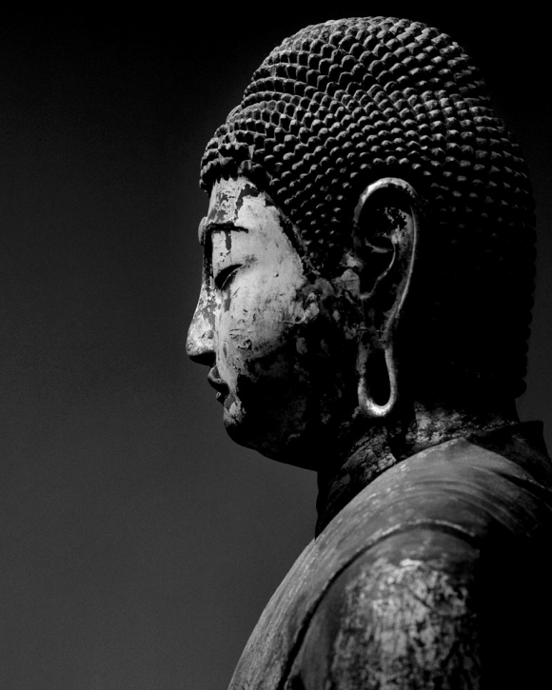
Digital Humanities in East Asia
Presentation at the
the Digital Humanities Mixer
August 11, 2016
Allan Cho
Irving K. Barber Learning Centre
University of British Columbia Library

Slide 2
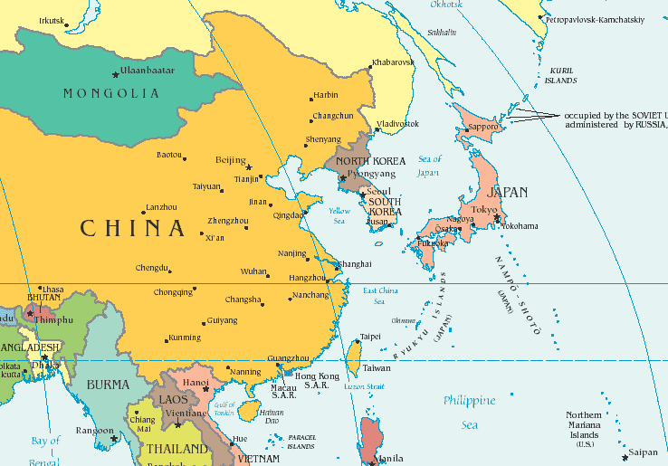
Outline of presentation (30 minutes)
Context in Hong Kong
Martial Arts Living Archive
Hong Kong Memory Project
MemoryHunt
DH in Korea – “West and the Rest”
Notes:
2

Slide 3
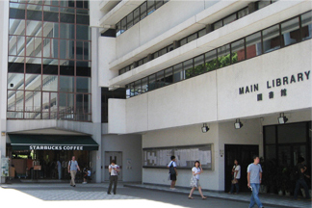
DH in Hong Kong’s academic libraries
Joint University Librarians Advisory Committee (eight libraries)
No institution has a dedicated centre that supports DH or digital scholarship
Ad hoc basis - it provides some level of institutional support for DH, but only if the need arises
Notes:
Emphasis is in intra-institutional collaboration & partnerships - takes a reactive approach to DH
3

Slide 4
Martial Arts Living Archive at City University of Hong Kong (CityU)

Slide 5
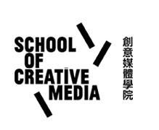
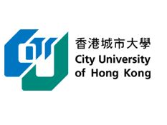
City University of Hong Kong
Jeffrey Shaw, Chair Professor of Media Art and Dean of the School of Creative Media
Leading figure in new media art since the 1960's in Europe
Documenting, representing, and re-interpreting intangible cultural heritage
--> utilizing the technical resources at CityU.
Notes:
Pioneered and set benchmarks for the creative use of digital media technologies in the fields of virtual and augmented reality, immersive visualization environments, navigable cinematic systems and interactive

Slide 6
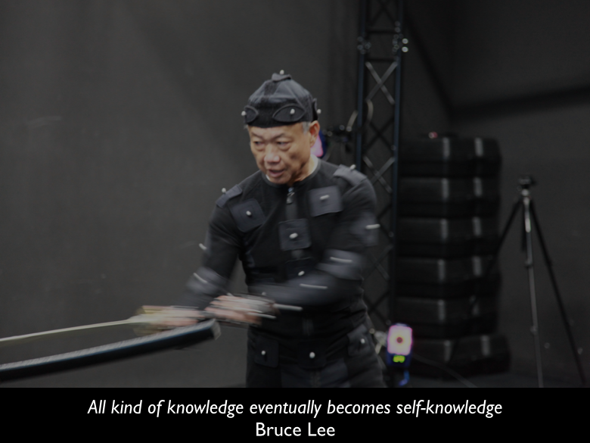
Martial Arts Living Archive at CityU HK
It’s the first ever comprehensive and precise documentation of Hong Kong’s Kung Fu traditions.
"For the majority of styles, important masters are still around, [but] they are ageing. A lot of them are in their 60s, 70s and 80s. A few passed away in the past year. There's an urgency to do it now." (Hing Chao)
Notes:
6

Slide 7
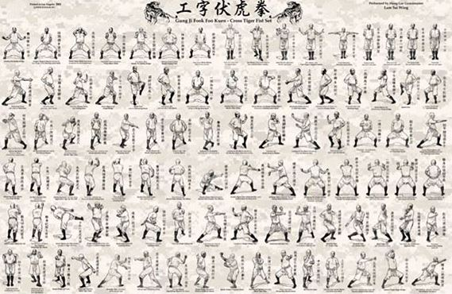
Traditional Documentation of Form
Notes:
Different martial art styles/ schools make use of various models of body mechanics which in the past was mostly orally transmitted (master-to-disciple)
7

Slide 8
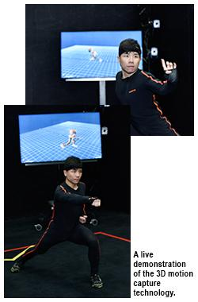
Capturing Knowledge
Data Capture Types through Motion Capture Technology
3D motion data
Stereoscopic video (panoptic from six points of view)
Panoramic video
Stills photography
HD high-speed video sequences
Spatial audio
Notes:
8

Slide 9
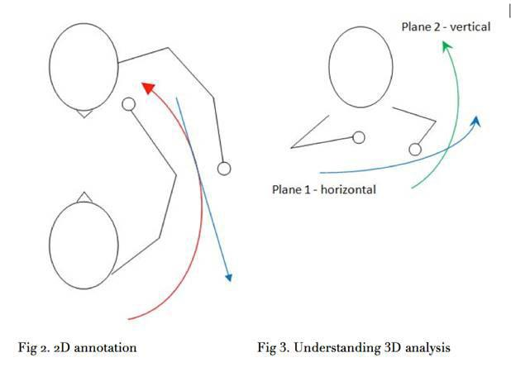
Knowledge through Data Manipulation
Using high-definition and high-speed 3D video capture of sequences, the activity of annotation itself includes such physical data for: momentum and acceleration.
4D analysis of Kung Fu also includes time.
Archive provides benchmarks in the formation of extensive analytics tools that has been done with the Frankfurt Ballet
Notes:
Citations
Carter, T. M., & Seaman, P. (2011). The management and support of outreach in academic libraries. Reference and User Services Quarterly,51(2), 163-171.
9

Slide 10
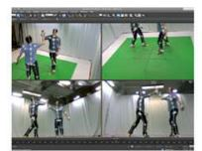
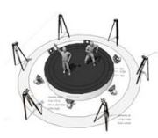
Work Done So Far
Lam Family Hung Kuen
Lau Gar Kuen 劉家拳
Monkey Stick 行者棒
Gung Gee Fok Fu Kuen 工字伏虎拳
Wing Chun
Siu Lim Tou 小念頭 performed by Jerry Yeung
Cum Kiu 尋橋 performed
Biu Zi 標指 performed
Ci Sau performed
Bak Zam Dou 八斬刀 performed by Kong Chi Keung 江志強
Fujian Yongchun White Crane
Sam Zin 三戰 performed
Kok Zin 角戰
Tin Dei Jan Zin天地人戰
Notes:
Citations
Carter, T. M., & Seaman, P. (2011). The management and support of outreach in academic libraries. Reference and User Services Quarterly,51(2), 163-171.
10

Slide 11
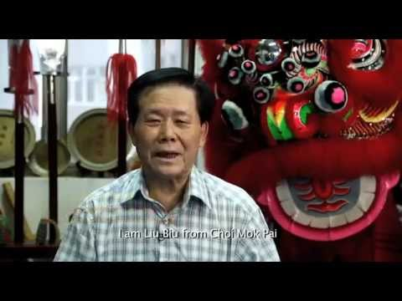
What is Being Documented?
Captured for the archive using state-of-the-art 3D motion capture technology developed by CityU’s Centre for Applied Computing and Interactive Media (ACIM).
All video and audio media is tagged along the time code from the outset to enable a finely tuned search among the huge datasets archived through various data capture processes.
"Speed, torque, torsion and force can be captured as physical data, not only for mere documentation but also future scientific research." - Jeffrey Shaw, HK CityU
Notes:
different martial art styles/ schools make use of different models of body mechanics which until now are mostly orally transmitted, often in a language crouched in esoteric terms.
11

Slide 12
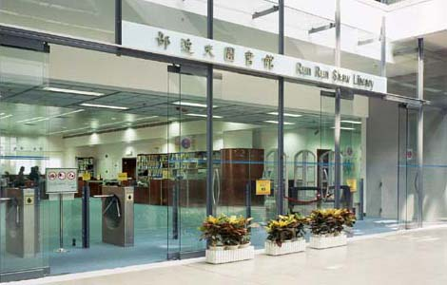
What About the Library’s Role?
The archive database is structured on multiple media types and ingests information based on the complete lexicon of Hong Kong kung fu.
A controlled keyword vocabulary (the Hong Kong martial arts thesaurus) and item-level descriptions define the fields for data entry.
Notes:
The International Guoshu Association (IGA) collaborates with the City University of Hong Kong (CUHK) to build The Hong Kong Martial Arts Living Archive . Now, with the help of FringeBacker on this online platform
archive will become a source for exhibitions and installations that promote rich cultural traditions,

Slide 13
Hong Kong History Memory Project
(https://www.hkmemory.hk/)
Notes:
Project initiated by Dr Patrick Ho, former Secretary for Home Affairs of the Government, in 2002
Leisure and Cultural Services Department (LCSD), the government department which provides leisure and cultural activities for the people of Hong Kong
It operates the Hong Kong Public Libraries (76 libraries), Hong Kong Public Museum (18 museums), civic centres, parks, performing venues, etc. all over Hong Kong
13

Slide 14
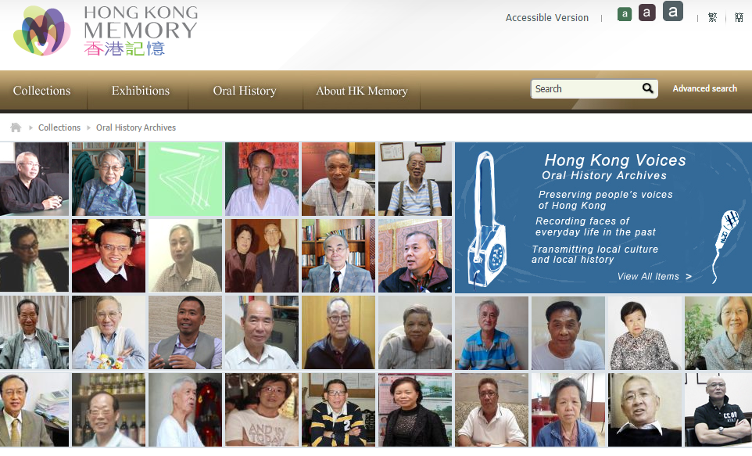
Major Components of Memory Project
Collections
Online Exhibitions
Oral History
Community Outreach

Notes:
14

Slide 15
Similar to the Chinese Canadian Stories project
Notes:
15

Slide 16
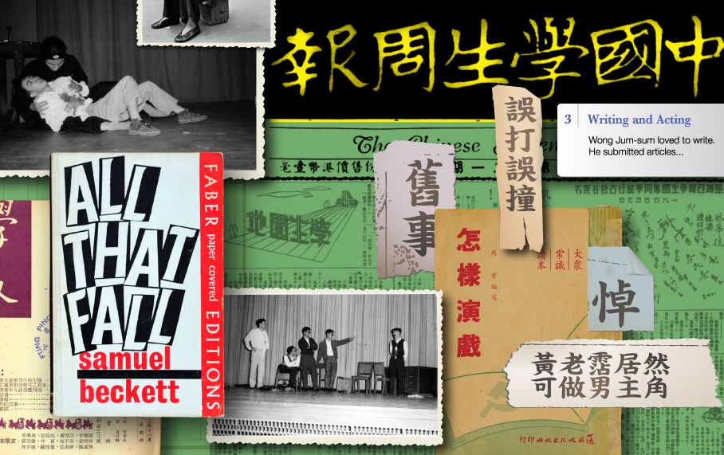
What Is It?
Hong Kong Memory (HKM) is a multi-media web site that gives free and open access to digitized materials on Hong Kong’s history, culture and heritage.
The materials include text documents, photographs, posters, sound recordings, motion pictures and videos.
Hong Kong Memory Website has been handed over to the Leisure and Cultural Services Department, the Government of the Hong Kong Special Administrative Region for continuous maintenance and development.
Notes:
Mostly full-time contract staff
13 full-time staff are now working on the project, most of them in content development
Design work mostly outsourced
High staff turnover
A key concern of the Government
Engaged a legal consultant to compile a set of copyright guidelines, based on copyright issues that may be encountered by the project
License agreement that allows the transfer of copyrights from the University to the Government
16

Slide 17
Copyright Challenge
A key concern from the HK Government
Engaged a legal consultant to compile a set of copyright guidelines, based on copyright issues that may be encountered by the project
License agreement that allows the transfer of copyrights from Hong Kong University (HKU) to the Government
Copyright image. Used under Creative Commons Attribution-NonCommercial-ShareAlike 2.0 Generic license

Slide 18
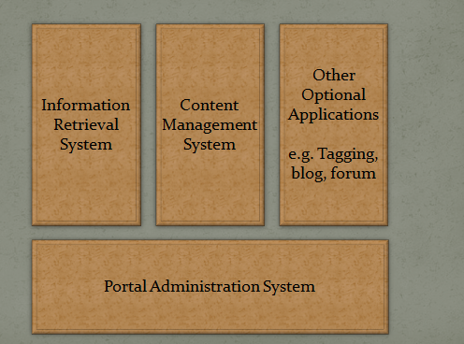
Web Platform & Technology
Technology was outsourced
Developed by Beijing company TRS Information Technology Limited
Hardware from IBM

Notes:
12 production servers, 1 backup server and a testing and development server
18

Slide 19
Community Engagement Component
School Memory Programme, to promote the idea of “learning history by doing history” to secondary school students, by providing them training in collecting, compiling, organizing and sharing school memories

Ordinary citizens record and share their real life history through digital technology by providing a simple and user-friendly digital tools and training workshops

Slide 20
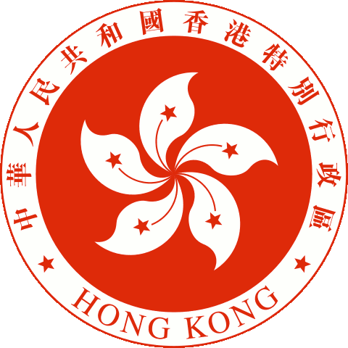
Partnerships
Hong Kong Government
Hong Kong Jockey Club
Centre of Asian Studies
The University of Hong Kong
University of Hong Kong Libraries
HKU Library has contributed to this project in numerous ways including the supply of content, technological support and staff expertise.

Slide 21
Memory Hunt in Japan http://dsr.nii.ac.jp/memory-hunting/
Notes:
The camera app is based on Open Camera

Slide 22
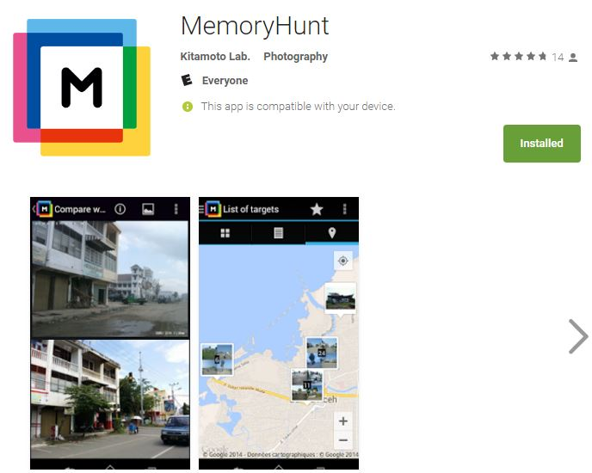
MemoryHunt
MemoryHunt is an app that enables users to find places using photographs “overlayed” on the viewfinder of the camera.
It was originally developed to find places where old photographs were taken.
Developed by the Center for Integrated Area Studies, Kyoto University

Slide 23
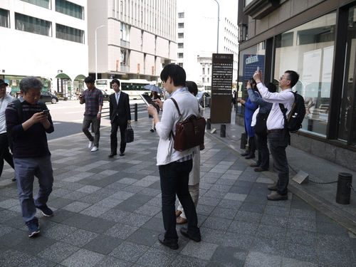
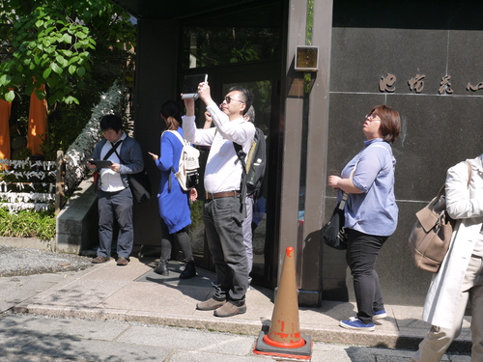
Kyoto’s Memory Hunt
Research was carried out by Prof. Nishi Yoshimi and Prof. Yamamoto Hiroyuki at Kyoto University
Photo metadata (such as latitude, longitude, time) is recorded during photo shoots
The app is a tool for recording new and current locations and landscapes

Slide 24
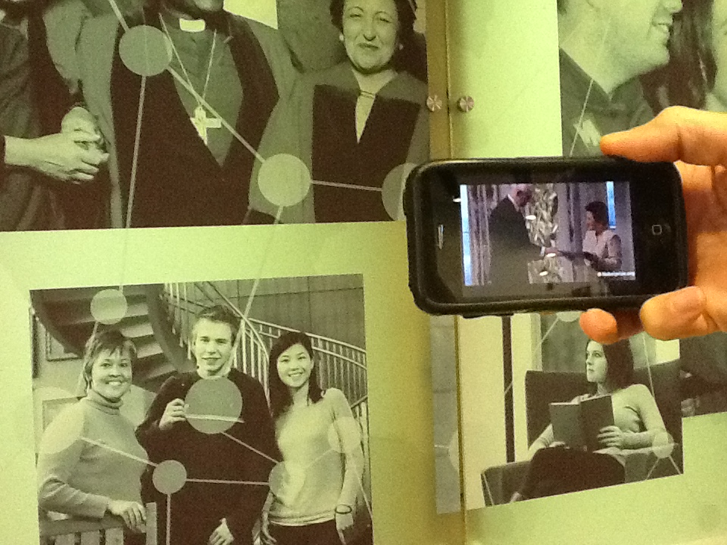
Similar to the Virtual Museum Project

Slide 25
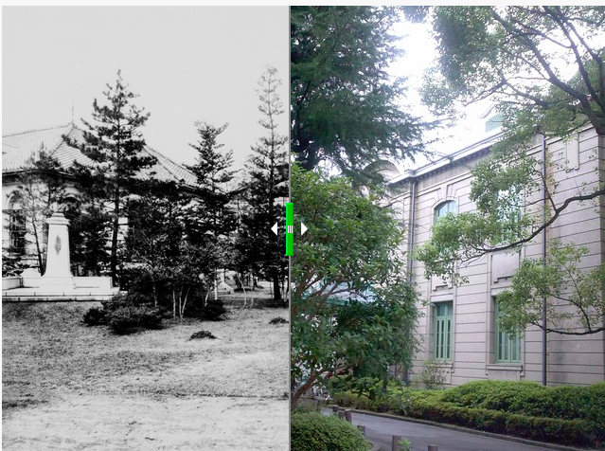
Memory Hunt
Notes:
Here, comparison with “augmented reality” (AR) helps understanding the feature of the app. First, AR shows information (such as old photographs) as an overlay in the real space to enhance the interpretation of the present landscape. On the other hand, our app uses the present landscape to enhance the interpretation of old photographs, which can be regarded as “augmented photography” (AP). Second, AP can be used as a preparation step for AR, because the app can record metadata about the location and the direction of the camera. This metadata can be directly incorporated into AR, so Memory Hunting can be considered as a complementary tool to AR.

Slide 26
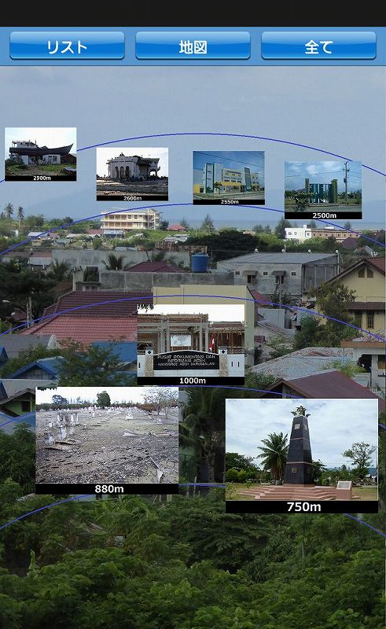
Disaster Reconstruction
Records the change of landscape in disaster affected areas. Overlay of photographs with the current landscape to capture details of change, while capturing information of disaster areas
Photographic tool for recording the reconstruction of the disaster areas

Slide 27
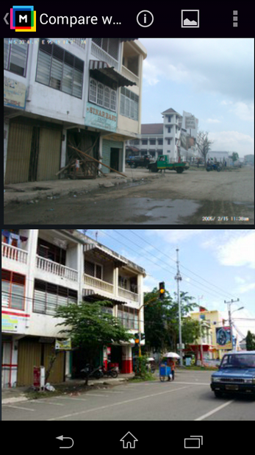
Disaster Reconstruction
1. Indonesia of Sumatra island, Sumatra earthquake tsunami (the Indian Ocean tsunami) is generated in December 2004
2. March 11, 2011 Great East Japan Earthquake

Slide 28
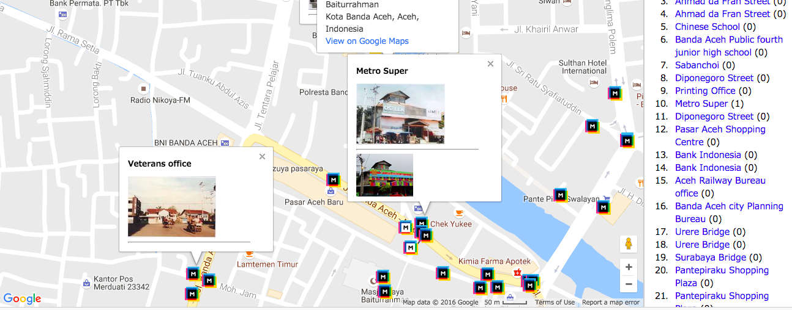
Disaster Reconstruction (Try Link)

Slide 29
DH in South Korea
Humanities departments in South Korea have dealt with cutbacks or been converted into a career-oriented ‘contents’ department
These measures are consequences of a pro-business, conservative government agenda
‘The crisis of humanities’ involves not the lack of funds ‒ as is the case in the United States
Rather, it’s a “disregard for humanities & liberal arts”
Notes:
humanities programs in South Korea and overseas Korean studies should not let the government of South Korea unilaterally determine the definition and direction of the digital turn in the humanities as a site for training students for the usd $2 trillion global cultural contents industry
29

Slide 30
References
Sidorko, P. E., & Yang, T. T. (2011). Knowledge exchange and community engagement: an academic library perspective. Library Management, 32(6/7), 385-397.
Cha, Javier. (2015). "Digital/Humanities: New Media and Old Ways in South Korea.“ Asiascape.
Mullaney, Thomas S. (2012). "The moveable typewriter: How Chinese typists developed predictive text during the height of Maoism." Technology and Culture. 53(4), 777-814.
Kitamoto, Asanobu. (2014). "Memory Hunting: A Mobile App for Collecting the Location Metadata of Old Photographs", Fourth Annual Conference of the Japanese Association for Digital Humanities (JADH2014), pp. 42-43.
Notes:
30

Slide 31
Questions?
allan.cho@ubc.ca
Twitter @allancho

