Slide 2
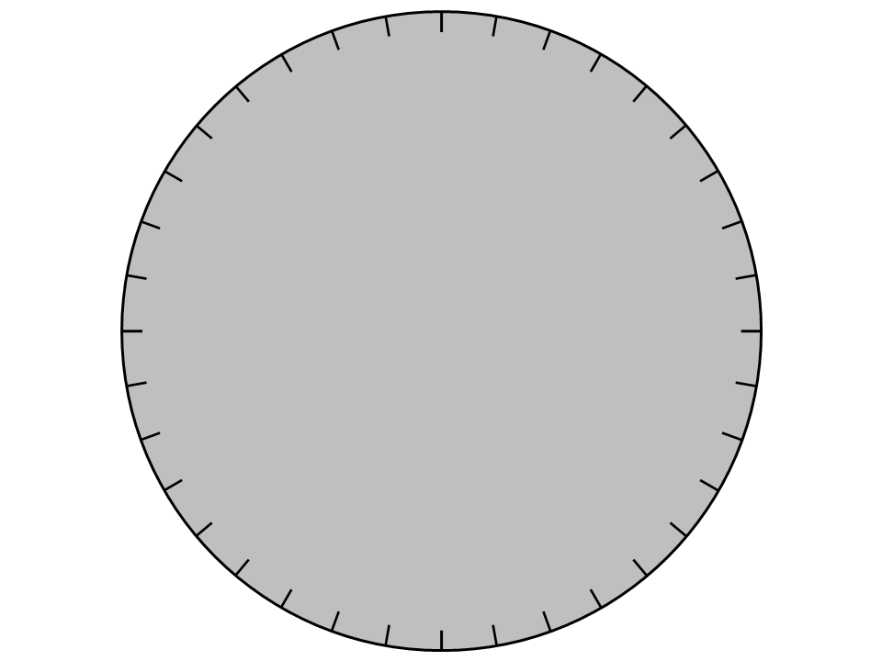

Slide 3
90°
80°
70°
60°
50°
40°
30°
E
20°
30°
20°
10°
10°
20°
30°
50°
40°
40°
50°
10°
N
S
50°
40°
40°
50°
30°
20°
10°
W
10°
20°
30°

Slide 4
90°
80°
70°
60°
50°
40°
30°
E
20°
30°
20°
10°
10°
20°
30°
50°
40°
40°
50°
10°
N
S
50°
40°
40°
50°
30°
20°
10°
W
10°
20°
30°

Slide 5
graphics for solstices, equinoxes

Slide 6
Polaris
90°
80°
70°
60°
50°
40°
30°
E
20°
30°
20°
10°
10°
20°
30°
50°
40°
40°
50°
10°
N
S
50°
40°
40°
50°
30°
20°
10°
W
10°
20°
30°

Slide 7
Polaris
90°
80°
noon
70°
60°
Jun 20
50°
noon
40°
30°
6 :08 a.m. Mar 20
20°
4 a.m.
20°
10°
E
10°
20°
40°
30°
30°
40°
50°
50°
10°
N
S
8 p.m.
6 :08 p.m. Mar 20
50°
40°
40°
50°
30°
20°
10°
W
10°
20°
30°

Slide 8
Polaris
90°
80°
70°
60°
50°
noon
40°
30°
Sep 22
5:52 a.m.
noon
E
Dec 22
20°
30°
20°
10°
10°
20°
30°
8 a.m.
50°
40°
40°
50°
10°
N
S
Sep 22
5:52 p.m.
4 p.m.
50°
40°
40°
50°
30°
20°
10°
W
10°
20°
30°

Slide 9
Polaris
90°
80°
noon
70°
60°
Jun 20
50°
noon
40°
30°
Sep 22
5:52 a.m.
noon
6 :08 a.m. Mar 20
20°
4 a.m.
10°
E
10°
Dec 22
30°
20°
20°
30°
8 a.m.
50°
40°
40°
50°
10°
N
S
8 p.m.
Sep 22
5:52 p.m.
6 :08 p.m. Mar 20
4 p.m.
50°
40°
40°
50°
30°
20°
10°
W
10°
20°
30°

