Slide 1
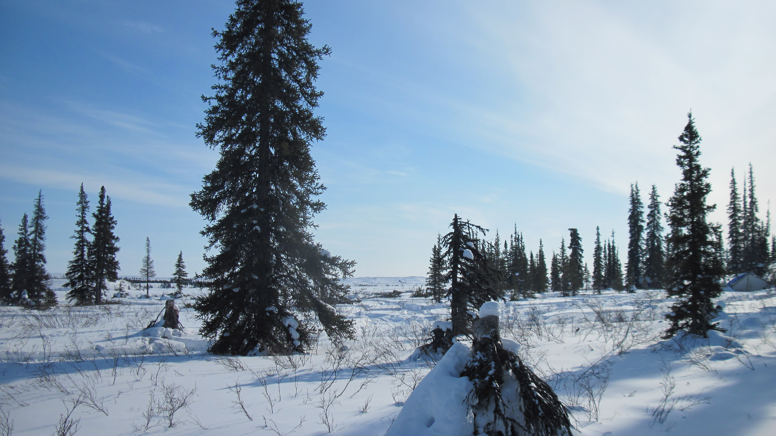
Lutsel K’e Dene School
L4L Report
2014

Slide 2
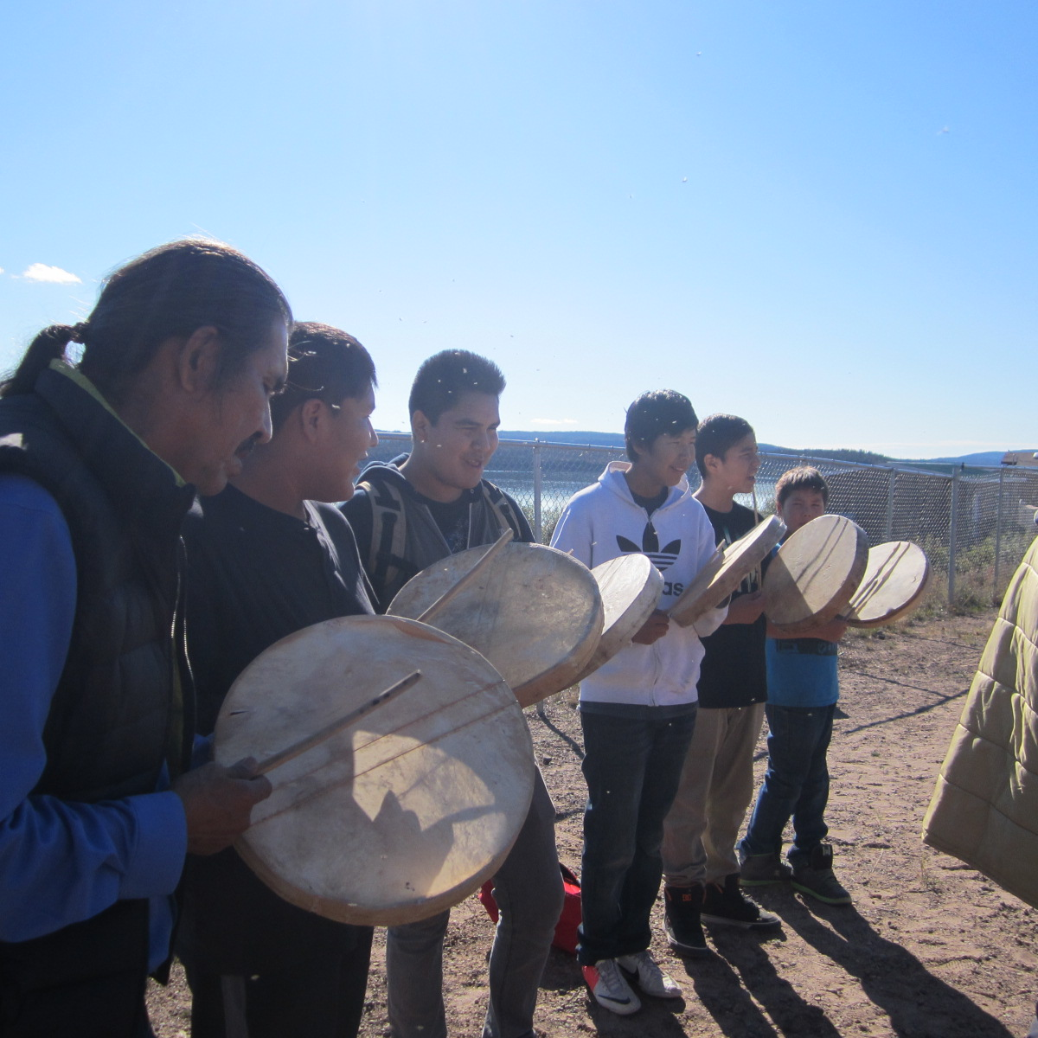
Education & Community
Carpentry & Trades
Literacy & Numeracy
Social Responsibility
Aboriginal Language & Culture
Staff Collaboration
Parent Engagement

Slide 3
Our specific goals this year:
Increase Math & Literacy levels (Gr. 9)
Increase average Attendance
Increase Parent Engagement
Cultivate more pride and spirit in the students and the school
Implement the new Kindergarten Curriculum
Complete the ELOs for all core subjects

Slide 4
2014 Targets

Slide 5
GRADE Data

Slide 6
GRADE 2013

Slide 7
2013 AAT Data
 | Grade 9
 | 2010 | 2011 | 2012 | 2013 | 5 Year Av | Trend
Writing | 50% | NA | 33% | 0% | 20.8% | -20%
Reading | 50% | NA | 0% | 0% | 12.5% | -12.5%
Math | 0% | 0% | 67% | 0% (1) | 13.3% | -13.3%
 | Grade 6
 | 2010 | 2011 | 2012 | 2013 | 5 Year Av | Trend
Writing | 25% | 0% | 20% | 66.7% | 27.3% | 39.4%
Reading | 75% | 100% | 40% | 33.3% | 57.2% | -23.9%
Math | 50% | 67% | 60% | 100% | 55.3% | 44.7%
 | Grade 3
 | 2010 | 2011 | 2012 | 2013 | 5 Year Av | Trend
Writing | 54% | 100% | 100% | 40% | 66.8% | -26.8%
Reading | 54% | 100% | 67% | 100% | 72.1% | 27.9%
Math | 50% | 0% | 67% | 100% | 47.3% | 52.7%
Notes:
# of students who have gained a year in reading

Slide 8
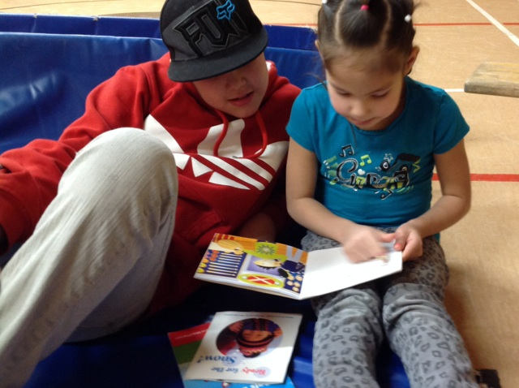
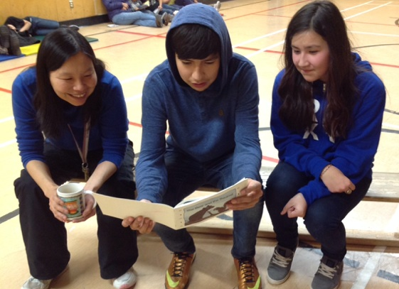
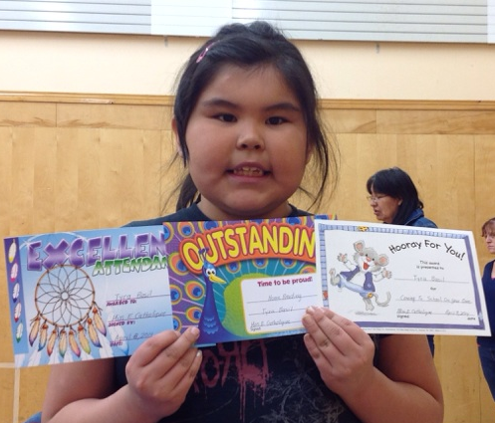
Everyone Reading!
Working on Literacy from many angles: Daily 5 in all classes, LLI interventions, Family Literacy Activities, Monthly Awards Assemblies, DeBeers Books in Homes, Career Fair…

Slide 9
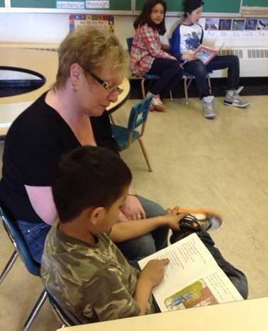
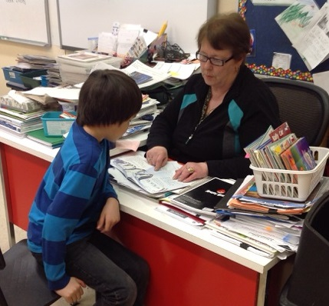
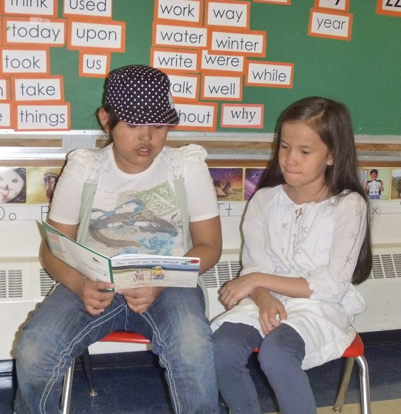
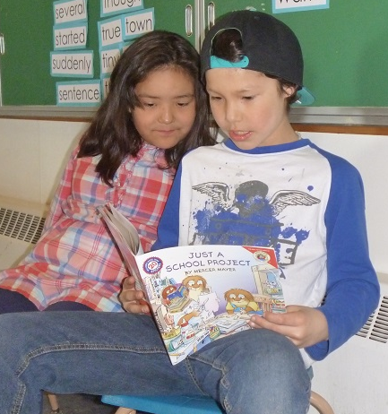
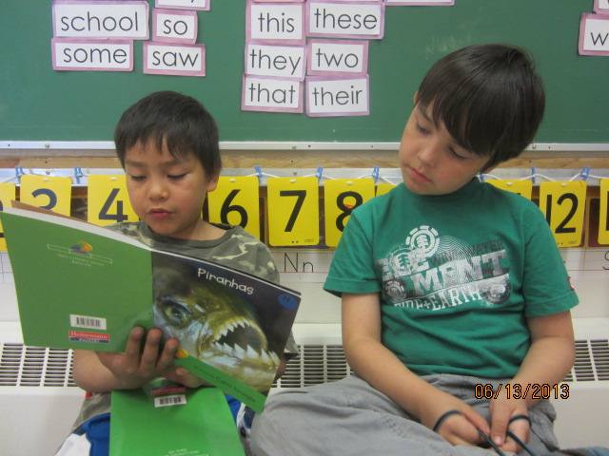
Guided Reading Groups, Integrated Planning, Interventions, Buddy Reading
Read Aloud, Guided Reading, Shared Reading, Word work. Buddy reading, Independent reading,
MYLI
Notes:
IPP pics, buddy reading, GR

Slide 10
Parent Engagement Data
New Strategies :
Open house BBQ
Community Lunches
Community FB Page
School Web site
Elders & community in school
Newsletter emails/calls
Fundraising Events
Joint Activities with LKDFN

Slide 11
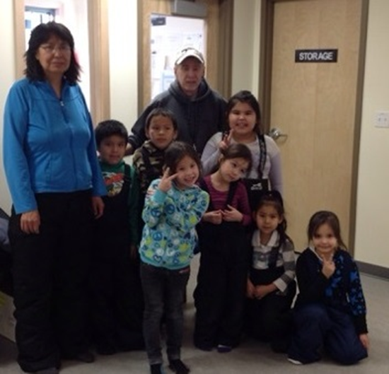
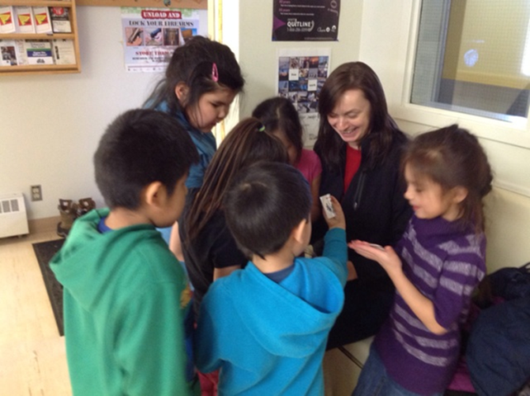
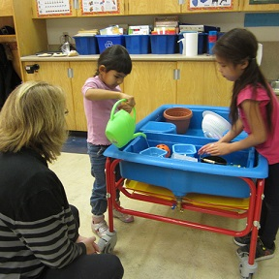
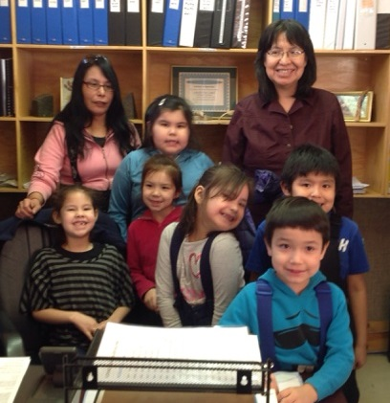
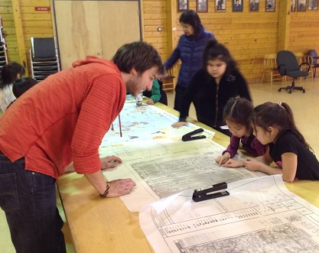
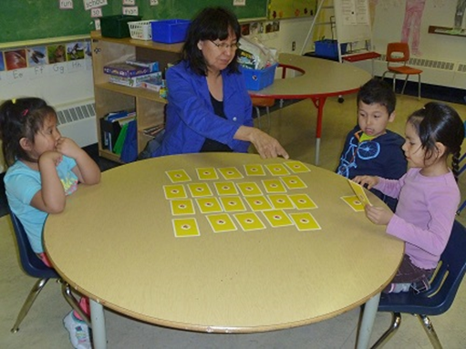
Kindergarten Integrated Planning
‘Our Community’ Unit
Encouraging community involvement in student learning

Slide 12
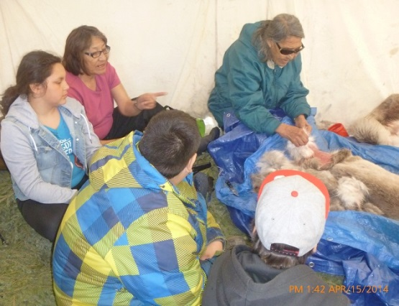
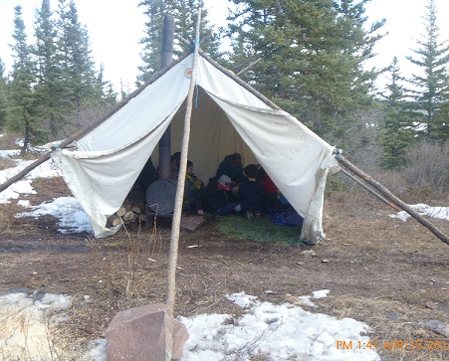
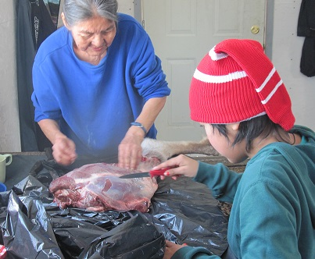
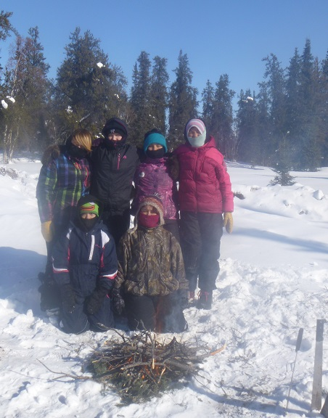
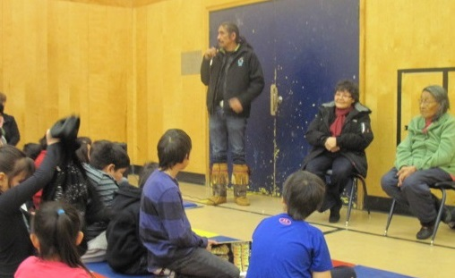
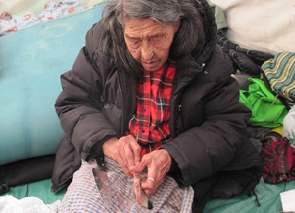
Aboriginal Language & Culture: Elders & Community Members in School and on the Land.

Slide 13
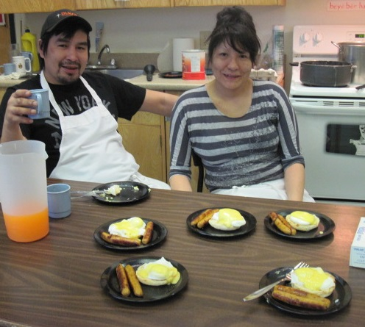
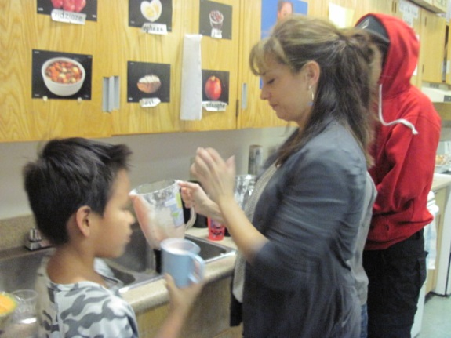
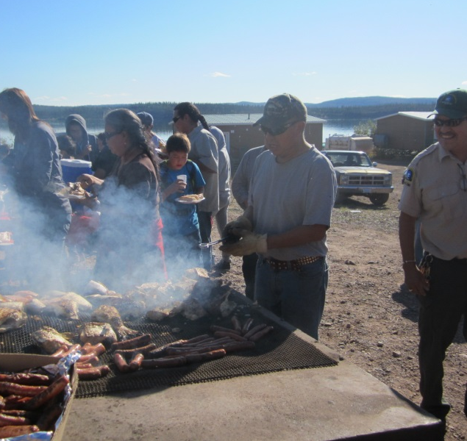
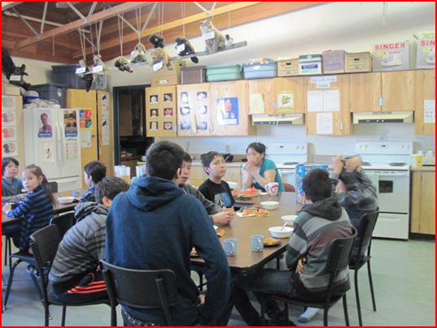
Healthy Lifestyle
The two community members that run our Breakfast Program have made it the success that it is – and it has supported increased attendance this year! Healthy snacks workshop, traditional foods, Community BBQs, Nutrition workshops
Notes:
Kids in the kitchen, community lunch, Coop tour,

Slide 14
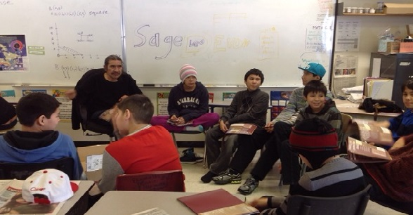
Aboriginal Shield Program

Slide 15
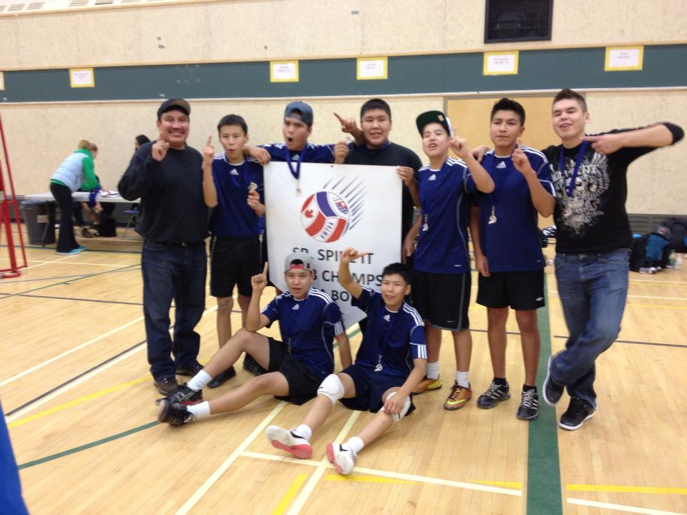
Winning Team in YK!
The team was proud of their Spike It! win. They also took silver in Super Soccer this year.

Slide 16
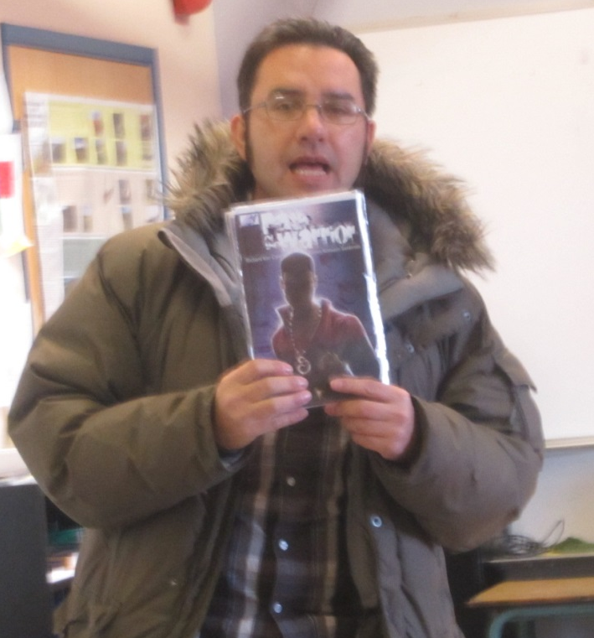
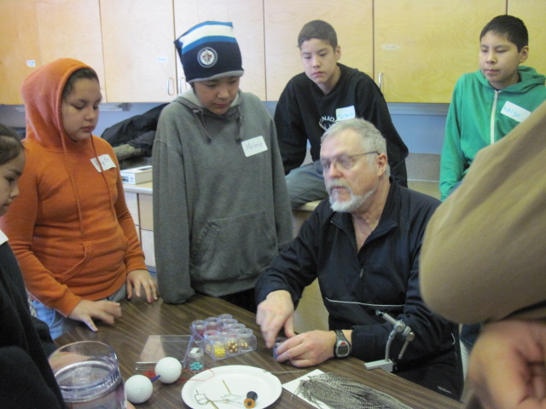
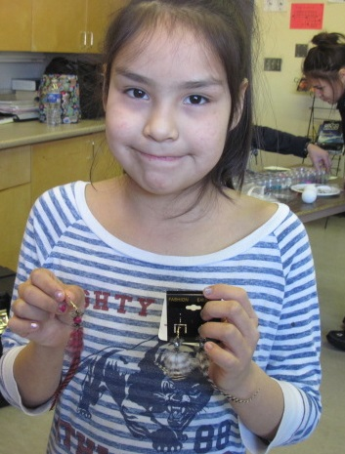
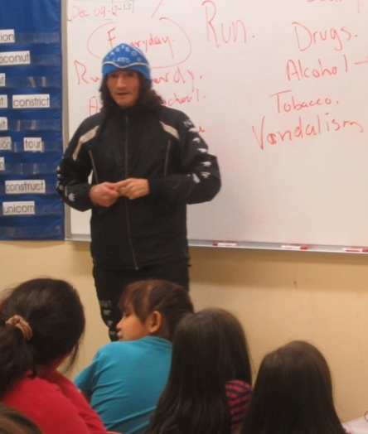
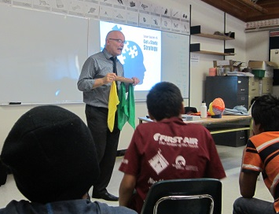
Special Guests:
Terry Small , Richard Van Camp, Let’s Talk Science, Sharon Firth, Caribou Legs, Dominion Diamond Trades, Ecology North, EMAB, De Beers, Richard Byrne, Discover E Science, LKDFN presentations on mining, caribou research–some of the guests we have hosted this year.
Notes:
Sharon firth, AWG, Byrn Richards, Lets talk science,

Slide 17
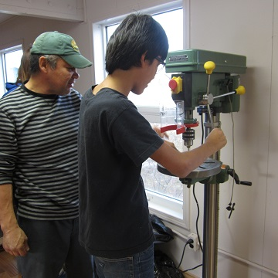
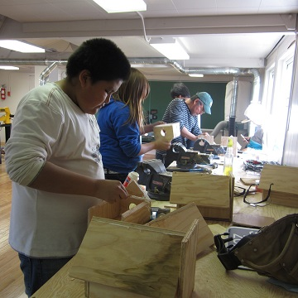
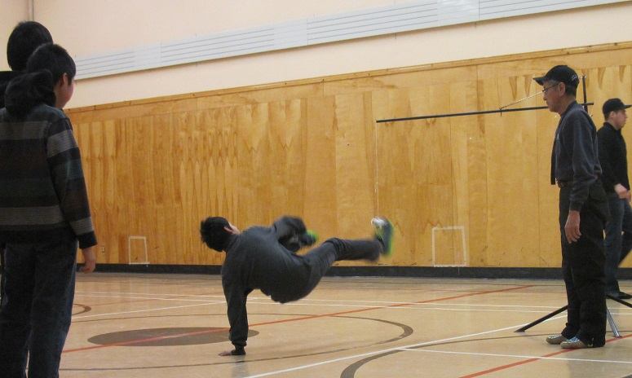
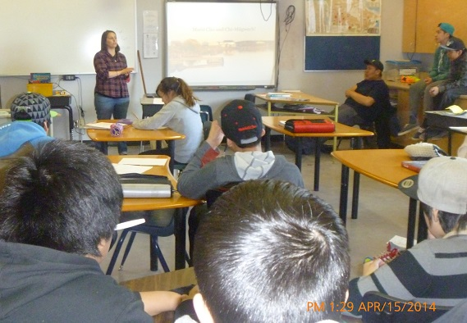
Careers & Trades - Sports
The shop in the old Aurora College building has been awesome this year. Students have done carpentry, electrical, plumbing, and traditional carving. Students made muskrat traps, bird houses, benches, carved caribou antlers…U of A student Kelsey talks about careers in environmental monitoring and wildlife biology.
Community Instructors
Students learn Traditional Dene and Inuit Games
Notes:
Winning team pics.

Slide 18
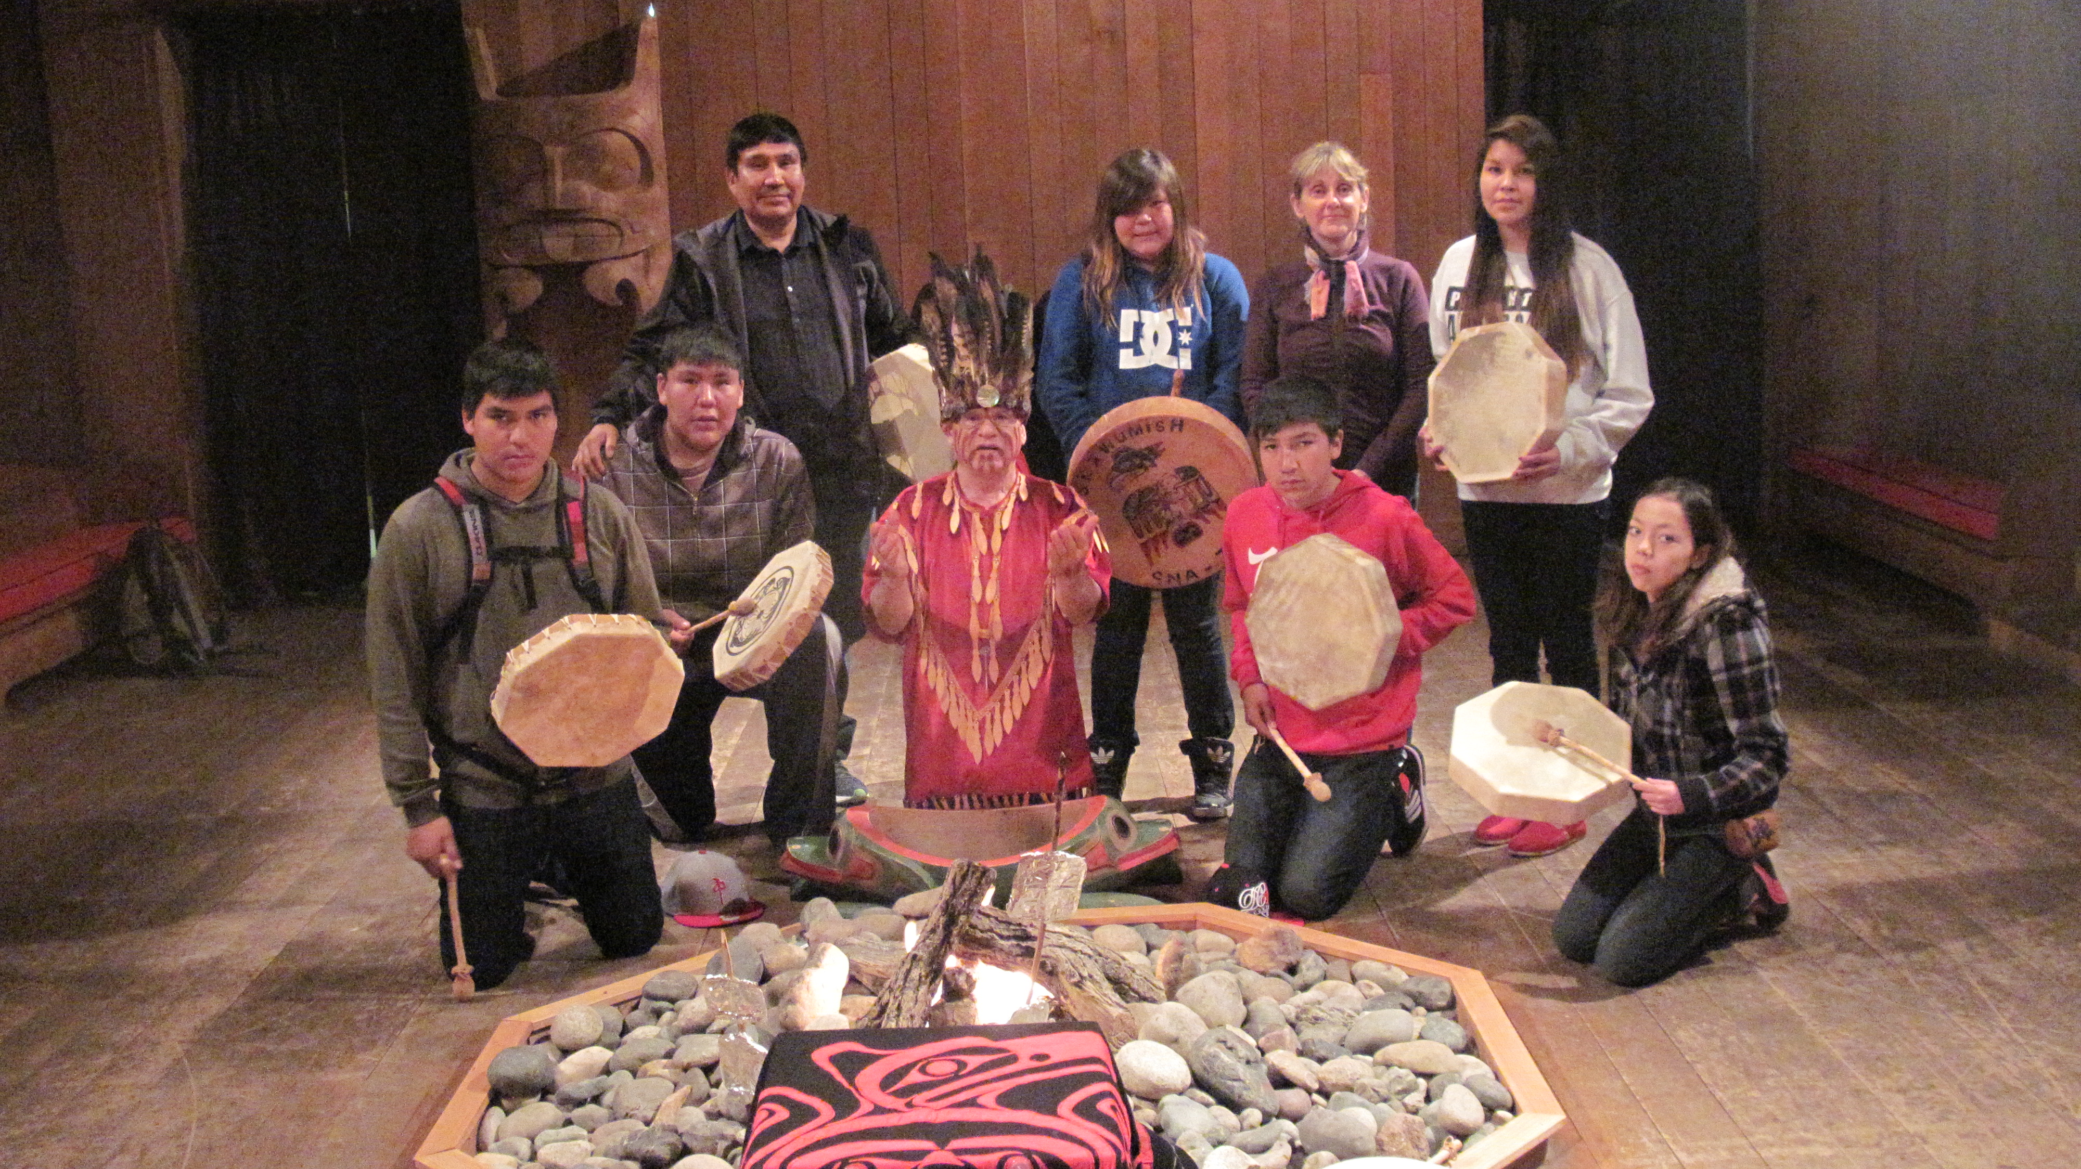
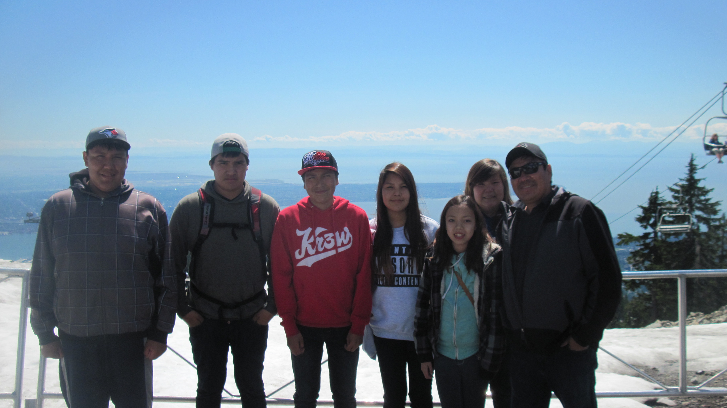
High School Trip to University of Alberta
Community Lunches
LKDFN Catering Contracts
Bingos and Sleepovers
Bake Sales
Community Cleanup Contract
Parent and DEA help with fundraising
Travel experience
Inspiration

Slide 19
Looking to the Future
Parent Engagement – Attendance, Homework
Literacy Intervention for at risk students
Retrofit for the school
Continue to integrate technology and social media into the instructional strategies and parent communication in the school.

