Slide 1
Labour market challenges of Bhutanese Refugees in Coquitlam, BC — A conceptual understanding
Presented At
Canada and Refugee Resettlement: Research and Innovation for the 21st Century” National Conference, June 20 - 22, 2012 in Richmond, BC
Raj Khadka
UBC (PhD Student)/
Finding Our Voices, ISS of BC

Slide 2
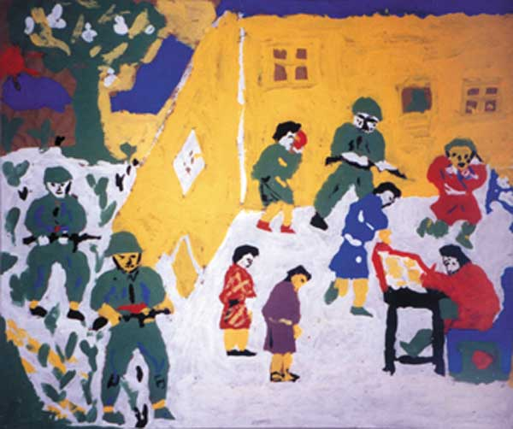
Bhutanese Refugees
Losthampa Bhutanese Of Nepali Origin
Stripped of their citizenship rights and expelled from Bhutan in early 1990s
Refugees camps in Nepal for about two decades
Third country resettlement, Canada 2009 (5000)

Slide 3
Employment Status & L.M. challenges
Total Population | Adults | Work Force | Employed Full Time | Employed Part Time | P. W. Disability | Seniors
206 | 148 | 104 | 12 | 14 | 11 | 11
Employment Status Data Source: Finding Out Voice, ISS of BC (2012,May)
Challenges : All-too-familiar barriers
Low Human Capital
Low level of Language ability
Lack of Canadian Experience& LM knowledge
Few and New (weak social capital)
Health :Physical and psychological
Soft skills & transportation
Mismatch between the economy of Source & receiving country

Slide 4
Theory of habitus and Capital framework of Pierre bourdieu
Habitus and capitals (economic, social & social)
Indigenous economy ( agriculture, Nonwage labor, reciprocity, labour relatioinships)
LM in Canada: Capitalistic labour market (wage labour, human capital)
Acquisition of new temporal habitus (rule of games/LM) and economic logic of Canadian labour Market
LM Outcome= Volume +Composition +Trajectory
Conclusion

