Slide 1
Explore BC: Part 2
Miss Chatrath
Science 10, Block ___

Slide 2
Table 1: Places Chosen
Category | Location
Starting Point | Templeton
Miss Chatrath’s choice | The One
University | SFU
Tourist attraction | Science World
Restaurant | Stepho’s
Ms. Nanda’s choice | Whistler
Provincial Park | Garibaldi

Slide 3
Table 2: Distance
Points A-B | Distance (km) | Distance (m)
Templeton-The One
The One - SFU

Slide 4
Table 2: Displacement
Points A-B | Displacement (km) | Displacement (m)
Templeton-The One
The One - SFU

Slide 5
Table 2: Time
Points A-B | Time (hours and minutes) | Time (s)
Templeton-The One
The One - SFU

Slide 6
Overall map
https://www.google.ca/maps/dir/Templeton+Secondary+School,+727+Templeton+Drive,+Vancouver,+BC+V5L+4N8,+Canada/The+One+Restaurant,+Kingsway,+Burnaby,+BC/Simon+Fraser+University,+8888+University+Dr,+Burnaby,+BC+V5A+1S6/@49.2506378,-123.049667,12z/data=!3m1!4b1!4m20!4m19!1m5!1m1!1s0x5486713d383ee161:0x9da2ff4354499bd2!2m2!1d-123.0603771!2d49.2787221!1m5!1m1!1s0x5486764934601849:0xe73ad3a9bf211467!2m2!1d-122.9772623!2d49.2206193!1m5!1m1!1s0x548679c0857a2227:0x506c3f6e30b55b!2m2!1d-122.9198833!2d49.2780937!3e0

Slide 7
How to take a screen shot
For PC’s
Press alt and prt sc (print screen) to capture
Ctrl v to paste
Crop the screenshot to fit your slides

Slide 8
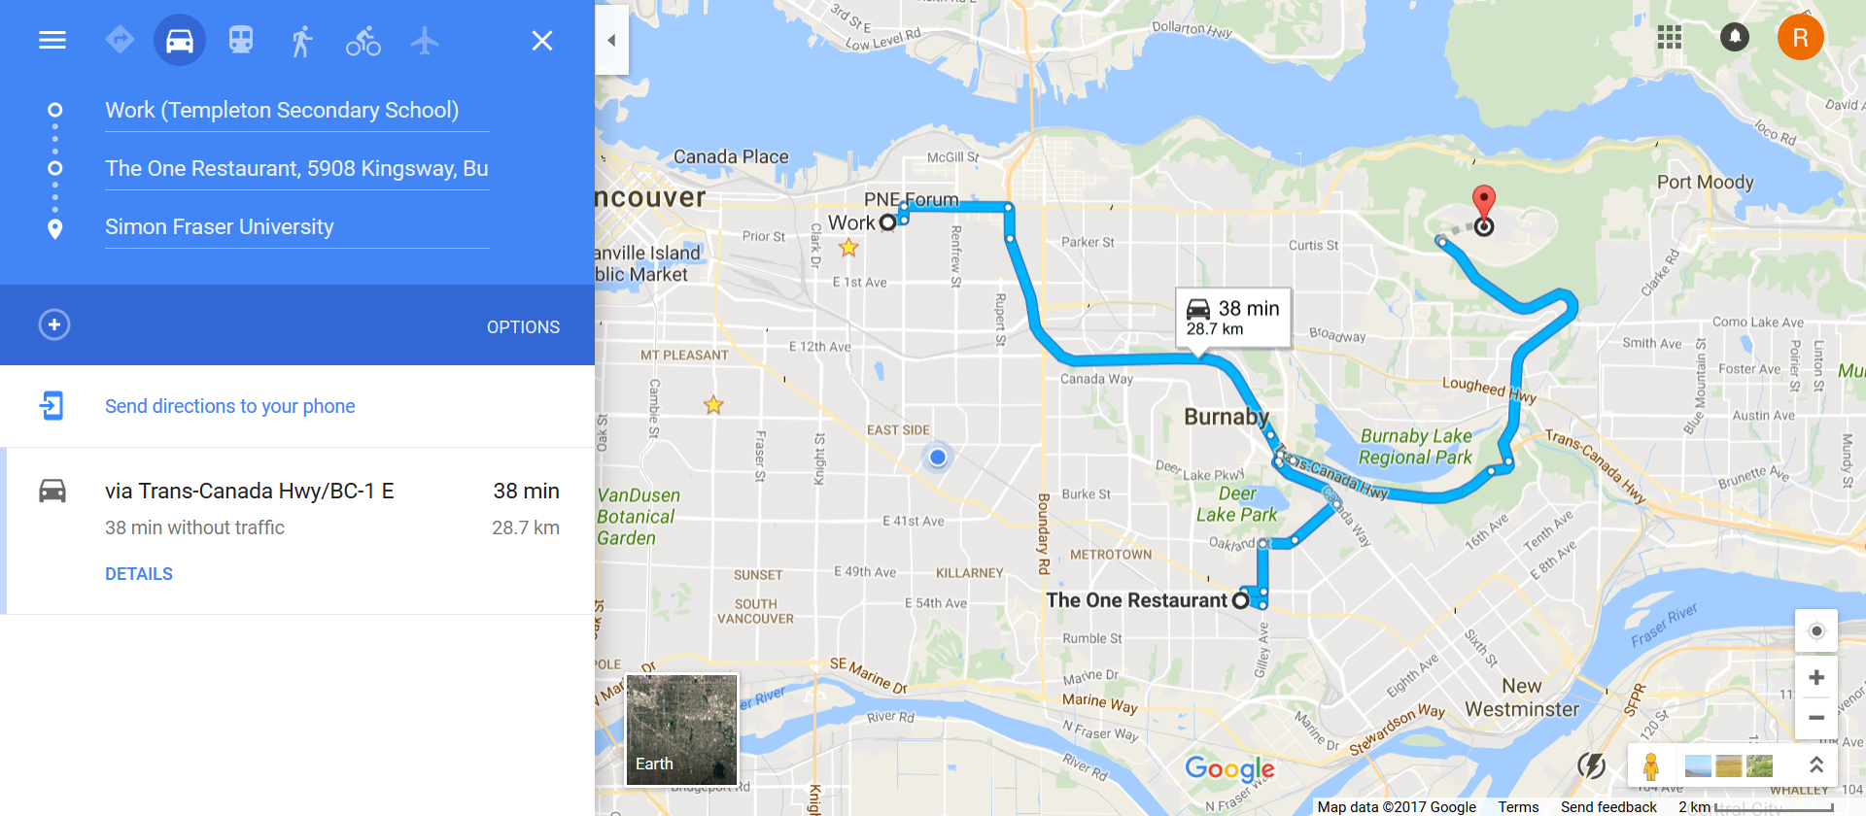
Overall map
Notes:
Note on how to screen shot things!!!!!!

Slide 9
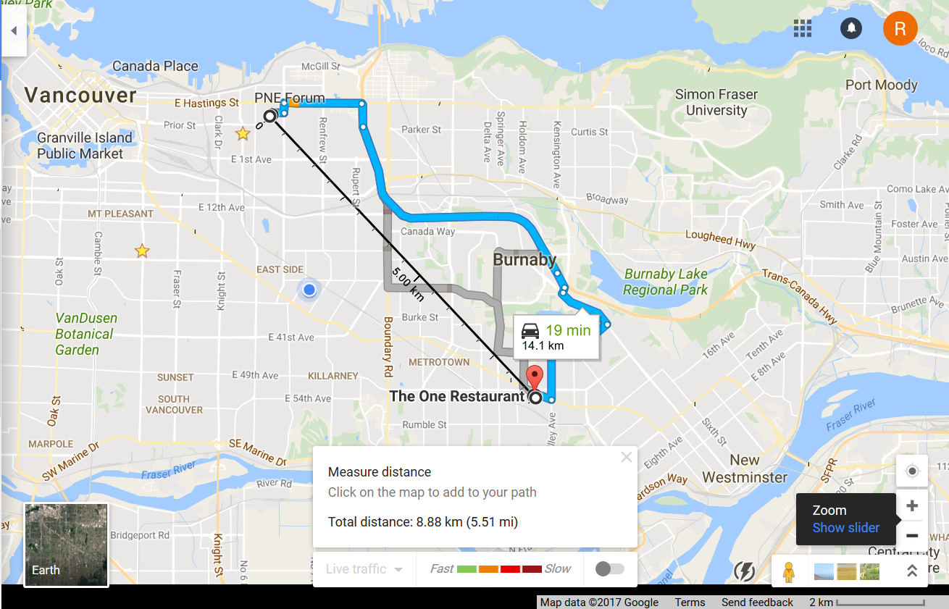
Displacement: Templeton-The one

Slide 10
Difference Between Displacement and Distance
Definitions
Equations
Example
Can be in point form – want the key points

