Slide 1
Global Opportunities
FT MBA 2025
Alina Yukhymets
Director, Masters Programs
Notes:
HI everyone, my name is Alina Yukhymets and I am Manager of Global Learning at the RHL. I am happy to be here today to tell you a little bit about the global opportunities open to the students in our MBA program.

Slide 2
Today’s Topics
Exchange
Global Network For Advanced Management (GNAM)
Yale Master of Advanced Management
Notes:
Today I will focus about the options open to our FT MBA program. These include Exchange, Global network for advanced management (or GNAM), Exchange, and Yale Master of Advanced Management.

Slide 3
UBC MBA Global Learning Opportunities
Global Immersion (Feb. 2024)
Exchange (Fall 2024)
Global Network Week (October 2024)
Global Network SNOCS (Fall 2024)
UBC MBA-Yale MAM Dual Degree

Slide 4
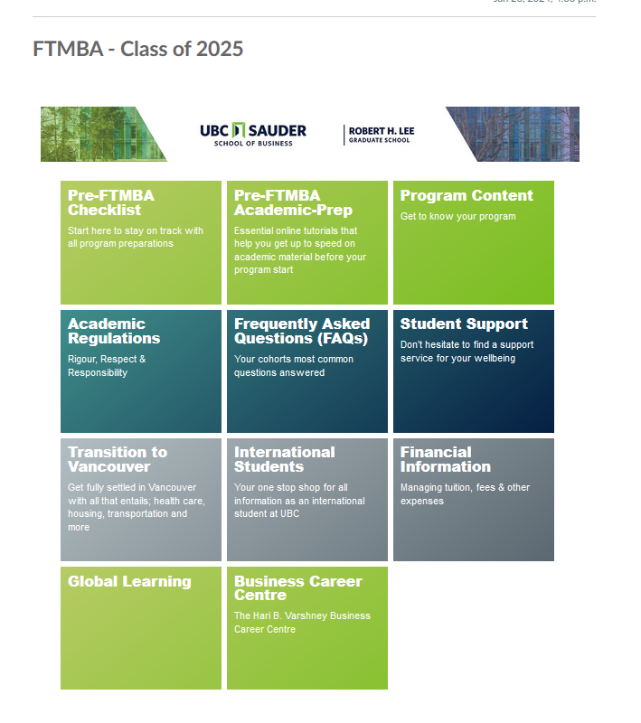
UBC MBA Global Learning Opportunities

Slide 5
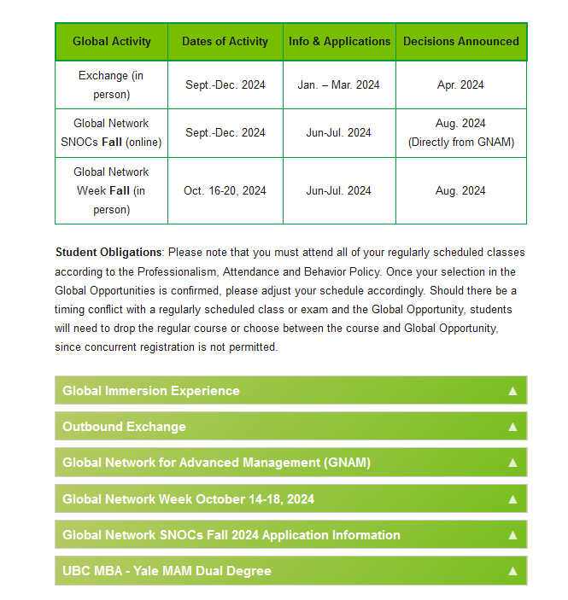
UBC MBA Global Learning Opportunities

Slide 6
UBC MBA Exchange Program
“Simply put, the benefits of exchange are beyond your imagination.”

Slide 7
UBC MBA Exchange Program
Why MBA Exchange?
Network with future international business leaders
Further global perspective
Study topics not available at UBC MBA
Get a head start on your international job search
Have a great experience that will change your life!
32 Business Schools in 22 countries

Slide 8
UBC MBA Exchange Program
Who Participates in Exchange?
About 15% of MBA Class
Students are selected by Sauder
Partner Schools accept 1 to 2 students

Slide 9
UBC MBA Exchange Program
How are Partner Schools Selected?
Academic Reputation
Relevant Courses
Academic Timeline (Fall Term)
Geographic Location
Ability to achieve a balance of students

Slide 10
UBC MBA Exchange Program
32 Business school partners globally
Notes:
In the FT MBA, we have semester exchange with our partner institutions around the world. Semester exchange is something our students really look forward to and it is a great way to expand your horizons, add another top business school to the resume, get some immersive experience in another country and for some, get a network of friends and contacts and possibly create some career opportunities in that region or country.

Slide 11
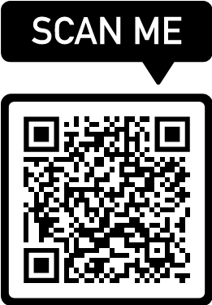
UBC MBA Exchange Program
Current Exchange Partners
https://blogs.ubc.ca/rhlprogramcontent/outbound-mba-exchange-program/

Slide 12
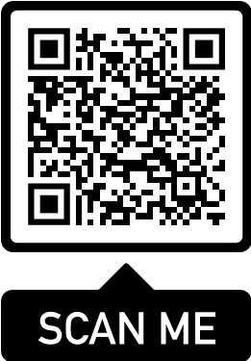
UBC MBA Exchange Program
Exchange Reports
https://blogs.ubc.ca/rhlprogramcontent/exchange-reports/

Slide 13
UBC MBA Exchange Program
When Do I Go On Exchange?
Fall 2024 - Periods 6 & 7
Timing differs by Exchange Partner
Earlier Start: Ex. National University of Singapore (August)
Later Start: Ex. Manchester Business School, ESADE (October)
Most are Sept-Dec
Attend full Term (3-4 months) or
Attend just one Period
e.g.: exchange during P6, back to UBC MBA for P7
Only possible at a few partner schools

Slide 14
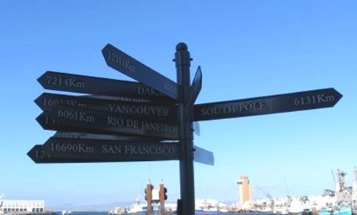
UBC MBA Exchange Program
Application Requirements
Application Form
Resume
Essay
Possibly Interview
Go Global Application Fee $415
(refundable if no spot)
Application via on-line portal
Application: Due March 17, 2024

Slide 15
UBC MBA Exchange Program
Selection Criteria
Reasons
Fit for Academic and/or Career goals
Academic Performance
Maturity & Professionalism
Strong ambassador for UBC Sauder

Slide 16
UBC MBA Exchange Program
Academic Requirements On Exchange
‘Full-Time course load’ comparable to
8 MBA courses
Track requirements before exchange or equivalent courses on exchange
Must PASS courses based on host school
grading scale

Slide 17
UBC MBA Exchange Program
Registration & Grading
Registered by RHL Office in exchange course
‘BA 530’ (12 - 13 Credits)
Completed coursework evaluated by Sauder after receiving host school transcripts
Pass/Fail in SSC
No grade conversion from host schools grades to UBC

Slide 18
UBC MBA Exchange Program
Exchange Costs:
UBC MBA Tuition
Airfare/Accommodation
Books & Study Packages
Language Class Fees
Personal Expenses
Application fee
EXCHANGE STUDENT SCHOLARSHIPS AVAILABLE!

Slide 19
UBC MBA Exchange Program
Exchange & MBA Job Search
Opportunity for International Job Search
Access to host school recruiting
Access to BCC Postings – COOL
MBA Internships
Talk to your Career Coach

Slide 20
UBC MBA Exchange Program
Decision-Making Tools
“Global Learning” Folder in Canvas
Exchange Partner Websites
Exchange Reports online
BCC Career Coach
Exchange Advising

Slide 21
UBC MBA Exchange Program
18 FT MBA 2023 students on Exchange in Fall 2022:
ESADE (Barcelona)
SDA Bocconi (Milan)
Rotterdam School of Management
ESSEC Business School (Paris)
WHU (Germany)
CEIBS (Shanghai)
Keio University (Japan)
Singapore National University
Most recent post-exchange job: Senior Consultant at Supply Chain company in Netherlands (RSM Exchange)

Slide 22
Global Network for Advanced Management - GNAM
UBC Sauder only Canadian member of GNAM
Unprecedented access to learning opportunities around the world
31 business schools
30 countries
5 continents
Notes:
First, the Global Network for Advanced Management. Global Network was launched 10 years ago, it is an international partnership spearheaded by the Yale School of Management, connecting leading global business schools, dedicated to integrating international experience into graduate business education. UBC Sauder School of Business is the only Canadian member of the Global Network
Global Network provides MBA students access to learning opportunities globally, and consists of 32 partners around the world) in 30 countries.
There are two types of Global Network Programs MBA students can apply for:
Global Network Weeks – intensive study at partner institutions in short courses that count for credit towards your MBA degree.
Global Network Courses – real-time virtual classes that count for elective credit
The opportunities are by application and some are quite competitive.

Slide 23
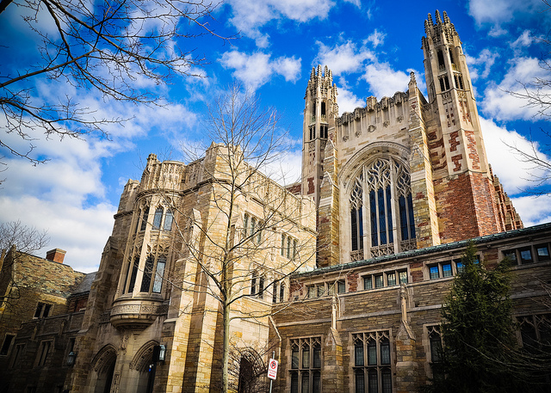
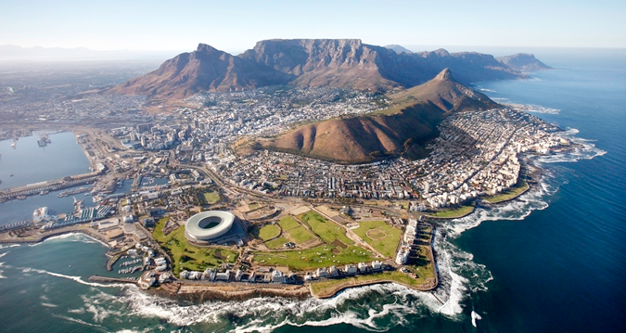
Global Opportunities/GNAM
Global Network Weeks
October 2024, between P6 and P7
One-week intensive course
Academic/Networking
Elective credit – 1.5 credits Pass/Fail
Notes:
Global Network Weeks are intensive one week courses, usually hosted on campus of each participating time during the same week, either in October, March or June. Due to the way the program calendars align, FT MBA students can participate in October of their second year and IMBA and PMBA students can participate in march or June.
Global Network Weeks include a variety of academic, cultural and networking activities. For instance if you were to attend the week at IE Madrid in Spain on Digital Transformation, you would have some academic lectures, some industry panels, visits to some companies in Madrid, some cultural activities such as a Madrid City tour and flamenco dancing lesson, and some networking events, such as welcome reception, and informal outings in the evenings. Usually you would work in teams through the week, and do a final presentation at the end. It’s a great experience, many of our students have take part over the years. For any given Global Network Week, we would usually have 30 to 50 students take part traveling to their chosen business schools. These can be quite competitive as usually more student apply than there are seats available. These are usually delivered in person and involve travel, but in the past 2 years have been offered exclusively online. We are looking forward tp returning to the in person delivery of the global network weeks.

Slide 24
Global Network Weeks
Sample TOPICS
“From ‘Made in China’ to ‘Invented in China’ Renmin (China)
“Service x Innovation: Omotenashi 3.0” Hitotsubashi ICS (Japan)
“Behavioral Science of Management” Yale University (USA)
“Gender, Equity, and Leadership in the 21st Century” UC Berkeley (USA)
“Sustainability and Innovation” UBC Sauder (Canada)
Notes:
These are some of the sample topics to give you an idea for the Global Network weeks. Usually the schools try to infuse local flavor into these custom topics to give students a chance to learn about business in that country.

Slide 25
Global Opportunities/GNAM
Global Network Courses (SNOCs)
Fall 2024 (during P6 and P7)
Small Network Online Courses
Elective credit
1.5 – 3.0 credits
Pass/Fail in UBC transcript
Notes:
Next we have Small Network Online courses, also known as SNOCs, which allow students to experience a course in another leading MBA program in a virtual delivery environment. It is a great way to learn a new topic, get a different perspective and expand your network. These courses run during regular terms, such as September to December and January to April and are always delivered online.
In the past few years, our students could apply to one of the 25-30 different topics offered each term.

Slide 26
Global Network Courses
Sample TOPICS
“Agile Leadership” ESMT Berlin (Germany)
“Business as a Force for Good: Sustainability and Sustainable Development
in Africa” Lagos Business School
“New Product Development” Technion-Israel Institute of Technology (Israel)
“Brand Cultures and Emerging City Markets” EGADE Tec de Monterrey (Mexico)
“Business Ethics Cross-cultural interaction, Neuroscience, AI and ESG” Hitotsubashi ICS (Japan)
Notes:
Here are some of the sample topics that have been offered in the past.

Slide 27
Yale Master of Advanced Management (MAM)
Notes:
Finally, those who are interested, will have an opportunity to learn more and apply for the Yale MAM dual degree program. Students can apply while they are in the MBA or after they complete their MBA degree. The Yale MAM program is 9 months in length and runs from August to May, full time on Yale campus.
Please visit the Yale MAM website for more information

Slide 28
Yale Master of Advanced Management (MAM)
Start UBC MBA: Aug 2023
“Convening emerging global leaders
The MAM is a one-year degree program for exceptional MBA graduates from top international business schools who aspire to become global leaders for business and society.”
Apply for Yale MAM: Spring 2024
Start Yale MAM: Aug 2024
UBC MBA graduation: May 2025
Yale MAM graduation: May 2025
Notes:
Finally, those who are interested, will have an opportunity to learn more and apply for the Yale MAM dual degree program. Students can apply while they are in the MBA or after they complete their MBA degree. The Yale MAM program is 9 months in length and runs from August to May, full time on Yale campus.
Please visit the Yale MAM website for more information

Slide 29
RHL Contacts – Global Learning
TBC
Manager, Global Learning
E: RHLglobal@sauder.ubc.ca

Slide 30
Questions?

