Slide 1


Facebook Analytics
New Facebook Timeline Metrics
Team DBN, SoHo Square

Slide 2
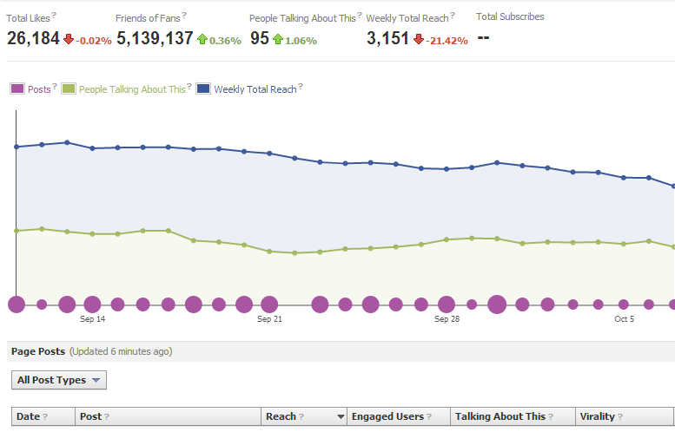

A Digital Paradigm Shift
Measuring Your Team’s Success
The public has generally found the new “People Talking About This” metric confusing and complicated. This has left most Facebook users reluctant to use the metric at all. Hopefully this research gives us some more perspective on what Facebook was trying to do when they launched it.
The Old World
The New World
1
The “Like” button has largely been the leading indicator for advocacy in the Facebook platform.
Fans can easily click this button to show their friends that they approve of a certain page/comment/picture.
2
Since the launch of the new Facebook Timeline format, new metrics have emerged to interpret advocacy.
The “Talking About This” metric provides more in depth information on how fans interact with the page and its contents.

Slide 3
Key Metrics
Definition: Facebook Story*
Total Likes
A story is created when someone likes your page/post, posts on your wall, comments on your post, responds to your event, mentions your page, tags your page in a photo, checks in at your place, or recommends your place.
1
The number of unique people that like your page.
Overview
Insights: Overview
Friends of Fans
2
The number of unique people who were friends with people who liked your page as of 2 days ago.
People Talking About This
The number of unique people who have created a story* about your page between a 1 week period.
3
Weekly Total Reach
The number of unique people who have seen any content associated with your page including Ads and Sponsored stories between a 1 week period.
4
Your Logo
Engaged Users
Virality
The number of unique people who have clicked on your post.
The percentage of people who have created a story from your page/post out of the total number of unique people who have seen it.
5
6

Slide 4
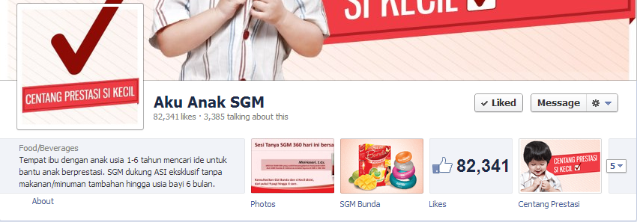
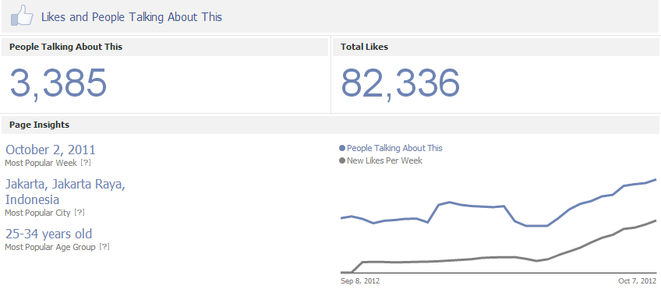
Public Perception
What Non-Admin Can See
Publicly Available Insights Page
Most Popular Week
Total Likes
Most Popular City
Click here
People Talking About This
Most Popular Age Group
New Likes per Week

Slide 5
Metric Relationship
Differences & Simmilarities between
“Like” and “Talking About This”
Advocacy
Analysis
Keep in mind...
“Like”
A fundamental difference between the 2 metrics is the time frame; “Like” is based on sum total at any given time and “Talking About This” is based on a week long period
“Talking About This” covers much more interactive touch points than “Like”
The one touch point that is similar to both is when fans like your page
“Talking About This” will tally both advocacy AND opposition, whereas “Like” only tallies advocacy
Consider the time frame of the activity of interest
Similarities
Irrelevant posts/comments/tags and “not attending” events do not contribute to advocacy
Like your page
Post on your wall
Respond to your event
Like your post
Comment on your post
Recommend you
There is overlapping data (1 weeks worth of “Like”s)
Tags you in a photo
Check in/recommend your place
Share your post
Answer a question
“Talking About This”
High “Talking About This” count could also mean people are spreading bad word of mouth

Slide 6
People Talking About This
Summary & Concluding Insights
7 day time period, ending 2 days prior to current date
There are 13 different ways a user can tally into the PTAT count
Plain text mentions don’t affect PTAT; only if users use @ or check in on mobile
PTAT uses unique tallies, therefore it doesn’t measure total engagement. It counts each person once evenen if he/she talks about the page ALOT.
Individual posts have a PTAT count which can only be seen on an admin account.
Summary
PTAT metric was designed to measure interactions beyond (and including) a Facebook “Like”.
It also goes beyond a metric of the page; also able to measure individual posts as well.
Pages focused on gaining likes without an engagement strategy will fall behind because there is now more than one button measured that gages advocacy.
What does this mean?

Slide 7
Facebook Metrics
Potentential Progress Chart
“Like”
“People Talking About This”
Future Metrics
1 button
Measures pure advocacy
Sum total/individual posts
No plain text recognition
All relevant buttons
Measures advocacy OR opposition?
7 day period/individual posts
Plain text recognition?
13 buttons
Measures advocacy and opposition
7 day period/individual posts
No plain text recognition

