Slide 1
iClicker Readiness
Instructions for participants to connect to the iClicker Cloud session (Laptop Version)
Login to iClicker Cloud = https://student.iclicker.com/#/login
If necessary, create a iClicker Cloud Student account: https://student.iclicker.com/#/account/create
Search for Institution = "University of British Columbia"
Search for Course = "Sauder Teaching Playbook", click to join
If you want to use your cell phone to answer questions rather than your laptop, download the iClicker Student' app from your relevant app store and follow the instructions above

Slide 2
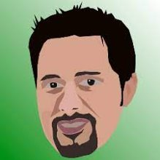
Opening Clicker Question
1. Should John Ries grow back his beard?
Yes
No
Other style (eg. The Werker)

Slide 3
Are we ready for in person and remote synchronous participants?
Remote Participants – If you wish to contribute
Camera on with lower camera quality (No HD)
Make Gallery view window as small as possible
In-situ Participants – if you wish to contribute
Press the microphone button nearest your seat
Speak naturally with good projection, no need to lean into the mic

Slide 4
Food For Thought
Return to Campus
August 26th, 2021

Slide 5
I would like to acknowledge that we are gathered today on the traditional, ancestral, and unceded territory of the Musqueam people.
This Photo by Unknown author is licensed under CC BY-SA.

Slide 6
Agenda
Updates from the Dean's Office (Bob/John/Joey)
Priority Return to Classroom technologies (Rob)
iClickers
Classroom Upgrades for Restricted and GTS rooms
Panopto Class Recording Service
Support available
Q and A (Rob and Learning Services Managers)
Pre-submitted
Open floor
Panopto Recorder Demo (for those interested)

Slide 7
Updates from Dean's Office

Slide 8
iClicker (audience response systems)
iClicker Cloud (aka Reef) - the UBC endorsed and supported audience response system
currently free for all students and instructors. Status past April 2022 still TBC
UBC is withdrawing support for the iClicker Classic (dedicated device) effective immediately
The bookstore is not stocking any devices unless by special request.
Pleases our students, some existing device policies may need to be revisited.
Notes:
A few administrative items before I kick off.
A sad announcement off the bat and that is a colleauge and friend for many of you, Fareed Teja, is no longer with us. He was offered, and accepted a promotion at Mulgrave school on the north shore. The entire LS team is very happy and proud of him, and if any of you wish to send him a word, let me know and I will share his contact info.
In my 15 years that I spent in the classroom teaching statistic, calculus and english language, interaction and humor were critical. I will welcome interruptions at any time. We do have a lot to cover so please feel free to raise your hand with a question for clarification, a short comment that gently nudges us along, or even better something that will give us all a laugh. In my classes, students paid attention more often than not because they didn't want to be the only ones not laughing when everyone else was.
It is under less than ideal conditions that we are gathered. I know the general anxiety level is high and while Learning Services can't solve all the issues, I hope by the end of today you all feel just a little less anxious about that first day of classes. We should be sharing stories from this past 18 months, like who christened the new studio in the basement with cheap champagne. We should be debating the merits of the new Netflix series, "The Chair" and spreading the rumor that Amazon Prime is interested in doing a business school version called the Division Chair with Ryan Reynolds hoping to have the honor to play Russell Lundholm.
If 10 years ago someone would have told me that I would be standing in front of this esteemd group for an hour talking about education technologies, I would have laughed. There are people in this room who would see me in the hallway and suddenly feel the need to use the washroom, or check their mailbox. You know who you are...
I'm going to move along fairly quickly, but I won't leave a slide without pausing for a few seconds for anyone who would like to contribute.
Let's go

Slide 9
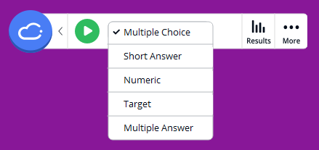
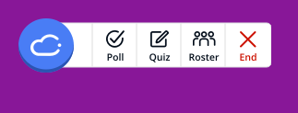
In case you were not aware
Added functionality
Added polling question formats
Self-paced quizzing
Automatic attendance tracking

Slide 10
I plan on using the iClicker Cloud system in some (or all) of my courses
Yes
No, I prefer to use another audience response system (Slido, Google, etc.)
No, I do not use an audience response system in my courses
Unsure, need more information

Slide 11
Updates on new classrooms
Different conversations for restricted spaces and the General Teaching Spaces (GTS), primarily around audience mics
UBC has implemented a campus-wide service for recording lectures with new USB cameras in all GTS classrooms and Panopto Recorder as the capture software
Sauder's implementation is different given our long-standing partnership with Panopto and our licensing arrangements (individual instructor vs. classroom computer)

Slide 12
Sauder's Proposed Recording Service
A fully-automated and scheduled service for every class, instructor and classroom including:
Preset as per SIS/FSC
Preferred sources
Automatic delivery to your Panopto folder for editing and distribution
Auto-branding and watermarking service still available Not sure what this is?
What do I need to do?
Confirm you have an account at http://ubc.ca.panopto.com
If not, send a ticket to help@sauder.ubc.ca subject = "Panopto Account Request"

Slide 13
Recommended Best Practices
"How do I know if someone in my class is absent?"
No need as the recording is automatic. Push the decision downstream as to when/how/to whom to circulate
"How can I make sure students are not intentionally missing classes because they know there are recordings available?"
Distribute recordings privately to those students absent via Canvas email or FSC
"What if all of my students want to see the recordings?"
Consider posting all recordings to your Canvas course 1 (?) week prior to midterms and final exams (if applicable) for all students
Notes:
I have been in discussions with a number of you about this service, and probably not surprisingly the reactions are diverse. Werner A. shared the example of one of his courses being based on challenging ethical topics where we can all agree having recordings is not appropriate and so for scenarios like this we have created an opt-out mechanism. Details of which will be shared next week but at least in my opinion, if you are considering opting-out, then I encourage you to develop alternatives that are going to be functional for those students who are absent through no fault of their own.

Slide 14
Samples of Recordings from Sauder GTS rooms
Simple Lecture – instructor audio with slides and doc cam
Lecture - with student audio
Whiteboard – auto tracking feature
Remote Guest Speaker – with Zoom

Slide 15
Auto Branding and Watermarking Demand
I will possibly use the auto-branding and watermarking service:
No
Yes
Not sure, need more info

Slide 16
If I am teaching an online section of a course, I plan on teaching it from:
A. My office in Henry Angus
B. My home studio
C. Sauder Studios
D. I am not teaching online this fall

Slide 17
Support Plans for your teaching and learning
Classroom Tech Readiness Check Drop-in Sessions
August 31 and September 2 => HA 243 from 10 AM until 2 PM
September 1 and September 3 => HA 037 from 10 AM until 2 PM
Teaching Online Playbook => Sauder Teaching Playbook
Canvas Course = https://canvas.ubc.ca/enroll/87WYFH to self-enrol
Wordpress = https://blogs.ubc.ca/sauderteachingplaybook
TA Training – as per email fromChristina Sylka and the CLC team
Orange Vests for 2 weeks
Help desk – HA 451 8 am until 5 pm (help@sauder.ubc.ca)
LS virtual office hours – details in the Canvas STP
Notes:
Call for editorial volunteers

Slide 18
Pre-submitted Questions (paraphrased)

Slide 19
"How can I transfer tips and tricks from remote teaching into my classroom?" RF
Drop-in Sessions August 31 to September 3
Tuesday (31) and Thursday (Sept 2) in HA 243 10 am until 2 pm
Wednesday (Sept 1) and Friday (Sept 3) in HA 037 10 am until 2 pm
Recommended = if you are in the building, see if your specific classroom(s) are free for ~10 minutes to complete your lectern login OR plan for this 10 minute delay during your first class.
This creates your profile in the specific computer in each class.

Slide 20
"For those courses with formal exams, and potentially both in-situ and remote students, how will we invigilate?" Anon
In-situ = 'regular' online exam support service (pre-covid) supported by your program (eg. UGO) office and Learning Services
Remote = 'The Finance model' supported by the CLC and Learning Services
Strongly recommended to have two separate copies within Canvas for each audience (content can be same)

Slide 21
"Are Sauder Studios still operational even though we've returned to campus?" TS
Yes although we have reduced facilities
DL 013 (original studio)
HA 043 (Pandemic Response studio)
We have converted DL 011, DL 005 and DL 009 back to their f2f configurations
Scheduler link in the STP

Slide 22
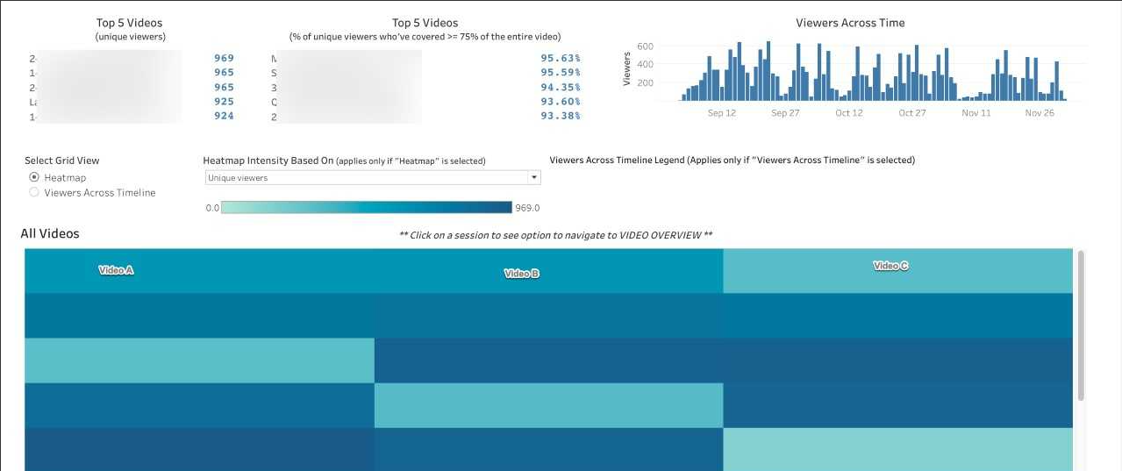
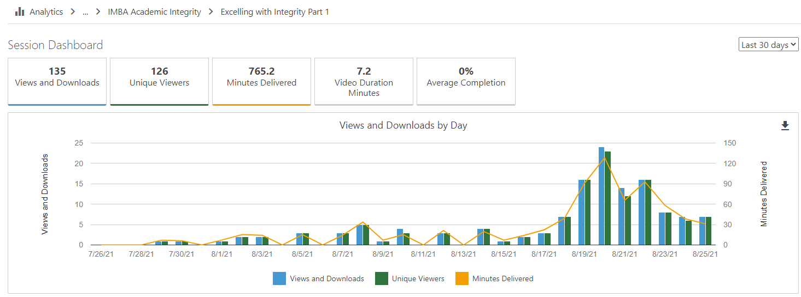
"Do instructors have access to activity data for the videos in Panopto?" AS
Self-Serve within Panopto account for folder(s) and video
Tableau Dashboard – Pilot project

Slide 23
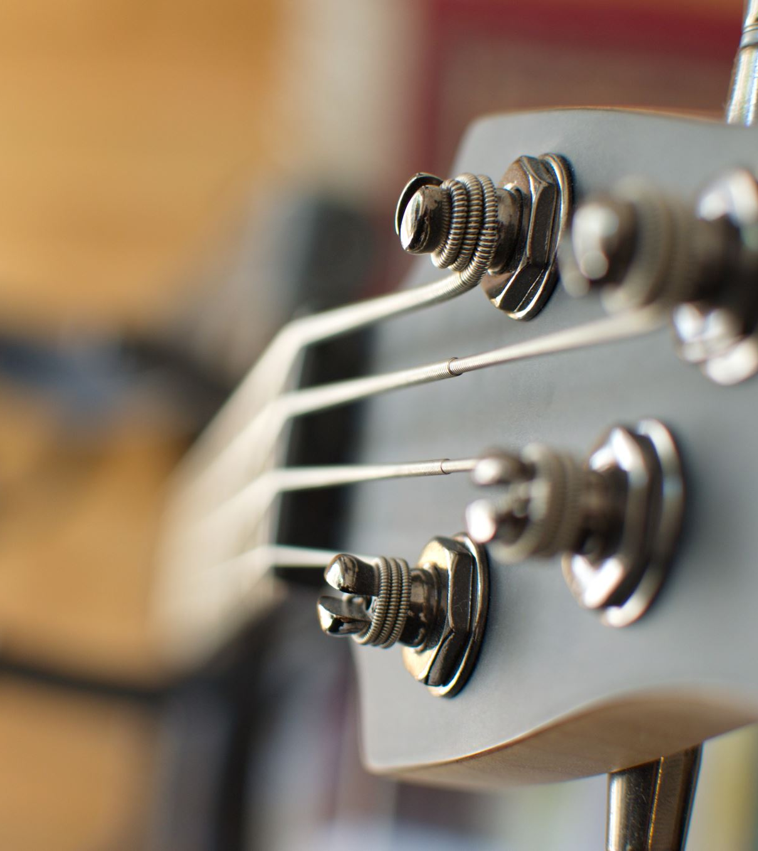
Panopto Recorder Demo

