Slide 1
Achieving Sustainability
Chuck Eckman
Lynn Copeland
CARL/ARL Joint Meeting Montreal, May 5, 2011
Notes:
1
Thanks for coming and introduction.

Slide 2
Presentation Outline
PKP Overview
Community Profile
Financial
--
Proposal & Next Steps
Notes:
2
Lynn will provide a brief introduction to PKP for those less familiar, talk about the ‘community’ of involved individuals and institutions, and outline the current financial picture.
Then Chuck will discuss the proposal we have for providing a sustainable foundation for the project

Slide 3
Public Knowledge Project
Aims to improve the quality of scholarly research and the public access to this research
Director: Dr. John Willinsky, Stanford and UBC
SSHRC funded 1998; continues today
Included first software development of OJS, OCS, OHS
Notes:
3
Initially PKP focused primarily on the scholarly research publishing in the third world, particularly Africa, and exposing it to the world. This was a research project, but, like many research projects, included a software development component – version 1 of OJS, OCS and OHS. The big difference was that the PKP software development has assumed a life of its own and the code base and development path have been professionalized.

Slide 4
PKP Software
2007: Synergies funded
SFU Library took on lead development of PKP software
Core team at SFU (underresourced):
3.5 fte technical
2 fte support
Administrative (in-kind)
Community & in-kind: plug-ins; translations, etc.
Notes:
4
More or less concurrent with the original PKP development was the proposal and granting of the $11 million Synergies project by the Canada Foundation for Innovation; Synergies’ goal was to effect the transition of Canadian HSS scholarly output to electronic form, in particular journals and theses. SFU became the BC node for Synergies, with UBC and UVIC being BC partners.
SFU Library and Willinsky agreed that SFU Library should become the lead developer and ‘home’ for the PKP software, a continuing and very fruitful relationship. As Synergies evolved, the PKP software was adopted by 4 of 5 ‘nodes’ and partially implemented by the 5th, along with its Erudit software. PKP also continued and expanded its relationship with others worldwide.
A core team was established under the direction of Brian Owen and development has continued.
A key component of the success of PKP has been the various fora and other community relationships with editors, librarians and developers. Translation into several dozen languages on a continuing and in-kind basis has also been key.

Slide 5
PKP Software
established software
Open Journal Systems (OJS)‏
Open Conference Systems (OCS)‏
Open Harvester Systems (OHS)‏
software in development‏
PKP Web Application Library (WAL)
Open Monograph Press (OMP))‏
Notes:
5
OJS is most famiiar: provides a platform for the management of the scholarly journal process – peer review, editing, etc. – as well as the publication. It does not deal with layout or similar activities, although various stylesheets are available. Various reading tools add to the strength of OJS.
OCS – is a platform for the management of a conference, including the capability of handling for example annual conferences, payments and the like. It provides capabiity for managing paper submission, exporting the conference papers and other useful features. The PKP conference in Berlin Sept. 26-28 2011 for example is using OCS.
The OHS is what it claims to be. One of the most notable examples of the use of OHS is for the CARL IR harvester.
Finally, the OMP, which will be released in the next few months, has, we believe, on the basis of early comment, tremendous potential to enhance the management of scholarly monograph publishing. It is being built using the WAL.
As PKP software matures, the various components are beginning to use a common suite of software – the web application library.

Slide 6
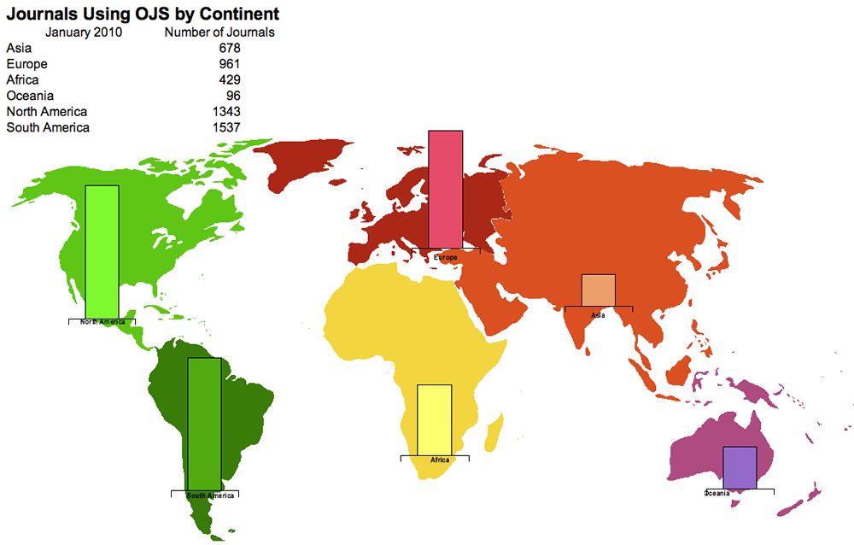
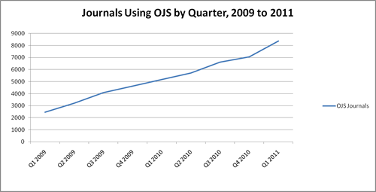
Notes:
6
In 2008, there were 5044 journals identified by continent, although there were over 8,000 journals identified. (since the software is open source indirect means of identifying use must be made).

Slide 7
Jan.2011: 8300 OJS Installations
Notes:
7
Now over 10,000 installations

Slide 8
OJS Journal Survey: March 2009
36% response rate
Commercial publishers: 6%
Scholarly societies: 32%
Independent /scholar publisher: 62%
83% Open Access policy
8% Open Access w. embargo
$188 Average first copy cost:
$1784 RLIN 2008 est. avg. 1st copy
Notes:
8
http://pkp.sfu.ca/files/OJS%20Journal%20Survey.pdf
998 of 2748 OJS journals responded; i.e. 36%
Commercial publishers: 6%
Scholarly societies: 32%
Independent or scholar publisher: 62%
Open Access policy: 83% (another 8% embargo OA)
Average first copy cost: $188 (compare w.RLIN 2008 estimate of $1784)

Slide 9
Libraries & Journal Hosting
Hahn: 2008 survey w. 80 ARL library responses
44% already hosting journals
21% in the planning stages
Cdn OA group: 2010 survey w. 33 responses
55% already hosting journals
24% considering
Notes:
9
The timing for these surveys might suggest the increasing role libraries are playing in scholarly communication through journal hosting.

Slide 10
PKP Finances: Current Income
Cash
Synergies: $300,000
Cost-recovery
hosting/development: $140,000 gross
Research grants: $ 50,000
Total cash: $490,000
In-kind
SFU Library : $ 75,000
Development partners: $ 50,000
Total in-kind: $125,000
Notes:
PKP has benefitted greatly from its Synergies funding, research grant funding, and contributions from its partners and the PKP community.
10

Slide 11
PKP Finances: Expenses
Staff 5.5 fte: $440,000
Hosting/Custom Dev.: $ 75,000
Infrastructure/Overhead: $ 25,000
Total: $540,000
(does not include research, hosting, in-kind, major development; underresourced especially as activity has increased)
Notes:
11

Slide 12
PKP Organization & Governance
Current:
Project, not an independent or formal entity
John Willinsky’s affiliations w. UBC & Stanford
SFU Library Synergies node and “home”
Notes:
To this point, PKP has operated well in an informal way, with forums, regular technical consultation, and other communications support including the two PKP conferences
12

Slide 13
PKP software: The Challenge
Synergies funding will be exhausted by March 2012
"PKP software and journal hosting is one of the most exciting development in a long time. The changes due to OJS and OCS are still emerging as several times a year another established journal opts to publish online and to use OJS software. Who knows what the impact of OMP will be, but it is certain it will be a positive change providing more opportunities for faculty to publish. This new role for libraries is being well received by faculty and graduate students with two or three journals being launched each year.”
-- Cynthia Archer, York University
Notes:
However, PKP is at a transition point. The Synergies funding will be exhausted by the end of fy 11/12 and it is not likely to be renewed.
With the broad uptake and success of the PKP software to this point, and its strong technical grounding, we believe strongly that it should continue.
13

Slide 14
PKP Finances: Long Term
Sources
Grant funding
Cost-recovery
Community partners/support
Support operations/development
Funding target
(9.17 fte, covering increased user base) $1,000,000pa
Notes:
We project that to continue as a healthy entity, supporting related research, cost-recovered hosting and, particularly, ongoing operations and development, a total of $1million per annum is required.
I’ll now turn it over to Chuck to discuss how we propose to move forward.
14

Slide 15
PKP Organization & Governance
Moving ahead – 4 options:
Status quo -- informal
More formal relationship w. SFU Library
An umbrella organization
Independent legal entity
Notes:
15

Slide 16
Initial Consultation Session
March 2011
Jim Fruchterman, President and CEO, Benetech
Carol Moore, University Librarian, University of Toronto
Oya Reiger, AUL for Digital Scholarship Services, Cornell University
Judith Russell, Dean of Libraries, University of Florida
John Teskey, Director of Libraries, University of New Brunswick
Key PKP and SFU Participants
Notes:
16

Slide 17
PKP Sustainability Campaign
Phase 1: April 2011 – September 2011
Develop campaign
Feedback/early adopters
Full launch at PKP 2011 Conference in Berlin
Phase 2: October 2011 – March 2012
Full roll-out
Notes:
17

Slide 18
PKP Organization
Proposed:
More formal relationship w. SFU Library
- avoid expense, complexity
Administrative changes:
Separate cost centre
Branding and trademarking
Governance
Notes:
18

Slide 19
Financial goal: $1,000,000 annually
SFU Library Lead Institution:
$100,000 cash and in-kind committed
Sponsoring Institutions:
$400,000 for operations, upgrades and development. $15,000 committed, $100,000 under discussion
Hosting and Custom Development Services:
$200,000 net
Research Grants:
$200,000 from gov’t agencies and foundations.
Developing Country Support:
$100,000 from donor agencies
Notes:
19

Slide 20
Grant Funding - $200,000
John Willinsky’s role
Sloan, IDRC, SSHRC, NSF, INKE
Focus on research and new development
Some cautionary notes:
Granting agency requirements & timelines
Research vs. production software
Notes:
20

Slide 21
Cost Recovery - $200,000
Strong support from March 2011 consultation
Requirements:
ISP-like hosting environment
New pricing model for hosting
Optimize ratio bet. revenues and expenses
Notes:
21

Slide 22
Academic Institutions Campaign
Value proposition: support for scholarly
communication services
Sponsorship: 3 tier Duraspace model:
Gold ($10K)
Silver ($5K)
Bronze ($2.5 K)
Development Partners: $50K - $100 K
Notes:
22

Slide 23
Thank You
http://pkp.sfu.ca
Questions, suggestions on PKP sustainability?
ceckman@sfu.ca
copeland@sfu.ca
Notes:
23

