Slide 1
Digital Repositories:
Present and Future
Hilde Colenbrander, cIRcle Coordinator
May 11, 2011 LIBR559L: Issues in Scholarly Communication and Publishing

Slide 2
UBC Place and Promise
Be a world leader in knowledge exchange and mobilization
Develop a campus strategy for making UBC research accessible in digital repositories, especially open access digital repositories

Slide 3
UBC Library Strategic Plan
Develop cIRcle into a showcase for research, with emphasis on local, regional and national collaborations

Slide 4
cIRcle Vision
Showcase UBC’s unique contributions to the world by making all UBC research publicly available through a single web portal

Slide 5
cIRcle Vision
Enable you (the UBC community) to use cIRcle as your database management system:
Store your research output in cIRcle
Create seamless access to your research from your web site
Let cIRcle take care of long term accessibility and preservation

Slide 6
cIRcle numbers
More than 33,400 items
~30,300 UBC theses and dissertations
~3,800 since 2008
~26,500 from 2007 and earlier
Top item in cIRcle viewed more than 9,200 times (since Sept 2010)

Slide 7
Putting vision into practice
Immediate:
Software upgrade
cIRcle librarian position
Ongoing/longer term:
Recognition of new forms of scholarship—new Awards
Collaborative projects
Data curation
Digital preservation

Slide 8
New DSpace features
cIRcle is upgrading from Version1.5.1 to 1.7
Enhanced statistics*
Embargo facility*
Batch metadata editing*
Authority control
Delegated administration
OAI-PMH harvesting of items from remote repositories/SWORD protocol
* cIRcle already has Atmire modules in place

Slide 9
New DSpace features
Discover, a faceted search tool
Batch imports and exports from zip files
Archival Information Package (AIP) Backup & Restore process
Curation system
Improved Google Scholar metadata exposure

Slide 10
DuraSpace.org
A not-for-profit organization dedicated to saving “our shared scholarly, scientific and cultural record” by supporting:
DSpace
Fedora
DuraCloud
UBC Library is a DuraSpace gold sponsor

Slide 11
DuraSpace developments
DSpace/Fedora integration
DSpace with Fedora under the hood
DSpace 1.8 tentative release date Oct 2011
More emphasis on curation tools?
DuraCloud
On demand storage and services in the cloud

Slide 12
Data curation
The next big thing for libraries!
Check out Sayeed Choudury’s The Case for Open Data and eScience:
circle.ubc.ca/handle/2429/30130 Presentation for Open Access Week, October 2010, at UBC Library
The Data Conservancy project

Slide 13
The Data Conservancy
Data Conservancy: a Blueprint for Research Libraries:
www.dataconservancy.org/
Led by Johns Hopkins University Libraries
Observational data in:
Astronomy
Earth sciences
Life sciences
Social sciences

Slide 14
The Data Conservancy
Objectives:
Diversity of domain sciences
Data preservation
Capacity building (institutes, summits, internships, and fellowships)
Libraries as cornerstone for sustainable infrastructure

Slide 15
Digital preservation
UBC Library Digital Initiatives
diginit.library.ubc.ca/
Artefactual Systems Inc
artefactual.com/
InterPARES 3 Project/cIRcle test bed
www.interpares.org/ip3/ip3_case_studies.cfm#cs15
DuraSpace
duraspace.org

Slide 16
Making it all work at UBC
cIRcle Co-ordinator (0.8 FTE)
Library Assistant (1.0 FTE)
Programmer/analyst (~0.33 FTE)
Project Librarian (1.0 FTE until July 2011) *
Project Assistant (0.5 FTE until Aug 2011)
Students assistants
* Permanent cIRcle Librarian position posted

Slide 17
Making it all work at UBC
DSpace contractor
atmire.com
Liaison librarians and other library staff
The UBC community: UBC faculty and researchers and their partners, students, staff, administrators

Slide 18
Making it all work at UBC
SLAIS graduate students
Professional Experience projects
Practicums
Co-op program
Graduate Academic Assistants

Slide 19
Making it all work at UBC
InterPARES project—cIRcle is a testbed partner
Acquisition policy
Intellectual property policy
Preservation policy
Implementation procedures: in collaboration with Artefactual Systems

Slide 20
Faculty work in cIRcle
Professor Judith Lynam School of Nursing:
“As an investigator who is taking up an ‘integrated KT’ approach to dissemination—it is helpful to have some additional ways to refer to work (e.g. reports) that are developed for a broader audience than the typical audience for peer reviewed publications”.

Slide 21
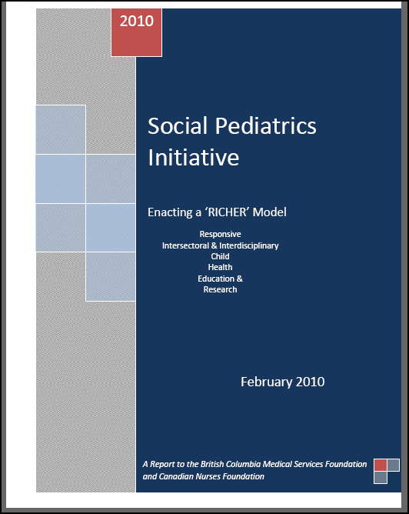

Slide 22
Faculty work in cIRcle
Emeritus Professor R.G. Matson Laboratory of Archaeology:
“cIRcle is searchable, has good use information, and, above all is reliable, in our world of constantly changing URLs.”
“We are impressed [with] the number of downloads recorded in cIRcle, indicating that it has a far wider circulation than we realized.”

Slide 23
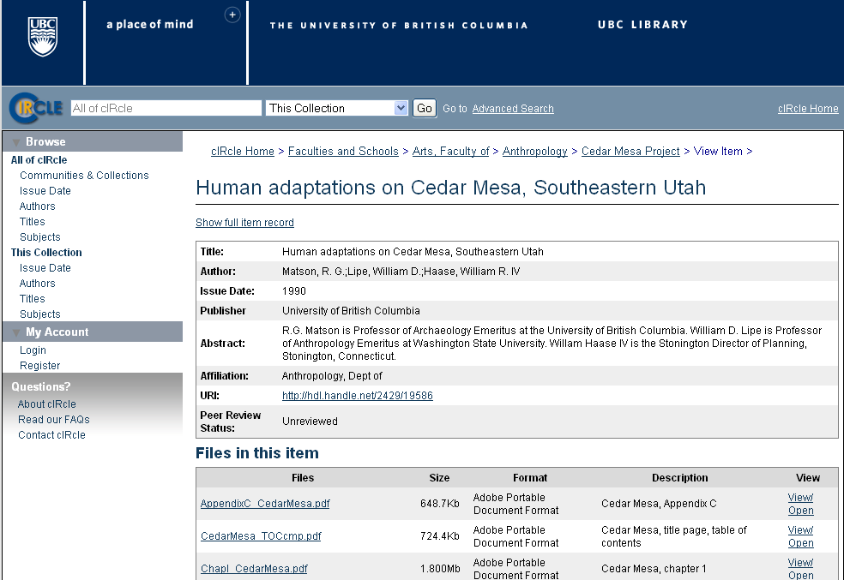

Slide 24
Student work in cIRcle
Andre Malan UBC undergraduate student
“Nothing makes me strive for excellence more than knowing that anyone in the world could see my work.”

Slide 25
Innovative Dissemination of Research Award
Recognizes and rewards innovative ways of communicating research
UBC students, faculty and staff are eligible
Awarded annually by UBC Library
2011 winner: Dimas Yusuf, 2nd Year UBC Medical Student for Transcription Factor Encyclopedia (Tfe) www.cisreg.ca/cgi-bin/tfe/home.pl

Slide 26
GSS cIRcle Open Scholar Award
Proposal for new Graduate Student Society Award to be launched in fall 2011
Incentive for graduate students to deposit non-thesis work (graded A or A+) in cIRcle
Biannual lottery—$$s!

Slide 27
Contact Information
Hilde Colenbrander
hilde.colenbrander@ubc.ca
https://circle.ubc.ca

