Slide 1
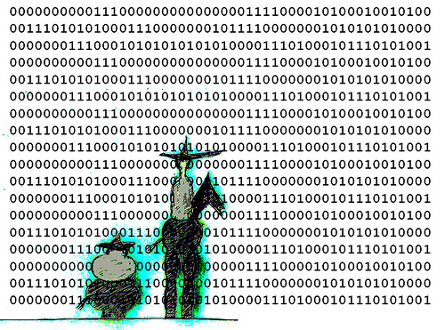
Research Data Management in Academic Libraries
Mayu Ishida
Qinqin Zhang
LIBR 559L
June 2011

Slide 2
Introduction
Data curation / Digital preservation
e-Science / e-Research
Research data management

Slide 3
Major Benefits
Accelerates scientific progress
Increases the visibility and impact of research
Ensures compliance with funding agency policies
Avoids duplication of research
Enables replication and verification of research results
Enhances collaboration

Slide 4
Background
Advancing information technologies
Data collection devices (e.g., sensors, satellites)
Data storage with more capacity for less money
“Data deluge” / data-centric research
Tradition of “open science”
Free exchange of ideas benefits all

Slide 5
Background continued
Promotion by public funding agencies
US
National Institutes of Health (NIH)
National Science Foundation (NSF)
Canada
Natural Sciences and Engineering Research Council (NSERC)
Sciences and Humanities Research Council (SSHRC)
Canadian Institutes of Health Research (CIHR)

Slide 6
Challenges
Raise awareness of data management
Reduce hidden and dispersed research data
Enforce data sharing mandates
Establish data and metadata standards
Different data practices in different disciplines
Provide data repositories and infrastructure
Centralized or distributed model?

Slide 7
Challenges continued
Foster culture of data sharing
Create incentives for data producers
Datasets as publications
Citations and DOIs for datasets
Tenure and promotion
“First crack” at the shared dataset to publish an article
Guidelines against misuse of shared datasets

Slide 8
Solutions - What academic libraries can do
Learn from other institutions with data management experience
US: MIT Libraries, Purdue University Libraries
UK: Digital Curation Centre
Educate faculty and students about data management
Subject librarians
Domain knowledge, working relationships with faculty
University archivists
Expertise in selection, appraisal, and preservation
Coordinate with funding agencies
Provide an institutional repository

Slide 9
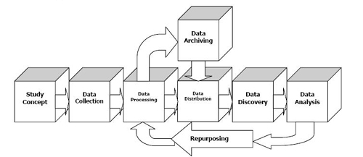
In the ideal case…
Plan from the beginning
User-friendly and comprehensive metadata and documentation
* Data Life Cycle from the MIT’s Data Management and Publishing website

Slide 10
Case Studies
Purdue University
e-Data http://www4.lib.purdue.edu/lcris/edata/
Part of Distributed Data Curation Center (D2C2)
e-Scholar searches across e-Data, e-Pubs and e-Archives
Massachusetts Institute of Technology
GeoData Repository http://libraries.mit.edu/gis/data/repository/about.html
University of Prince Edward Island
Islandora http://islandora.ca/about
Fedora, DSpace, REDcap

Slide 11
Case Studies continued
DYRAD
http://www.datadryad.org/
OpenDOAR Directory of Open Access Repositories http://www.opendoar.org/

Slide 12
Future Development
Cross-institutional, interdisciplinary and international collaborations
Examples:
Climate change studies
Purdue University and UIUC’s collaboration on developing Data Curation Profile

Slide 13
Thank you!

Slide 14
References
Text
Kasja Weenink, Leo Waaijers and Karen van Godtsenhoven. (2008). “A DRIVER’s Guide to European Repositories.” Web. 5 June 2011.
Gore, Sally A. “e-Science and Data Management Resources on the Web.” Medical Reference Services Quarterly 30:.2 (2011),:167 -177. Print.
CARL. 2009. “Research Data: Unseen Opportunities – An Awareness Toolkit commissioned by the Canadian Association of Research Libraries.” Web. 5 June 2011.
Borgman, Christine L. “Research Data: Who Will Share What, with Whom, When, and Why?” Beijing, 2010. Print.
---. Scholarship in the Digital Age: Information, Infrastructure, and the Internet. Cambridge Mass.: MIT Press, 2007. Print.
“CIHR Policy on Access to Research Outputs.” CIHR 29 Nov 2007. Web. 5 June 2011.
“DRIVER Search Potal.” Driver 2 June 2011. Web. 6 June 2011.
“Final NIH Statement on Sharing Research Data.” National Institutes of Health 26 Feb 2003. Web. 5 June 2011.
Hey, Tony, and Anne Trefethen. “The Data Deluge: An e-Science Perspective.” Wiley Series in Communications Networking & Distributed Systems. Ed. Fran Berman, Geoffrey Fox, & Tony Hey. Chichester, UK: John Wiley & Sons, Ltd, 2003. 809-824. Web. 5 June 2011.

Slide 15
References
“NIH Data Sharing Information.” National Institutes of Health 17 Apr 2007. Web. 5 June 2011.
“NSF Cyberinfrastructure: A Grand Convergence.” NSF. Web. 6 June 2011.
“NSF Dissemination and Sharing of Research Results.” National Science Foundation 30 Mar 2011. Web. 5 June 2011.
“NSF Grant Proposal Guide Chapter II.c.2.j.” National Science Foundation 13 Jan 2011. Web. 6 June 2011.
“Open Knowledge Commons.” Open Knowledge Commons. Web. 5 June 2011.
Salo, Dorothea. “Innkeeper at the Roach Motel.” Library Trends 57.2 (2008) : 98-123. Web. 6 June 2011.
“Science.gc.ca Access to Research Results: Guiding Principles.” Science and Technology for Canadians 17 Nov 2010. Web. 6 June 2011.
“SSHRC Research Data Archiving Policy.” SSHRC 5 May 2011. Web. 5 June 2011.
“Why Open Access?” SPARC. Web. 5 June 2011.
Images
verbeeldingskr8. “Don CodeShot. “ Web. 4 June 2011. Under Creative Commons Licensing.
MIT Libraries. “Data Life Cycle.” Web. 5 June 2011.

Slide 16
Resources
“Data Management and Publishing” by MIT Libraries
http://libraries.mit.edu/guides/subjects/data-management/index.html

