Slide 1
The Collaborative Environment: The Use of Wikis in Scholarly Communication
Will Engle
LIBR 559L
June 14, 2010

Slide 2
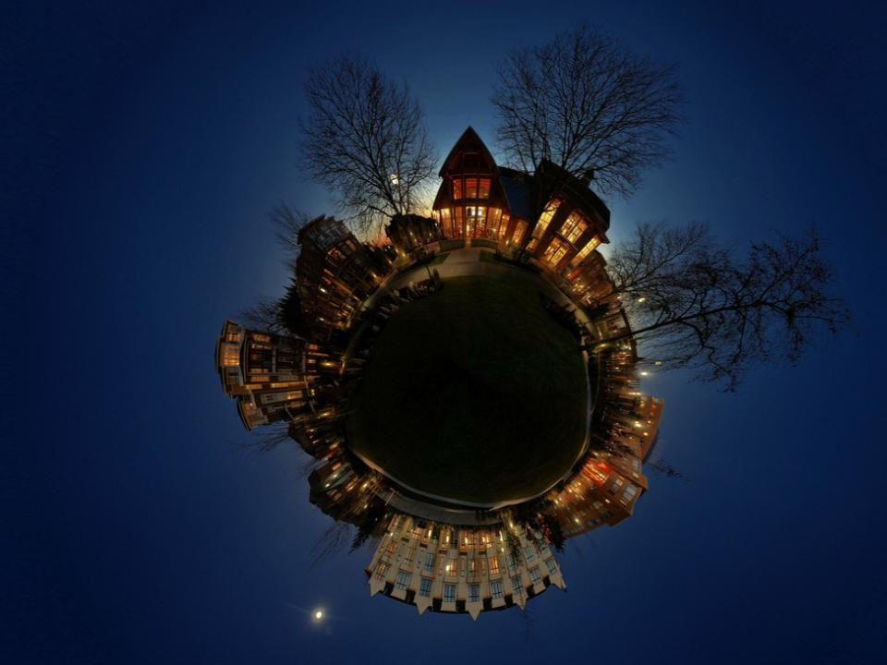
A wiki is a tool for distributed collaboration
Notes:
Wiki is a content management system that uniquely facilitates collaboration

Slide 3
Scientific and scholarly advancement are processes of collaboration
__
Research builds upon, challenges, or reuses previously published knowledge
(Panton Principles, n.d.)
Notes:
It’s important to acknowledge that scientific and scholarly advancement are a process of collaboration. Research builds upon, challenges, or reuses previously published knowledge. Research is often done by teams; for examples, Scientific articles are typically co-written by labs or by other collections of colleagues, because most experiments cannot be done by just one person; scientific discoveries are now typically made by several or many people cooperating (Sanger, 2008).

Slide 4
Early Wikipedia Model:
A serious encyclopedia in which the results were not proprietary, but were freely distributable in any desired medium
Notes:
In the year 2000, Jimmy Wales and Larry Sanger launched their first online encyclopedia called Nupedia. Had in place a process not to different from publishing in a real encyclopedia or, for that matter, a journal. Scholars and experts we invited to write and submit and article. Once that article was submited, it would then go through a review process, be copyedited, given final approval, then turned over to a web expert that would do the mark-up and post it online.
Nupedia was exciting in the idea that article were not going to be proprietary but were freely distributable under a GNU Free Documentation License
...in virtually any desired medium.
The question.. How fast would it grow? (Shirkey, 2008).

Slide 5
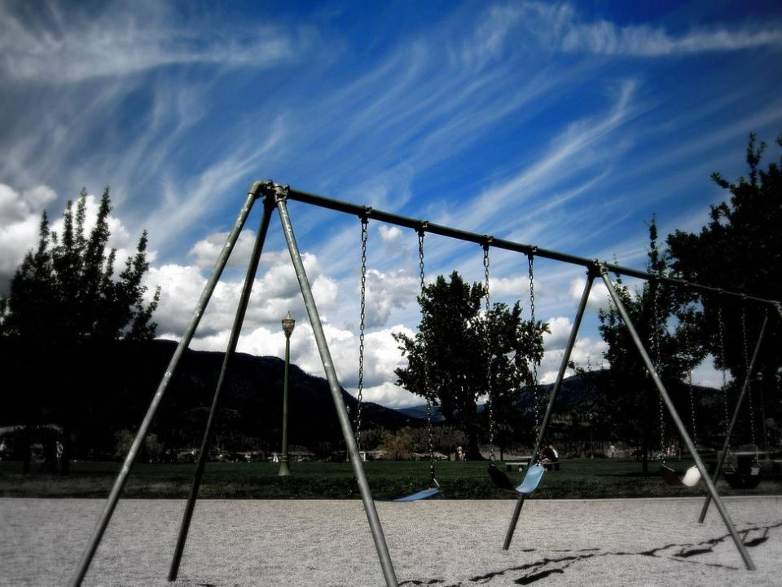
Not very quickly
Notes:
Nupedia launches in March 2000
In November 2000, only 2 full length articles are published
after 9 more months, only 20 finished articles

Slide 6
Ward Cunningham: Groups of people who want to collaborate also tend to trust one another
Notes:
Ward Cunningham -
1995 creates first wiki
Radical thought:
Groups of people who want to collaborate also tend to trust one another
Observed that most of the tools for collaboration were concerned with complex collections of roles and requirements - only designated writers could create text, only editors could approve text, only web masters could publish it, etc. (Shirky, 2008)

Slide 7
No distinction between reader and writer
Version control
Notes:
-No distinction between the idea of editor and reader; a user can move between those two roles
-Every wiki page is the sum of total changes with all earlier edits stored as historical documentation (version control)
-not much has changed
Back to wikipedia:
in 2001,
Wales and Sanger decided to try creating a collaborative website using Ward Cunningham’s Wiki Model as a way to provide an additional source of collaborativly-produced draft articles that could be then expanded, reviewed, and polished for use on Nupedia.
Results:
advisory board hates it
-offended their mission of creating a rigorously controlled knowledge base, designed and edited by experts
-must move to their own url and thus wikipedia is born.
--Sanger emails his mailing list asking them to humor them and take 5 or 10 minutes to write a new article,
-within weeks, it has more articles than nupedia,
-by end of the first year, 15,0000 articles have been posted to wikipedia
-in 2003, Nupedia is shut down – it contains a total of 24 articles that have gone through its review process (and has 74 more in progress).
-in 2005, the scientific journal Nature publishes a study that shows in Scientific Topics at least, Wikipedia content rivals the the Encyclopedia Britannica in accuracy
-
In 2005, the Scientific Journal publishes a study

Slide 8
Can Wikis be Used to Improve Scholarly Communication
And Collaboration?
Notes:
Wikipedia shows that the wiki model of collaboration is valid and can be successful; however, can it be applied to scholarly communication?

Slide 9
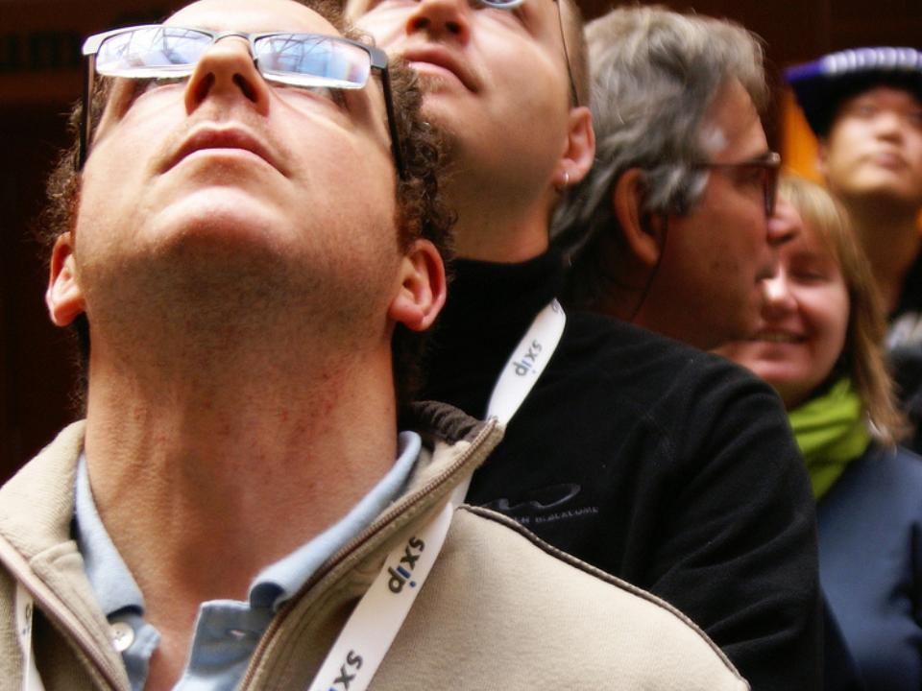
It depends
Notes:
-Wikis are still emerging technology
-It depends on how you define scholarly communication
It depends on how your define collaboration
Nature surveyed more than 1,000 Nature authors and found that although more than 70% had heard of Wikipedia and 17% of those con- sulted it on a weekly basis, less than 10% help to update it.

Slide 10
Three Aspects of Scholarly Communication
Conducting research, developing ideas and communicating informally with other scholars and scientists
Preparing, shaping and communicating to a group of colleagues what will become formal research results
The ultimate formal product that is distributed to libraries and others in print or electronically
(Thorin, 2006)
Notes:
Suzanne Thorin’sThree aspects
First, there’s the phase where you conduct research, develop ideas, and communicate informally
Second, preprint phase –shapng and communicating what will become formal research results (peer review)
Third, the ultimately published article. Book, bookchapter, etc that gets collected by libraries and others

Slide 11
Larry Sanger (2008):
Derivative versus Original Communication
Notes:
. Should science communication be collaborative
Original communication is aimed at advancing knowledge in the field with never-before-published findings, discoveries, first-hand accounts, survey data, theories, arguments, proofs, and so forth.
Derivative communication sums up what is already known, takes the form of encyclopedia articles, textbooks, and popular science books and magazines.
I would say that databases fall in the middle of these two (raw data is not necessarily derivative, but without analysis or processes, it is not quite original communication
---

Slide 12
The purpose of a scholarly journal is not only to disseminate information to the community but, in its present configuration, it also provides quality control, a trusted archive and author recognition.
(Rowland, 1997)
Notes:
But the location of the article in a distinguished journal is paramount because it helps to ‘brand’ the author by linking her/his name and work to that journal. …The author is placed in an exclusive ‘club’ of the very best researchers and his/her ability to get grants, tenure and promotion is enhanced.(Thorin, 2006)

Slide 13
Advantage of Wikis
Central repository for information
Central repository for communication
Tracking and revision
Intertextuality
Notes:
They act as Central Repository for Information - it becomes the central database for knowledge/Information gaps can easily be filled
Discussion – most modern wikis platforms come with built in discussion pages/forums and are connected to the discussion topic at hand – that discussion is centrally located at the information point
Version control – changes can be tracked and reversed.
Information is not static – information can be linked and contectualized. Math articles/dissertations/thesis are often published in a linear article or paper but not read that way as readers often need to contextual info such as a specific theorem that the author is building an argument upon.
Frequent users also see opportunities for raising their profile within their communities and laying foundations for future collaborations (Procter et al., 2010)

Slide 14
In the standard scholarly publishing environment, updating information requires the generation of a new article.
(Mietchen et al., 2011)
Notes:
Wikis are dynamic
Dynamic articles can evolve with the content and their focus may shift over time. In the context of science, dynamic publications could thus integrate scientific discourse and be potentially always up to date. In a scientific wiki, for instance, there would be no explicit errata, only improved versions of an article.

Slide 15
Barriers to Use
Lack of credit or ownership
Lack of control
Perceptions about quality and scholarly merit
Need for static, citable/archivable end-product
Notes:
Despite the fact that research in general is a highly dynamic process, it is required that the researcher frequently delivers a static output of his work. This output must be citable so that it can be used by the research community

Slide 16
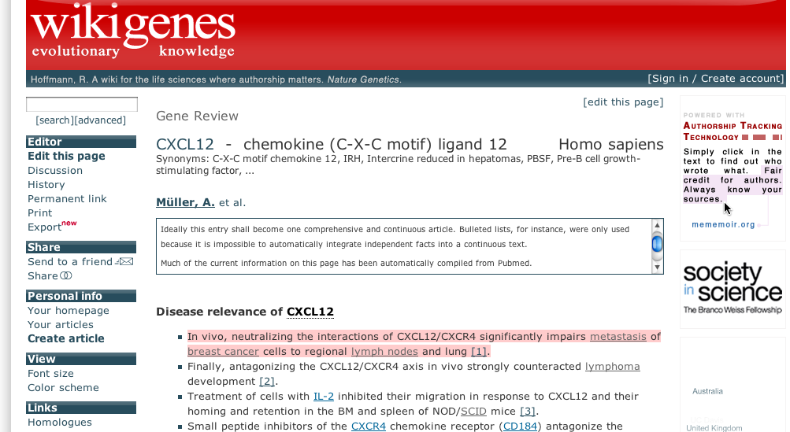
Wikigenes:
A wiki for the life sciences where authorship matters.
Notes:
The rationale behind WikiGenes is to provide a platform for the scientific community to collect, communicate and evaluate knowledge about genes, chemicals, diseases and other biomedical concepts in a bottom-up process b/c the traditional publishing model is too slow to keep up with the advancements and knowledge made in this arena.
users can rate each other,
and a self-regulating reputation system can be implemented
‘Open access

Slide 17
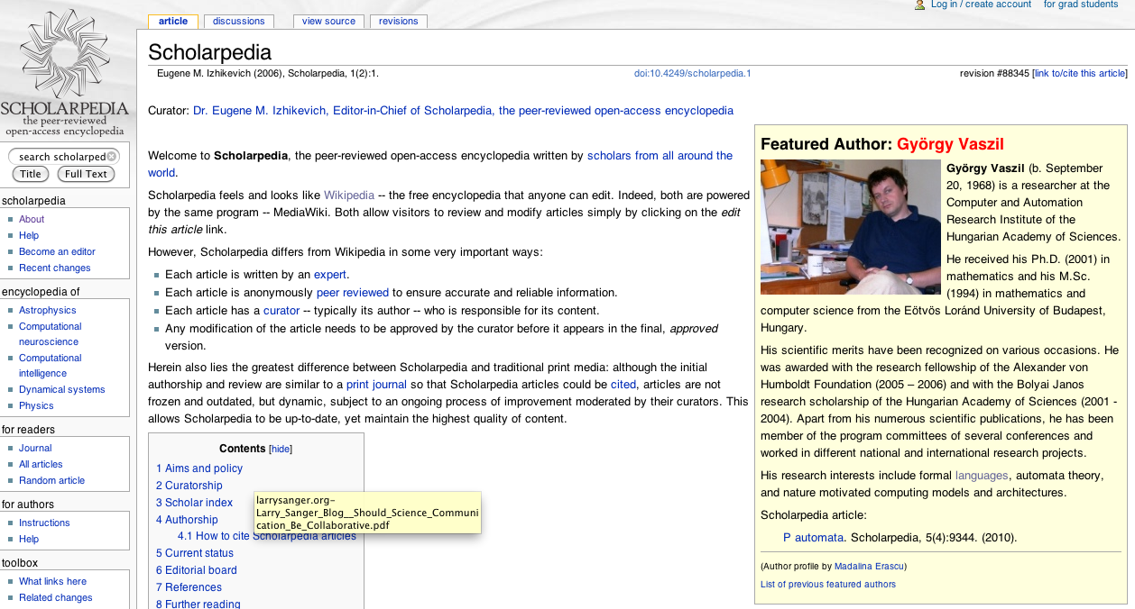
Scholarpedia
Notes:
Each article is written by an expert.
Each article is anonymously peer reviewed to ensure accurate and reliable information.
Each article has a curator -- typically its author -- who is responsible for its content.
Content is Dynamic and updatable

Slide 18
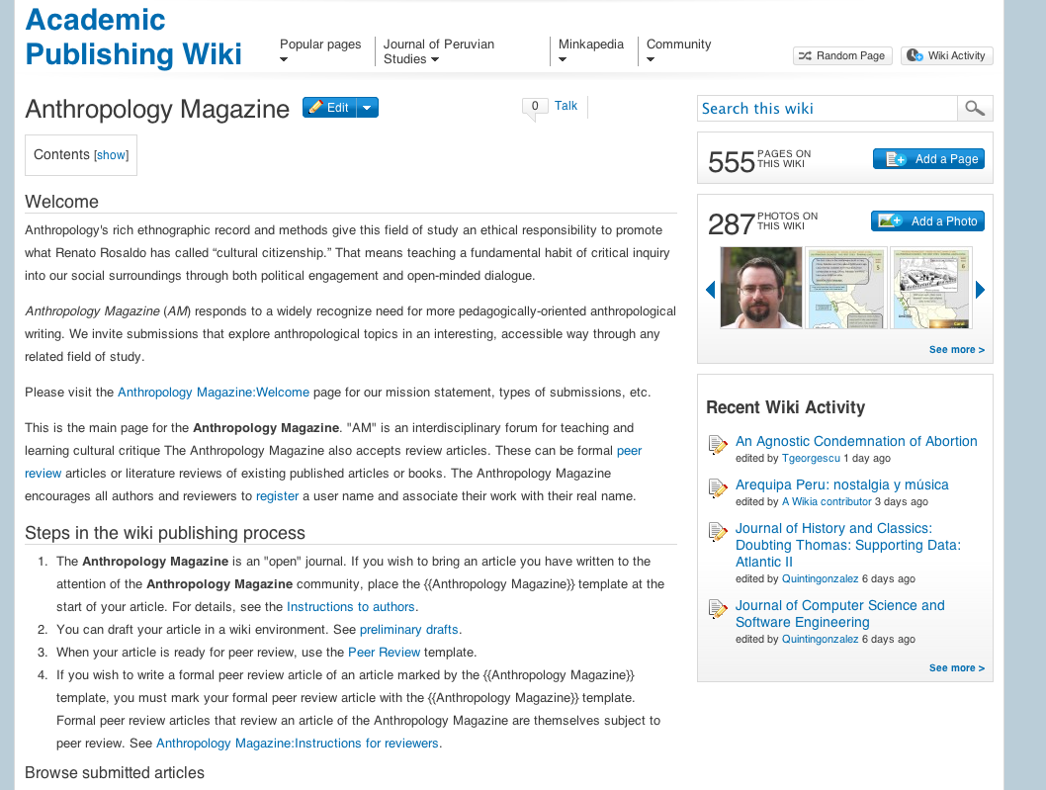
Notes:
Anthropology Magazine –
A wiki journal
Peer review
Reviews count as wiki articles available for reading
Anthropology Magazine is committed to the idea that the fruits of intellectual activity should be widely distributed, without the restrictions to distribution that can be imposed by copyright. In particular, if you publish your article in Anthropology Magazine, you explicitly give up your right to have control over the production of copies of your article and you give up your control over the right of others to create derivative works.

Slide 19
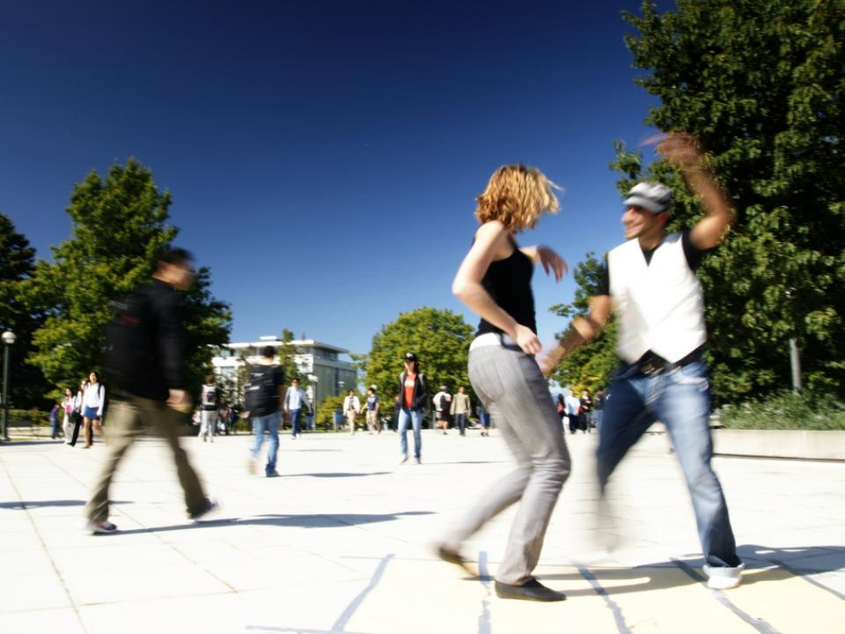
Outlook
Notes:
Time: 1:22
Novak

Slide 20
Semantic Wikis
Information can be given meaning so that can it might function like a table in the relational database system
Notes:
Semantic mark up gives well-defined meaning, better enabling computers to process information like a database

Slide 21
The Formal Product Is Changing
Explosion in research
Explosion in pricing
Libraries changing from owning intellectual works to merely licensing them
Impact Factor Spiral
Digital communication

Slide 22
Public & Transparent Peer Review:
Wikis are used for transparent peer review. Reviewers could even edit the submitted text by themselves rather than writing a report about what should be changed.

Slide 23
Larry Sanger (2008):
An article that is written with a large and diverse set of authors—particularly if it is under the gentle guidance of experts—can be expected to be lengthier, broader in its coverage, and fairer in its presentation of issues.
Notes:
End on this note:
Sanger recommends a middle route:
An article that is written with a large and diverse set of authors—particularly if it is under the gentle guidance of experts—can be expected to be lengthier, broader in its coverage, and fairer in its presentation of issues, than an article written by a single or a few hand-chosen authors.
It will be longer, because many collaborators will compete with each other to expand the article. It will be broader in its coverage, because the collaborators often can fill up gaps in exposition that others leave. It will be fairer in its presentation of issues, because self-selecting collaborators in a very open project will tend to have a diversity of views, and they must compromise in order to work together at all.

Slide 24
References
Arita, M. (2009). A pitfall of wiki solution for biological databases. Briefings in Bioinformatics, 10(3), 295 -296. doi:10.1093/bib/bbn053
Grace, T. P. L. (2009). Wikis as a knowledge management tool. Journal of Knowledge Management, 13(4), 64-74. doi: 10.1108/13673270910971833
Hinten, C. V., Hense, A., & Razum, M. (2008). A Wiki for Collaboration and Publication in Research. 2008 IEEE Fourth International Conference on eScience, 790-794. Ieee. Retrieved from http://ieeexplore.ieee.org/lpdocs/epic03/wrapper.htm?arnumber=4736900
Hoffmann, R. (2008). A wiki for the life sciences where authorship matters. Nat Genet, 40(9), 1047-1051. doi:10.1038/ng.f.217
Huss, J. W., Orozco, C., Goodale, J., Wu, C., Batalov, S., Vickers, T. J., Valafar, F., et al. (2008). A Gene wiki for community annotation of gGene Function. PLoS Biol, 6(7), e175. doi:10.1371/journal.pbio.0060175
Procter, R., Williams, R., Stewart, J., Poschen, M., Snee, H., Voss, A., & Asgari-Targhi, M. (2010). Adoption and use of Web 2.0 in scholarly communications. Philosophical Transactions of the Royal Society A: Mathematical, Physical and Engineering Sciences, 368 (1926), 4039-4056. doi:10.1098/rsta.2010.0155
Sanger, L. (2008). Should science communication be collaborative? Plenary address at 10th conference of the International Network on Public Communication of Science and Technology. Retrieved from http://larrysanger.org/2008/06/should-science-communication-be-collaborative/
Shirky, C. (2008). Here comes everybody : the power of organizing without organizations. New York: Penguin Press.
Thorin, S. E. (2006). Global Changes in Scholarly Communication. In H. S. Ching, P. W. T. Poon, & C. McNaught (Eds.), eLearning and Digital Publishing (Vol. 33, pp. 221-240). Berlin/Heidelberg: Springer-Verlag. Retrieved from http://www.springerlink.com.ezproxy.library.ubc.ca/content/w873x131171x2421/

Slide 25
Photo Credits
All photos by http://www.flickr.com/photos/rogic/. Used with permision from the creator.

