Slide 1
Creating Safe Spaces and Self Care
Notes:
® Restricted use/access limited only to volunteer/staff capacity with The AMS Sexual Assault Support Centre, UBC Vancouver, Musqueam Territory.
45 minutes
Bring:
-SASC brochures, promotional material
-SASC USB stick with presentation on it; hard copies of speaking notes/slides

Slide 2
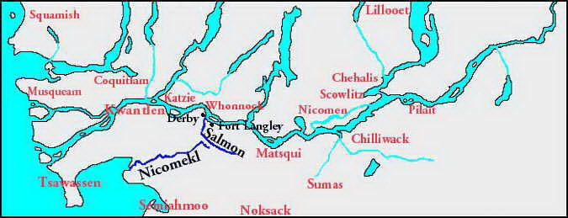
Notes:
Acknowledgment:
Vancouver is on the ancestral, traditional and unceded, and land of the Coast Salish peoples, specifically Musqueam, Squamish, and Tsleil-Waututh
Ask participants why its important to do an acknowledgment, especially given the subject matter.
Facilitator introduction:
Introduce self and the SASC.
Group round:
Name, pronoun, why you are taking this course

Slide 3
Sexual Assault Support Centre (SASC)
We provide UBC campus community members of all genders access to specialized sexual assault services, which include:
Crisis and short-term emotional support
Legal, medical, and campus-related advocacy
Resource area located within The SASC
Community Lending Library
Referrals to a variety of services, within UBC and/or off campus
Outreach services
Volunteer program for UBC students
Notes:
About the Sexual Assault Support Centre, we offer...
We provide UBC campus community members of all genders access to specialized sexual assault services, which include: -Crisis and short-term emotional support for survivors of sexual assault, and/or any other forms of violence -Legal, medical, and campus-related advocacy -Resource area located within our space in the Student Union Building – brochures, condoms, pregnancy tests, menstrual products, buttons, etc -Community Lending Library -Referrals to a variety of services, within UBC and/or off campus -Outreach services, including public education, workshops, community and volunteer training -Volunteer program for UBC students

Slide 4
*Trigger Warning
Notes:
Discuss with group:
-Ask folks if they have seen *trigger warning before, what does it mean?
-Acknowledge that some of the topics discussed will be triggering
-You are all here for different reasons, some of you may be new to this topic, other well versed
-Important to realise that everyone in this room has their own experiences with violence, sexual assault affects 1 in 4 women, 1 in 6 men, 1 in 2 trans identified individuals
-Discuss that survivors respond in a variety of ways including anger, anxiety, depression, try to bury feelings. Often folks learning about this topic can also feel various emotions, so be mindful of how its affecting you.

Slide 5
Creating Safe Spaces
Notes:
Group Discussion:
Ask group to think about a safe space for them. What does it look like, smell like, feel like, sound like.
Now ask group what a safe space looks like, and how in this class we can create a safe space- List things on a whiteboard.
-Create guidelines, make sure not to miss:
Confidentiality
Use proper pronouns
Leave if you need to
Be respect of language
Be mindful of your positioning in the world. Give example
Acknowledge your limits/boundaries
Check in with The SASC or utilize the website if needed
Don’t forget to take care of yourself

Slide 6
Supporting Survivors
Notes:
-It’s important to discuss supporting a survivor techniques as you go into the course to contribute towards creating a safe space.
-Ask group to share some do’s and don’t’s for supporting a survivor

Slide 7
Do:
Listen. Refrain from offering advice
Tell them “It’s not your fault”
Believe the person’s story
Recommend resources and other helpful services if needed
Let them make their own decisions about what they want to do
Maintain confidentiality
Be aware of language and cultural differences/ barriers
Set your own boundaries
Don’t:
Ask why
Make decisions for them
Buy into sexual assault myths
Be a superhero or rescuer
Apply your own labels
Press for more details
Forget to take care of yourself
Notes:
Make sure to mention these

Slide 8
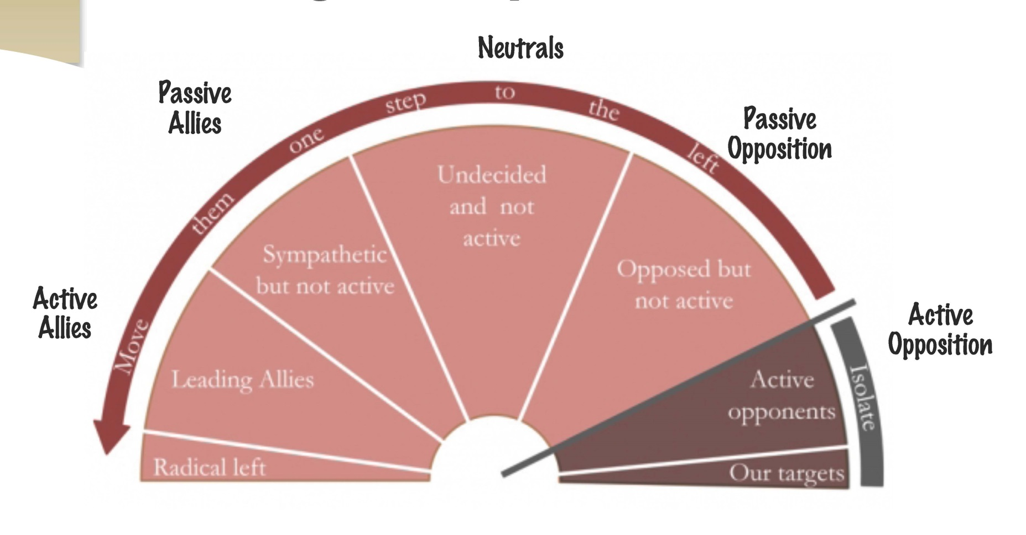
Spectrum of allies
Notes:
-You are all here for a reason, because you want to learn more about this topic- would you describe yourselves as allies?
-Discuss diagram
-Think about the UBC community, people you know and where perhaps other folks lie on it.
-Being an allie is life long work and part of it is interacting with passive opponents and educating them on these topics. It’s not easy, but its how change happens.

Slide 9
Self Care
Notes:
-As discussed before this is a triggering topic and as well as creating a safe space in the classroom its important to be mindful of practising self care when you leave.
-Self care comes in many forms including psychical, mental, spiritual. Think about some examples of what you do for self care from going swimming to seeing your therapists or taking medication for anxiety.
-Discuss the flower diagram:
-The ground/earth is what’s grounding you, anchoring you, etc (eg. Faith, Yoga, coping skills, meditation, meds, etc)
-The space around the flower/above the earth is what’s supporting/holding up the flower (eg. Family, friends, pets, etc)
-The petals are self-care activities that one is currently doing or is planning to begin (eg. Exercise, mindfulness, more sleep, read, etc)
Ask group to fill out the flower and use it throughout the course to keep grounded.

Slide 10
Location: UBC Vancouver campus,
Student Union Building,
2nd floor - #249M
Telephone: (604)-827-5180
Hours: Monday-Friday 9am-5pm
Web: www.gotconsent.ca | Find us on
Notes:
Thank you!

