Slide 1
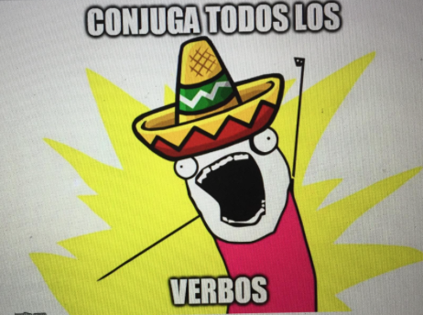
Los Verbos Regulares -AR
Regular –AR verbs

Slide 2
In Spanish there are three types of regular verbs, those that end in –AR, -ER and –IR
This ending sets up a pattern for how the verb will be conjugated.
-AR verbs in Spanish are the most common type and the easiest to conjugate. The difficulty is that there are so many to learn.

Slide 3
Hablar: To speak
Yo hablo -o
Tú hablas -as
Usted habla -a
Él/ella (Juan) habla -a
Nosotros hablamos -amos
Ellos/ellas hablan -an
Ustedes hablan -an

Slide 4
Examples
-Rosa, tú hablas español ¿no?
Rosa, you speak Spanish right?
-Sí, hablo español y francés.
Yes, I speak Spanish and French.
-¿Qué idioma hablan ustedes en casa?
What language do you all speak at home?
Hablamos inglés en casa.
-We speak English at home.

Slide 5
Regular verbs that end in -ar conjugate the same way as hablar, verbs such as :
Conversar To chat, converse
Desear To want, wish
Estudiar To study
Hablar To speak
Necesitar To need
Terminar To finish
Tomar To take, to drink
Trabajar To work

Slide 6
-¿A qué hora terminas tu clase?
What time do you finish your class?
-Termino a las cinco.
I finish at five.
-¿Qué necesita usted?
What do you need?
-Necesito un lápiz y un cuaderno.
I need a pencil and a notebook

Slide 7
Because the conjugated verb indicates the speaker, the subject pronoun is usually not included. However, it is necessary to use it more often with habla and hablan because él/ella/Ud (and ellos/ellas/uds. )all have the same conjugation
When one verb is used right after another, the second one isn´t conjugated:
Deseo hablar con Alberto.
Necesitamos estudiar esta noche.

Slide 8
“hablo” can mean either “I speak” or “I am speaking” . In Spanish the simple present tense is used for both the present and progressive tenses.
Roberto trabaja hoy y mañana.
Roberto is working today and tomorrow.

