Slide 1
TDI Facilitator Training
2019-2020 Pilot
Notes:
Hello
You have come to the TDI Facilitator Training for our 2019-2020 Pilot Study.
This module has been developed at the Human Early Learning Partnership at the University of British Columbia.

Slide 2
Welcome!
We are grateful that your community is taking part in the Toddler Development Instrument (TDI) pilot project.
This presentation will provide you with information about the TDI project and your important role as a TDI facilitator.
Notes:
Welcome to the TDI facilitator training for the 2019 TDI pilot.
We are so grateful that your community has agreed to take part in the Toddler Development Instrument (TDI) pilot project.
This presentation will provide you with more information about the project and your important role as a facilitator of the TDI.

Slide 3
OVERVIEW
TDI Introduction
What is the TDI?
Background and purpose
TDI Pilot Details
TDI timeline
Who is participating?
Facilitating the TDI
TDI facilitator’s role
Ethics requirements
TDI materials and resources
Notes:
Here is an overview of the material we will be covering.
The training will begin with an introduction to the TDI. I will explain: what is the TDI, I will provide you with some background information, and I will explain the purpose of the TDI project.
In the second part, we provide details for the TDI pilot project. We will show the timeline for the TDI project and we will also show you which communities and which professionals working with young children and their families are participating.
Finally, we will provide you with all of the key information you and your community need for facilitating the TDI. We will walk through the steps you need to know in your role as a TDI facilitator. We will explain how to make sure that all ethics requirements are in place, and we will point you to additional TDI materials and resources that we prepared for you.

Slide 4
TDI Introduction
Notes:
So, let me introduce the TDI to you.

Slide 5
What is the TDI?
15 minutes
Participation is voluntary
All responses are confidential – individual responses will NOT be made public
Survey
Notes:
What is the TDI? The TDI is a survey for collecting information on the experiences of toddlers and their families. The TDI was developed at HELP in collaboration with parents and caregivers, ECD professionals, policy makers, and researchers. The TDI survey takes 15 minutes to complete, participation is completely voluntary and all responses are confidential – individual responses will NOT be made public.

Slide 6
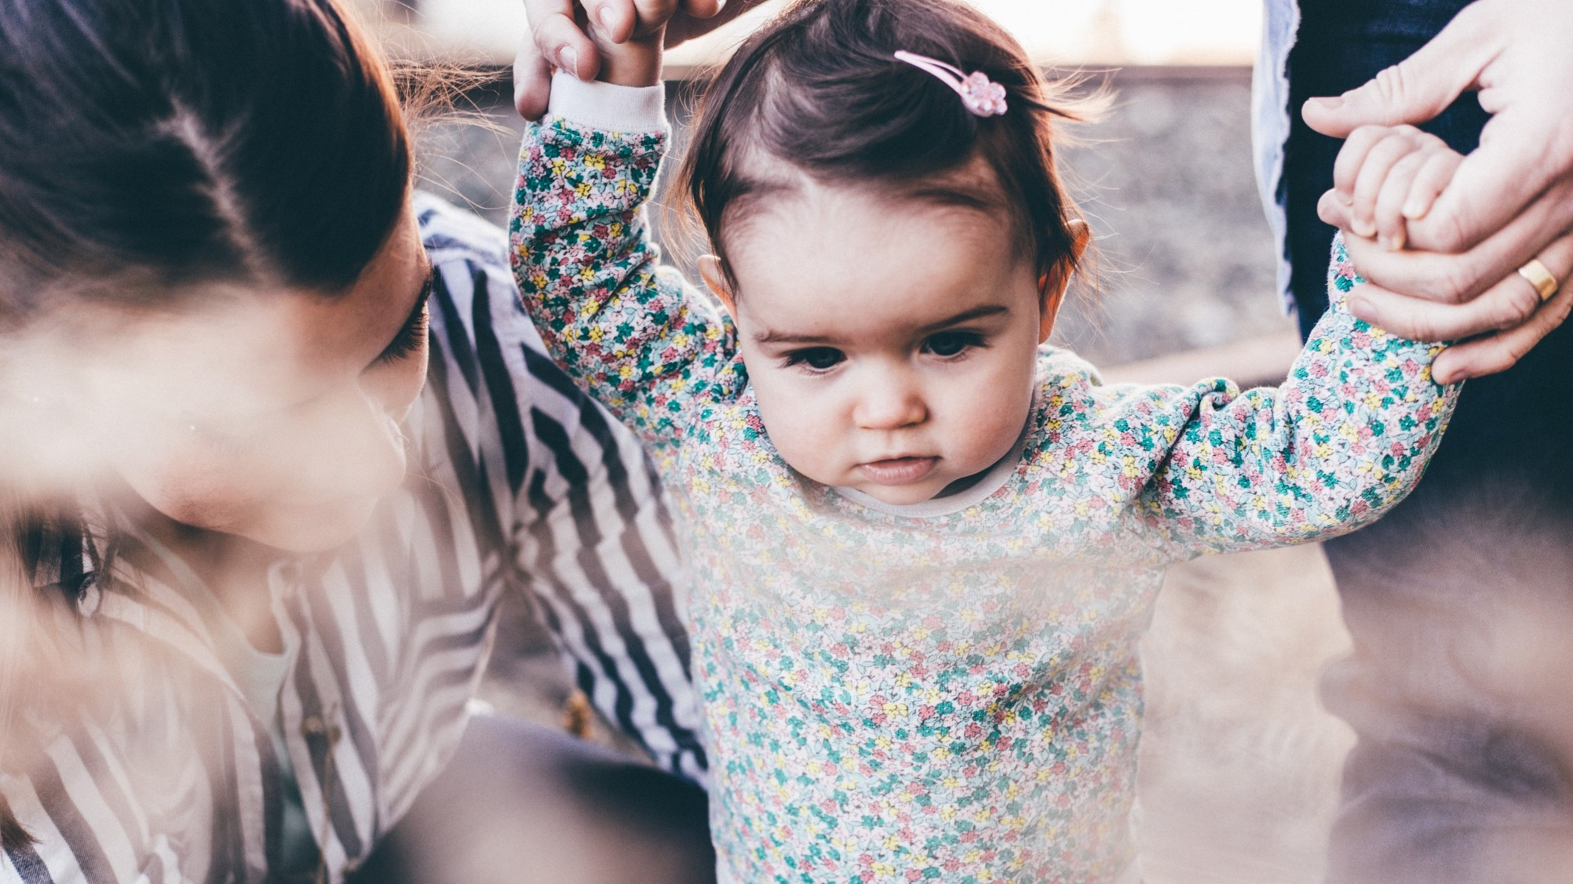
Who fills out the TDI?
Parent-completed
12 – 24 months old
Notes:
The TDI survey is to be completed by parents or primary caregivers of toddlers, specifically children between 12 and 24 months of age.

Slide 7
Why is the TDI Important?
Evidence to inform local planning
Notes:
Information collected on the TDI will help inform planning in your community to improve supports for families with young children. Once we have collected the information, we aim to share community-level summaries with local early years professionals and other community stakeholders so that they may in turn use the information as evidence to inform local planning. Ultimately, we anticipate that this process of collecting, sharing, and applying community-level information obtained directly from families will help to build and strengthen resources and support systems for young children and their families.

Slide 8
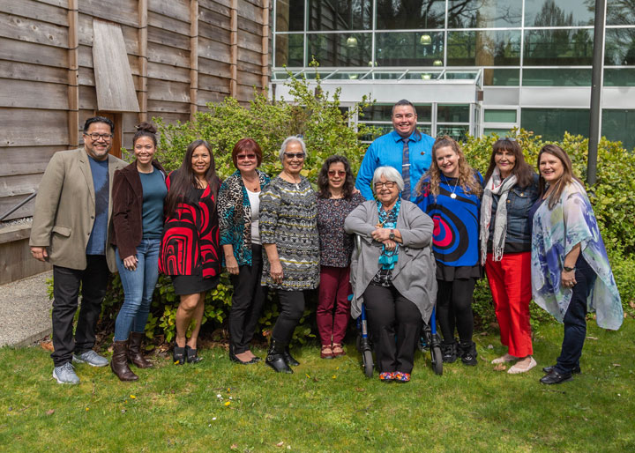
TDI development & background
Notes:
The TDI was developed in Canada through years of collaboration, and in partnership with many stakeholder groups: including researchers from across Canada, community-based professionals working with young children and their families, HELP’s Aboriginal Steering Committee, managers in the health and education sectors, government staff, and parents of toddler-aged children.

Slide 9
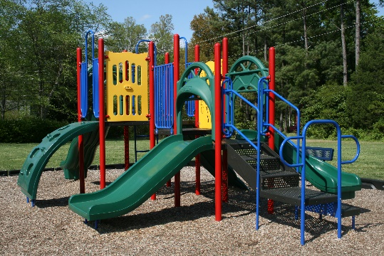
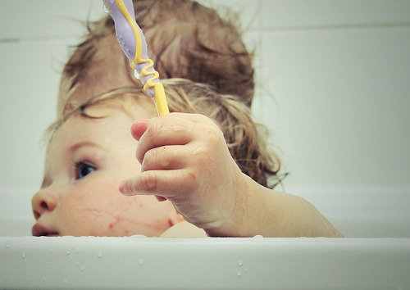
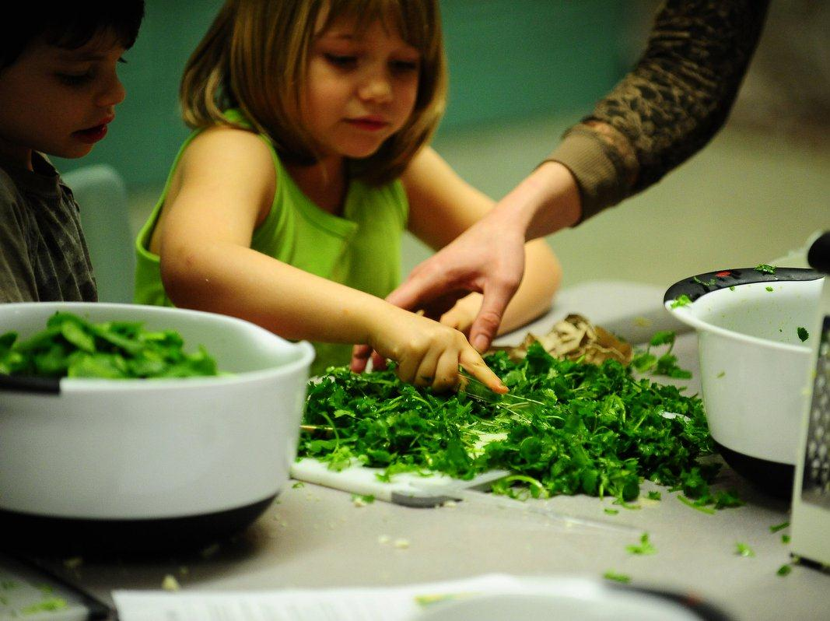
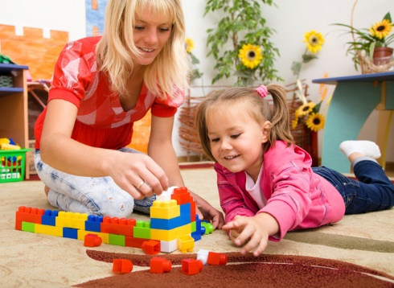
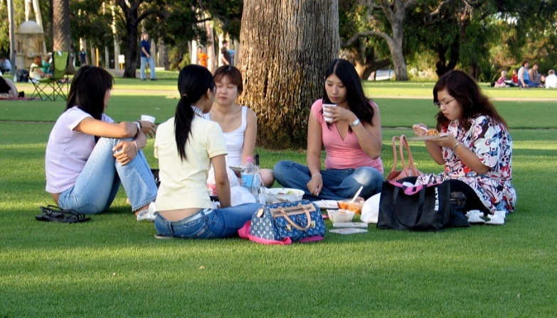
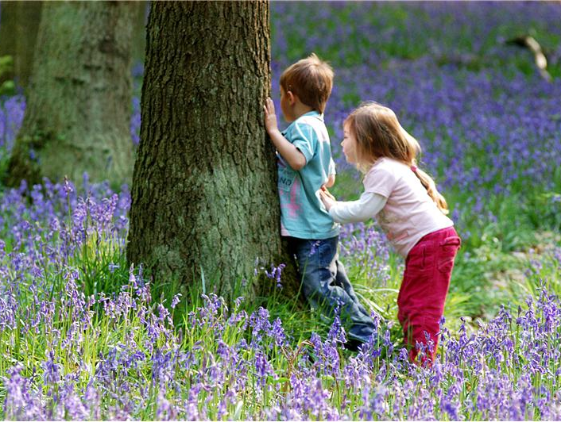
Topics covered on the TDI
Community Resources
Social Supports
Caregiver Well-being & Context
Social Conditions → Wellbeing & Development
Health-related behaviors
and resources
Child Activities
Notes:
The TDI covers a range of topics including:
Multiple topics are covered on the TDI – All questions on the TDI are fundamentally important for understanding how the social conditions in which children grow up affect their wellbeing and development
First, the TDI asks about children’s daily activities, such as outdoor play, screen time, spending time with other children and interactions with their caregivers.
Second, we ask about Health-related behaviours and resources such as nutrition and sleep, brushing teeth, immunizations, and access to the health care system
The TDI also asks questions about the Caregivers and about the context in which they are raising children
This includes questions about the social support that families receive from their family, friends, and neighbors,
Questions about Access and barriers to community resources, such as childcare, playgrounds, and family services, and finally, some demographic and socioeconomic questions, to acknowledge the financial and economic context as well as social and cultural factors that affect the day-to-day experiences of families with young children
questions such as parent education, employment, income.

Slide 10
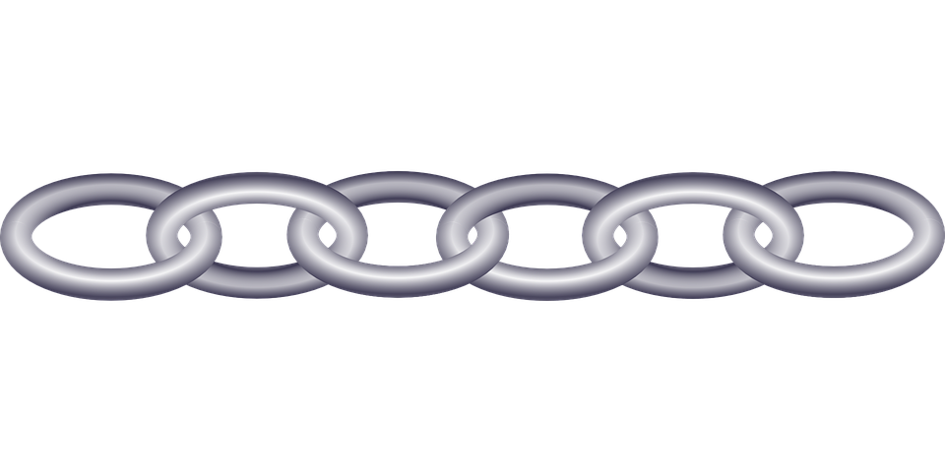
HELP’s Monitoring System
Notes:
The TDI is part of a longitudinal child development monitoring system at the Human Early Learning Partnership, UBC. Some of you may be familiar with some of the other HELP tools and data resources – you may even have used information collected through these tools to inform decision making within your organization or community.
If we are able to demonstrate the feasibility of using the TDI in communities such as yours, the long-term goal is to link the TDI information on families with young children with data from the other tools -- so that we can observe what is happening with children over time, and which factors make a difference for the health and wellbeing of our children.
We anticipate that Collecting and sharing data from the TDI and HELP’s other child monitoring tools will help us understand how we, in communities in British Columbia, can build a early childhood support system that helps all children and families thrive.

Slide 11
HELP’s Monitoring System
Parent-
completed
Notes:
With HELP’s monitoring system, we are trying to capture the voices of parents, teachers, and children themselves. The TDI is completed by parents of toddlers.
A unique aspect of HELP’s monitoring system is that the different surveys capture the voices of different stakeholder groups.
The TDI is completed by parents of toddlers.

Slide 12
HELP’s Monitoring System
Parent-completed
Parent-
completed questionnaire
Parent-
completed questionnaire
Notes:
The CHEQ – which stands for Childhood Experiences Questionnaire – is similar to the TDI. It contains similar questions and is also completed by parents.
The important difference is that the CHEQ is filled out by parents when their children start school – that is, parents complete the CHEQ t the beginning of the kindergarten year.

Slide 13
HELP’s Monitoring System
Teacher-completed
Parent-
completed questionnaire
Parent-
completed questionnaire
Teacher-
completed questionnaire
Notes:
The EDI – which stands for Early Development Instrument – captures the voice of teachers. The EDI is completed by kindergarten teachers during the middle of the kindergarten year, and gives us holistic information on children’s social competence, emotional maturity, physical health and wellbeing, their cognitive development, and their communication skills.

Slide 14
HELP’s Monitoring System
Self-completed
Self-
completed questionnaire
Notes:
The MDI – the Middle Years Development Instrument – captures the voice of children themselves.
The MDI is completed by children in elementary school, in grades 4 and grade 7. On the MDI, children can tell us about their wellbeing, their social relationships with peers and with adults, and how they spend their time out of school.

Slide 15
HELP’s Monitoring System
Parent-
completed questionnaire
www.help.ubc.ca
Self-
completed questionnaire
Notes:
Further information on HELP’s monitoring system and all our surveys can be found at HELP’s website: help.ubc.ca

Slide 16
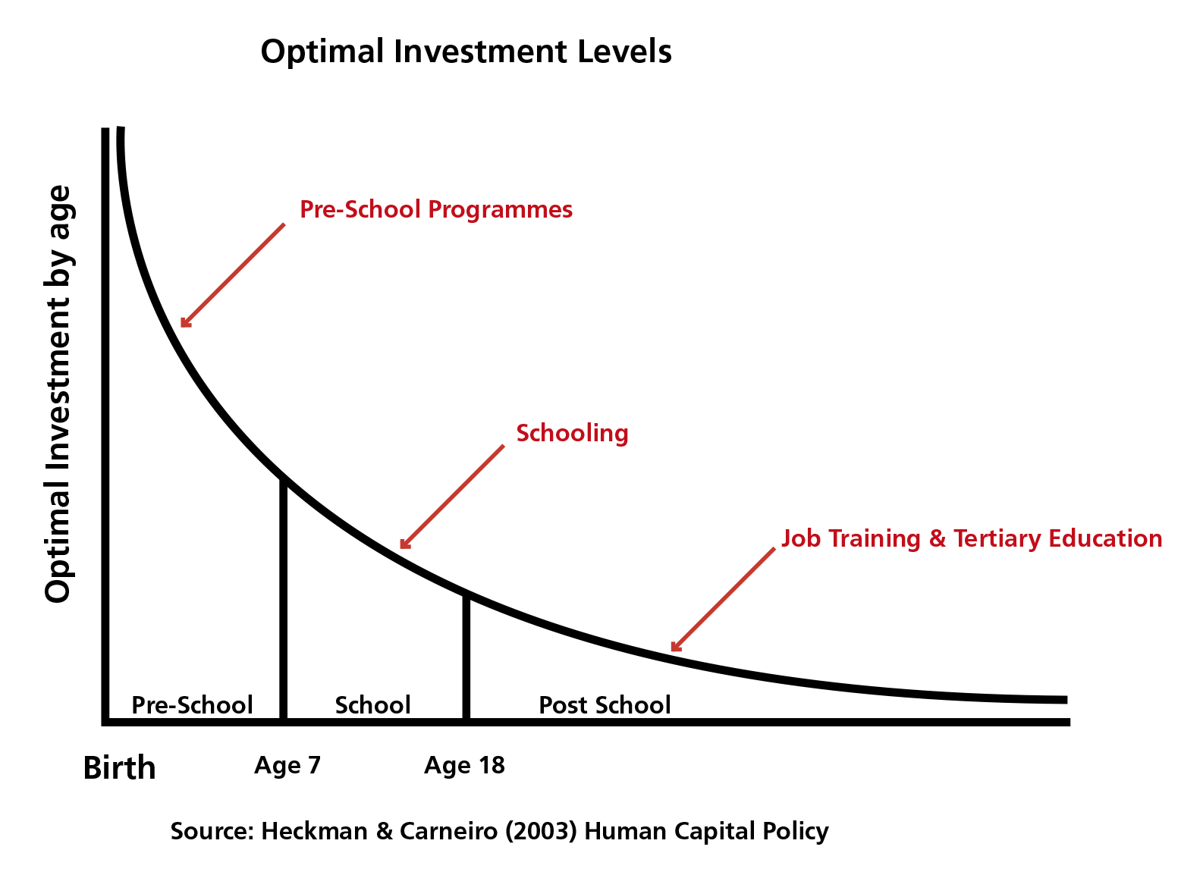
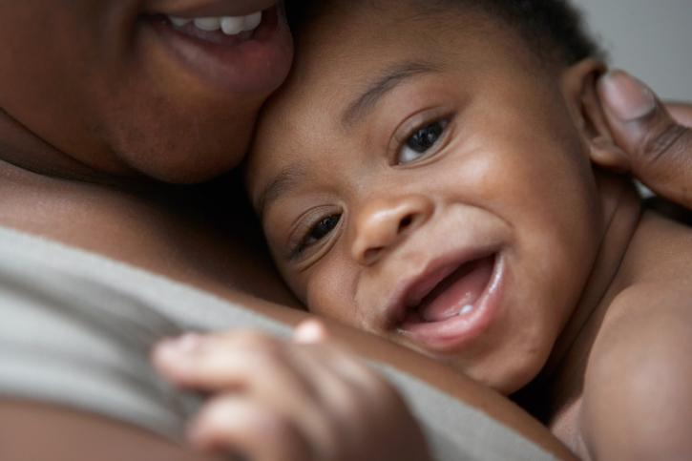
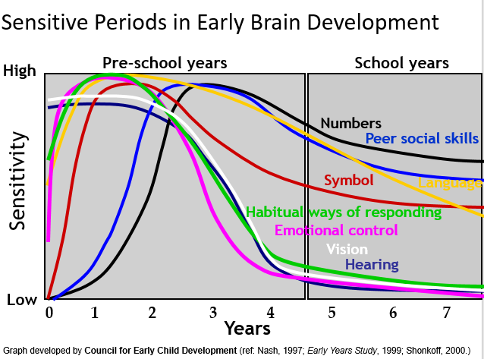
Importance of early childhood experiences
0 – 5 years old
Notes:
Research has repeatedly shown that children’s early experiences are fundamentally important for lifelong health and wellbeing. This is true of both positive and adverse experiences. This first years of the life course exhibit the period during which the brain develops most rapidly.
At this time, the brain is the most sensitive to external influences and experiences.
Given that early experiences shape our brains and set the foundations for lifelong learning and health, the period from conception to school entry is the optimal time to invest in children.
In fact, research shows that for every dollar our society invests to support children during the early years, we gain multiple dollars back in the long term, due to future gains and savings in health care costs, education outcomes, employment, and justice services.

Slide 17
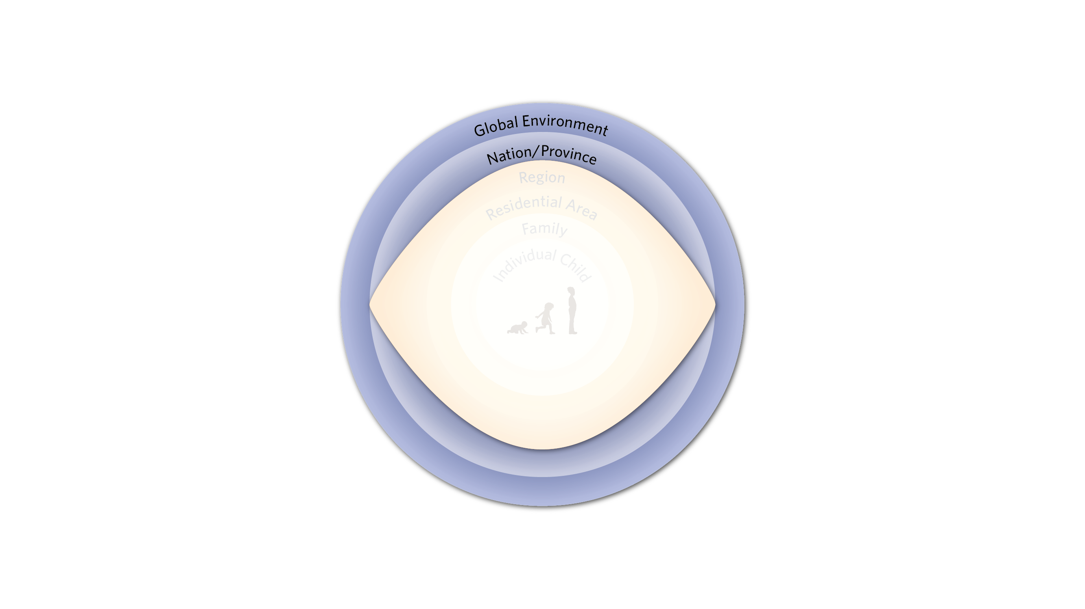
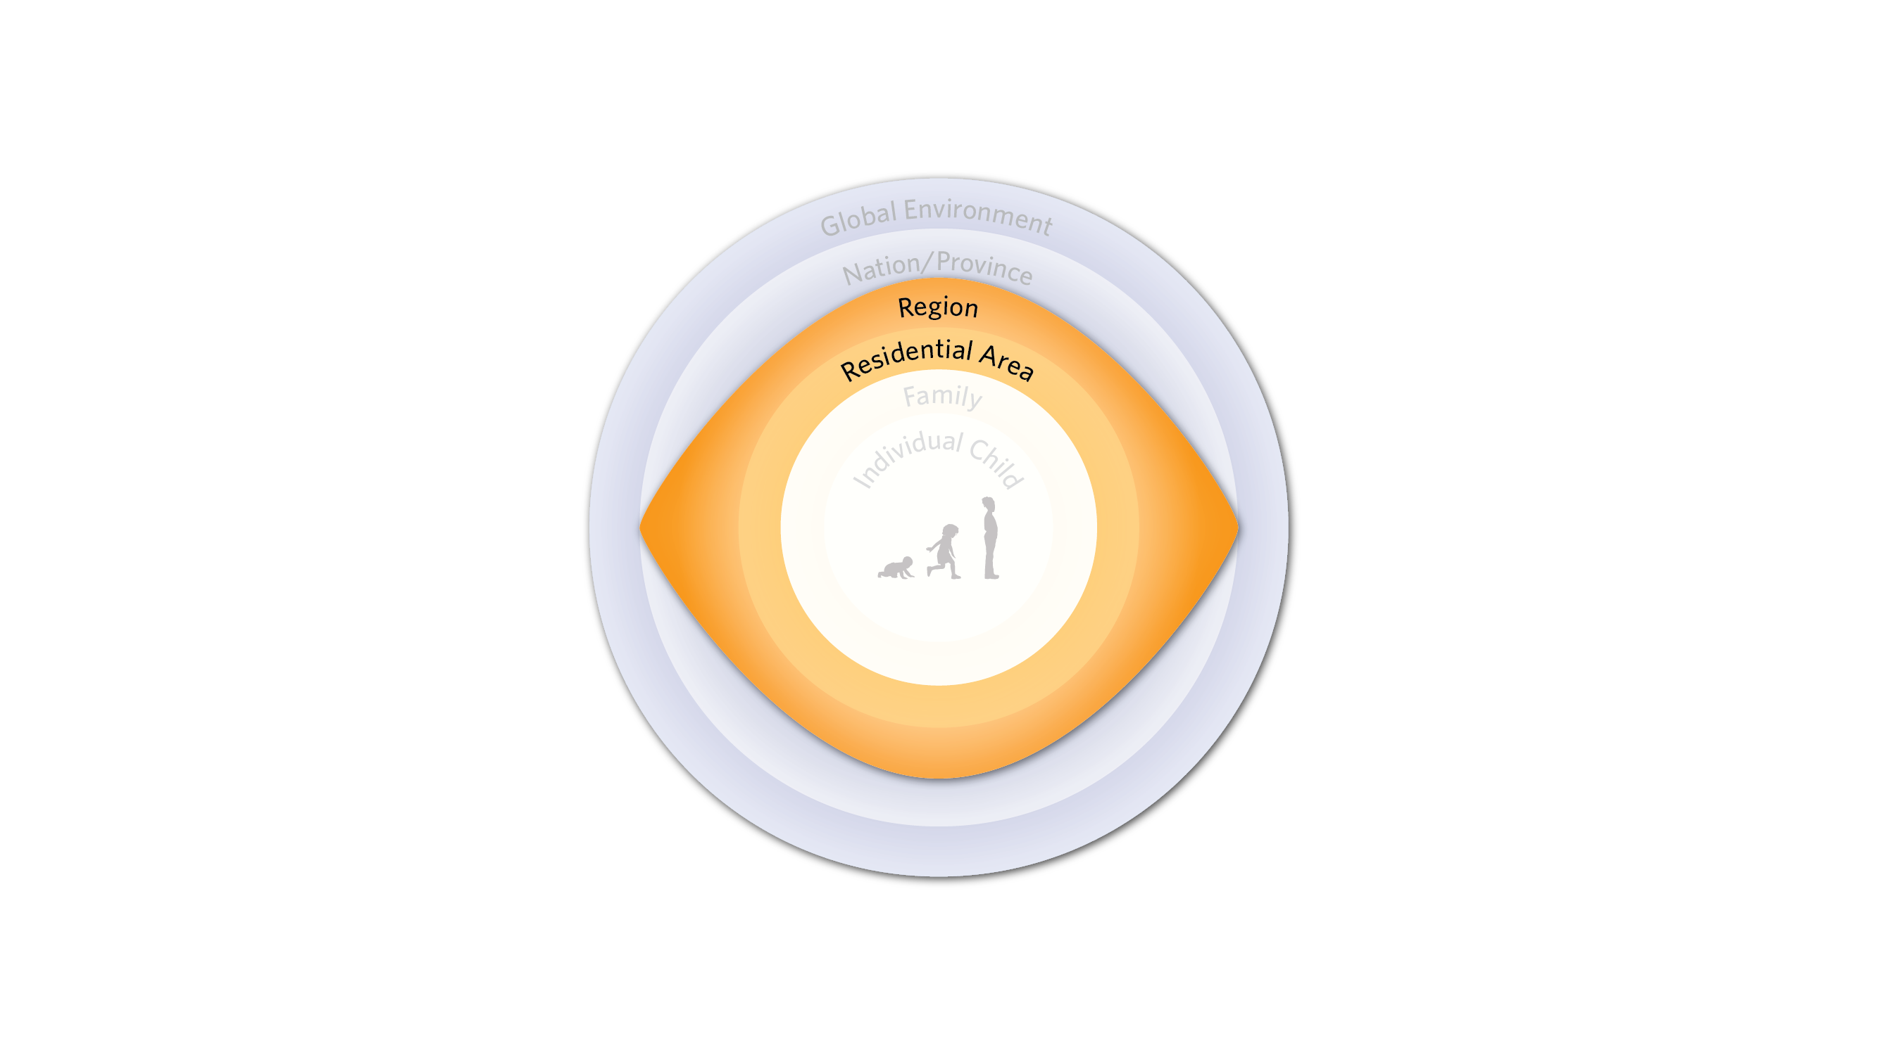
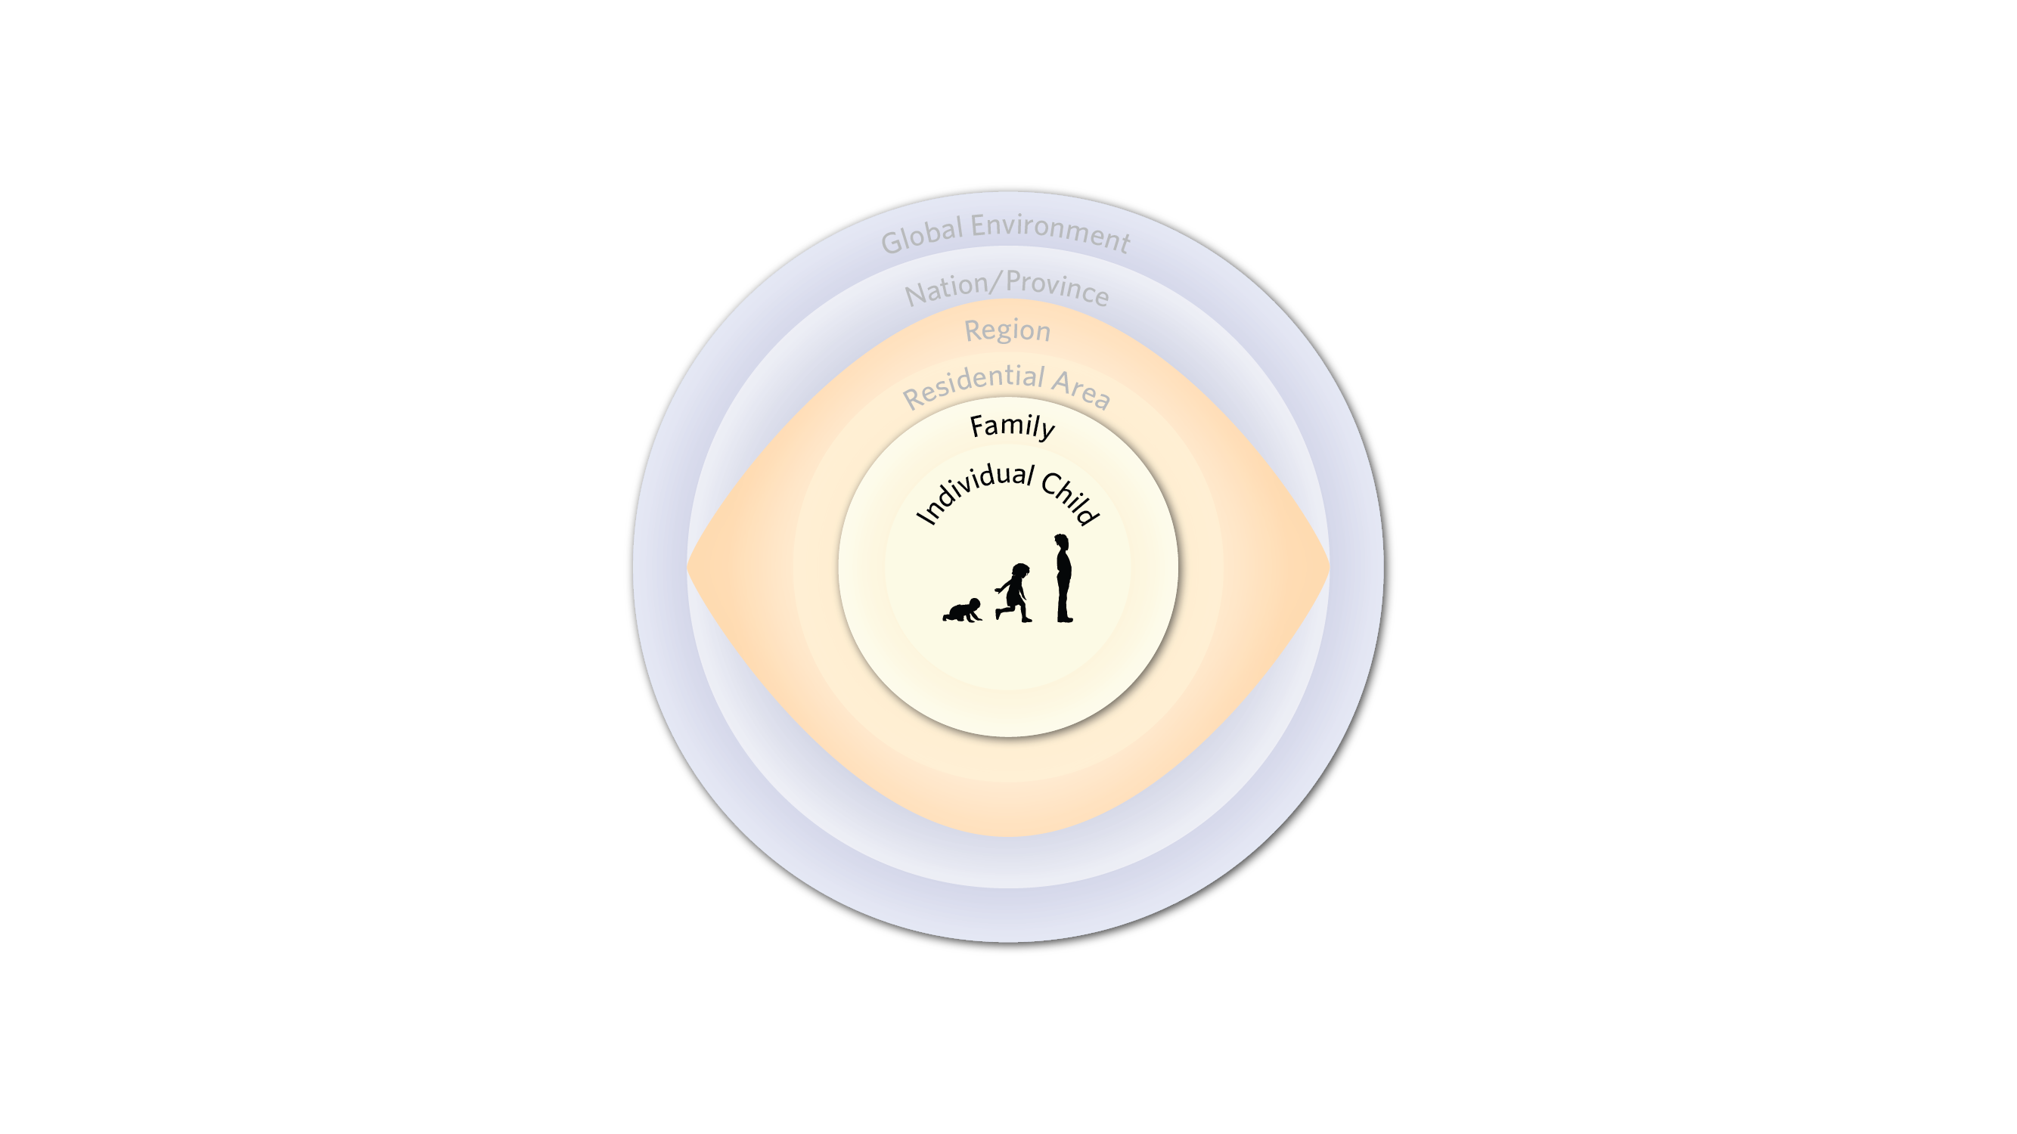
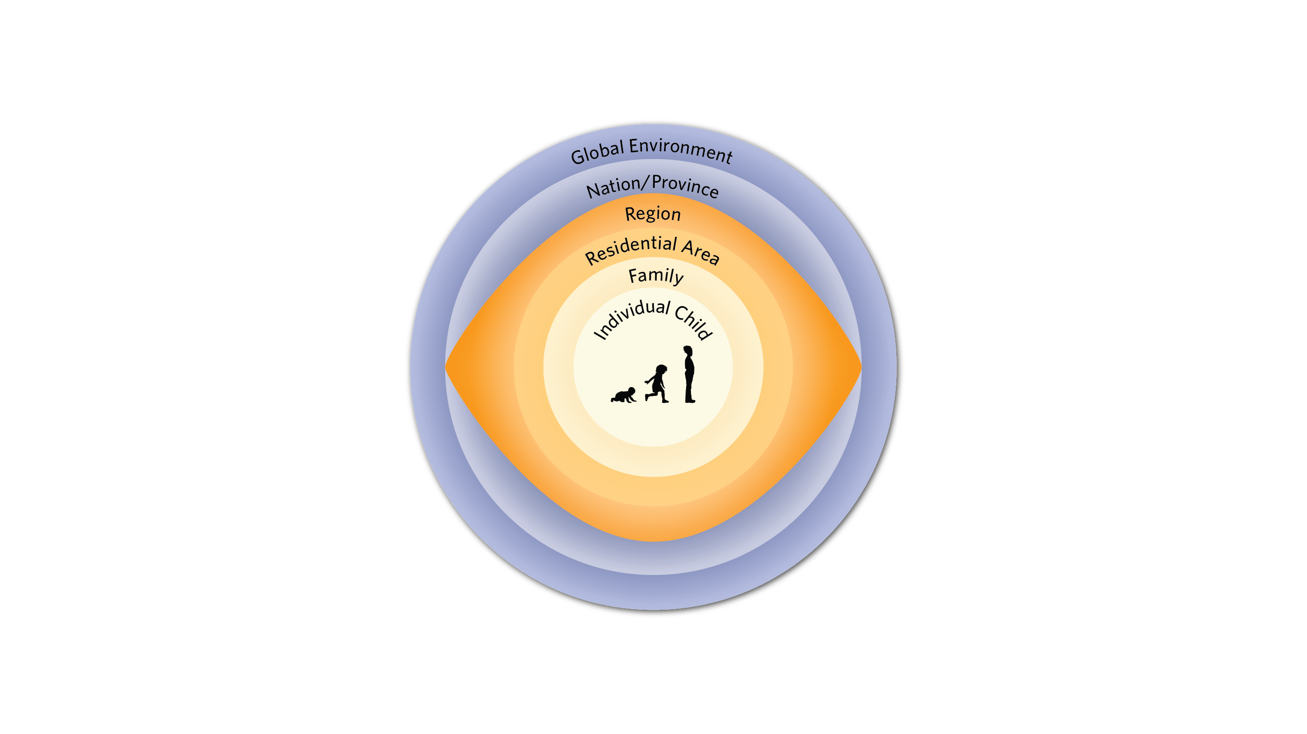
Notes:
Of course, early childhood experiences do not happen in a vacuum.
They happen in the context of our families, communities, and social conditions.
At HELP, we use the bioecological model of child development to conceptualize how child development is affected by a rage of different environments. In other words, to understand early childhood experiences and child development, we must understand them in the context of the the family, community, the characteristics of the residential area, the resources, programs, and services that exist within a region, and the policies and economic dynamics that happen at the the provincial or national or global level.
and even global context as well as the interactions between these experiences. This understanding of the importance of different environments or “ecologies” that impact child development is referred to as a bioecological model of child development.

Slide 18
How do we measure early experiences in BC?
Notes:
Given early experiences are so important, what are the ways in which we measure them in British Columbia?
Right now there is a gap in information about children’s experiences in early childhood. There are some tools that seek to track children’s development at this age, but the use of these tools varies across (and even within) provinces and territories across Canada. Also, most exising tools focus on developmental outcomes of the individual child and they do not cover a child’s experiences and do not address the social context and conditions in which children grow up.
In summary, currently in BC, or anywhere else in Canada, there is no system in place to regularly collect and share information on children’s experiences before school age – filling this gap is part of the vision for the Toddler Development Instrument!

