Slide 1
A Nursing Education Scholarship
Pecha Kucha
EKM Education Forum October 16th 2013
of 20

Slide 2
What is a Pecha Kucha?
20 slides in 20 minutes that advance automatically!
Devised by Astrid Klein and Mark Dytham of Klein Dytham architecture in 2003.
Japanese slang for “chatterbox”
of 20
Notes:
A concise way of giving a presentation

Slide 3
Why is Nursing Education Scholarship Important?
of 20

Slide 4
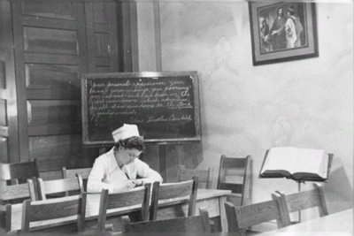
Nursing Education
of 20
Notes:
History where we have come from

Slide 5
What is the purpose of higher education for nurses?
of 20

Slide 6
We want our students to be able to:
care competently
solve complex ill-defined problems
be leaders
be creative
think differently!
of 20

Slide 7
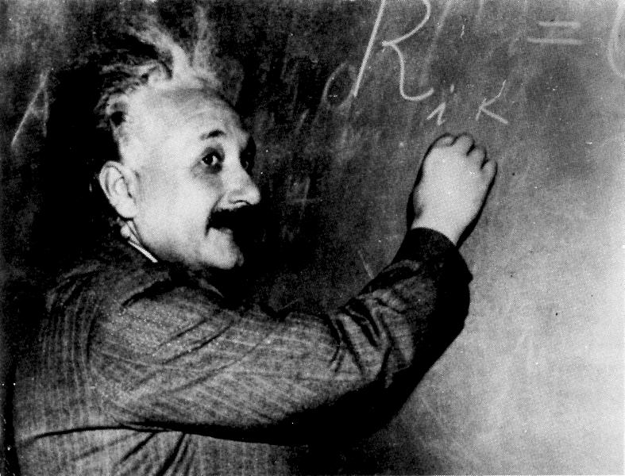
Theory
of 20

Slide 8
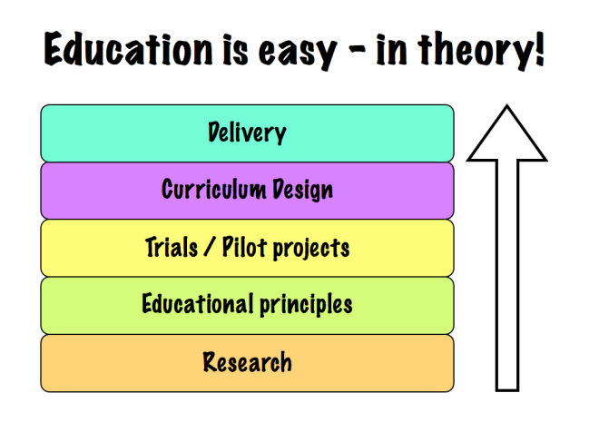
Education is easy – in theory!
of 20

Slide 9
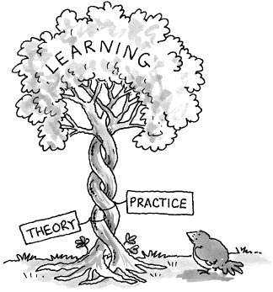
of 20

Slide 10
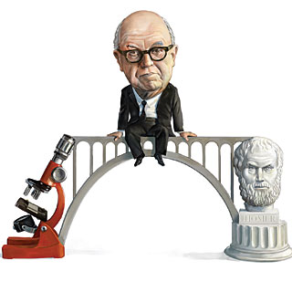
Art or Science?
of 20

Slide 11

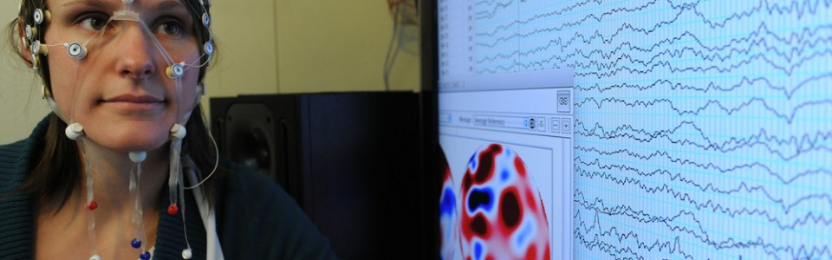
Science
of 20

Slide 12

Art
of 20

Slide 13

of 20

Slide 14
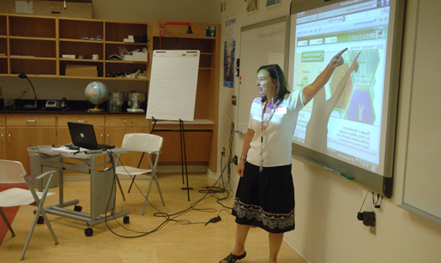
Classroom Technology
of 20

Slide 15
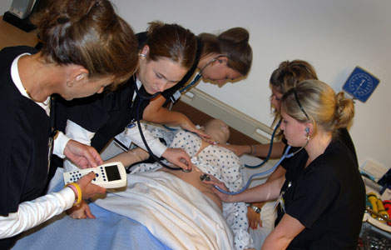
Simulation
of 20

Slide 16

Social Media
of 20

Slide 17
What are the barriers?
of 20

Slide 18

Finding Money
of 20

Slide 19

Finding Time
of 20

Slide 20
Nursing Education Scholarship
Is not simply educational research...
…but research IS an imperative
Requires active dissemination
Is important
Is achievable
We can all do it
of 20

