Slide 1
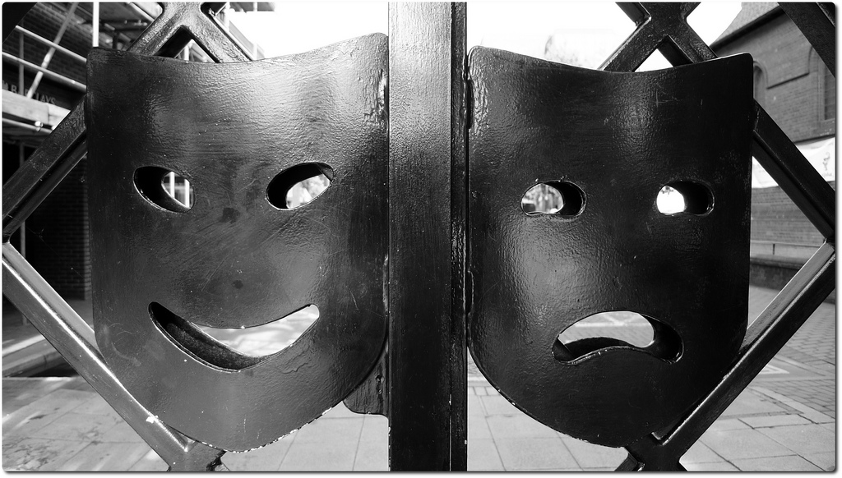
Technology in the Classroom: Friend or Foe?
Tessa Higney – March 7, 2016

Slide 2
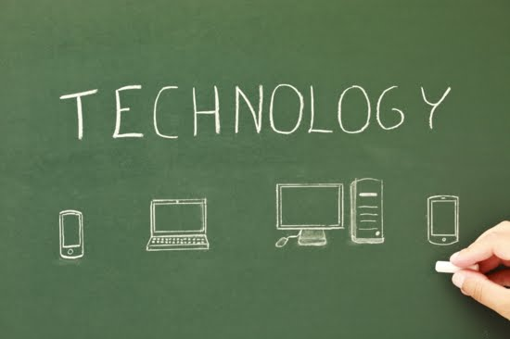
Your Perspective
Complete survey
How is your life impacted by technology?
Should we as educators be concerned with the increasing demand to ‘teach with tech?’
Notes:
Engage in quick conversation concerning the answers to the survey questions
Do we have similar results? How do you think students results would differ?

Slide 3
My Inquiry Process
Personal concern for physical, mental and social health of students
Concern for health and well-being of teachers
What does ‘science’ say?
Going against mainstream beliefs?
What can we do as teachers?
Notes:
Why did you choose this topic for your inquiry project?
Previous knowledge and interest
Concern for my own health and the health of my students
Worry that I am ‘swimming upstream’ with the ever increasing push for technology in the classroom
Wanting to find ways to balance the educational approach and have evidence to support my beliefs
My approach
Previous knowledge, finding evidence to back up my knowledge
Started with scientific component (effects of radiation on a cellular level)
Very complex and difficult to transfer knowledge to others
Branched off to the social and basic cognitive effects, more applicable to educational setting
Canadian and international regulations surrounding exposure to EMF
BC specific and Ministry of education guidelines

Slide 4
The Science
Ionizing radiation has high energy X-rays and gamma rays and possesses enough energy to break molecular bonds and remove electrons from atoms or molecules creating charged atoms know as ions.
Non-ionizing radiation (the kind that cell phones and baby monitors emit) has a much lower energy radiation and is not known to break that electron bonds of a molecule but does however have enough energy to heat a molecule and vibrate the atom.
Notes:
- Read a variety of studies all with varying results

Slide 5
The Pros and Cons
Positives
Negatives
Some studies suggest increase simple reaction time and choice reaction time (Koivisto)
Prepares students for the demand of technology in ‘real world’
Multi-modal approach to learning
Lacking development of communication skills (Giedd)
Categorized as possible carcinogen (category 2B)
Suggested correlation to cancer, fertility rates and autism (Standing Committee on Health)
Notes:
From my research so far, here is a list of basic pros and cons.
Becoming aware of my biases – need to examine both sides
Studies demonstrate a wide variety of results – validity?

Slide 6
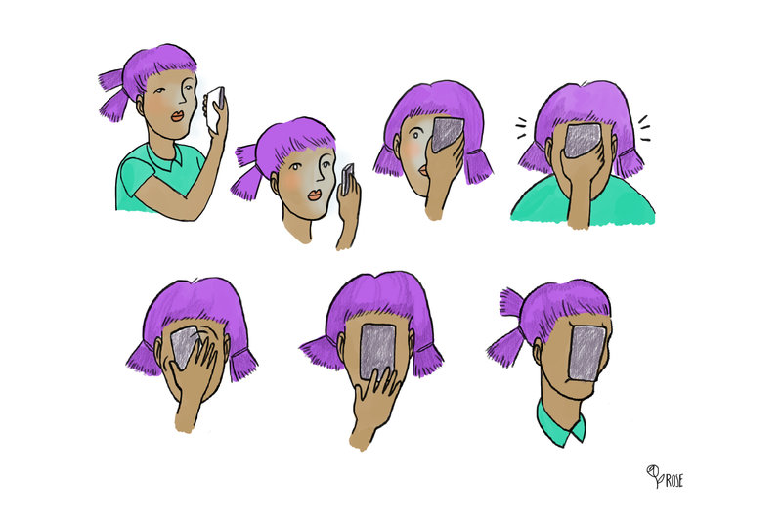

Slide 7
BC Standards
Safety Code 6 (2015)
‘Limits of Human Exposure to Radiofrequency Electromagnetic Energy…’
Several cases of EHS (electrohypersensitivity) in BC schools
Winlaw Elementary school parents petition to have Wi-fi turned off (Nelson Star)
No acknowledgement from the BC Ministry of Education (BC’s Educational Plan)
Notes:
- Does not include any specific guidelines for children and vulnerable people (pregnant or elderly)

Slide 8
In Classroom Practice
BC Hydro EMR testing kits
Chris Rowan’s ‘Zone’In’ and ‘Unplug Don’t Drug’ (Sechelt, BC)
C4ST (Canadians for Safe Technology)
Notes:
Conduct a technology survey in your class to develop awareness of their usage
Teach responsible technology use (don’t sleep with devices, not using them two hours before bed, communicating outside of devices)
Chris Rowan: local BC pediatric occupational therapist, offers workshops for teachers, parents and students on how to unplug from devices and manage technology use responsibly

Slide 9
To be continued…
Why is there such a push to incorporate technology into the classroom? $$$
How are other countries approaching this technology surge?
Following up with research surrounding upcoming studies (physiological and biological effects)
Notes:
Topics I have not had chance to research the following topics

Slide 10
References
Health, S. C. (2015). Radiofrequency electromagnetic radiation and the health of canadians Canada. Parliament. House of Commons.
http://publications.gc.ca/collections/collection_2015/parl/xc62-1/XC62-1-1-412-13-eng.pdf
Lin, J. C. “Effect of Cell-Phone Radiation Exposure on Cognitive Function in Humans.” IEEE Antennas and Propagation Magazine 45, no. 6 (December 2003): 146–47. doi:10.1109/MAP.2003.1282190.
Uhls, Yalda T., Minas Michikyan, Jordan Morris, Debra Garcia, Gary W. Small, Eleni Zgourou, and Patricia M. Greenfield. “Five Days at Outdoor Education Camp without Screens Improves Preteen Skills with Nonverbal Emotion Cues.” Computers in Human Behavior 39 (October 2014): 387–92. doi:10.1016/j.chb.2014.05.036.

Slide 11
References cont’d
Government of Canada, Health Canada. “It’s Your Health - Safety of Wi-Fi Equipment.” Publication, October 4, 2011. http://www.hc-sc.gc.ca/hl-vs/iyh-vsv/prod/wifi-eng.php.

