Slide 1
Large field of solar arrays that need to be facing the sun
Close to a city that creates acid rain and other damaging forms of precipitation
Create a centralized system to control the array using ORBCOM subscriber communicator, and actuate the panels to adapt to changing conditions

Slide 2
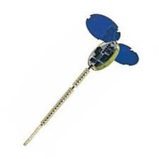
ECE Server
Routing to appropriate S/C
Integer-in-email data
Email OSI packet commands
Control Logic
Raw sensor data acquisition
Processing algorithms
Subscriber Communicator 1
Subscriber Communicator 2

Slide 3
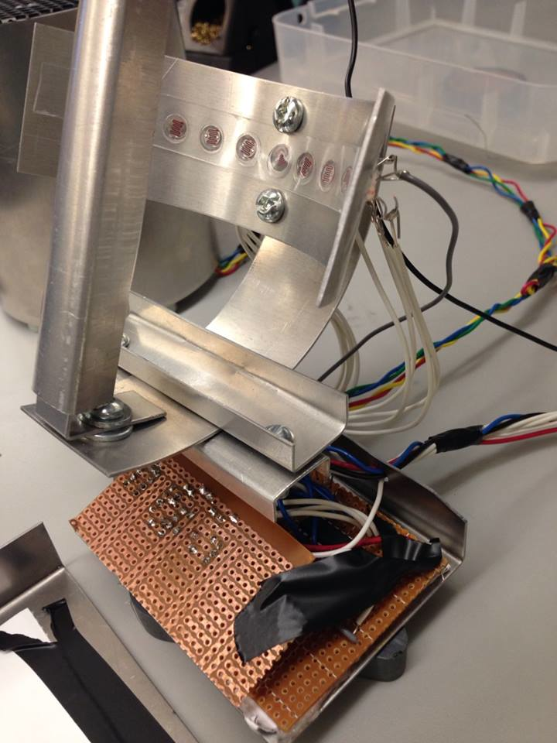
Light Sensor
Analog Detection of sun position using LDRs in a “sundial” array
14 Measurable positions with 8 sensors
Optical encoder circuit
Multiplexer and excitation circuit

Slide 4
Actuator: Solar Panel
Servo for opening / closing
solar panels
Solar Panels
Motor & Circuitry in the box
Servo for opening/closing
of solar panels
Motor to rotate solar panel

Slide 5
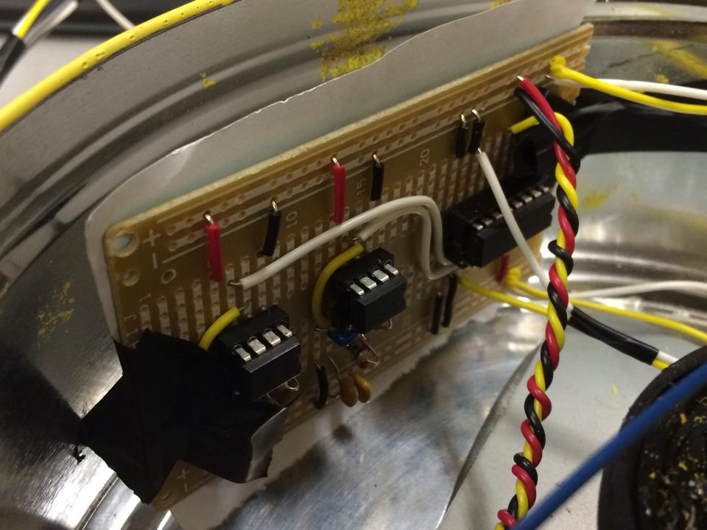
Actuator: Solar Panel
DC motor driver circuit with close loop
Feedback from potentiometer.
Voltage divider to limit range (0.1-3.2V)
L298 for H-bridge
Driving servo with fixed frequencies
Generate from 555 timers.
A MUX is implemented for opening/
Closing of solar panel.

