Slide 1
IACDC 2014 Educating Youth for Democratic Futures Moroccan Centre for Civic Education Marrakesh, Morocco
“ Environmental Education and Democratic Citizenship in Canada: Lessons from the History of Children and Childhood”
Dr. Mona Gleason and Claudia Diaz-Diaz
Department of Educational Studies
University of British Columbia, Canada
(Not for publication or downloading © of authors)

Slide 2
Care for the Environment and Active Citizenship
Cultivation of “environmental citizenship” key focus in British Columbia, Canada
Environmental Learning and Experience Framework (2007)
Two salient elements
1) “Experiential Learning Cycle”
2) “Conceptualizing Environment”

Slide 3
C.A.R.E
A consideration of Complexity (complex systems)
A consideration of Aesthetics (aesthetic appreciation)
A sense of Responsibility (responsible action and consequences of action)
The practice of an environmental Ethic (development of values that foster protection of the natural world to avoid crises)

Slide 4
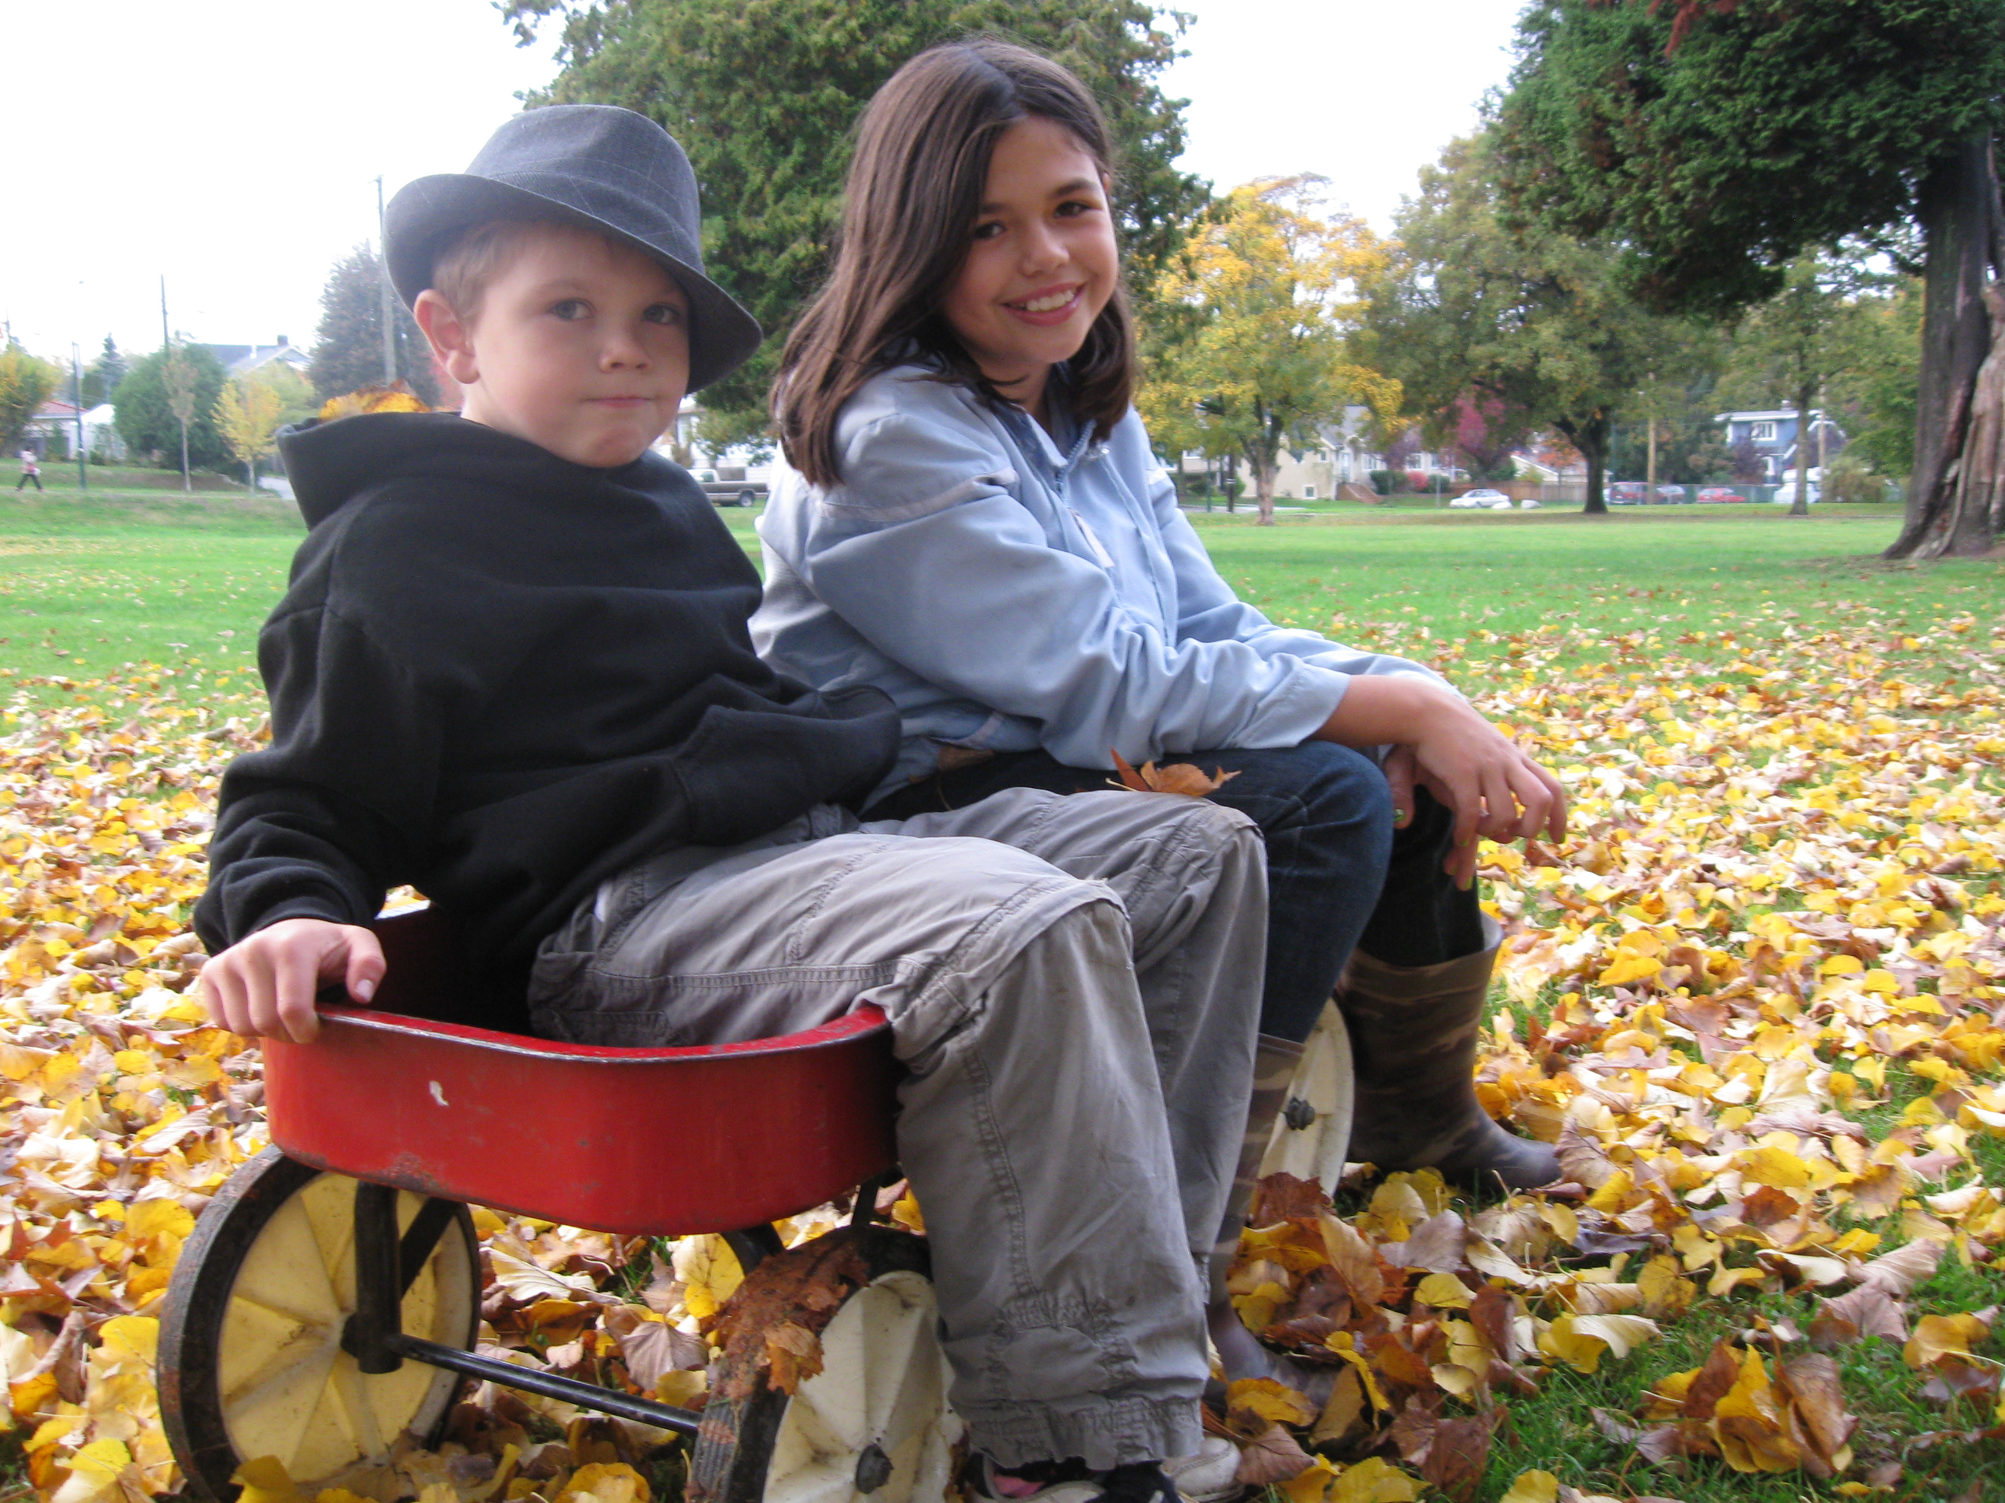
The Child in the ELE Framework
Discursive production of the ideal young citizen

Slide 5
Research Questions
How did children interact with the environment in the past?
What role did it play in their lives?
What bearing did it have on their education as young citizens?

Slide 6
Turning to the Past
Archival records of the Elementary Correspondence School (ECS), established in 1919.
ECS operated by the then-named Department of Education of British Columbia
Curricular materials sent to families in remote, underserviced areas who requested them for their children

Slide 7
Letters from Children to the ECS – 1920s and 1930s

Slide 8
Voices left out
Letters are dominated by White Anglo-Celtic perspective
Colonization of Canada, BC decimated the Aboriginal population and displaced Aboriginal peoples in province from their home territories
“silences” speak instead to the workings of unequal and oppressive relations of power in the history of BC and Canada

Slide 9
Emerging Themes
1) Negotiations with an often-harsh physical environment that both challenged the process of securing access to public schooling.
2) Key role that the landscape played in shaping young White settlers’ culture, their sense of self, and their belonging to broader communities of family, peers, and nation.

Slide 10
Central Argument
While the ELE framework presents contemporary educators with pedagogical ideas to “re-connect” children to the environment as its protectors, and to do so within the frame of educating for effective citizenship, history reveals that rural BC children were already deeply embedded in the physical environment and relied on it for their sense of identity and place in the broader world of family and community.
This past should be more robustly included in our contemporary efforts regarding environmental citizenship.

Slide 11
Historicizing the Contemporary Focus on Environmental Citizenship
Research attempts to place the contemporary ELE framework within the history of education and history of children and childhood
key source: archival letters from children to ECS teachers and officials
History enriches our understanding of the present!

Slide 12
Negotiating the Landscape

Slide 13
I have six children to (sic) whom school is an impossibility and my only neighbour on the island has a child also. We live on Valdes Island…and we have no school, store, or post office. Our nearest school is over two miles away on Galiano Island but the intervening water in Portier Pass is very treacherous and unsafe. The tides flow through at from four to eight knots an hour and there are bad whirlpools in it. It is out of the question that the children could row there, and we have no motorboat, so I have been trying to teach them myself. (Mrs. Arthur Patterson, Shaw’s Landing, 1923)

Slide 14
Anxiety over Schooling
“I would not like to see (her two children) grow up without any schooling.” (1925)
…that he did not like to see his son grow up “without learning.” (1923)
“I find it very difficult to give them much time as I have so any other duties to attend to... I am anxious for them to get along with their work, but they cannot do their lessons alone.” (1925)
“I cannot teach them properly. Every moment of my time is overworked and it breaks my heart to see them growing up in ignorance.” (1923)

Slide 15
The Land is My School

Slide 16
C.A.R.E
A consideration of Complexity (complex systems)
A consideration of Aesthetics (aesthetic appreciation)
A sense of Responsibility (responsible action and consequences of action)
The practice of an environmental Ethic (development of values that foster protection of the natural world to avoid crises)

Slide 19
Children’s Connection to the Land – Complex Systems and Kid’s Labour
I have been so busy all summer, in the garden, building fences and clearing more land for the garden. The sugar beets did not grow any size and are no good, the turnips in that garden aren’t good either, but the carrots are just right for pickles…My 34 hills of potatoes are sure grand. Dad said that there will be about 2 ton of potatoes, one ton of saleable turnips, 10 sacks of large carrots, 1 sack of pickling carrots, 10 sacks of parsnips, and 20 lbs. of pears.
(Alma Prout, 13, from Griscome, BC, 1936)

Slide 20
Children’s Connection to the Land – Aesthetic Appreciation
….“the summers are very beautiful up here among all the islands and passes….”
“It is very pretty up there along the steep bluffs where we gather ferns and flowers.” (1934)
…“Columbines are very pretty,” she wrote, “but I don’t know if I like them better than the Lady’s Slipper….but they are awfully pretty when they are pressed…they are such a pretty pink.” (1934)
“… “I am keeping a record of the birds I see each day….there are very few red-headed wood peckers here this year, usually there are a lot more….we have flickers here too.” (1935)
…“I am interested in nature study and Mr. Cowan at the Provincial Museum say I am the Canadian champion Bendire’s shrew catcher.” (1935)

Slide 21
Children’s Connection to the Land – Ethics of Respect
I try hard to walk through the woods without making a sound. I was doing so once and heard an odd noise ahead of me. I looked up and saw a moose about 20 paces from me in the middle of the road. I stopped and stood still in the road. I was too surprised to do anything. That moose just walked down the road quietly and turned off into the woods. I am glad that I have learned not to be afraid of anything in the woods, because it is just as afraid of me.
(Alma Prout, 1936)

Slide 22
Conclusions
History matters and can enrich the curriculum
Historical perspective adds complexity, depth, and nuance to contemporary environmental education
The environment has long been a central force shaping the experience of schooling, the construction of individual identity, contributions to communities, and the sense of civic belonging

