Slide 1
Welcome to Vancouver!

Slide 2
About Me
Professor of Teaching in Earth Ocean and Atmospheric Science (EOAS)
Grew up here in Vancouver
Lots of training in Education (more on this later)
For 10 years, 75% of teaching in “Vantage College” 90% of those students are from China
Love working with international colleagues (like you!)

Slide 3

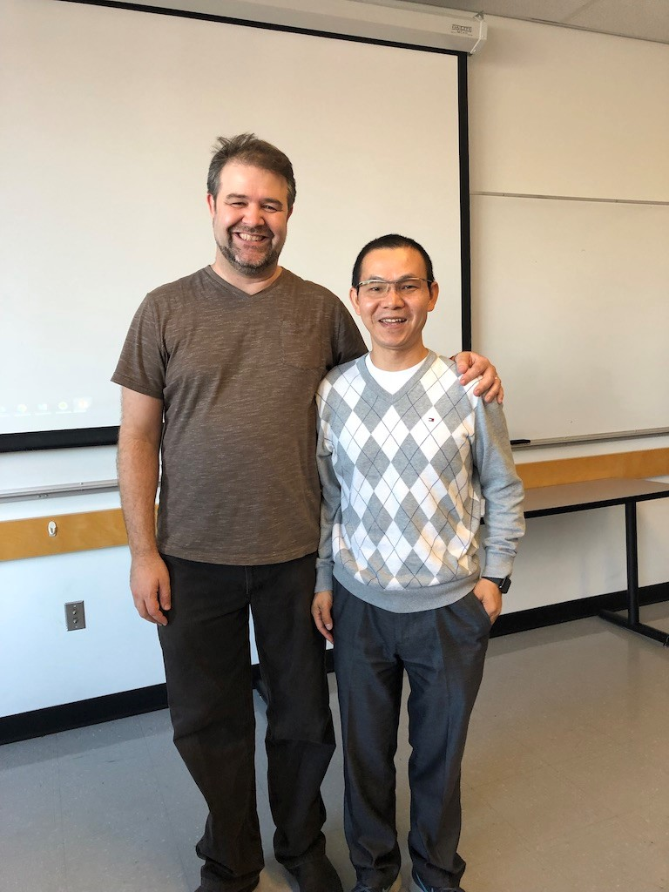
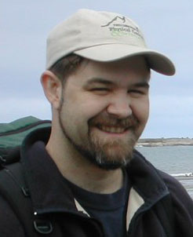
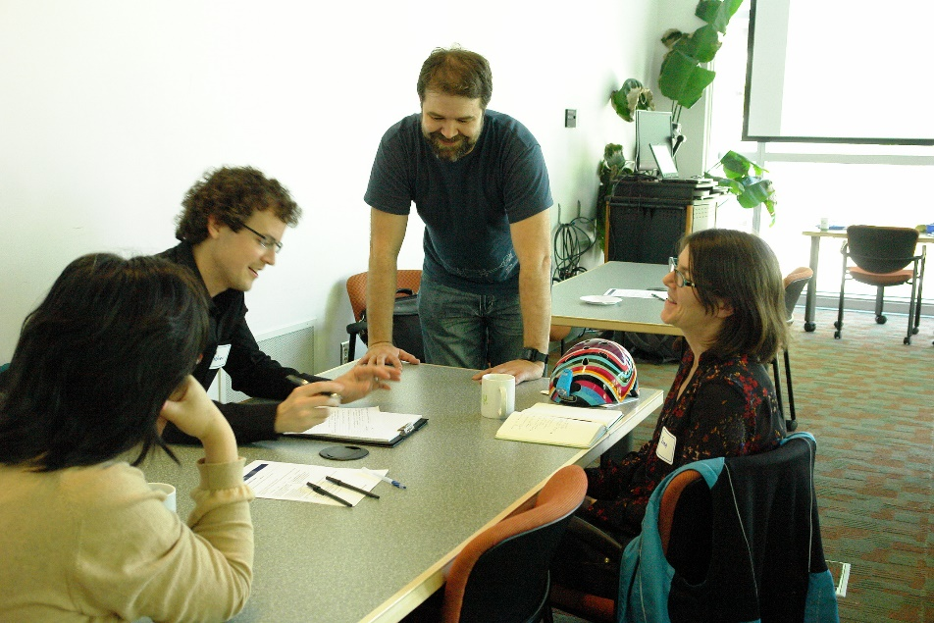
About Me

Slide 4
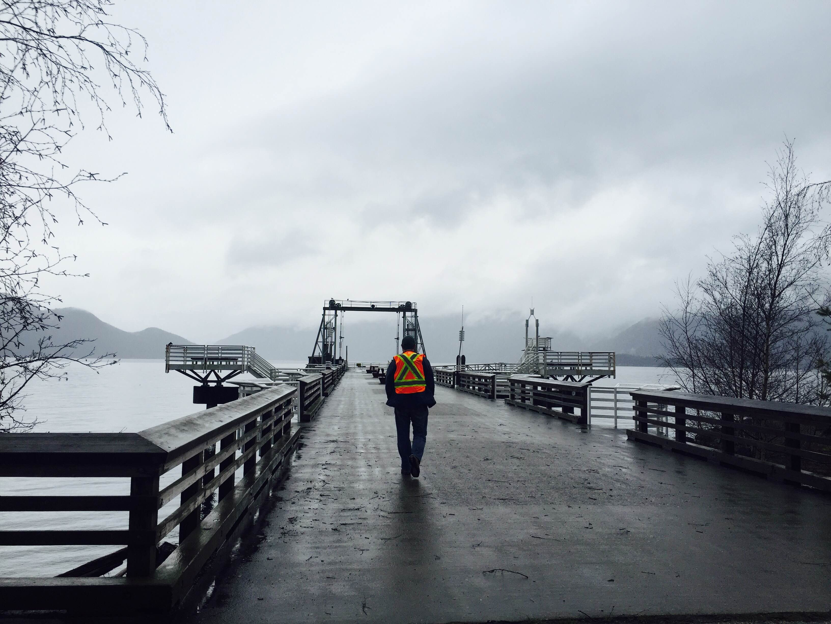
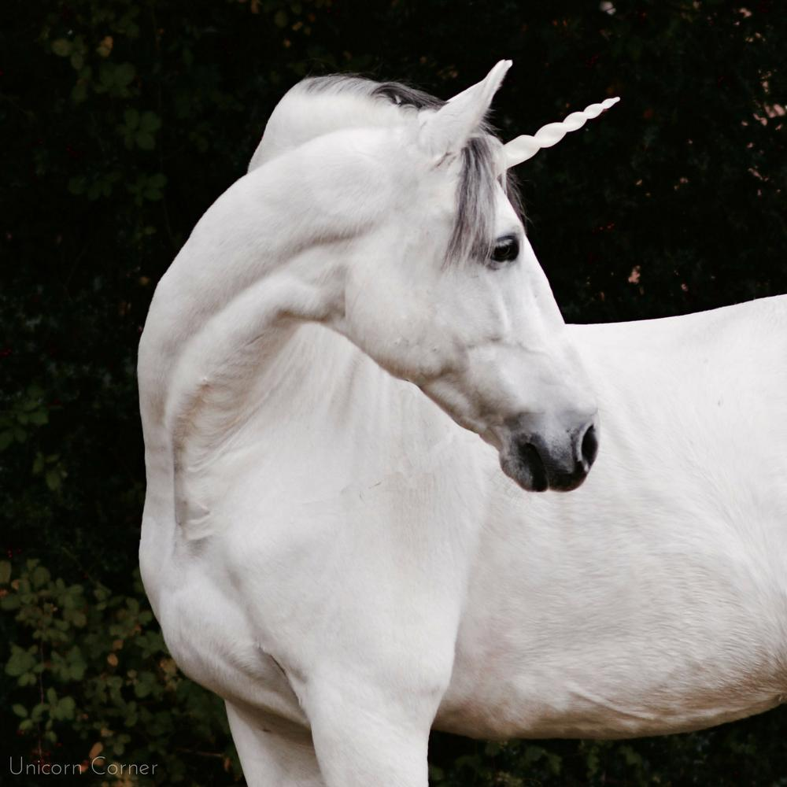

Slide 5
Number Code

Slide 6
1
2
3
4
5
6
7
8
9
0

Slide 8
1
2
3
4
5
6
7
8
9
0
1
2
3
4
5
6
7
8
9

Slide 9
The schedule for the semester
July and August – Teaching!
Much of that is me!
But also
Observations – not your specialty, on purpose
3 day Course Design Intensive – with Shaya
Other Guest lecturers

Slide 10
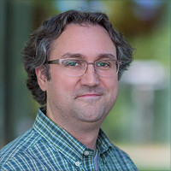
Some Guests
Warren Code – What was the Carl Weiman Science Education Initiative (CWSEI)?

Slide 11
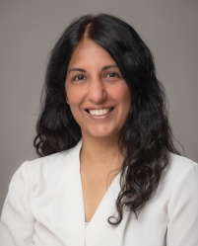
Some Guests
Anka Lehki – Team Based Learning

Slide 12
With me
Active Learning
Experts and novices
Preparing for observations
Asking Questions
Assessment
Two stage exams
Microteaching

Slide 13
Sample lesson?

Slide 14
Seismic Waves 地震波
How many of you have been in an earthquake?
你们中有多少人曾经经历过地震?
How many of you have heard of seismic waves before?
你们中有多少人以前曾听说过地震波?

Slide 15
Seismic Waves
Objectives 目标:
  By the end of this lesson you will be able to 在这堂课结束后你将会:
  Define Seismic Waves 定义什么是地震波
  Compare and Contrast two types of Body waves
  比较和对比两种地震波

Slide 16
Seismic Waves
Seismic waves
  What are seismic waves 什么是地震波？
  Motion caused by the Earth 地震波由地球中的运动造成
    Before, during, and after an earthquake 在地震之前，之中，和之后
    Like sound waves in rock 像石头中的声波

Slide 17
Seismic Waves
1) Body Waves 体波
  Waves within the body of the Earth 在地球体内的波浪

Slide 18
Seismic Waves
1) Body Waves
a) P-waves P-波 (Pressure 压力 or Primary 第一)
  Fastest 最快
  Particle motion is parallel to propagation粒子运动与传播平行
  Can move through solids or fluids 可以通过固体或者液体移动

Slide 19
Seismic Waves
1) Body Waves
b) S-waves S- 波(Shear 切变 or Secondary 第二)
  Slower than P-waves 比P-波慢
  Particle motion is perpendicular to propagation 粒子运动垂直于传播
  Can only move through solids - not fluids 只能通过固体流动

Slide 20
Demo 演示

Slide 21
Seismic Waves
2) Surface waves 表面波
  Next class 下堂课

Slide 22
Seismic Waves
Post Test 测试
What is a seismic wave?
什么是地震波?
Two types of body waves?
两种体波
  What is the difference between these two body waves?
  这两种波有什么区别?

Slide 23
Summary 总结
Earthquake detectors?
地震检测仪?

Slide 24
How did that feel?

Slide 26
Why are you here?

Slide 27
What skills do you hope to learn?

Slide 28
So who cares?

Slide 29
How can I help you succeed?

Slide 30
What questions do you have for me?

Slide 31
I’m Looking forward to working with you!

Slide 32
Homework!
Read Chapter 1 of How People Learn
https://nap.nationalacademies.org/catalog/9853/how-people-learn-brain-mind-experience-and-school-expanded-edition
Decide what You are going to work on this term in class and on your own time.
What course or skill are you going to improve?

Slide 33
Tourist Homework!
Go to either:
Stanley Park

Slide 34
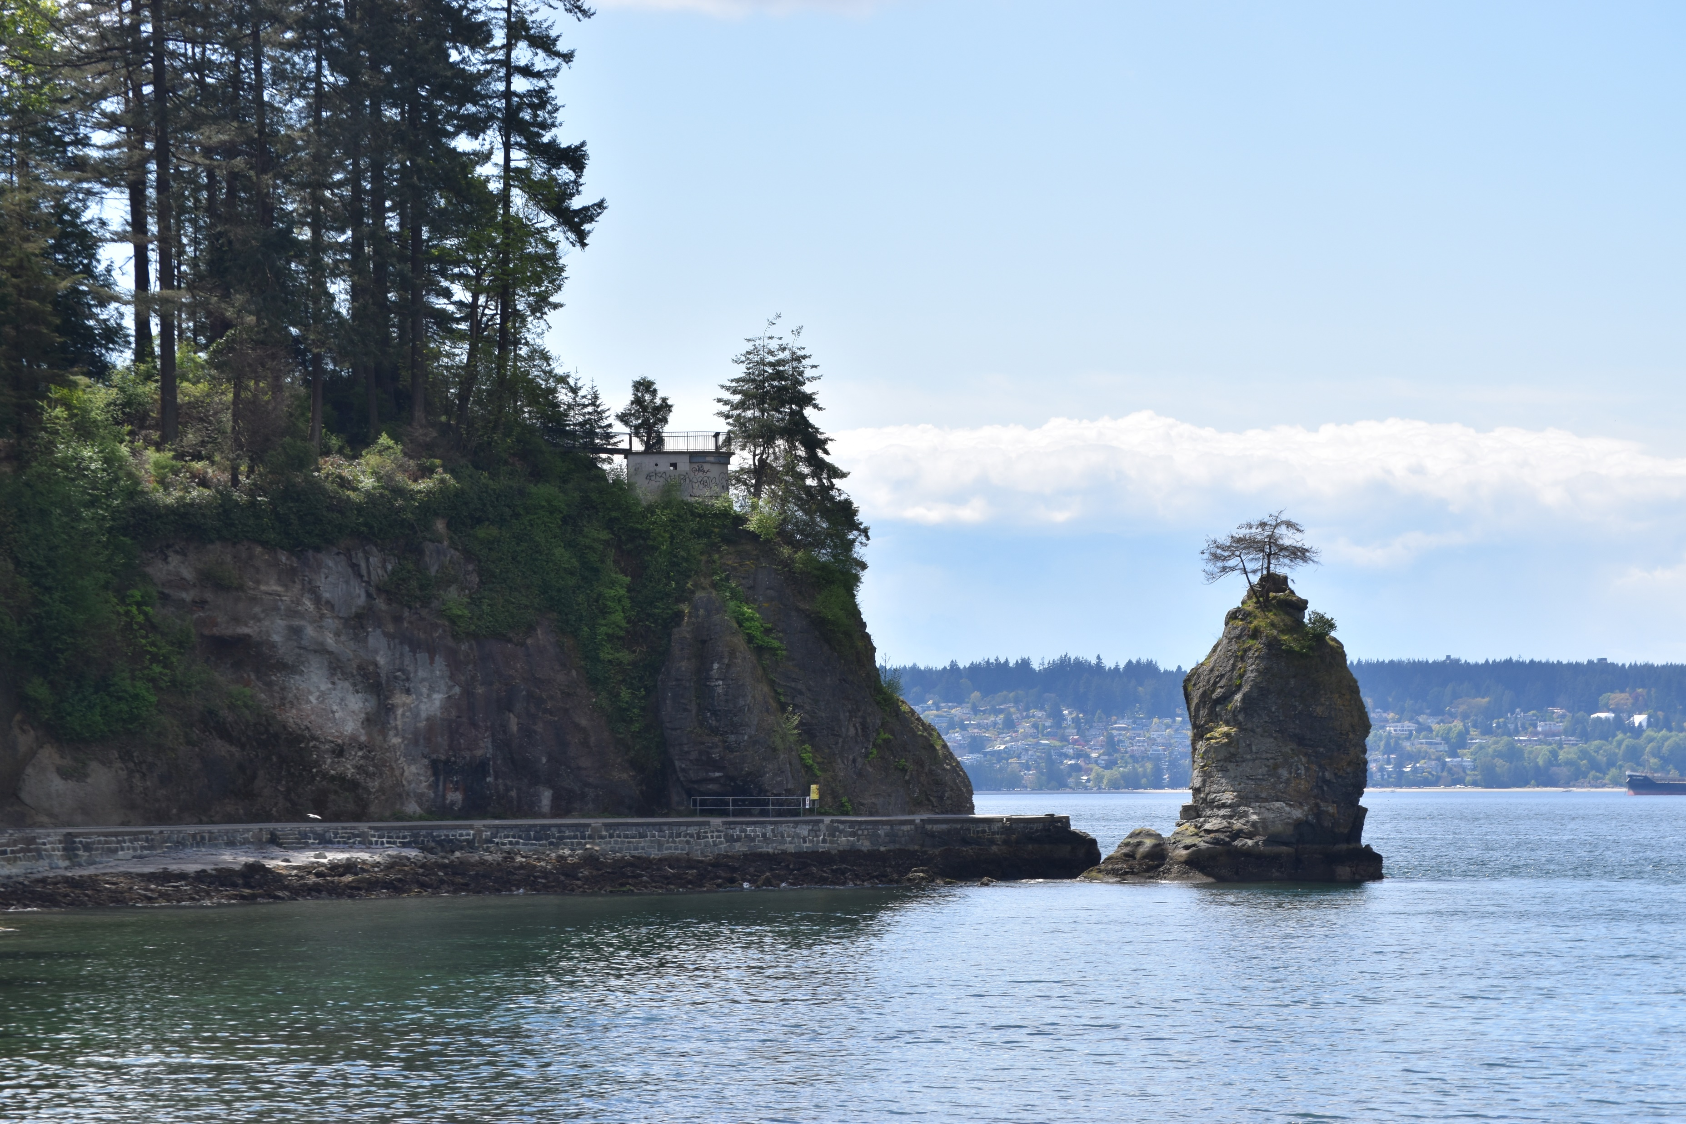

Slide 35
Tourist Homework!
Go to either:
Stanley Park
Or
Granville Island
(or both, you will have time)

Slide 36


